Slide 1
path planning & ATR
Akshay

Slide 2
Career
Finished college in '22
Learned Computer Vision, Deep Learning Basics
Worked IRAD for 2 years
Path Planning
Navigation
Surveillance
Theoretical Motion Planning
ATR
SSD
RTDETR

Slide 3
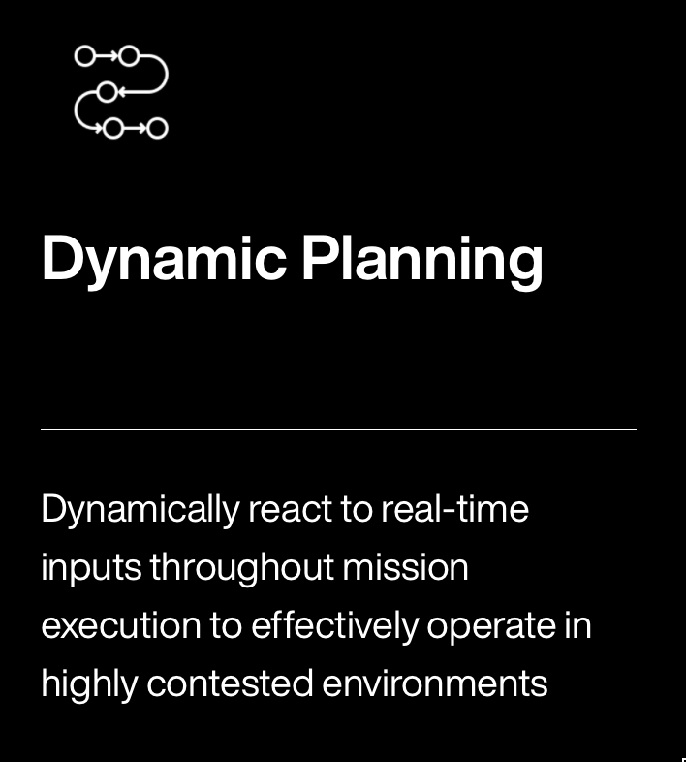
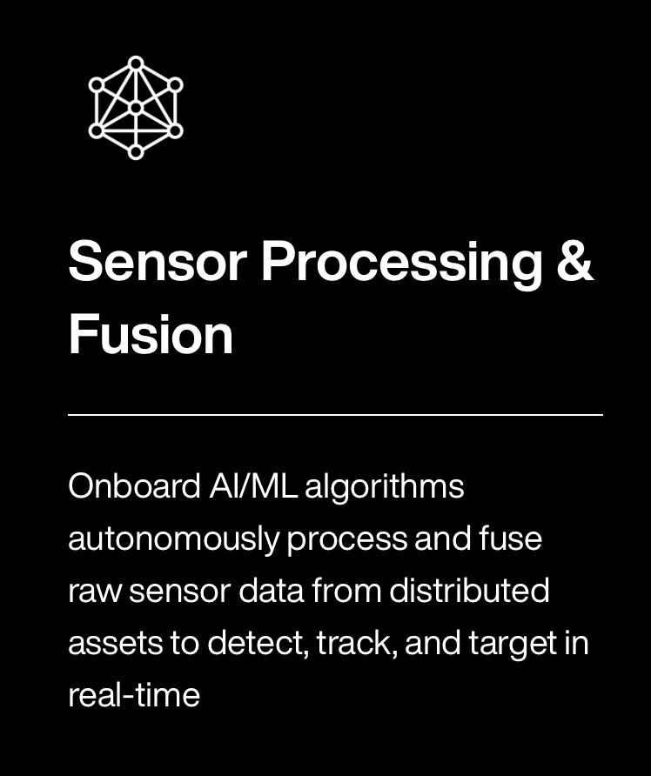
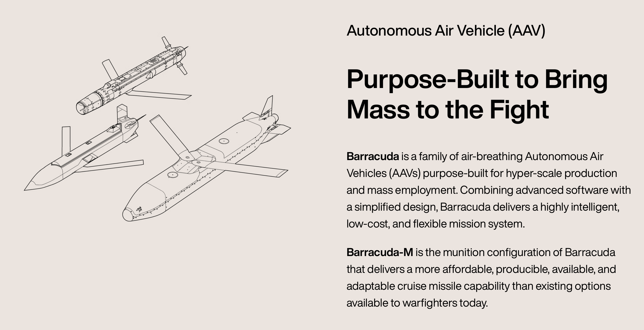
Close the Algorithm Gap against Anduril
Capabilities:
Sensor Fusion
EO Data Pipelines
Fury
Barracuda

Slide 4
Path Navigation: Visibility Graphs
"Implement A* search for path planning"

Slide 5
Surveillance: Latency Graphs
"Do research on surveillance algorithms"

Slide 6
Motion Planning with Bezier Curves
"Implement this paper from MIT"

Slide 7
What are Bezier Curves?

Slide 8
Bezier Curves for Motion Planning

Slide 9
Frontier Research

Slide 10
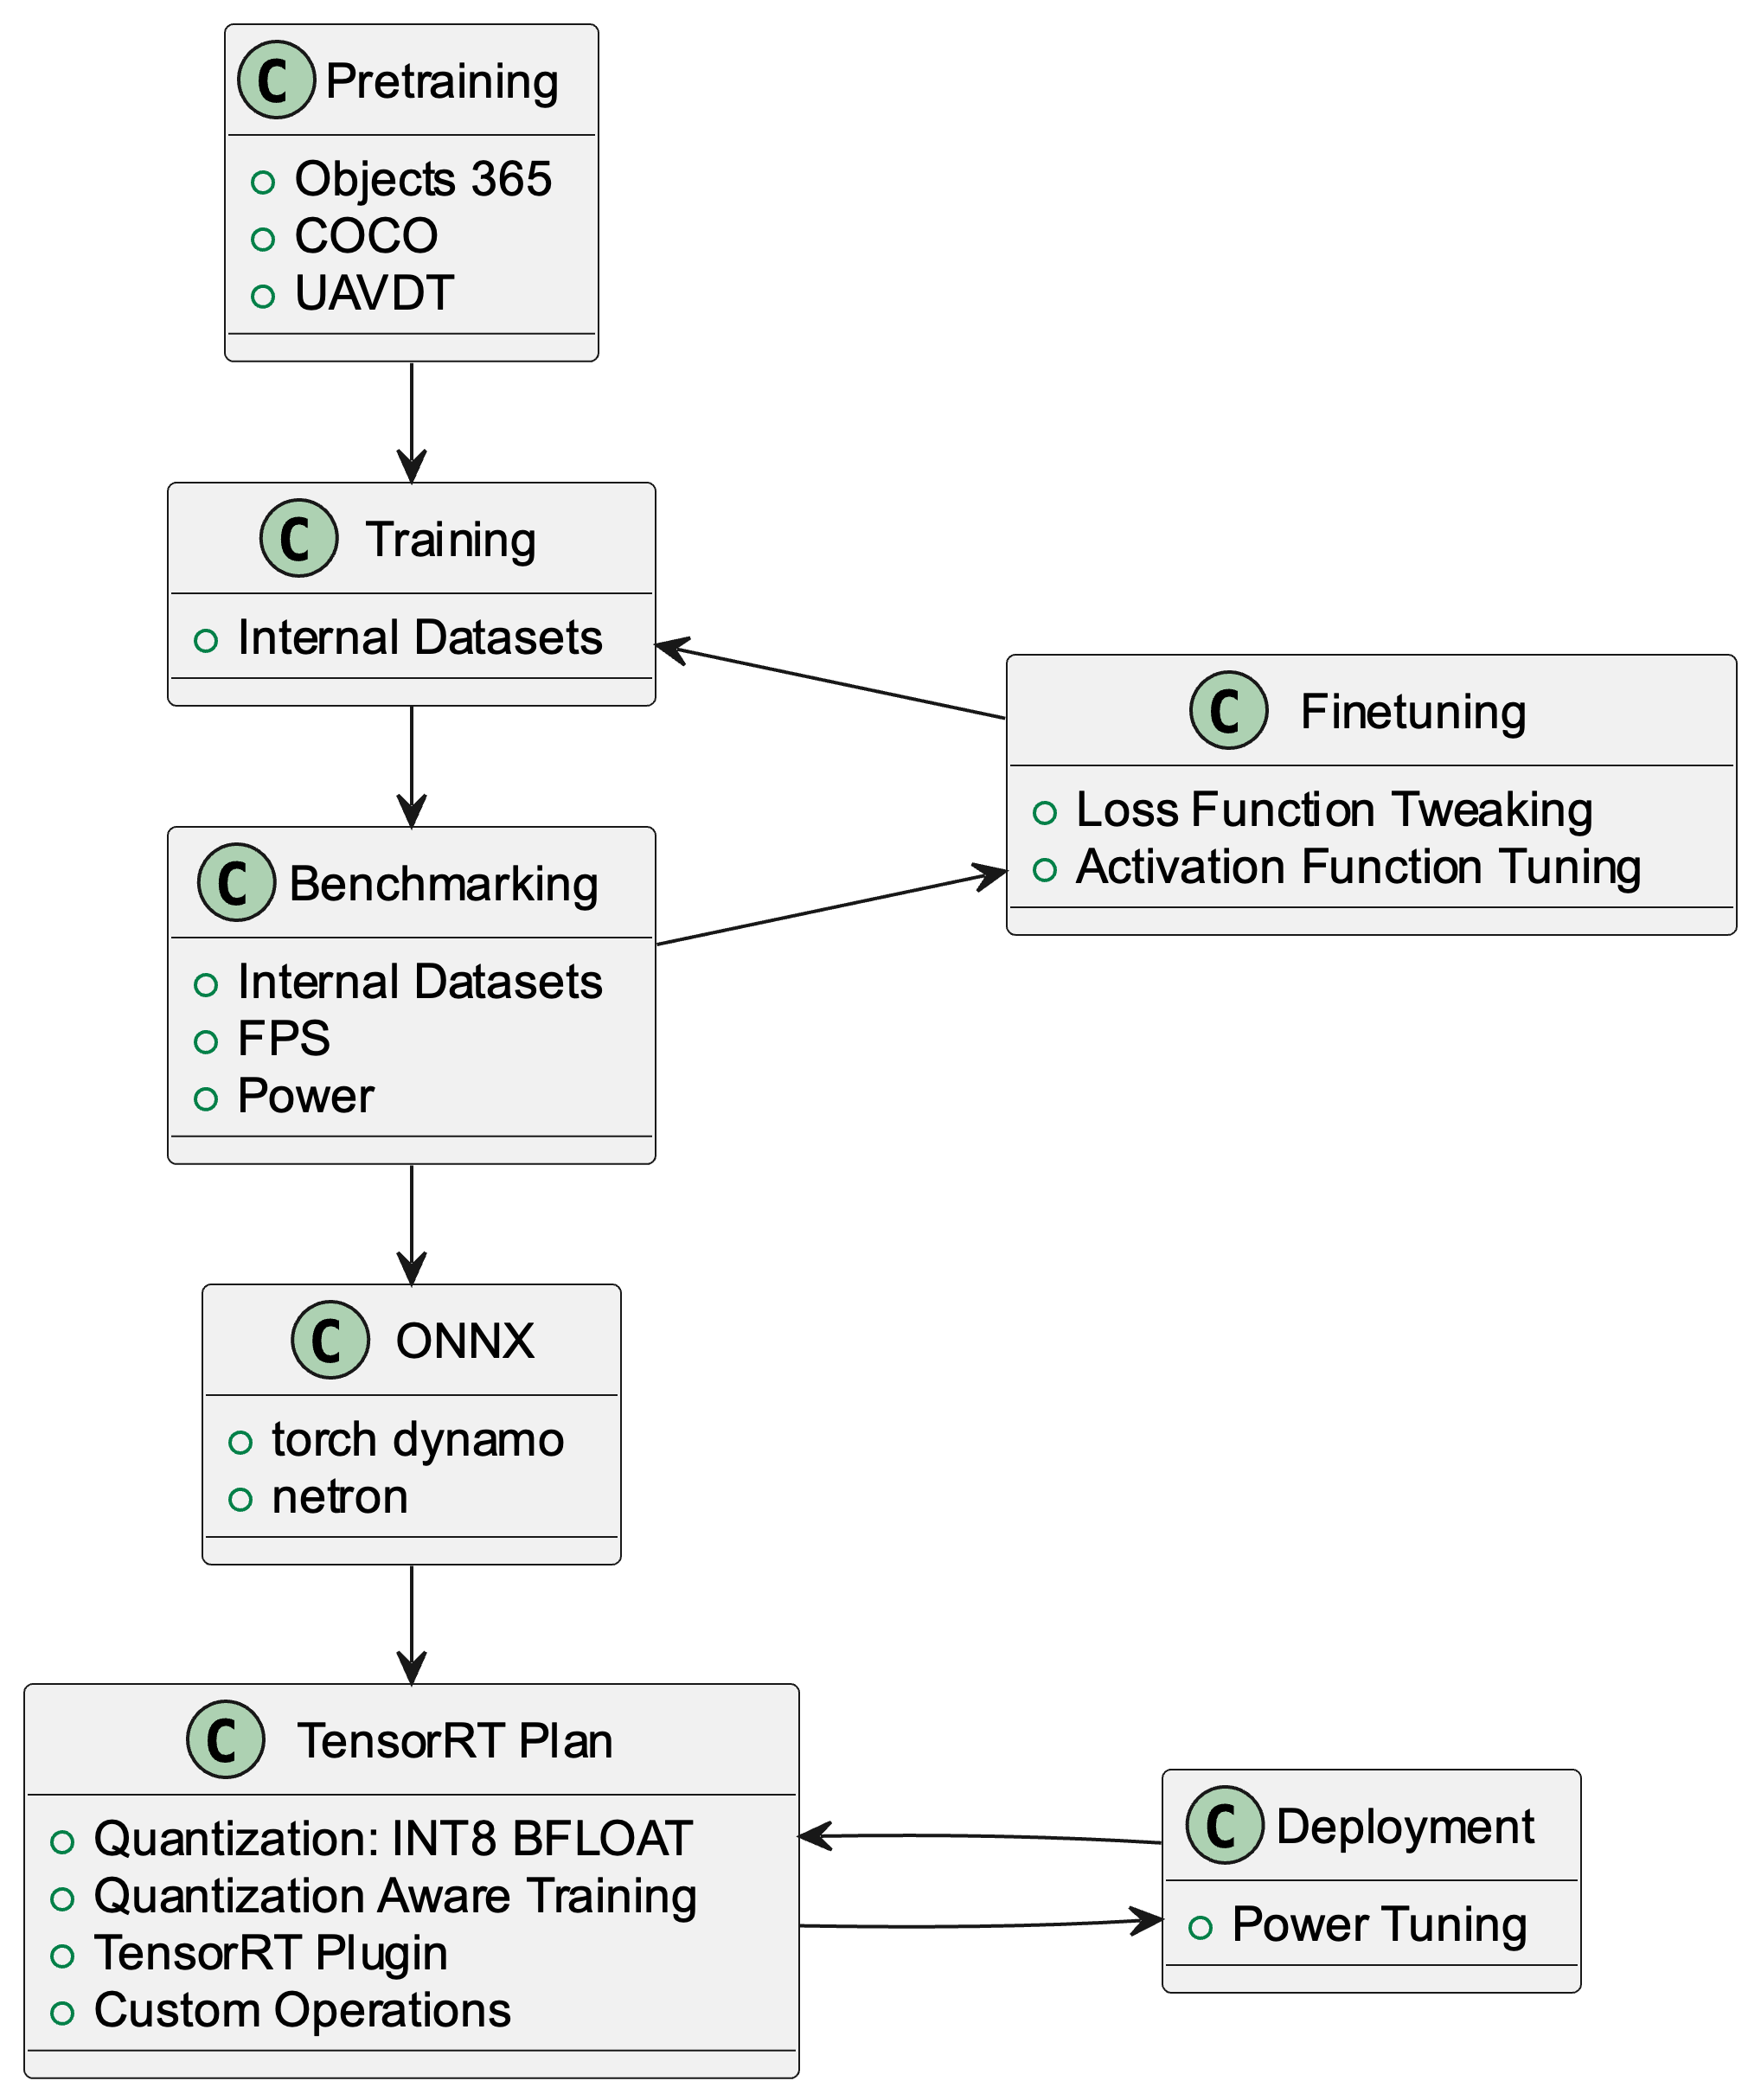
Automated Target Recognition
Data Preparation
Generation
Augmentation
Network Architecture
SSD
RTDETR
Tooling

Slide 11
Data Preparation
Data Generation
Unreal Engine
Microsoft Flight Simulator
Data Augmentation
Corrupt Images
Notes:
A bit of technical writing

Slide 12
Network Architecture: Object Detection

Slide 13
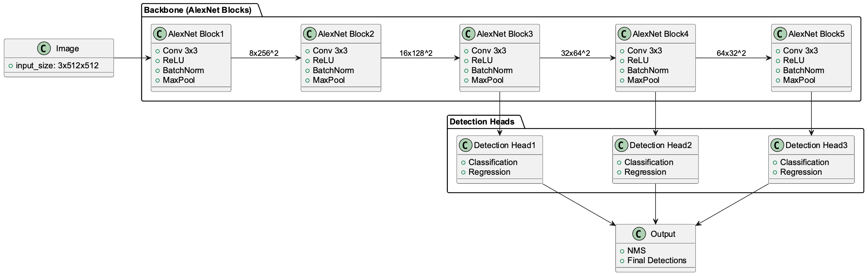
Network Architecture: SSD

Slide 14
Network Architecture: RTDETR

Slide 15
Frontier Research
Unsupervised Learning with Autoencoders
Fused Detection and Tracking Pipeline with RNNs
GANs for Data Augmentation

Slide 16
Smaller Projects
Image Registration
Image Projection

Slide 17
Image Registration: DFT Registration
Fourier Transform: alternate representation of any periodic signal

Slide 18
Image Projection
Camera lens have roughly four parameters
Image Center
Focal Length
Radial Distortion Coefficient
Tangential Distortion Coefficient

