Slide 1
Agenda: Akshay Gulabrao
Path Planning
Visibility Graphs
Latency Graphs
Motion Planning
Automated Target Recognition
SSD
RTDETR
Smaller Projects
Kalman Filter, Image Registration, Image Projection

Slide 2
Path Navigation

Slide 3
Surveillance

Slide 4
Motion Planning with Convex Optimization

Slide 5
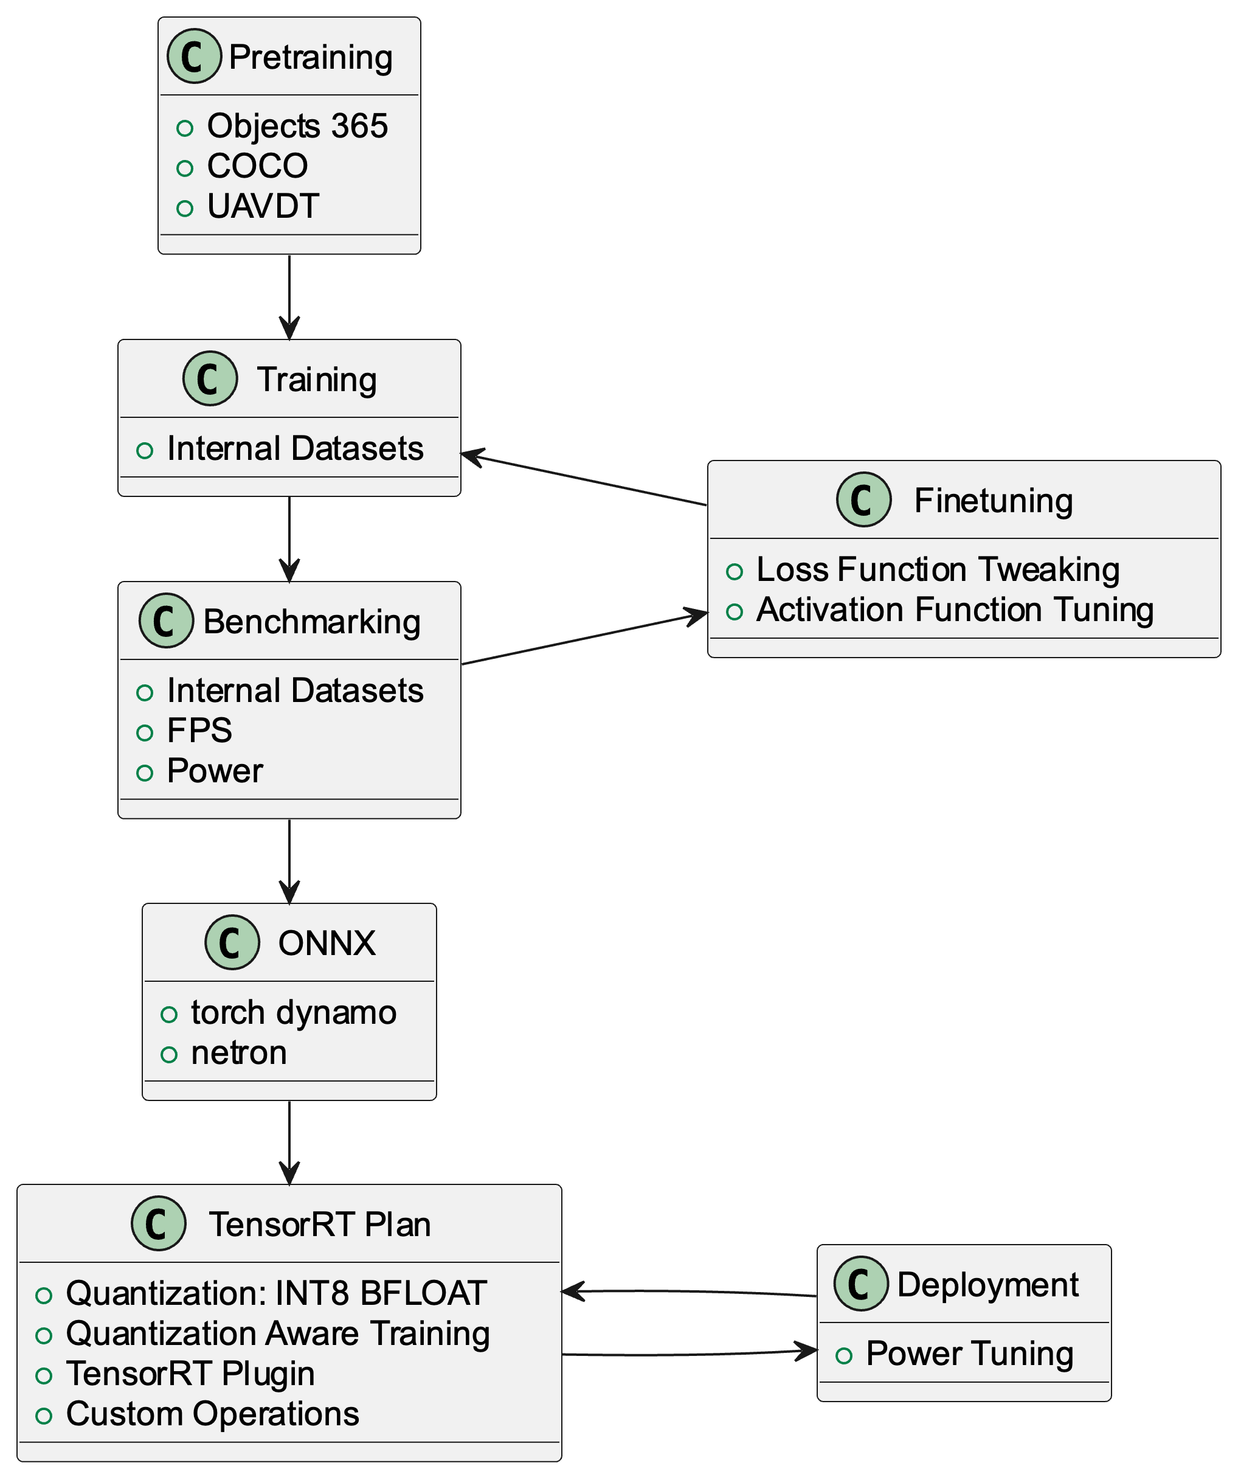
Automated Target Recognition
Data Preparation
Generation
Augmentation
Network Architecture
SSD
RTDETR
Tooling

Slide 6
Data Preparation
Data Generation
Unreal Engine
Microsoft Flight Simulator
Data Augmentation
Corrupt Images
Notes:
A bit of technical writing

Slide 7
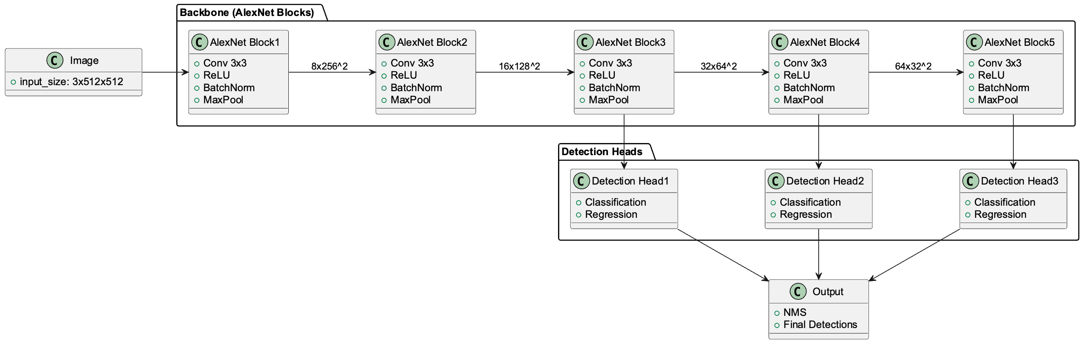
Network Architecture: SSD

Slide 8
Network Architecture: RTDETR

Slide 9
Tooling
COCO
torchvision
torch-lightning
Ultralytics

