Slide 1
Automatic Road Extraction from Satellite Image
Group 10
Ishan Arora (IIT2017501)
Vikrant Singh (IIT2017502)
Srikar Anand (IIT2017504)
Akshay Gupta (IIT2017505)
Naman Deept (IIT2017507)

Slide 2
Abstract
This paper presents the project titled ”Automatic Road Extraction from Satellite Image” which aims to extract Road networks from Satellite images of the ground. This is more challenging compare to roadextraction from the aerial images because satellite images are more noisy and comparatively of the lower resolution than the aerial images. Variety of the network structures with different number of the epochs or iteration times are used to train the model and to determine the model with best network structure so that results can be obtained with more accuracy.

Slide 3
Introduction
Road network detection is the process of detecting and extracting the road network from high resolution satellite images. It is essential for many applications like map generation and updating. To do this road network detection, resolution of satellite images plays an important role. If experts try to label the road pixels manually, it will take more time and will lead to errors. Hence an automatic method is proposed here.
Satellite images consist of the various parts of the earth and various other planet and stars which are taken through the use of the satellites. Satellite images provides the details about various natural and man-made features of the earth. These help in the various fields of studies like astronomy, agriculture, geology, etc. These are also used in google maps which help in finding and locating the different paths and locations. Road extraction from these images is one of the most important application as it can be of great help for the map, tourists,cabs, etc

Slide 4
Implementation Details:
Learning using Patch based labels
The inputs are a set of satellite images provided and these maps to corresponding binary image which is the expected output for those provided satellite images. These satellite images can either be of the form of RGB or grayscale ,the corresponding mapped image is of the same size of the image. In our training image folder we have two folder the corresponding maps are provided as same image file name but in different folders named "groundtruth" and "images".

Slide 5
Proposed Network
We propose modeling the observed map distribution using neural networks. Neural networks are particularly better suited to aerial or satellite image labeling tasks because they offer several distinct advantages. Most importantly, neural networks have been shown to work particularly well on perceptual tasks with large amounts of labeled data .The main advantage is the ease with which the neural networks workings can be parrallelized in the GPU cores this makes it much efficient to be worked with the large datasets and it yields results with more accuracy and precision.
"CNNs" or Convolutional Neural Networks are generalized versions of multi-layers perceptrons which are best networks used in the field of computer vision and image processing, image segmentation.The basic fundamental mathematical operation involved in this is mathematical convolution

Slide 6
Network Implementation and post processing
The proposed network is implemented in the Keras platform with TensorFlow backend
We tried running the data based on training models, and the corresponding weights were obtained
For every input satellite image we get the corresponding CSV output of the image (comma separated value) first value is given as i-x-y where i is the image number x and y are the coordinates based on the patch size as 16, and the second value is the intensity value
Thus we obtained the desire output image reading that CSV file and making that image using PIL in python.
The size of the patch is “16*16” ,So our implementation goes as copying the first value of the pixel i.e a multiple of 16 into a non multiple value which are present in the same grid.

Slide 7
Masking
The intermediate output generated is a binary image where the white part shows the network of roads while the black part represents the rest.
We use this image as a mask on the original image to highlight the roads while keeping the remaining areas intact.
The final output will have the network of roads highlighted in black.

Slide 8
Dataset
We have used the Road_segmentation_dataset which can be downloaded from: https://www.kaggle.com/srikaranand/road-segmentation-dataset .

Slide 9
Base Paper
The base paper which has been used by us for the implementation of this project titled as Automatic Road Extraction from Satellite Image is “Volodymyr Mnih and Geoffrey E. Hinton, ”Learning to Detect Roads in High-Resolution Aerial Images”, Department of Computer Science, University of Toronto, 6 King’s College Rd., Toronto, Ontario, M5S 3G4, Canada, 2013”.

Slide 10
Base Paper Methodology
At training time we are presented with N map and aerial image patch pairs. We train the neural network by minimizing the total cross entropy between ground truth and predicted map patches
We pretrain the neural network f using the procedure of Hinton and Salakhutdinov, which makes use of Restricted Boltzmann Machines (RBMs)
Since our neural network has real-valued inputs and logistic hidden units, in order to apply RBM-based pretraining, we use an RBM with Gaussian visible and binary hidden units
We train an RBM on the PCA representations of aerial image patches by approximately minimizing Contrastive Divergence using stochastic gradient descent with momentum
Once the RBM was trained, we initialized the weight matrix W1 and bias vector b1 from Equation 4 with the RBM weights w and b

Slide 11
Base Paper Methodology (Contd..)
The neural network is trained using stochastic gradient descent to minimize cross entropy between the ground truth map patches and the predictions
We do not use pre-training when training, as this did not improve performance
As with training of the neural network f, we randomly rotate each training case before it is processed in order to remove a bias towards roads in some orientations
We train a convolutional neural network to predict small noise-free patches of natural images given larger patches that had noise added to them
Since our post-processing procedure repeatedly applies a local filter at fixed intervals over a larger image, it can be seen as a type of convolutional neural network where the convolution is followed by subsampling

Slide 12
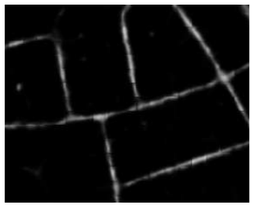
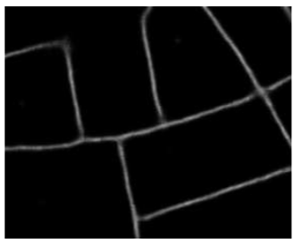
Base Paper Methodology (Contd..)
Figure 1(b) shows the result of applying the post-processing procedure to the predictions from Figure 1(a). The process clearly removes disconnected blotches, fills in the gaps in the roads, and generally improves the quality of the predictions. While we do not do so in this paper, the post-processing procedure can be applied repeatedly, with each application receiving the predictions made by the previous application as input. This process propagates confident predictions along the predicted road network
Figure 1(a)
Figure 1(b)

Slide 13
Base Paper: Similarity with our project
The part which we had taken from the base paper is the idea of using neural networks to detect the roads from images. By studying how the base paper has implemented the convolution neural networks and related techniques to detect the roads from high resolution aerial images, we have tried to use it our project. Although the idea of using convolution neural network(CNN) is same, but the CNN model which had been implemented in our project has been modified in order to make it fit for detecting the roads in satellite images as CNN in base paper is only fit for aerial images.

Slide 14
Base Paper: Modifications done
The one of the part which we had modified in our project compared to the method given in base paper is that the base paper has made use of the aerial images while in our project we have used satellite images.Since aerial image which are mainly taken from near to earth surface through drones,etc, hence they are of much higher resolution than the satellite images which make it much easier to detect patterns like roads in aerial images. While satellite images which are of lower resolution compared to aerial one required better neural network models

Slide 15
Base Paper: Modifications done
The another modification which we have made from base paper is that we have tried to sharpen the input image using appropriate image sharpening filters and sharpening techniques to make the differences clear so that we can yield better and more accurate results. The method used in base paper has not used any such kind of sharpening techniques.

Slide 16
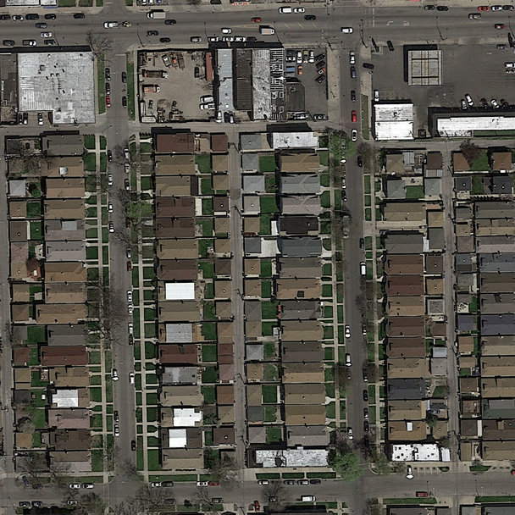

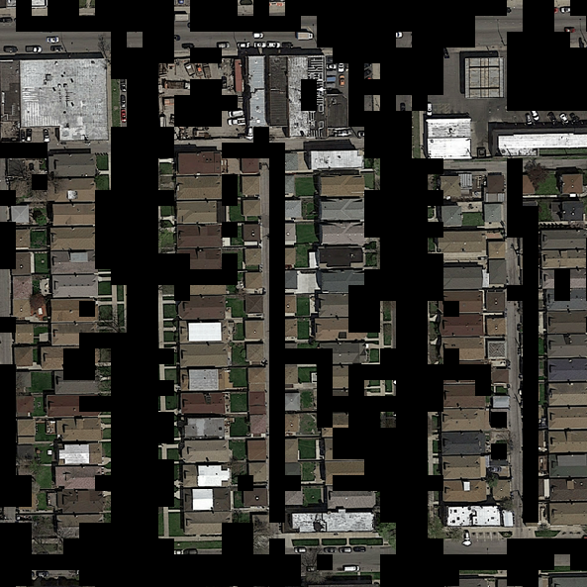
Results:
We have generated a binary image(Intermediate Output) from the satellite image where the white portion represents the network of roads while the black part depicts the rest. This image is then used as a mask on the original image to obtain the output image(Final Output) which highlights the roads in the original image.The roads are extracted from the network of roads in satellite image with an accuracy of 90.78%
Input Image
Intermediate Output
Final Output

Slide 17
ACTIVITY TIME CHART
Project Title - Start of February
Literature Review, Problem Statement, Formulation and Report - Mid-February
Finalizing Methodology - End of February
Understanding and learning concepts and technologies required - First week of March
Dataset Collection - First week of March
Coding and Implementation(75%) -2nd Week of March to 3rd April 2020.
Complete Coding and Implementation - 12th April 2020
Testing and Improvement - 15th April 2020
Submission - 25th April 2020

Slide 18
Language , Tools and Requirements
Python 2,3
Keras , Tensorflow , OpenCV and PyTorch Libraries
Operating System - Linux (Ubuntu) or Windows
Intel i5 or above processor
RAM - 8GB minimum

Slide 19
Literature Review : Road detection from Satellite Images, International Journal of Applied Earth Observation and Geoinformation (2007)
Deals with the possibility of using Artificial Neural Networks for detecting Roads from High-Resolution Satellite Images on a part of RGB Ikonos and Quick-Bird images from Kish Island and Bushehr Harbor. One of the most important advantages of neural networks as compared to conventional statistical methods is that they are distribution-free operators, because the learning and recalling depend on the linear combination of data pattern instead of the statistical parameters of the input data. The output is the pixels of output image,each being 0 (Background Pixel) or 1 (Road pixel). It was found that there is no need to design more than 10 neurodes in hidden layer as it does not improve results noticeably

Slide 20
Literature Review : Road Extraction from High Resolution Image with Deep Convolutional Network
This paper which was named as ”Road Extraction from High Resolution Image with Deep Convolutional Network” was published in March 2018 by National Engineering Laboratory for Transportation Safety and Emergency Informatics, and authored by Wei Xia, Yu-Ze Zhang,Jian Liu, Lun Luo and Ke Yang. In this paper the authors tried to make a Deep Convolutional Neural Network (DCNN) which would detect Roads in Satellite Images taken by the Satellite GF-2. TheGF-2 satellite data is used for experiments, as its images may show optical distortion in small pieces. Experiments in this paper showed an accuracy of more than 80%

Slide 21
Literature Review : Automated Road Extraction from High Resolution Satellite Images
This paper was produced in International Conference on Emerging Trends in Engineering, Science and Technology (ICETEST - 2015)authored by Jose Hormese and Dr. C. Saravanan . In this paper they illustrated a novel approach to road extraction from satellite images using vectorisation approach which mainly applied through 3 steps.
1. the image is segmented to roughly identify the road network regions
2. the decision making and continuity procedure to correctly detect the roads
3. the Vectorization step to identify the line segments or curved s egments which represent the roads segmentation .

Slide 22
References
[1]Sample Input and Output images produced by the first method (Binary classification of pixels)[Online Image] Retrieved February 14,2020 from URL(https://www.kaggle.com/wurenzhe/satellite-road-segmentation)
[2] Volodymyr Mnih and Geoffrey E. Hinton, ”Learning to Detect Roads in High-Resolution Aerial Images”, Department of Computer Science, University of Toronto, 6 King’s College Rd., Toronto, Ontario, M5S 3G4, Canada, 2013
[3] M. Mokhtarzade and M.J. Valadan Zoej, ”Road detection from high-resolution satel-lite images using artificial neural networks”, International Journal of Applied EarthObservation and Geoinformation, 2007 32-40.
[4] Wei Xia, Yu-Ze Zhang, Jian Liu, Lun Luo and Ke Yang,”Road Extraction from HighResolution Image with Deep Convolution Network—A Case Study of GF-2 Image”,22-March-2018, National Engineering Laboratory for Transportation Safety andEmergency Informatics, China Transport Telecommunications Information Center,Beijing.

Slide 23
References Continued..
[5] Jose Hormese , Dr. C Saravanan, ”Automated Road Extraction From High Reso-lution Satellite Images”, National Institute of Durgapur , International Conferenceon Emerging Trends in Engineering, Science and Technology (ICETEST - 2015).
[6] Jose Hormese , Chandran Saravanan ,”A CONVOLUTIONAL NEURAL NET-WORK APPROACH TO ROAD CLASSIFICATION FROM SATELLITE IMAGES”, Journal of Theoretical and Applied Information Technology ,15th December 2018.Vol.96. No 23.
[7] P. Yadav and S. Agrawal, ”ROAD NETWORK IDENTIFICATION AND EXTRACTION IN SATELLITE IMAGERY USING OTSU’S METHOD AND CONNECTED COMPONENT ANALYSIS”, GIS Cell, Motilal Nehru National Institute of Technology Allahabad,The International Archives of the Photogrammetry, Remote Sensing and Spatial Information Sciences, Volume XLII-5, 2018 ISPRS TC V Mid-term Symposium “Geospatial Technology –Pixel to People”, 20–23 November 2018, Dehradun, India
[8] Corentin Henry, Seyed Majid Azimi and Nina Merkle, ”Road Segmentation in SAR Satellite Images With Deep Fully Convolutional Neural Networks”,IEEE GEOSCIENCE AND REMOTE SENSING LETTERS, VOL. 15, NO.12, DECEMBER 2018

