Slide 1
Forecasting Energy Trading Prices Using Time Series Models
Submitted By :-
Ishan Arora (IIT2017501)
Vikrant Singh (IIT2017502)
Srikar Anand (IIT2017504)
Akshay Gupta(IIT2017505)
Naman Deept (IIT2017507)
Submitted To:-
Dr. Pavan Chakraborty

Slide 2
Abstract
This report describes the 6th semester project our group is working on, titled "Forecasting Energy Trading Prices Using Time Series Models". Time series analysis have been the subject of a great interest in the recent times. Time series analysis is used for prediction and forecasting. It has many real life applications in field of business, sales, etc such as economic and sales forecasting. In this paper, the energy trading price has been predicted using the time series analysis of various features such as weather, stock. This has been done through the use of ARIMA, HMM and the neural network such as LSTM.

Slide 3
Introduction:
Time series analysis is of utmost importance in the modern world where every industry wants to enhance its revenue by predicting the future of their product and adjusting their production , consumption, maintain their market
Time series analysis of data not only helps in forecasting but also helps in understanding the past of subject in consideration statistically . It also helps in learning the trends which affects various business domain , also it can be used for monitoring physical systems , software systems , financial trading systems, weather forecasting etc.
Conditions on which energy prices may depend are :
Coal based electricity prices are dependent upon coal production, coal import, oil prices
Solar energy based electricity are dependent upon weather conditions on daily basis
Under this project, basically we will perform time series analysis for forecasting which essentially has two parts, firstly forecasting of weather variables like solar irradiation, wind speed, temperature etc. and secondly predicting energy trading prices generated that were dependent upon these .
Time Series Analysis helps us to understand what are the underlying forces leading to a particular trend and helps us in forecasting and monitoring the data points by fitting appropriate models to it.
Traditionally, time series forecasting was under the scope of statistics and models like Auto-regressive Integrated Moving Average (ARIMA), but due to possible non-linearity in the data, we had also used Long Short Term Memory (LSTM) models which are more reliable and accurate over this kind of data. We had also implemented it through Hidden Markov Models (HMM) and the results have been compared.

Slide 4
Motivation
We aim to explore new possibilities and incorporate them in our everyday lives to make it more comfortable and easy going
Time series analysis has been in use around us for the longer time
It has been used in statistics, geophysics, data mining, etc for the forecasting purpose
It also has a great impact in the field of business to predict sale sand stock prices
The main motive for using the time series is that it can predict or forecast the future

Slide 5
Problem Definition:
In this paper titled as "Forecasting Energy Trading Prices Using Time Series Models", we aim to implement an efficient system for predicting the prices of energy trading .
For this purpose different data-sets related with various features such as weather and stock prices can be used as these prices depend on these features.
To study and predict the results, time series analysis need to be done on these data-sets.
Time series analysis can be done through the use various tools and technologies such as ANN, SVM, correlation, etc.
In this paper we had tried to implement time series analysis using the ARIMA (Auto Regressive Integrated Moving Average), Hidden Markov Model(HMM) and the LSTM (Long Short Term Memory) network . We also compared the results found from these three models.

Slide 6
Literature Review:
Forecasting Next-Day Electricity Prices by Time Series Models
Published by IEEE 2002 by Francisco J. Nogales,Javier Contreras, Member, IEEE, Antonio J. Conejo, Senior Member,IEEE, and Rosario Espınola
This paper has given two efficient and accurate model to predict the electricity prices based on the time series analysis using dynamic regression and transfer function models
The first method called dynamic regression approach relates the price at particular hour t with the prices at the past time
The second model called transfer function approach assumes that the price and the demand series are stationary i.e. their mean and covariance is constant
To study the results of these models, datasets from two different markets was collected, one from Spanish and other from the Californian market
Average error found in Spanish market was around 5% and in Californian market was 3%
The results obtained from these models were sufficient to predict the prices so that these could help the producers and the consumers

Slide 7
Literature Review:
Time Series Analysis of Household Electric Consumption with ARIMA and ARMA Models
The introduction of correlation as a phenomenon that may be generated through lagged linear relations leads to proposing the autoregressive (AR) and autoregressive moving average (ARMA) models
Adding non-stationary models to the mix leads to the autoregressive integrated moving average (ARIMA) model popularized in the landmark work by Box and Jenkins (1970)
Autoregressive models are based on the idea that the current value of the series,xt, can be explained as a function of past values,x_{t−1}, x_{t−2}, ..., x_{t−p}
We may be using ARIMA model to generate the future use of the energy consumption from the given present datasets, along with this model Bayesian Vector Auto-regression Model (BVAR) can also be used to get the desired prediction in the energy utilisation and consumption trends

Slide 8
Proposed Methodology
Dataset aggregration and preparation.
ARIMA Models (Auto Regressive Integrated Moving Average)
LSTM Models (Long Short Term Memory)
Hidden Markov Model (HMM)

Slide 9
Dataset aggregation and preparation:
The dataset has been gathered from various resources and combined to form a single dataset.
Dataset has been collected from :
Wholesale electricity Data and SEDS data provided by US EIA [2000-2013].
SP index daily price data, Yahoo finance [2000-2013].
This dataset is used to make a multi-variate time series model and to analyse further with the rich features included in the dataset .

Slide 10
ARIMA MODEL (Auto-Regressive Integrated Moving Averages):
The ARIMA model is a generalised form of ARMA model since our model is non-stationary i.e value of mean and variances is not same at every instant.
It is a triple (p,d,q) these values need to be specified.
ARMA model is a combination of AR(auto regression) and MA(moving Averages). The model is generalised and thus is best suited for this kind of problem.
The mathematical equation is given as:

Slide 11
LSTM Models (Long -Short Term Memory):
Working :
LSTM Models are the special kind of neural networks with the capability of learning long term dependencies. Architecture of LSTM unit consists of the cell and the three gates which are input gate, output gate, and forget gate. The job of cell is to remember the values over the arbitrary intervals of the time while the job of the gates is to regulate and control the flow of data and information from in and out of the cell.
The cell keeps track of the dependencies between the elements of the input system.

Slide 12
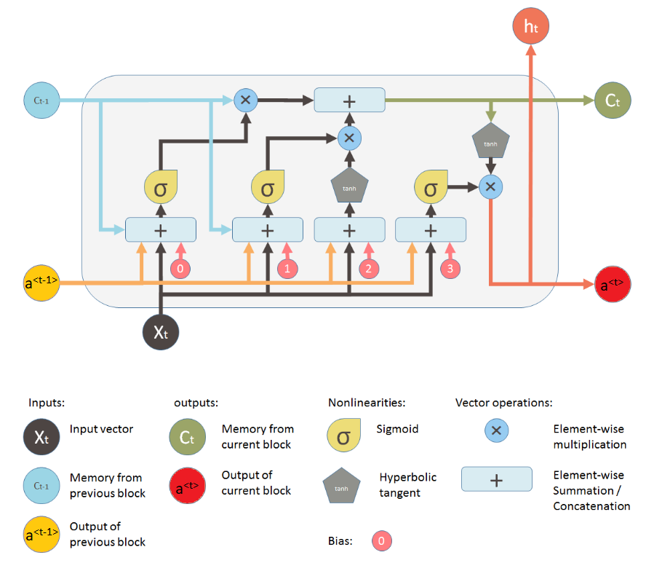
LSTM contd.
Figure 1: Common LSTM unit architecture

Slide 13
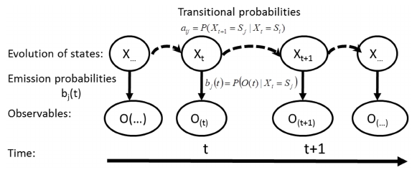
Hidden Markov Model (HMM)
HMM is a statistical generative model which considers the system being transitioned in certain number of states. The model assumes that the state is can not directly observed, but the dynamics or the output of the state can be observed.
HMM Assumes current state independence.
The structure of the chain is given by :

Slide 14
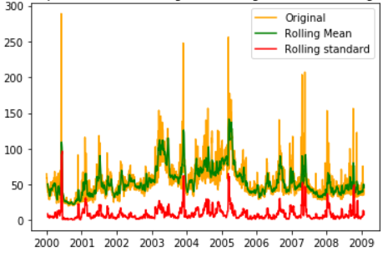
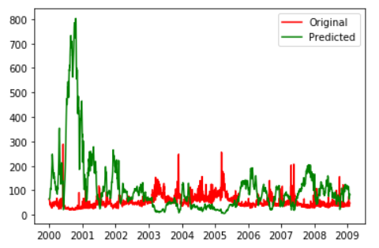
Experimental Data and Results:
Results obtained using ARIMA:
Figure 2 : Graph of actual vs predicted training prices using different methods (X axis: date in year and Y axis: price in $ per megawatt)
Figure 3 : Graph of actual training prices vs predicted training prices (X axis: date in year and Y axis: price in $ per megawatt)
Root mean squared error for prediction with ARIMA model is 147.5509182239792

Slide 15
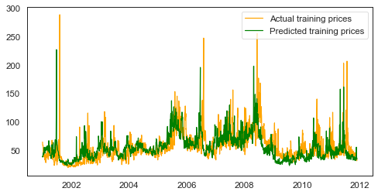
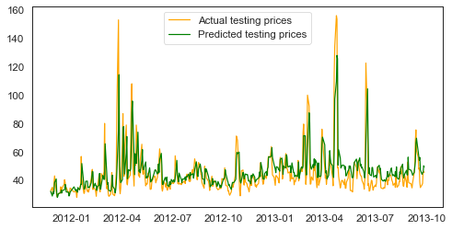
Results obtained using LSTM:
The LSTM model used 85% of the data to train the model and the 15% of the data to test the model and root mean square error of the error is calculated .
Figure 4 : Graph of actual training prices vs predicted training prices (X axis: date in year and Y axis: price in $ per megawatt)
Figure 5: Graph of actual testing prices vs predicted testing prices (X axis: date and Y axis: price in $ per megawatt)
Train root mean square error: 12.518183038575403
Train absolute error: 8.148153889445059
Test root mean square error: 11.747577291919768
Test absolute error: 7.403125770781229

Slide 16
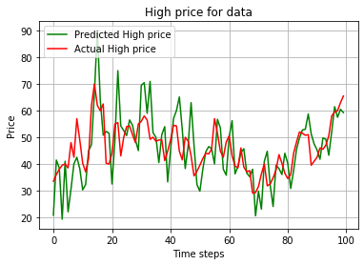
Results obtained using HMM:
Figure 6 : Graph of actual vs predicted trading prices
Root mean squared error on high prices using Hidden Markov model is 9.273716892379236.

Slide 17
Conclusion:
Three different time series models has been used in time series analysis and future price prediction of stock prices .
ARIMA Model showed a large rmse value of 147.5509182 for this multi-variate time series model.
Hidden Markov Model was a rather simple uni-variate time series model which showed rmse value of 9.27371689237. This model may fail to perform well under multi-variate conditions.
Lastly, LSTM Model is presented which performed the best among the three models with training set rmse value of 12.518183038575403 and the testing set rmse value of 11.747577291919768 when given the multi-variate time series data.
On comparison, it can be concluded that the LSTM model was better performing when given a multi-variate time series data which can deal with multiple features efficiently.

Slide 18
Future Work:
A multi-variate time series hidden markov model can be implemented with the input features same as in the dataset prepared . Results of this new hidden markov model can be compared with the already implemented LSTM model and ARIMA model as in this project . Also different hyper - parameter tuning can be performed on the LSTM model to improve the efficiency of the model . New features that affect the stock prices thay may not be considered in this project can also be included to further the work in this project .

Slide 19
Requirements
Intel i7 or above processor
RAM - 8GB minimum
Operating System - Linux (Ubuntu), Windows
Python 3
Tensorflow v1.14 with Keras API
Pandas , Numpy , SKlearn statsmodel python libraries
matplotlib and seaborn libraries for plotting purposes
jupyter notebook or spyder IDE
Google Colab resources
Google Chrome web browser for Google Collaboratory

Slide 20
References:
[1]Francisco J. Nogales, Javier Contreras, Member, IEEE, Antonio J. Conejo, SeniorMember, IEEE, and Rosario Esp ́ınola, ”Forecasting Next-Day Electricity Prices byTime Series Models”, IEEE TRANSACTIONS ON POWER SYSTEMS, VOL. 17,NO. 2, MAY 2002, 342-348
[2] Pasapitch Chujai, Nittaya Kerdprasop, and Kittisak Kerdprasop, ”Time Se- riesAnalysis of Household Electric Consumption with ARIMA and ARMA Models”,International MultiConference of Engineers and Computer Scientists 2013 Vol I,IMECS 2013, March 13 - 15, 2013, Hong Kong
[3] S. Yan, “Understanding LSTM and its diagrams,” Medium, 15-Nov-2017. [Online].Available: https://medium.com/mlreview/understanding-lstm-and-its-diagrams-37e2f46f1714. [Accessed: 11-Mar-2020].
[4] Andrew Ng,“Deep Learning Specialization,” Coursera. [Streaming Video]. Avail-able: https://www.coursera.org/specializations/deep-learning. [Accessed: 11-Mar-2020].
[5] Wholesale electricity Data for the PJM West Hub provided by EIA, [Online]. Available: https://www.eia.gov/electricity/wholesale/. [Accessed: 15-Feb-2020]
[6] SP index daily price data, Yahoo finance, [Online].Available: https://finance.yahoo.com/quote/%5EGSPC/. [Accessed: 15-Feb-2020]
[7] Colah’s blog, ”Understanding LSTM Networks” Posted on August 27, 2015. [On-line]. Available: https://colah.github.io/posts/2015-08-Understanding-LSTMs/. [Ac-cessed: 11-Mar-2020]

