Slide 1
Web Traffic Time Series Analysis
7th Semester Project
Submitted By:
Srikar Anand (IIT2017504)
Akshay Gupta (IIT2017505)
Submitted to:
Dr. Pavan Chakraborty

Slide 2
ABSTRACT
This report titled ”Web Traffic Data Exploration and Time Series Analysis ” describes the 7th semester project in which web traffic prediction is done through careful data analysis involving various data exploration methods and then time series analysis is done to predict the future of web traffic for the given Wikipedia articles. In the recent times web traffic analysis has been aggressively being used by web site owners to predict the traffic on web pages and correspondingly scale up or down the infrastructure depending upon the traffic in order to provide efficient services as well as reduce cost and detect anomalies pertaining to security concerns.

Slide 3
INTRODUCTION
Time series analysis is of utmost importance in the modern world where every industry wants to enhance its revenue by predicting the future of their product and adjusting their production , consumption and maintain their market .
Time series analysis of data not only helps in forecasting but also helps in understanding the past of subject in consideration statistically .
Sequential or temporal observations emerge in many key real-world problems, ranging from biological data, financial markets,weather forecasting, network congestion to audio and video processing. [1]
The field of time series encapsulates many different problems, ranging from analysis and inference to classification and forecast.

Slide 4
Literature Review
Forecasting Web Page Views : Methods and Observation [3]
In this paper , main focus was given to extracting trends and seasonal patterns which are the two most impactful factors for web page views forecasting. Time series is mainly decomposed into three factor i.e. Trend , Season and Noise
For the short-term prediction , HW procedure and SSM procedure has been used , since in web pages there exist seasonality at multiple time scales .
They used different methods to find remedy of sudden massive noise which could have detrimental impact on forecasting .
For the long-term prediction , ESSF algorithm is used to extract the global trend and scale the long term season effect after removal of short term seasonal impact from HW .

Slide 5
For short term prediction , two methods were used ;
Holt - Winter Procedure : This is a probabilistic approximation method in which the current state is an exponentially weighted running average of recent season-adjusted observations.The forecasting of h time units ahead is given by this following equation: ˆx(t+h)=L(t)+hT(t)+I(t−d+h mod d) ,where x1,x2,...xtis given time series and ˆx(t) is predicted at time t.
State Space Model: The underlying principle is guided by Markov Model where states are characterized by Markov process and is a linear combination of states added with Gaussian noise. When web page view showed long range seasonality and trends both the above model were far from predicting the outcome
For long term prediction ESSF was used:
ESSF : is used for long term prediction of web page views keeping the track of long term trend , and seasonality pattern as in the modified equation . Smoothness regularization and scalable yearly season improved prediction accuracy in comparison to earlier used models

Slide 6
2. Web Traffic Prediction of Wikipedia Pages [2]
This research paper used RNN seq2seq model to predict the web page views. The prediction model was built on : (1) number of hits , (2) features that were extracted from URLs , (3) day of week - analyses the weekly seasonality information ,(4) year to year autocorrelation, (5) page popularity and (6) lagged page views .
These were the features used by RNN seq2seq model based on Encoder/Decoder Architecture to predict the outcome. Rolling median was used as measure of median to avoid sensitivity based on sudden spike in the data.
Feature window is used instead of entire time series length to capture the trend which is later used to derive and forecast weekly , monthly or yearly trend

Slide 7
3. WaveNet: A Generative Model For Raw Audio [4]
This research paper used causal convolutions to make sure that the model can not violate the ordering in which the data was modelled. For any given time-series , the prediction p(xt+1|xt,xt−1,xt−2...x1) emitted by time-step t cannot depend on any future time-steps e.g.xt+1,xt+2etc , Only the past can influence the time-series prediction .
While training , the conditional predictions can be made in parallel because of all the time-steps of ground truth with the given time-series is known. Generating with the model , all the predicted values at any time is fed back into the model to predict the next sample.
dilated convolutional network was used to further increase the receptive field by the order of magnitude , this way computational cost was also minimised.

Slide 8
Associated Challenges
Pre-processing the data
Data needs to be cleaned up and any errors have to be removed
Data needs to be divided into parts to be studied properly
Determining the techniques to study data
Appropriate filters and techniques must be chosen to identify the trends and variations in the data
Analyzing and Judging the data based on filters applied
Filtering out irrelevant data that is not suitable for forecasting/predicting based on the results achieved by analyzation
Choosing the relevant models for forecasting based on results achieved by analyzation
Interdependency of sites / articles to each other and response to real world events
Making a good software model to create a dashboard software

Slide 9
Proposed Methodology
We used Wikipedia Article dataset provided by Google on kaggle[1] to train the models. For the Web-App Wikimedia rest-api was used to fetch real time data for the predictions.
Data Analysis Results
Applying ACF and PACF on the data showed that data is stable enough across different languages, and it follows a trend. The hyperparameters for ARIMA different languages are figured out from the graphs.
Fourier Transform of the data showed the strongest frequencies present in the data. This gave a clue on the stability of the data as well. Multiple peaks imply less stability. Most of the data is not too smooth, so appropriate model must be used for prediction.
Decomposing the data proved the nature of the data is approximately linear in terms of seasonality, but non-linear in the trend. So the models like ARIMA and LSTM can be applied.

Slide 10
2. Modelling
2.1 Long Short Term Memory (LSTM)
Long Short Term Memory (LSTM) are the special kind of Recurrent Neural Networks (RNN).
LSTM have the capability to learn the long term dependencies. As such, the sequence of observations must be transformed into multiple examples from which the LSTM can learn. [6]
From the results of data analysis, It can be said that LSTM model can be used directly to predict the data, without much requirement of data transformation.
LSTM would have good efficiency, especially in this case where data is highly periodic and depends on the past data most of the times.

Slide 11
2. Modelling
2.2 ARIMA
The ARIMA model is a generalised form of ARMA model since our model is non-stationary i.e value of mean and variances is not same at every instant.
It is a triple (p,d,q) these values need to be specified.
ARMA model is a combination of AR(auto regression) and MA(moving averages). The model is generalised and thus is best suited for this kind of problem.
ARIMA applies differencing on ARMA model to make the time series stationary. Differencing can be applied multiple times, which is the second parameter, d.
Theses values can be extracted from the graphs of ACF, PACF and the differencing graphs.

Slide 12
2. Modelling
2.3 CNN
Standard tasks for CNNs are generally image recognition or text classification etc. These kind of neural networks are very powerful to learn spatial invariant patterns.
CNN inspired by WaveNet architecture were modified to learn temporal pattern in this project.
With the help of dilated causal convolution layer which helps in maintaining the temporal order and long-term dependencies without any explosion in complexity of the architecture , it is made possible.
The temporal order must be maintained which is done by maintaining the causal structure . Causal structure provide the needed temporal flow but long-term dependencies should also be handled.

Slide 13
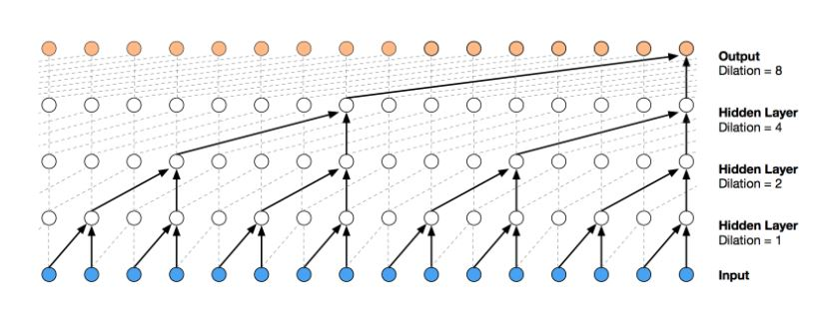
2. Modelling
The dilated convolutions allows to increase the receptive area exponentially where filters are not applied in sequential manner to the input but instead use a skipwith a set dilation rate.
Increasing dilation rate in an exponential manner, it was possible to capture history 256 days of history with 9 dilated convolution layer. In this project , a stack of 8-dilated convolution layer followed by 2 dense layer were used which is then used to learn pattern in time-series
Also used activated gating and skip connections to improve the accuracy
2.3 CNN
.
Figure : A dilated causal convolutional network

Slide 14
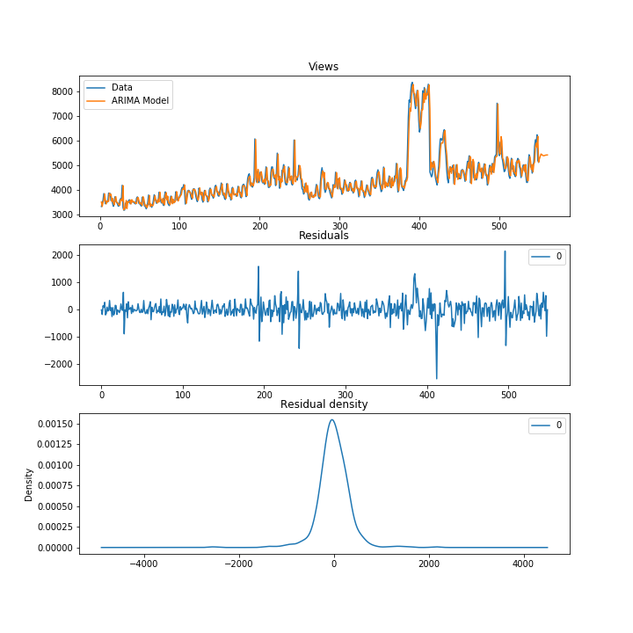
RESULTS (ARIMA)
ARIMA
Root mean squared error for prediction with ARIMA model on the given dataset is 337.862382

Slide 15
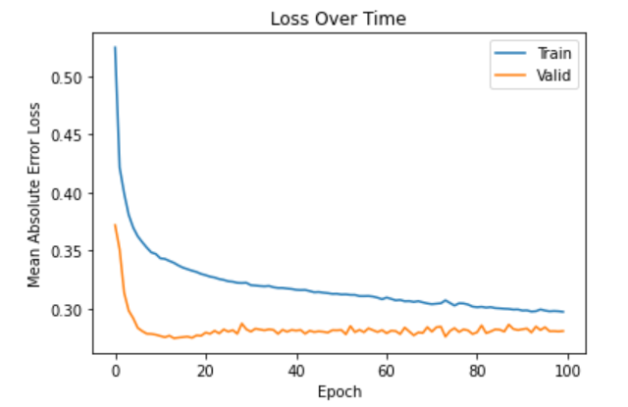
RESULTS (LSTM)
Figure shows the mse loss for training and validation phase for LSTM model
Root mean squared error for prediction with ARIMA model on the given dataset is 287.845766

Slide 16
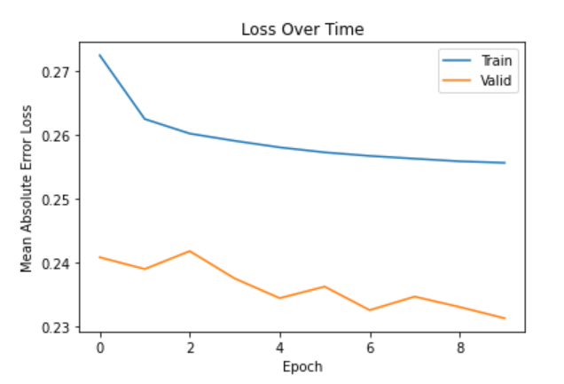
RESULTS (CNN)
Figure shows the mse loss for training and validation phase for LSTM model
Root mean squared error for prediction with ARIMA model on the given dataset is 271.942186

Slide 17
Conclusion
Time series analysis is a must for every organization to understand seasonality, cyclic,trend and randomness in the data .
In this project , three different models for time series analysis is done namely ARIMA , LSTM , and CNN.
The root mean square error for ARIMA model was found to be 337.862382.
The root mean square error for LSTM model was found to be 287.845766.
The root mean square error for CNN model was found to be 271.942186.
The CNN model was found to be great at picking recurring patterns in time-series.CNN predictions was also found to be more accurate and expressive when compared to LSTM and ARIMA model.

Slide 18
References
Forecast future traffic to Wikipedia Pages [Online],Available: https://www.kaggle.com/c/web-traffic-time-series-forecasting [Accessed : 10-09-2020]
N. Petluri and E. Al-Masri, ”Web Traffic Prediction of Wikipedia Pages,” 2018IEEE International Conference on Big Data (Big Data), Seattle, WA, USA, 2018,pp. 5427-5429, doi: 10.1109/BigData.2018.8622207.
Jia Li,Andrew W. Moore, ”Forecasting Web page views : Methods and Observation”, Journal of Machine Learning Research 9 (2008) 2217-2250
0oord, Aaron Dieleman, Sander Zen, Heiga Simonyan, Karen Vinyals, OriolGraves, Alex Kalchbrenner, Nal Senior, Andrew Kavukcuoglu, Koray. (2016).WaveNet: A Generative Model for Raw Audio
Auto correlation and partial auto correlation [Online].Available: http://sfb649.wiwi.hu-berlin.de/fedchomepage/xplore/tutorials/sfehtmlnode59.html.[Accessed: 16-Sep-2020]
Jason Brownlee, ”How to Decompose Time Series Data into Trend and Seasonality”Posted on January 30, 2017. [Online]. Available:https://machinelearningmastery.com/decompose-time-series-data-trend-seasonality/ [Accessed: 16-Sep-2020].
Shi Yan, “Understanding LSTM and its diagrams,” Medium, 14-Mar-2016. [Online].Available:https://medium.com/mlreview/understanding-lstm-and-its-diagrams-37e2f46f1714.[Accessed: 16-Sep-2020].
Eugine Kang, ” Time Series : Arima Model”, Medium , 26-Aug-2017. [Online].Availablehttps://medium.com/@kangeugine/time-series-arima-model-11140bc08c6[Accessed: 16-Sep-2020]
https://github.com/farizrahman4u/seq2seq [Accessed : 01-11-2020

Slide 19
THANK YOU!

