Slide 1
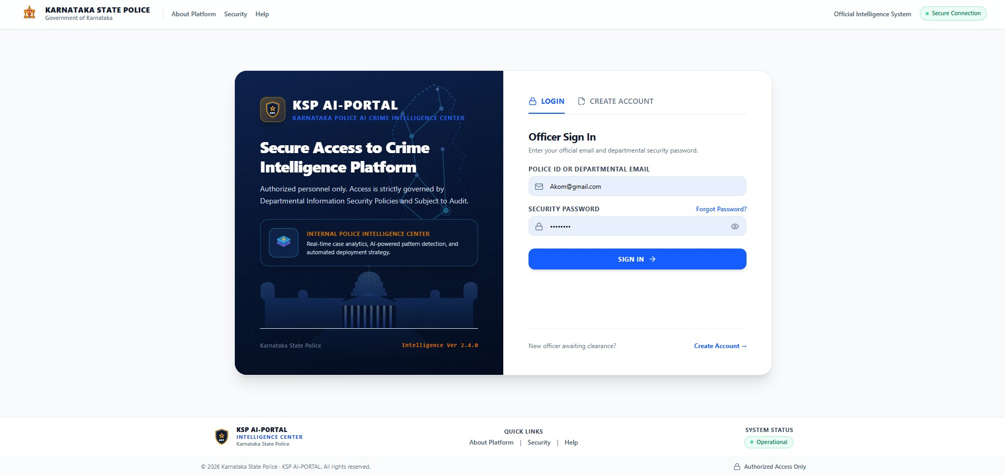
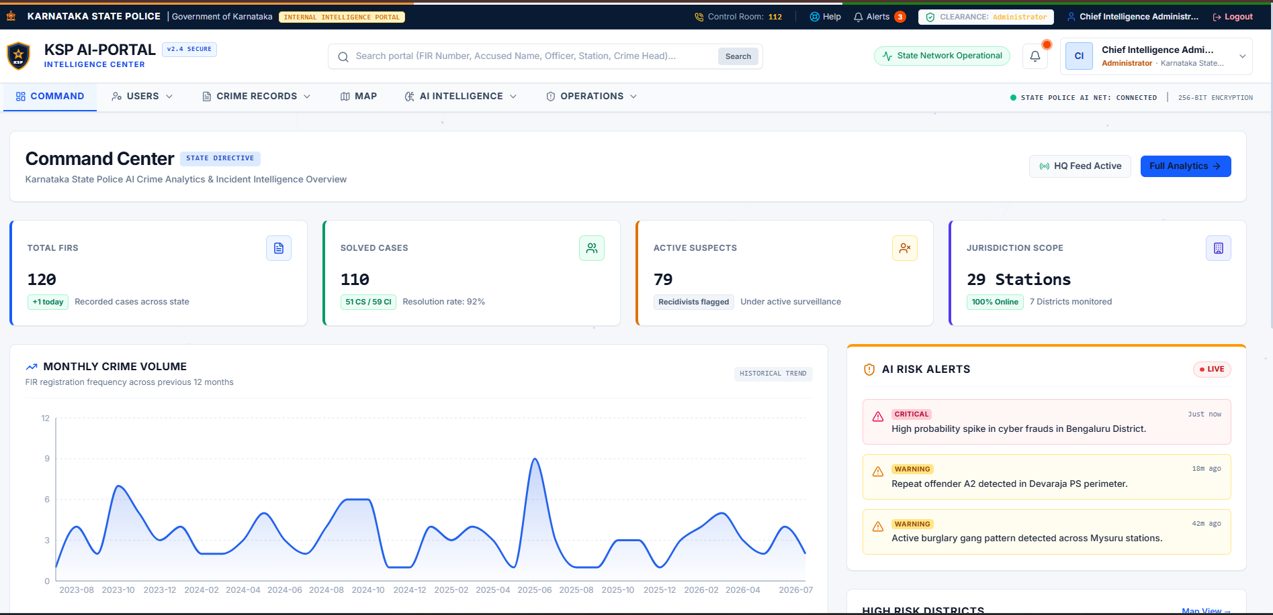
TEAM TRAILBLAZERS
AI-Powered Criminal Network Analysis System
A web-based crime intelligence platform
COLLEGE
Alva's Institute of Engineering and Technology
DEPARTMENT
GUIDE
Department of AIML & ISE
ANJIT RAJA R
TEAM MEMBERS
ACADEMIC YEAR
KSP AI-Portal: Intelligence Center
AKSHAY H | OMKAR K S
2026 – 2027

Slide 2
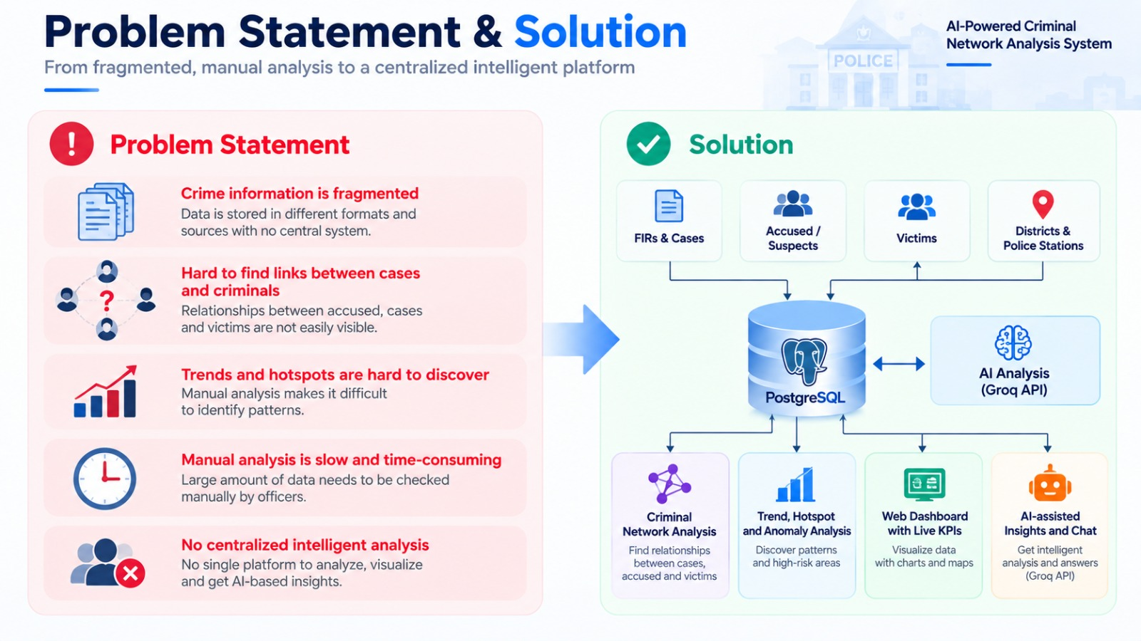
Problem Statement & Solution
From fragmented, manual analysis to a centralized intelligent platform
Problem Statement
Solution
Crime information is fragmented
Hard to find links between cases and criminals
Trends and hotspots are hard to discover
Manual analysis is slow and time-consuming
No centralized intelligent analysis
✓
Centralized PostgreSQL crime database
✓
Criminal network analysis of relationships
✓
Trend, hotspot and anomaly analysis
✓
Fast web dashboard with live KPIs
✓
AI-assisted insights and chat (Groq API)
AI-Powered Criminal Network Analysis System
2

Slide 3
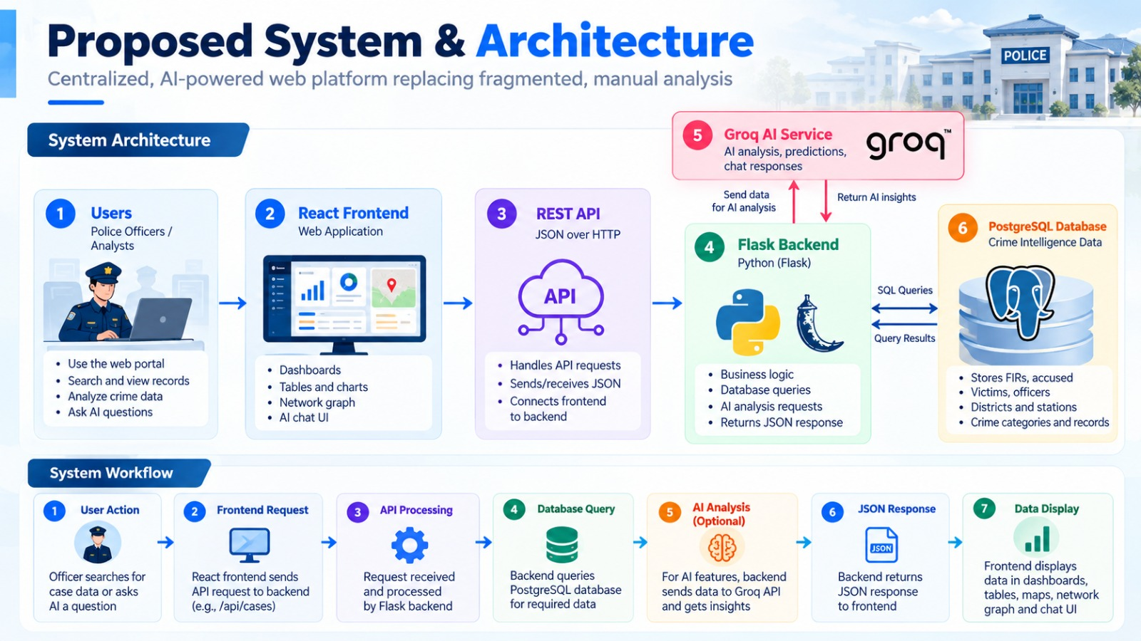
Proposed System & Architecture
Centralized, AI-powered web platform replacing fragmented, manual analysis
Groq AI Service
Flask calls Groq for AI analysis
User
React Frontend
REST API
Flask Backend
PostgreSQL DB
Officers / analysts use the web portal
Dashboards, tables, network graph, chat UI
JSON over HTTP between frontend and backend
Business logic, queries, AI requests
PostgreSQL hosted on Render; stores FIRs, accused, victims, stations
Centralized data • Relationship analysis • AI-assisted insights
AI-Powered Criminal Network Analysis System
3

Slide 4
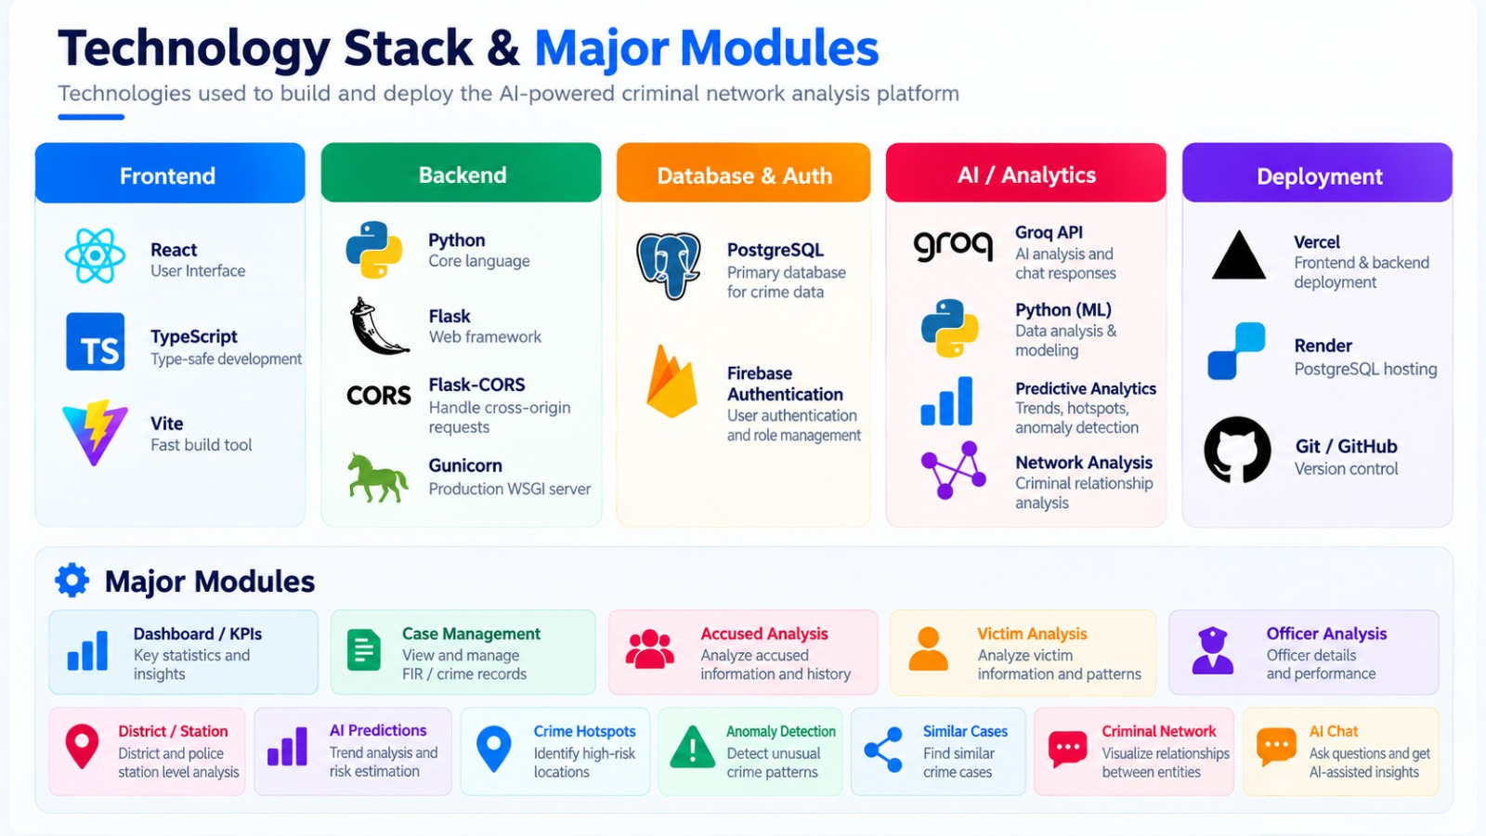
Technology Stack & Major Modules
Frontend
Backend
Database
AI
Deployment
React
Python
PostgreSQL
Groq API
Vercel
TypeScript
Flask
Render
Vite
Flask-CORS
Gunicorn
Modules
Dashboard / KPIs
Case management
Accused analysis
Victim analysis
Officer analysis
District / station
AI predictions
Crime hotspots
Anomaly detection
Similar cases
Criminal network
AI chat
AI-Powered Criminal Network Analysis System
4

Slide 5
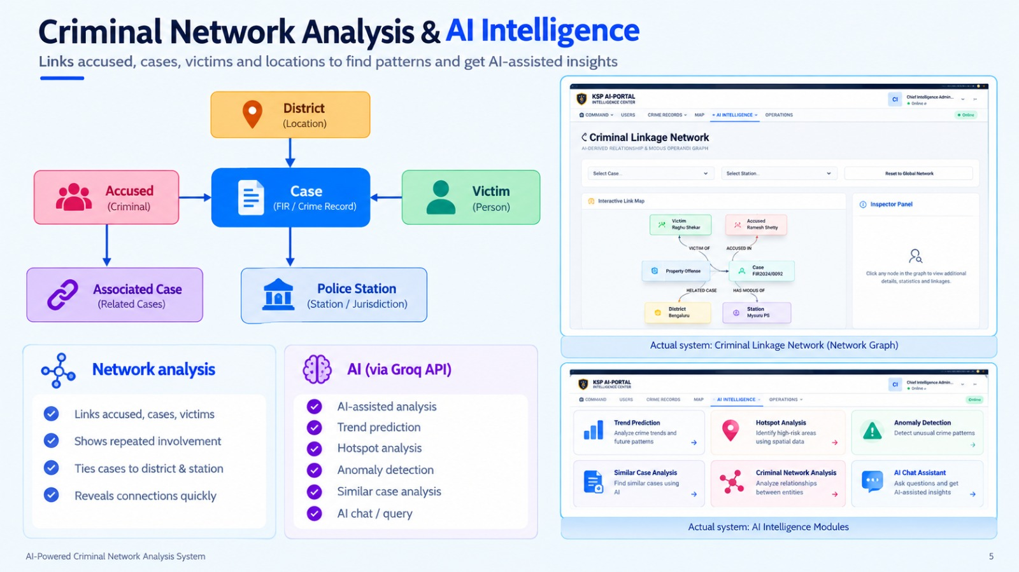
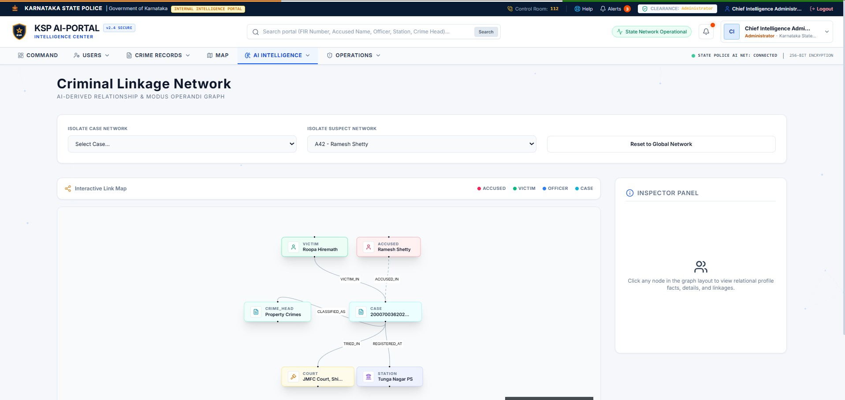
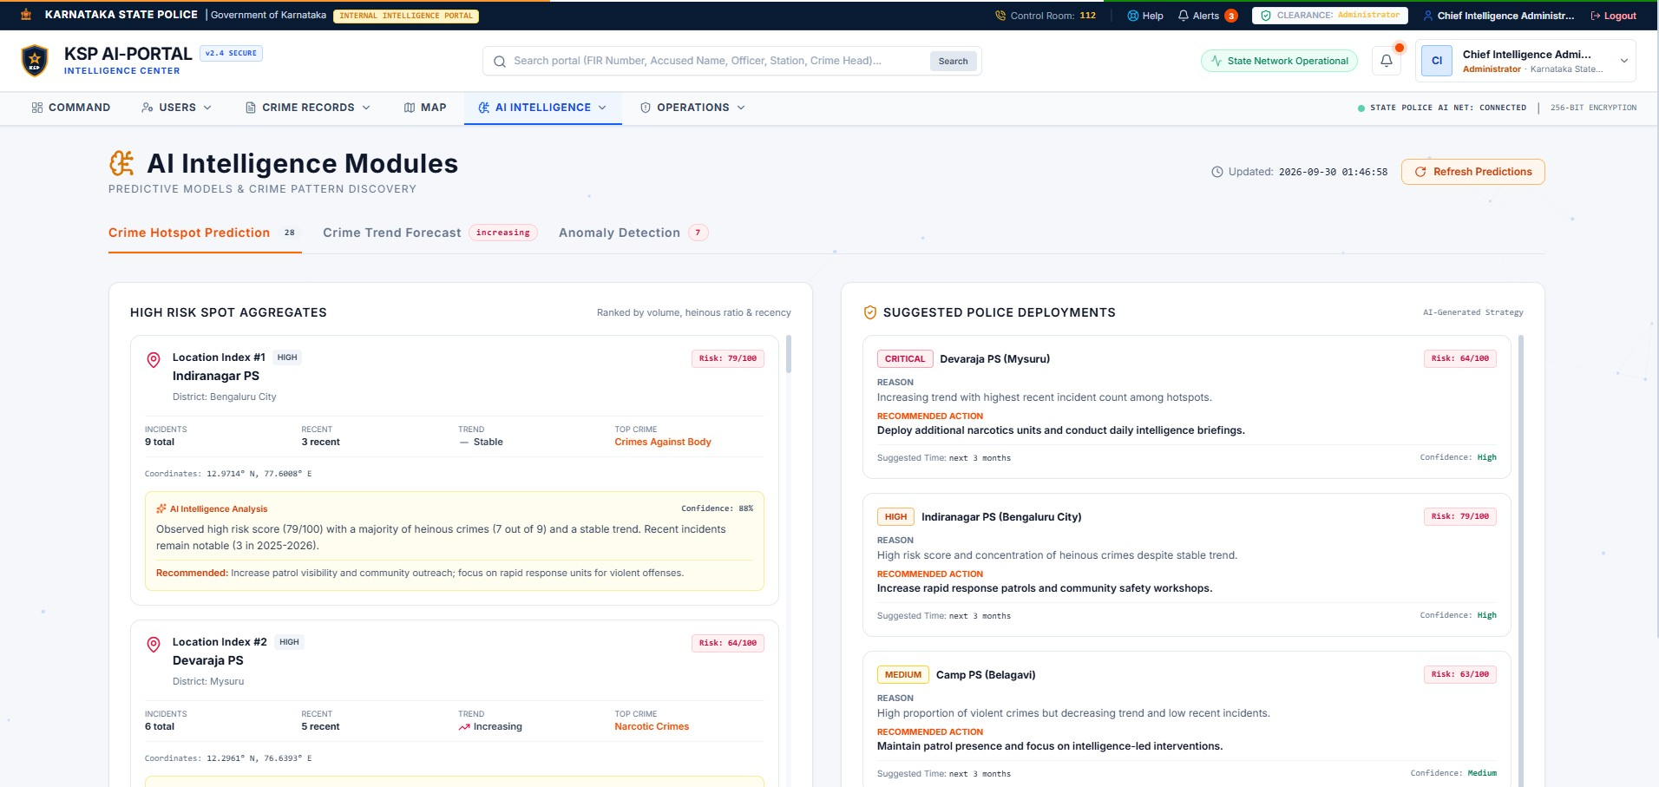
Criminal Network Analysis & AI Intelligence
District
Accused
Case
Victim
Associated Case
Police Station
Actual system: Criminal Linkage Network (top), AI Intelligence Modules (bottom)
Network analysis
AI (via Groq API)
Links accused, cases, victims
Shows repeated involvement
Ties cases to district & station
Reveals connections quickly
AI-assisted analysis
Trend prediction
Hotspot analysis
Anomaly detection
Similar case analysis
AI chat / query
AI-Powered Criminal Network Analysis System
5

Slide 6
Data Analytics, API & Deployment
Current system / database statistics (verified via API)
120
110
59
10
51
Total FIRs
Solved
Closed
Pending
Charge-sheeted
79
120
7
29
1
Accused
Victims
Districts
Police Stations
Today's FIR
GET /api/cases/kpis → HTTP 200
React
REST API
Flask
PostgreSQL
JSON
Dashboard
✓
Frontend & backend on Vercel
✓
PostgreSQL on Render: connected
✓
API returns HTTP 200
✓
CORS verified
✓
Frontend/backend integrated
✓
Dashboard shows DB data
AI-Powered Criminal Network Analysis System
6

Slide 7
Conclusion & Future Scope
Conclusion
Future Scope
Centralized crime intelligence platform
Faster access to crime information
AI-assisted analysis
Relationship and trend analysis
Web-based production deployment
Advanced graph / network algorithms
Improved predictive analytics
Real-time police data integration
More advanced anomaly detection
Role-based access control enhancements
Mobile application
More sophisticated AI models
Thank You
Questions & Discussion
AI-Powered Criminal Network Analysis System
7

