Slide 2
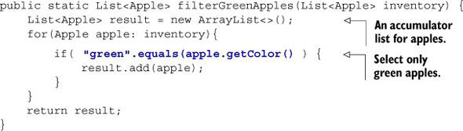
Need of behavior parameterization
1) Filtering green apples

Slide 3
Need of behavior parameterization (Cont…)
2) Parameterizing the color
public static List<Apple> filterApplesByColor(List<Apple> inventory,
String color) {
List<Apple> result = new ArrayList<>();
for (Apple apple: inventory)
{
if ( apple.getColor().equals(color) ) {
result.add(apple);
}
}
return result;
}

Slide 4
Need of behavior parameterization (Cont…)
3)
public static List<Apple> filterApplesByWeight(List<Apple> inventory,
int weight) {
List<Apple> result = new ArrayList<>();
For (Apple apple: inventory)
{
if ( apple.getWeight() > weight )
{
result.add(apple);
}
}
return result;
}

Slide 5
Need of behavior parameterization (Cont…)
Drawback
DRY (Don’t Repeat Yourself)
What if the requirement is to filter with different attributes of an apple, for example, its size, its shape, its origin, and so on?
What if you want to alter the filter traversing to enhance performance ?
➔ Expensive from Effort Perspective

Slide 6
Need of behavior parameterization (Cont…)
Better way than adding lots of parameters to cope with changing requirements.
Define an interface to model the selection criteria
public interface ApplePredicate
{
boolean test (Apple apple);
}

Slide 7
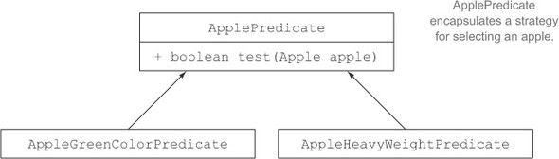
Need of behavior parameterization (Cont…)

Slide 8
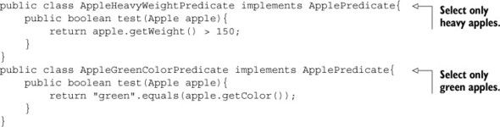
Need of behavior parameterization (Cont…)

Slide 9
Behavior parameterization
How can you make use of the different implementations of ApplePredicate?

Slide 10
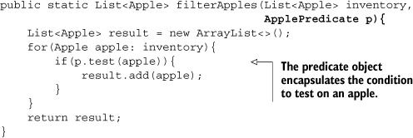
Behavior parameterization (Cont…)
Filtering by abstract criteria

Slide 11
Behavior parameterization (Cont…)
Behavior parameterization means:
The ability to tell a method to take multiple behaviors
(or strategies) as parameters and use them internally to accomplish different behaviors.

Slide 12
Behavior parameterization (Cont…)
public class AppleRedAndHeavyPredicate implements ApplePredicate
{
public boolean test(Apple apple)
{
return "red".equals(apple.getColor()) && apple.getWeight() > 150;
}
}
___________________________________________________________
List<Apple> redAndHeavyApples =
filterApples(inventory, new AppleRedAndHeavyPredicate());
___________________________________________________________
➔ we’ve parameterized the behavior of the filterApples method!

Slide 13
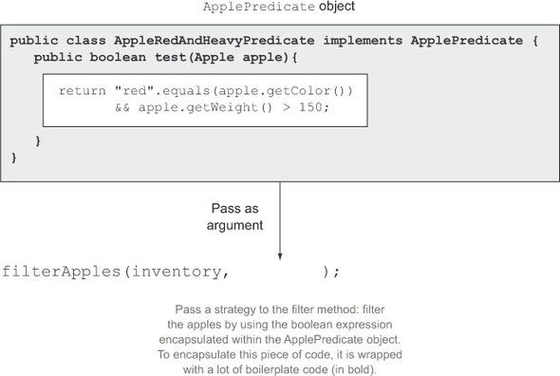
Parameterizing the behavior of filterApples and passing
different filter strategies

Slide 14
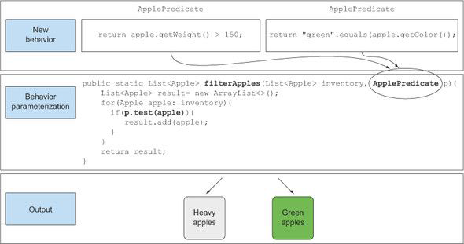

Slide 15
Anonymous classes
Anonymous classes don’t have a name.
They allow you to declare and instantiate a class at the same time.

Slide 16

Anonymous classes (Cont…)
Using an anonymous class

Slide 17
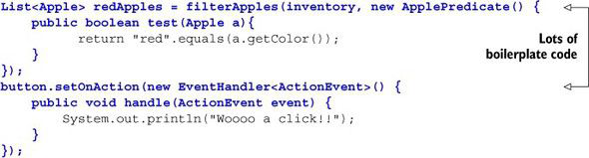
Anonymous classes (Cont…)
Anonymous classes are still not good enough.
First, they tend to be very bulky because they take a lot of space

Slide 18
Lambda expression
Using a lambda expression
List<Apple> result =
filterApples(inventory,
(Apple apple) -> "red".equals(apple.getColor()));

Slide 19
Lambda expression
What is Lambda Expression ?
Lambda expressions, which let you represent a behavior or pass code in a concise way.

Slide 20
Lambda expression
A lambda expression can be understood as a concise representation of an anonymous function that can be passed around

Slide 21
Anonymous— We say anonymous because it doesn’t have an explicit name like a method would normally have:
Function— We say function because a lambda isn’t associated with a particular class like a method is.
But like a method, a lambda has a list of parameters, a body, a return type, and a possible list of exceptions that can be thrown.
Passed around— A lambda expression can be passed as argument to a method or stored in a variable.
Concise— You don’t need to write a lot of boilerplate like you do for anonymous classes.

Slide 22
OOP
Java8tester
ListenerTest
RunnableLambda

