Slide 1
Airline Delay Prediction Blue Team
Airline Delay Prediction Model
Kayla Choothesa
Bowen Duan
Vipul Devidas Borse
Jagruti Divse
Abhishek Balasaheb Jadhav
Akshay Dattatray Jadhav

Slide 2
Agenda
Problem Statement
Data Extraction
Data Visualization
Data Clean
Models
Random Forest Classifier
Naive Bayes
Decision Tree
K Nearest Neighbor (KNN)
Logistic regression
Support Vector Machine(SVM)
Findings
Prediction

Slide 3
Problem Statement
Using data provided by the Research and Innovative Technology Administration (RITA) and Bureau of Transportation Statistics (BTS) regarding flight delays for domestic flights from the years 1994, 1995, 2000, 2004, 2006, and 2008;
we used various predictive modeling techniques in order to build a model.
We then used the highest performing model to predict whether a new set of flights would be delayed or not.
Kayla Choothesa

Slide 4
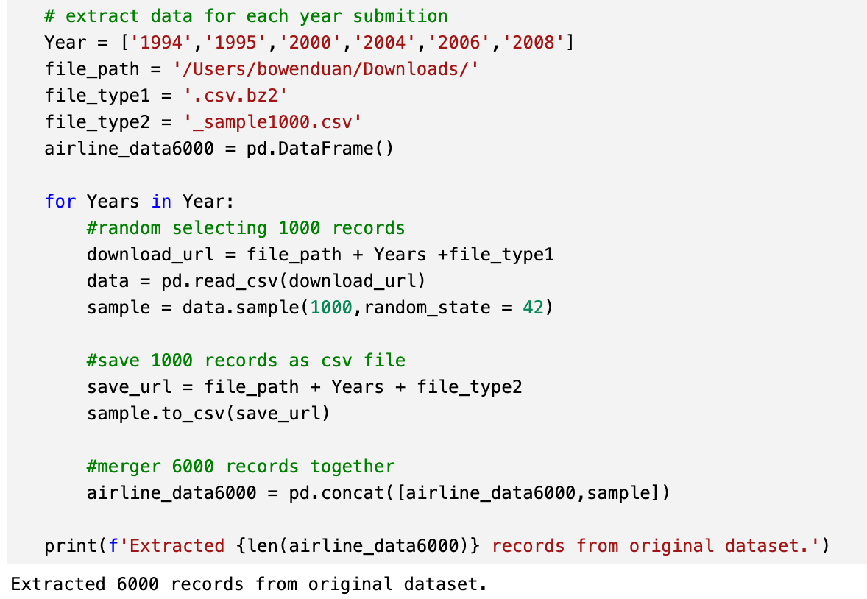
Airline Delay Data Extraction
Randomly Selecting 1000 records from each years
Save randomly selected data for each year
Merger each year records together
Kayla Choothesa

Slide 5
Data Visualization

Slide 6
Delay rate had decreasing since 2004, compared before 2004; December has the highest delay chance, following by June and May.
Percentage of Delay By Years
Percentage of Month
Bowen Duan

Slide 7
Delay rate vary from carriers, and not related to flight frequency. But majority of carriers delay more than 50%
Percentage of Delay By Carrier
Bowen Duan

Slide 8
Take US company as example, it had different delay percentage among different airport.
Percentage of Delay By Origin Airport for US company
Bowen Duan

Slide 9
Cleaning Data

Slide 10
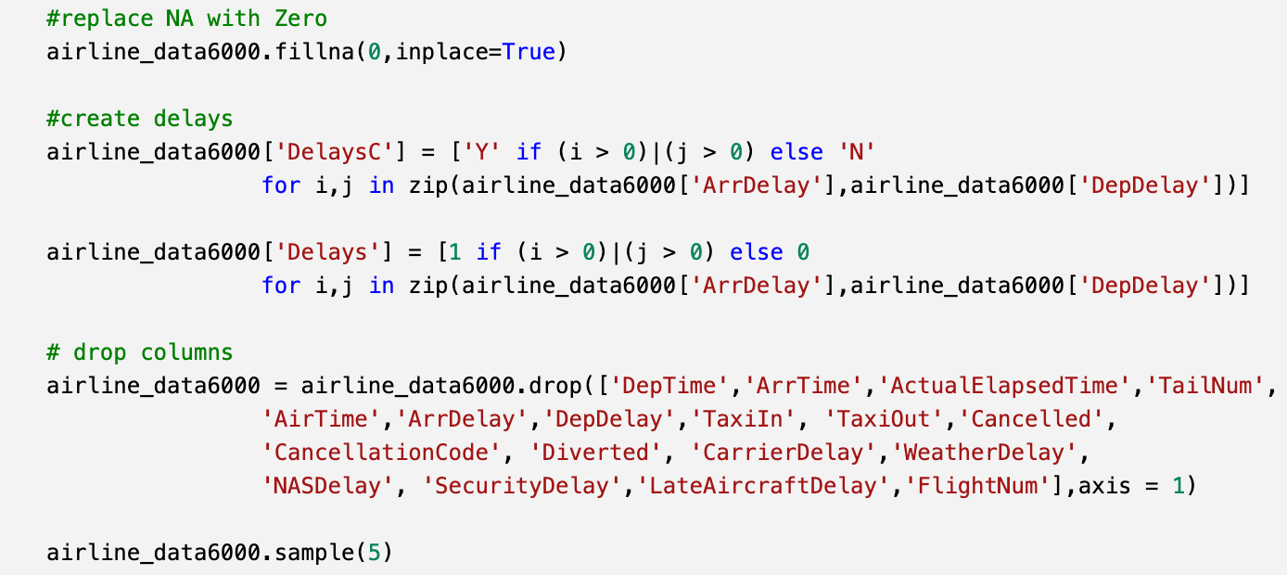
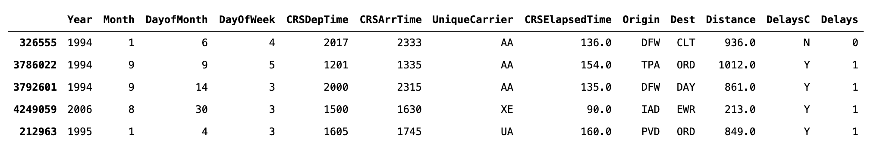
Cleaning Data
Create columns for category Delay and numerical Delays
Based on findings in data visualization, we keep Year, Month, DayofMonth, DayofWeek, all scheduled time, airports, and distance as predictors
Bowen Duan

Slide 11
Training Model

Slide 12






Training Model
Naïve Bayes
Decision Tree
SVM
Random Forest
Logistical regression
K Nearest Neighbor

Slide 13
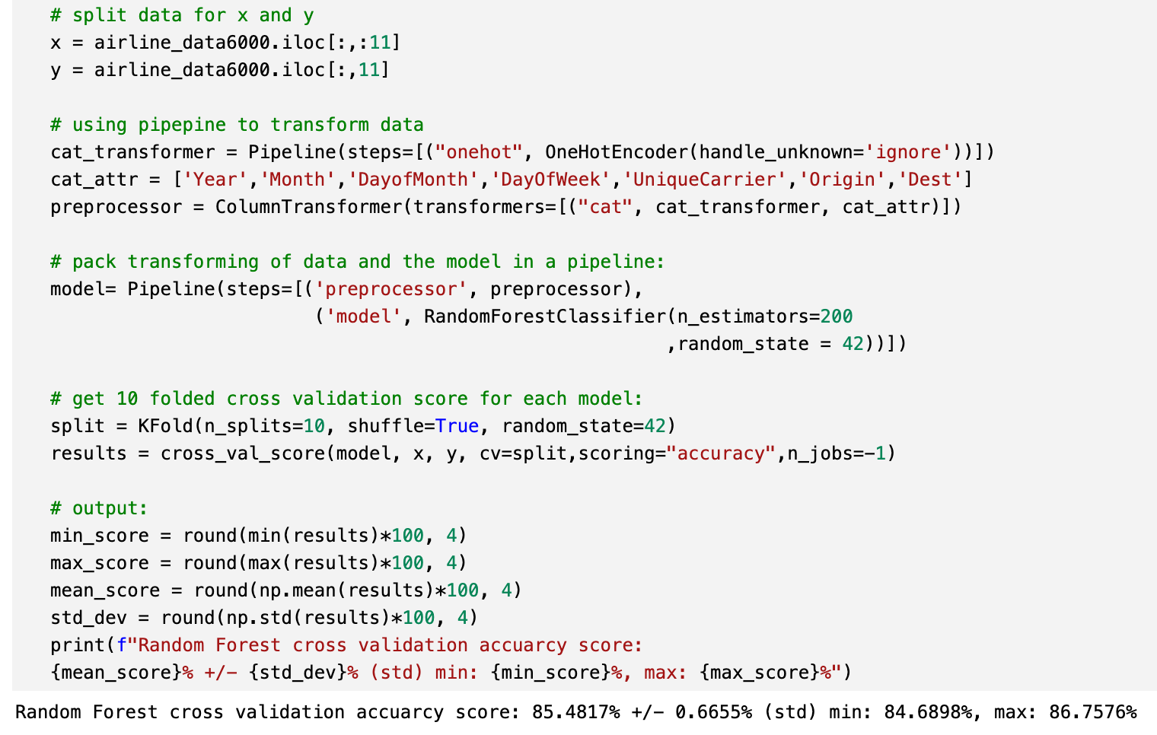
Training Model – Random Forest
For sklearn RandomFoerestClassifer, it needs all input transformed into numerical.
Using sklearn Pipeline to build up data transform and training process.
Using OneHotEncode to transform all attributes excepted time attributes as dummy columns
Using cross validation to test modeling
Bowen Duan

Slide 14
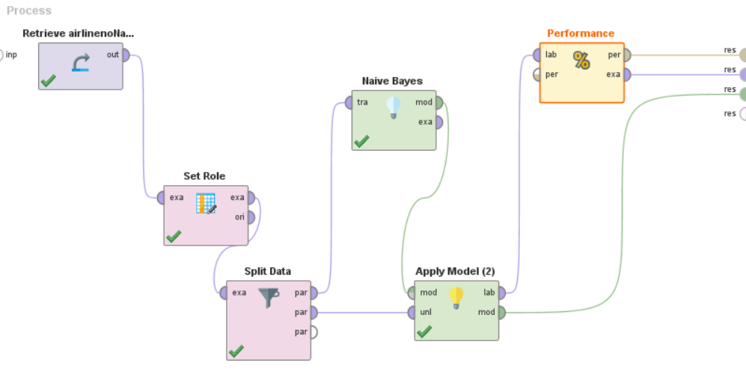
Training Model – Naive Bayes
Abhishek Balasaheb Jadhav

Slide 15
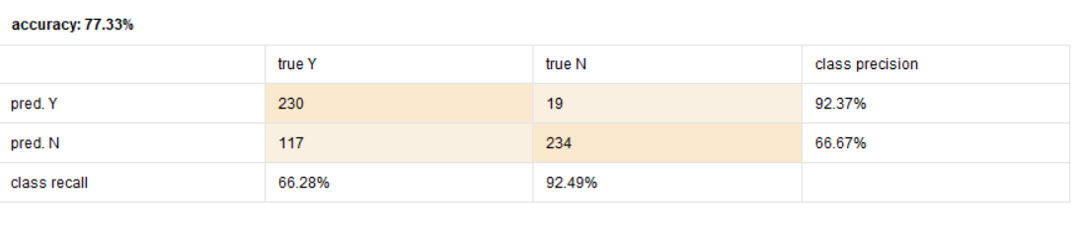
Training Model – Naive Bayes
Classification error 22.67%
Accuracy 77.33%
Predicted Y (92.37%)
230 Predicted true Y
19 Predicted true N
Predicted N (66.67%)
117 Predicted true Y
234 Predicted true N
Abhishek Balasaheb Jadhav

Slide 16
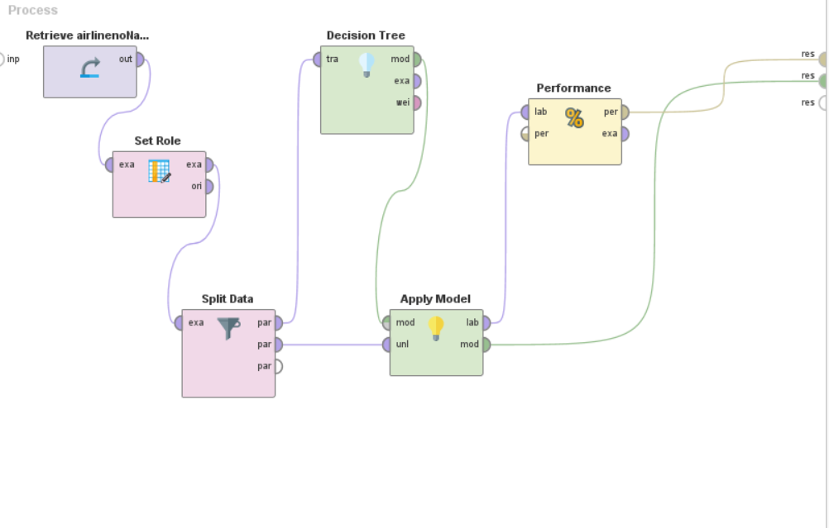
Training Model - Decision Tree
Vipul Devidas Borse

Slide 17
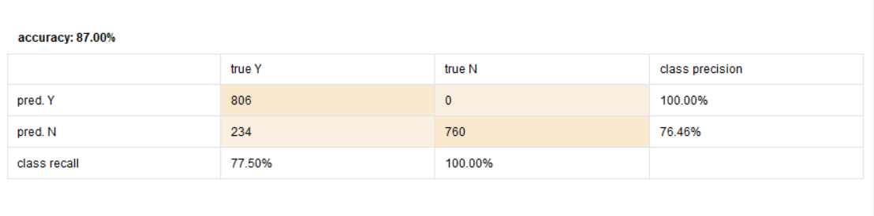
Training Model - Decision Tree
Classification error 13.00%
Accuracy 87.00%
Predicted Y (100%)
806 Predicted true Y
0 Predicted true N
Predicted N (76.46%)
234 Predicted true Y
760 Predicted true N
Vipul Devidas Borse

Slide 18
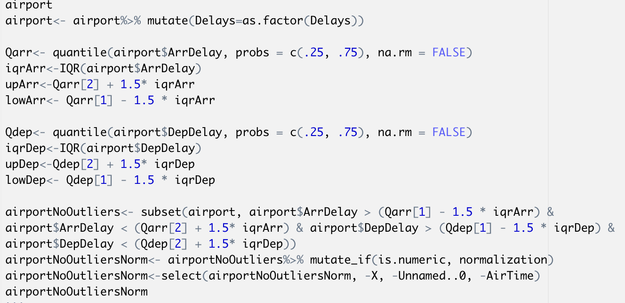
Training Model – K Nearest Neighbor
Eliminating outliers
Normalizing the data
http://stat-computing.org/dataexpo/2009/supplemental-data.html
Kayla Choothesa

Slide 19
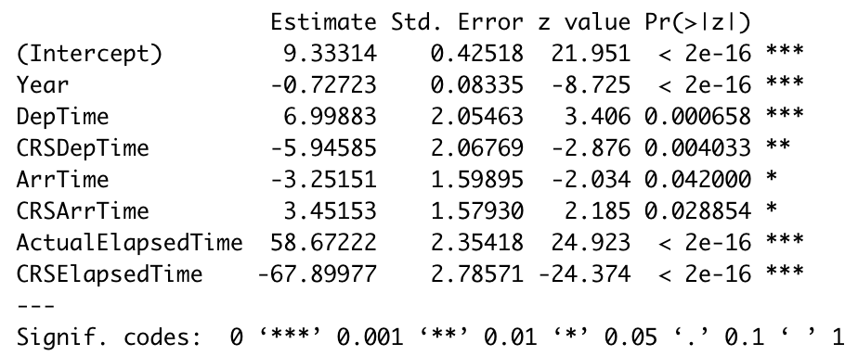
Training Model – K Nearest Neighbor
Using p-values to determine which attributes to include in the KNN model
http://stat-computing.org/dataexpo/2009/supplemental-data.html
Kayla Choothesa

Slide 20
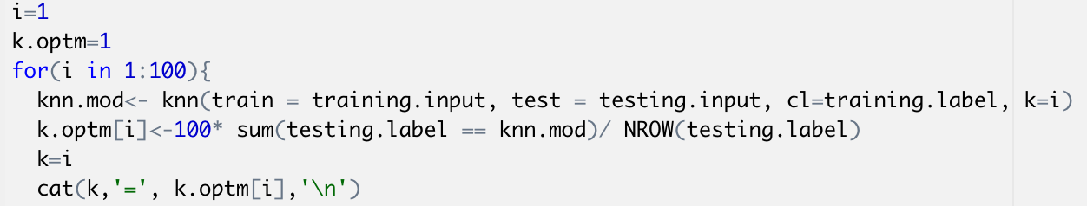
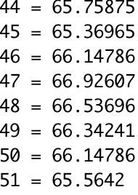
Training Model – K Nearest Neighbor
Finding the best k-value to use
http://stat-computing.org/dataexpo/2009/supplemental-data.html
Kayla Choothesa

Slide 21
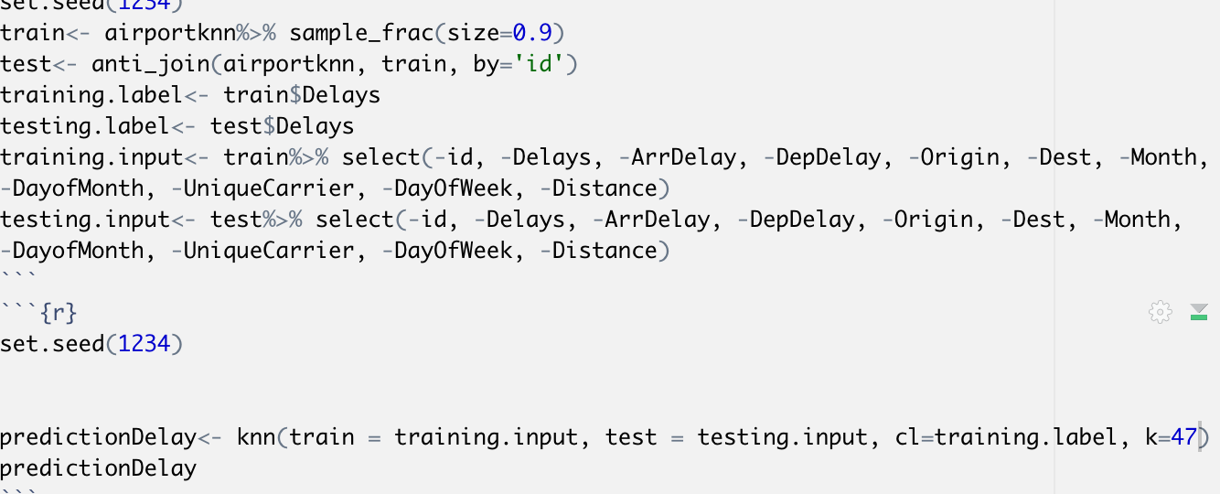
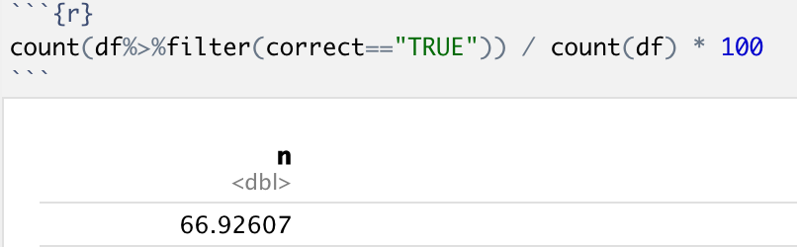
Training Model – K Nearest Neighbor
Finding the accuracy- 66.9%
http://stat-computing.org/dataexpo/2009/supplemental-data.html
Kayla Choothesa

Slide 22
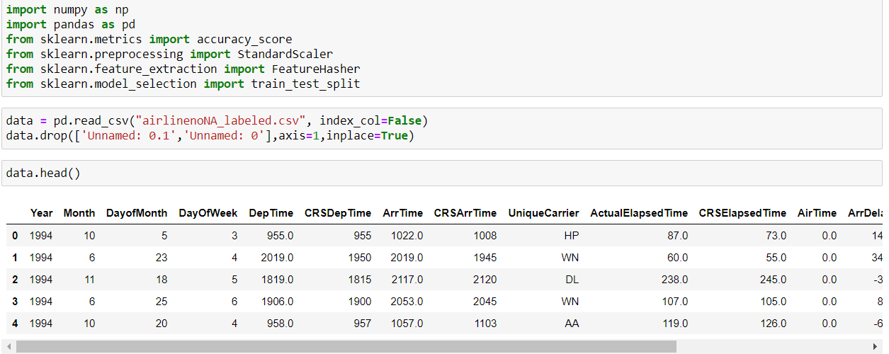
Training Model - Logistic Regression
Reading Cleaned Data
Jagruti Divse

Slide 23
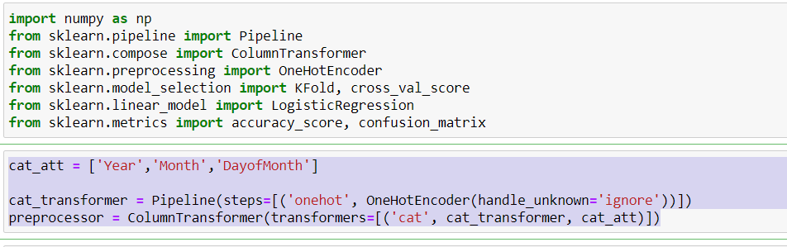
Import and Data Preprocessing
Training Model - Logistic Regression
ncjdn
Creating Pipeline and
Transformer Objects
Jagruti Divse

Slide 24
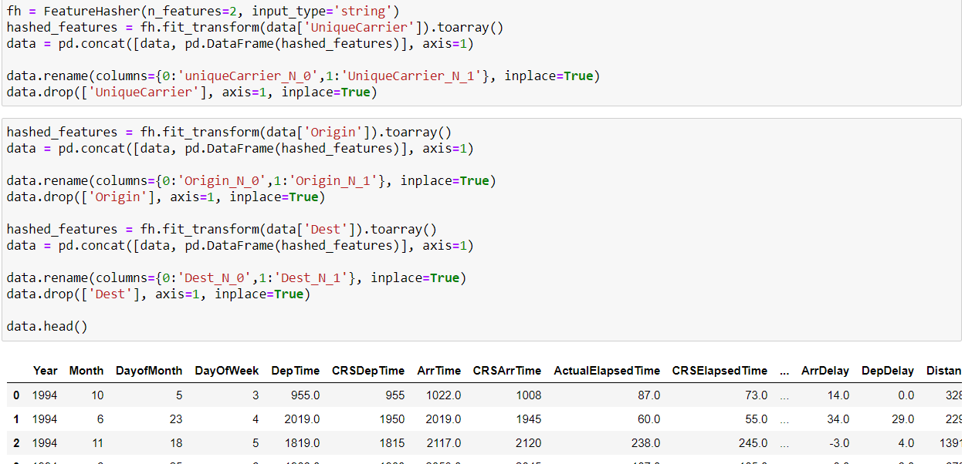
Data Preprocessing
Training Model - Logistic Regression
fjijdkdjdhskjhckha
Hashing String features
To Numeric values
Jagruti Divse

Slide 25
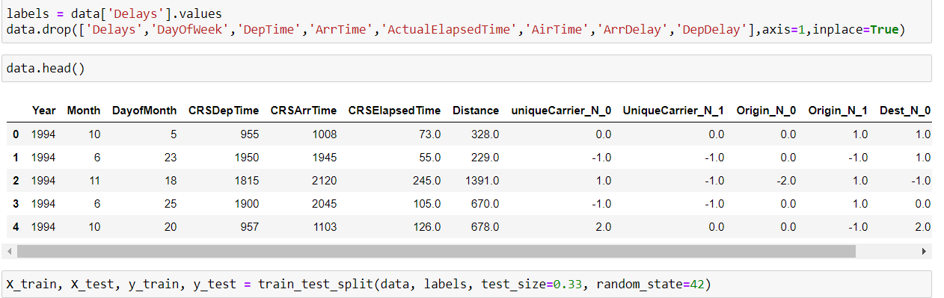
Train Test Split of Dataset
Training Model - Logistic Regression
Splitting the data
Into training and testing part.
Test size: 33%
Jagruti Divse

Slide 26
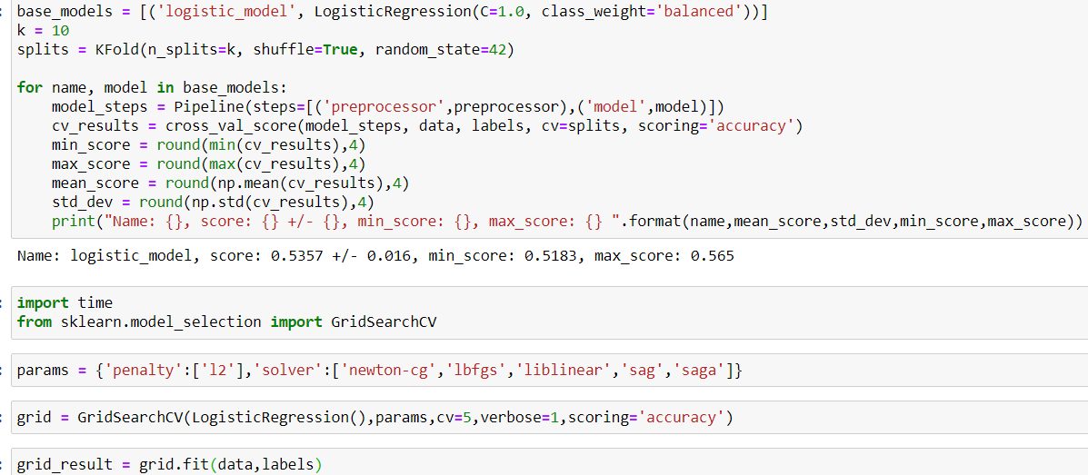
Using K-fold CV technique
Training Model - Logistic Regression
Using K fold cross validation
To select the best model.
Jagruti Divse

Slide 27
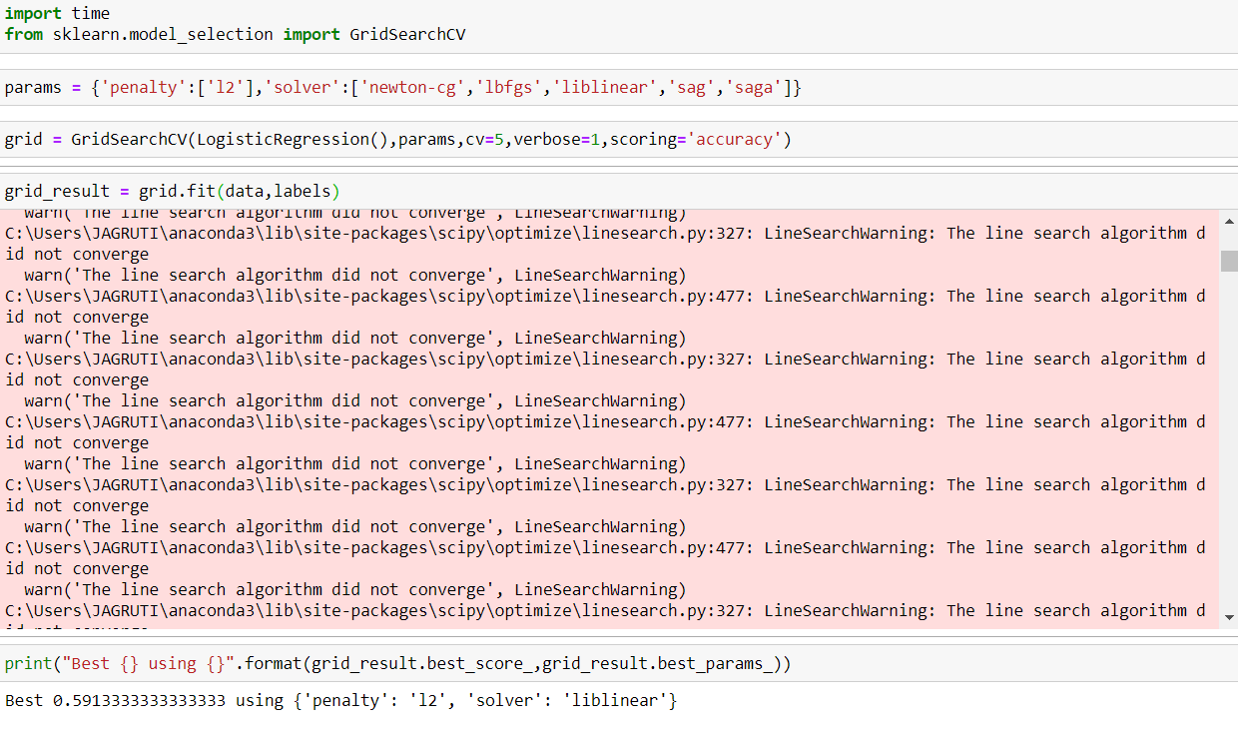
Accuracy using Logistic Regression Model
Training Model - Logistic Regression
f
Finding the Accuracy: 59.13%
Jagruti Divse

Slide 28
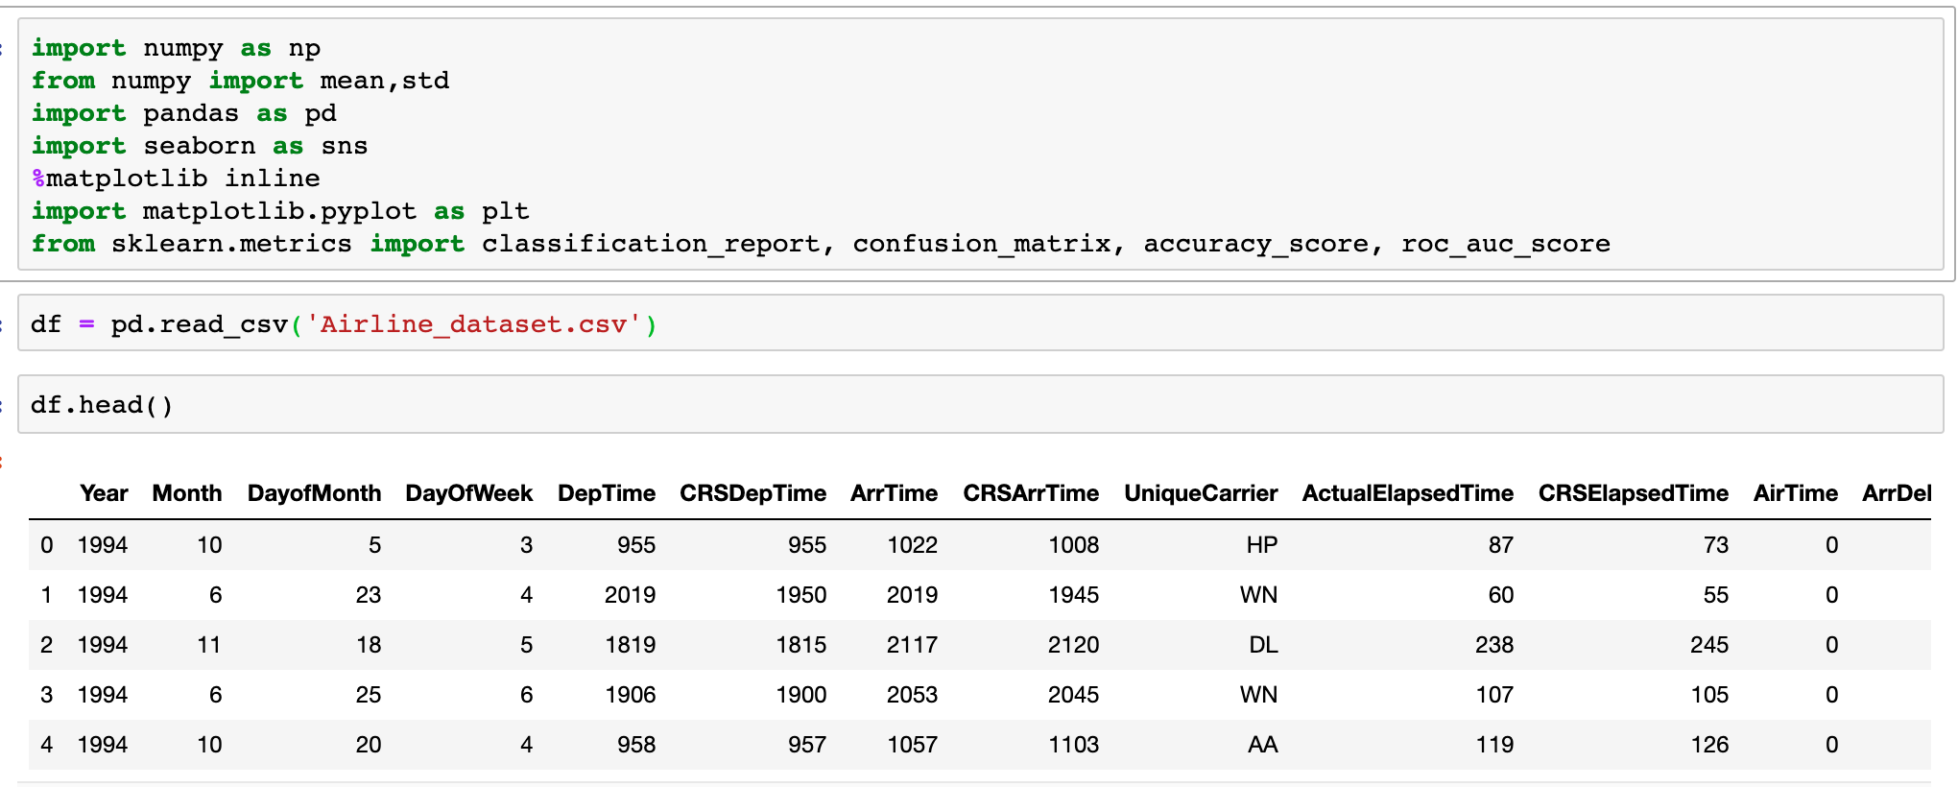
Training Model – Support Vector Machine
Import Data
Data Extraction
Akshay Dattatray Jadhav

Slide 29
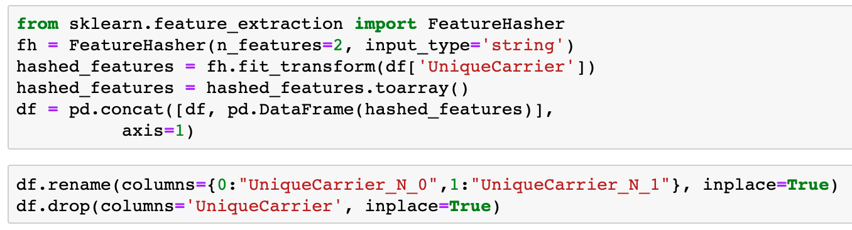
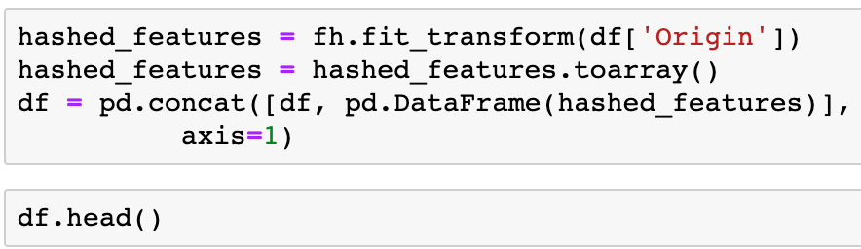
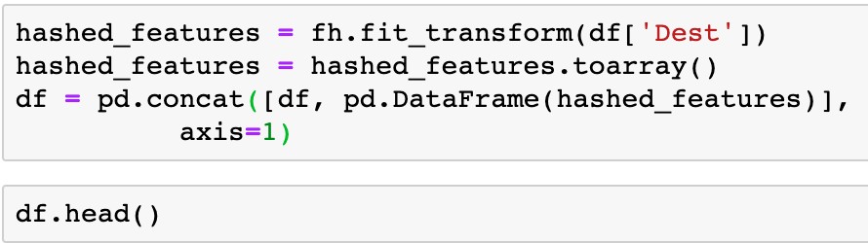
Training Model – Support Vector Machine
Data Processing
Akshay Dattatray Jadhav

Slide 30
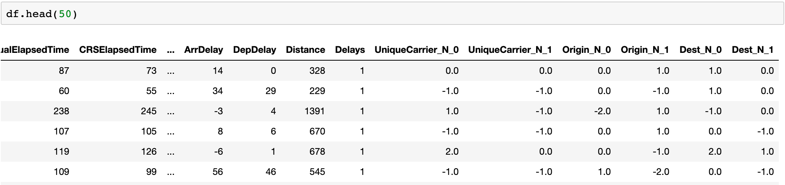
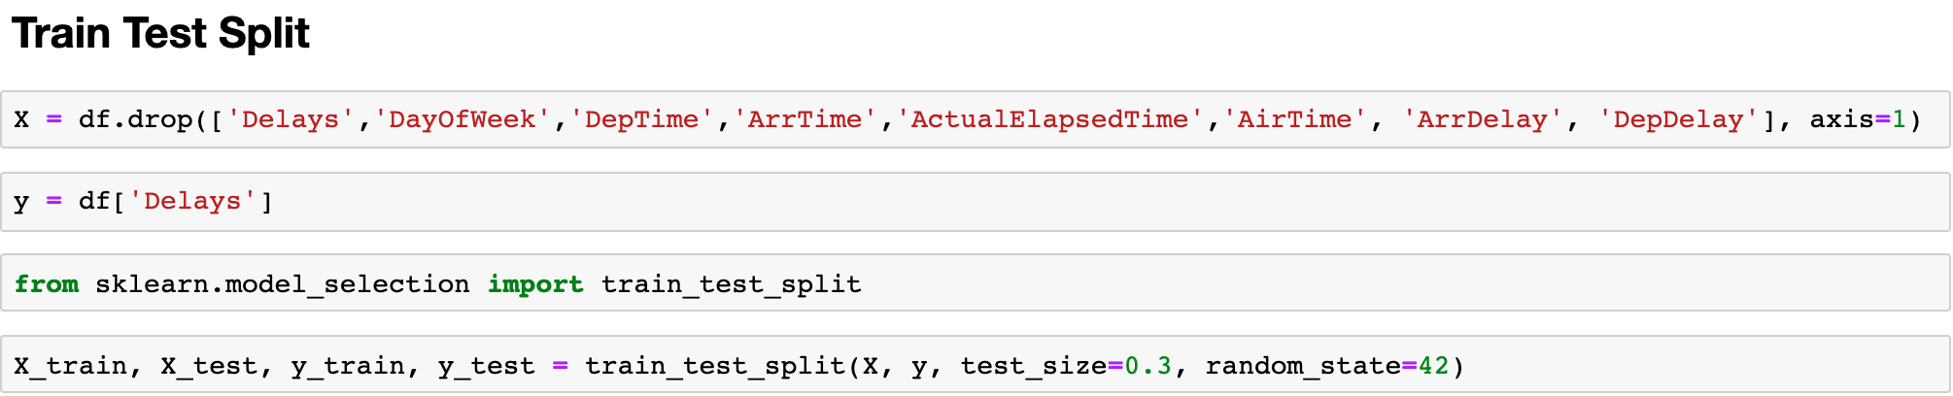
Train Test Split of dataset
Training Model – Support Vector Machine
Akshay Dattatray Jadhav

Slide 31
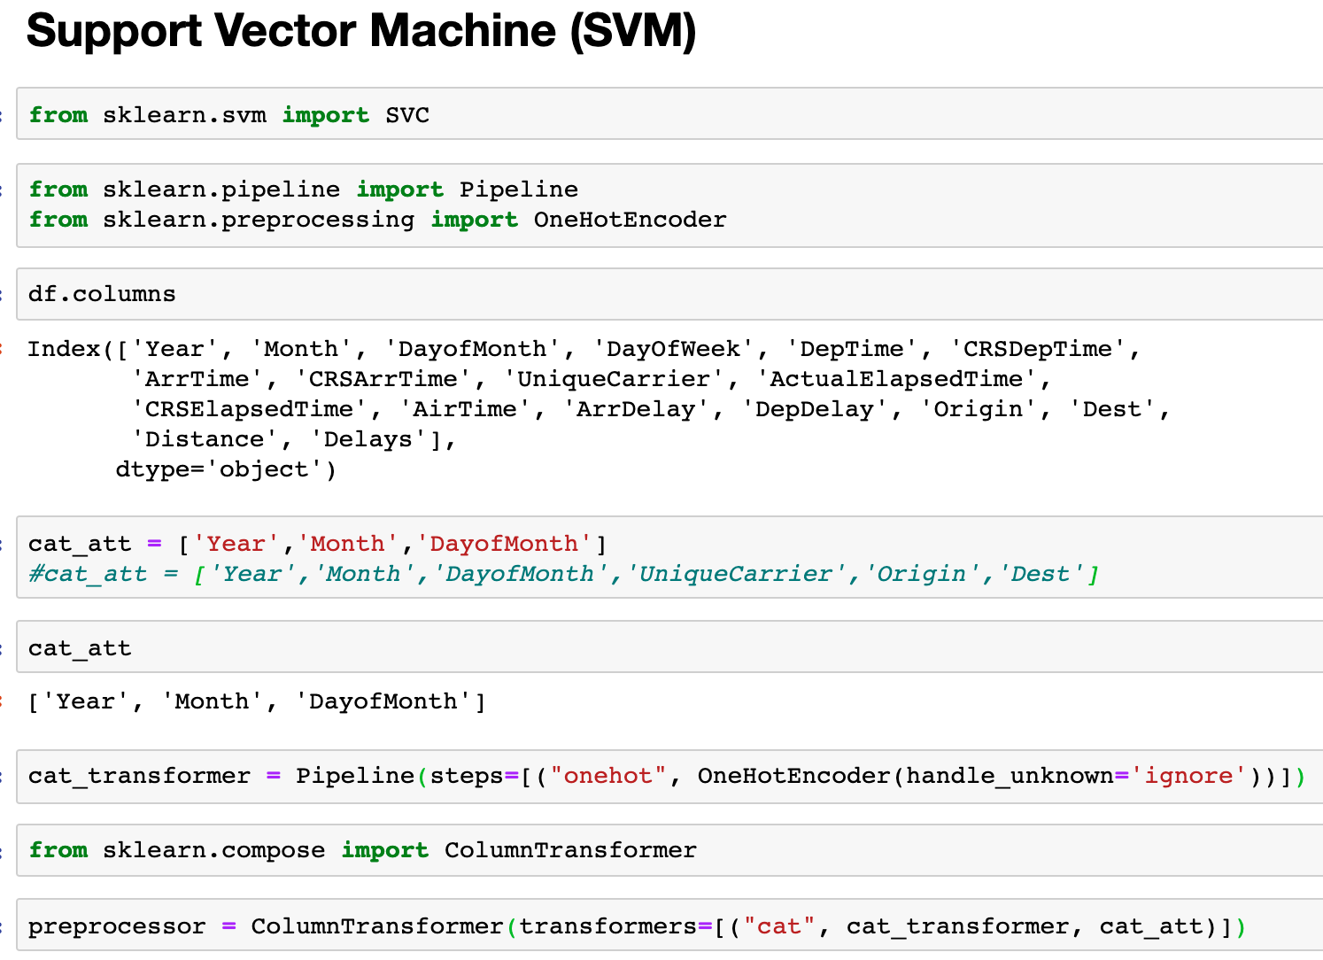
SVM model import and Data preprocess
Training Model – Support Vector Machine
Akshay Dattatray Jadhav

Slide 32
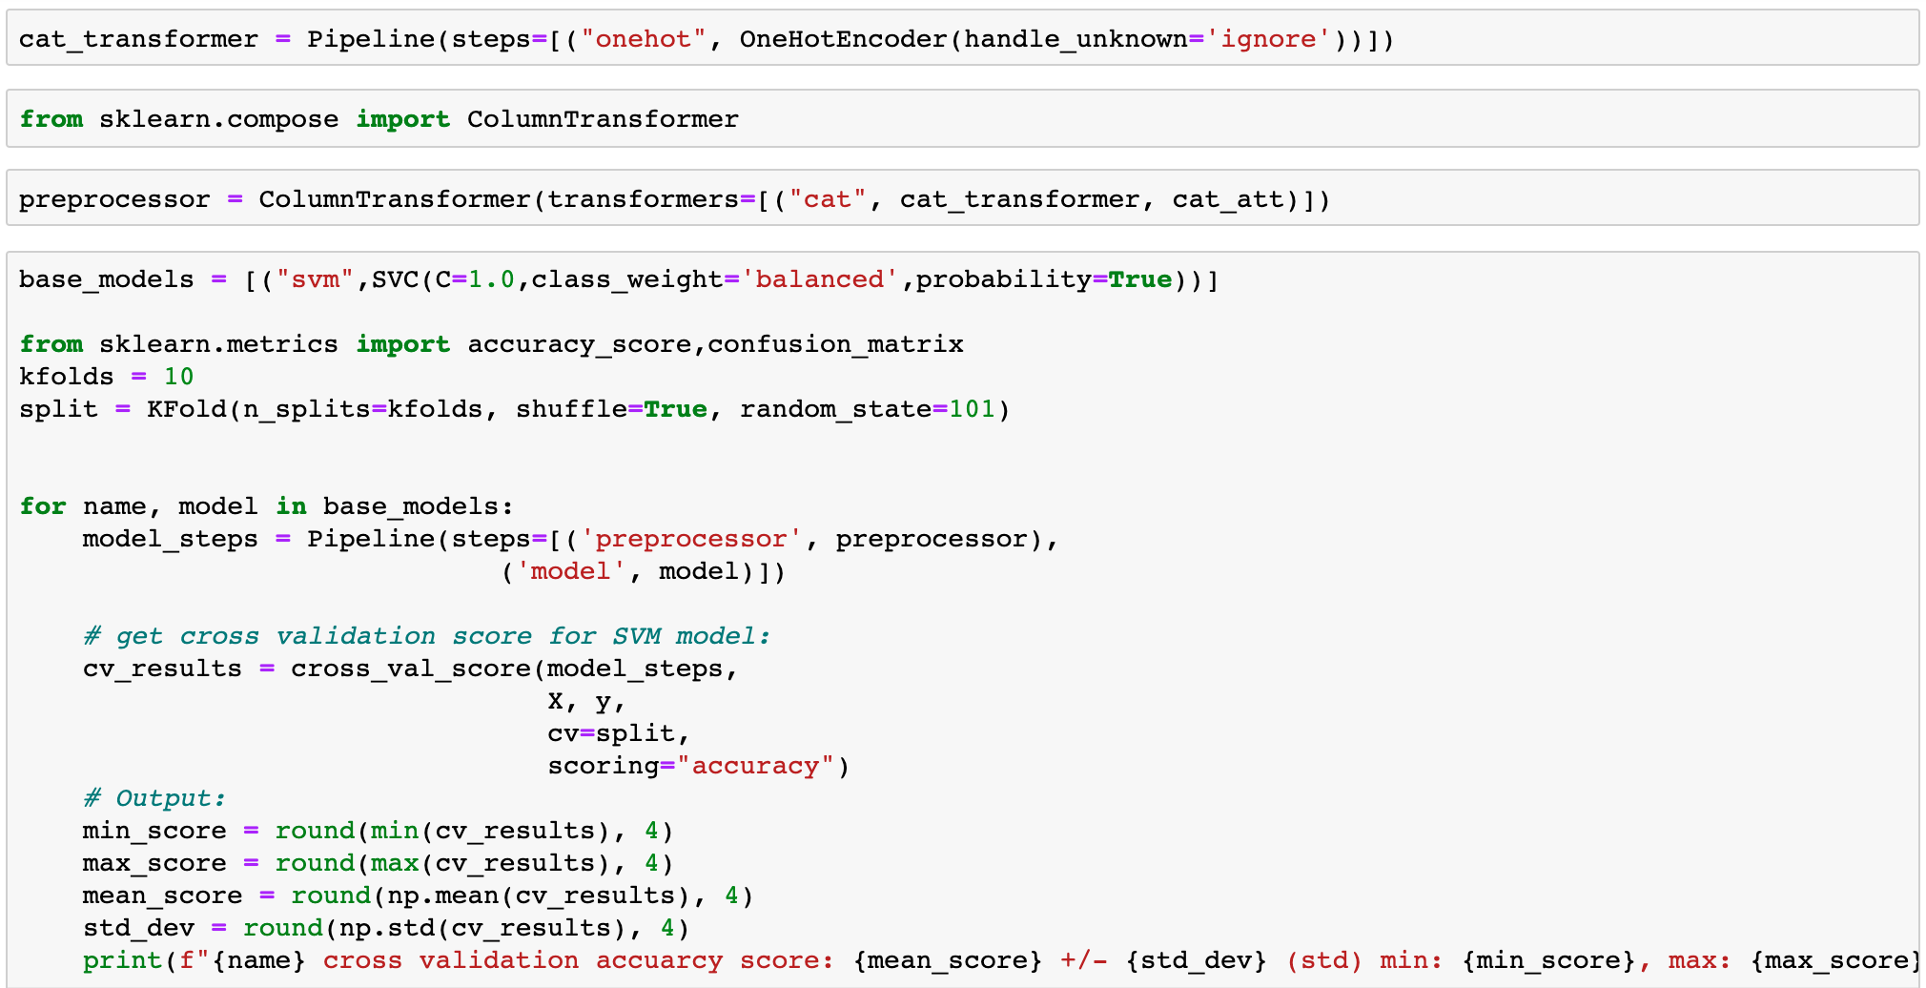
Training SVM model using K-fold CV technique
Training Model – Support Vector Machine
Akshay Dattatray Jadhav

Slide 33
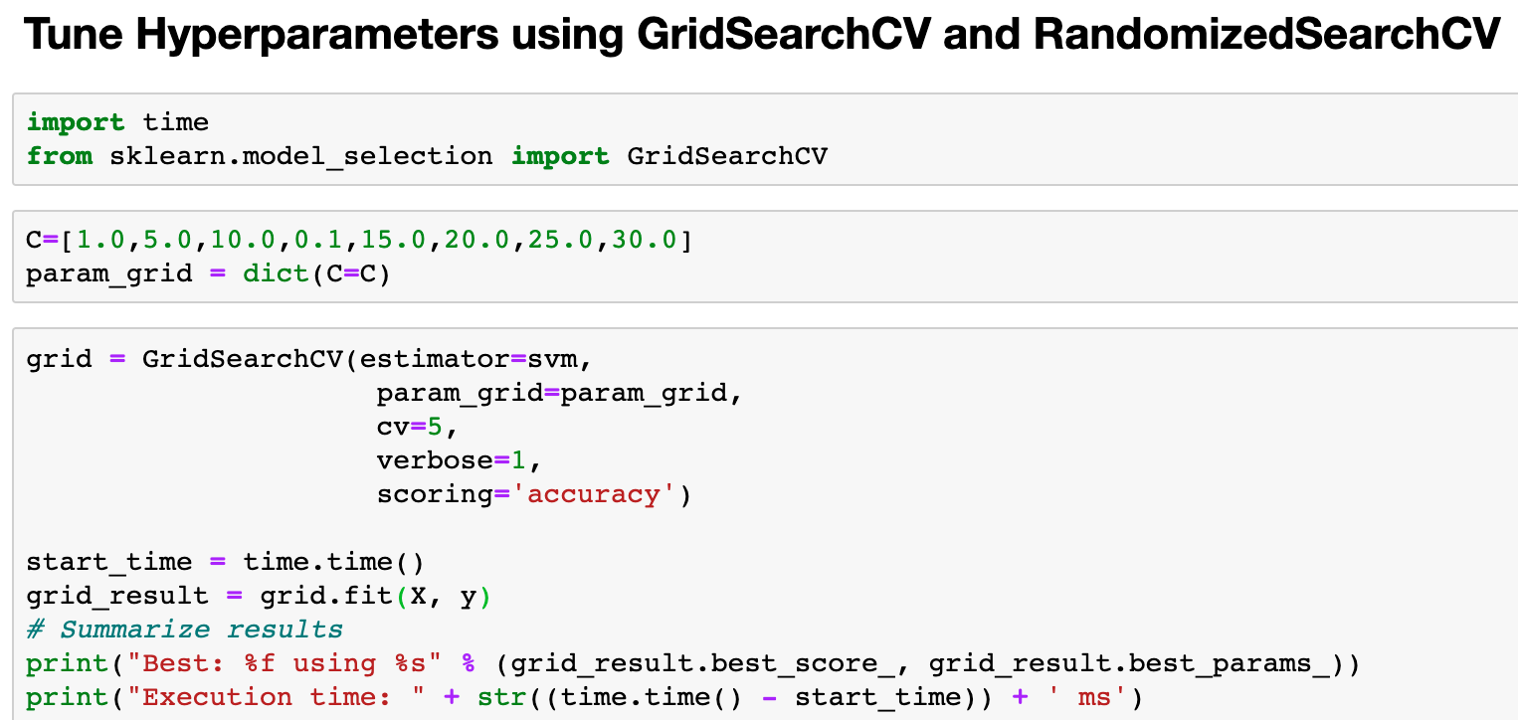

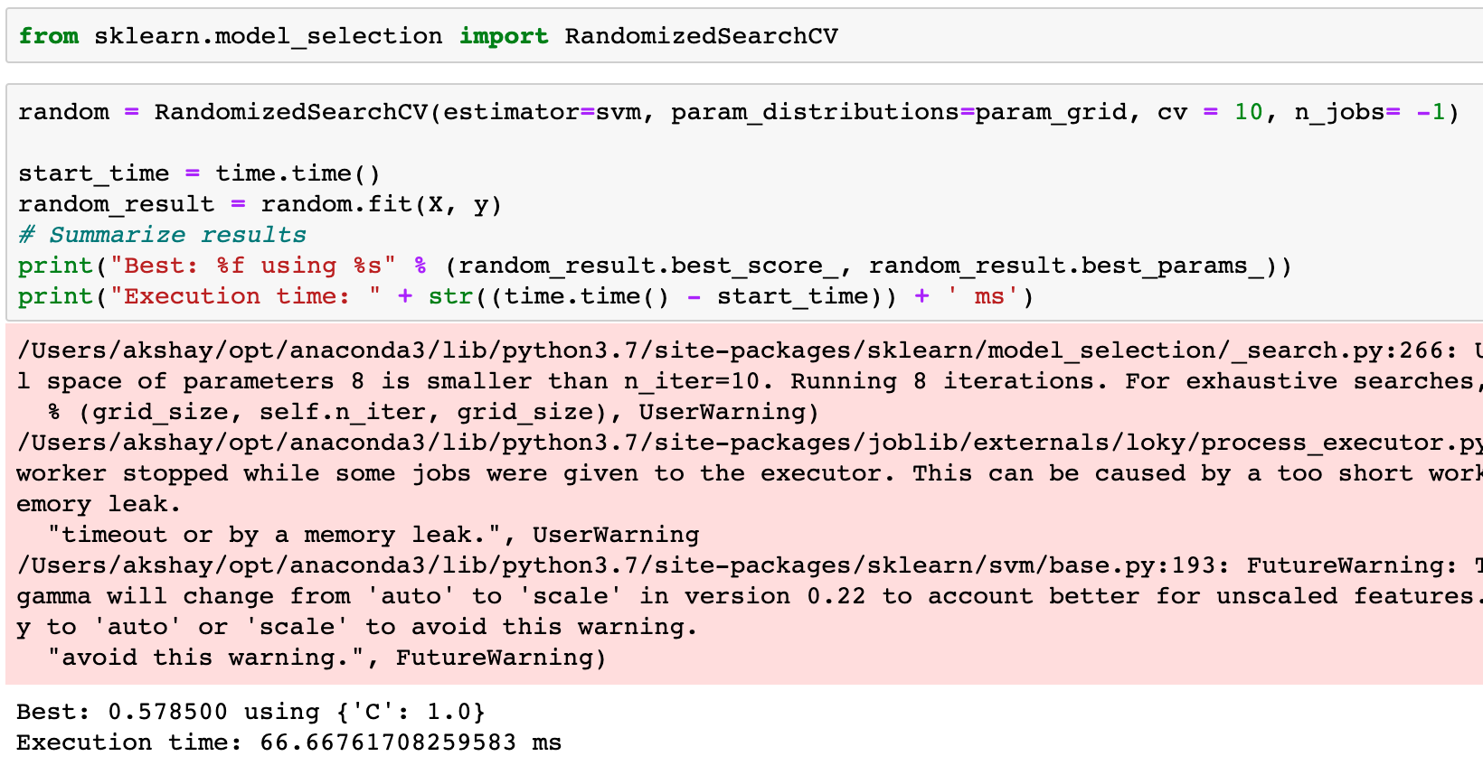
HyperParameter Tuning Techniques
Training Model – Support Vector Machine
Akshay Dattatray Jadhav

Slide 34
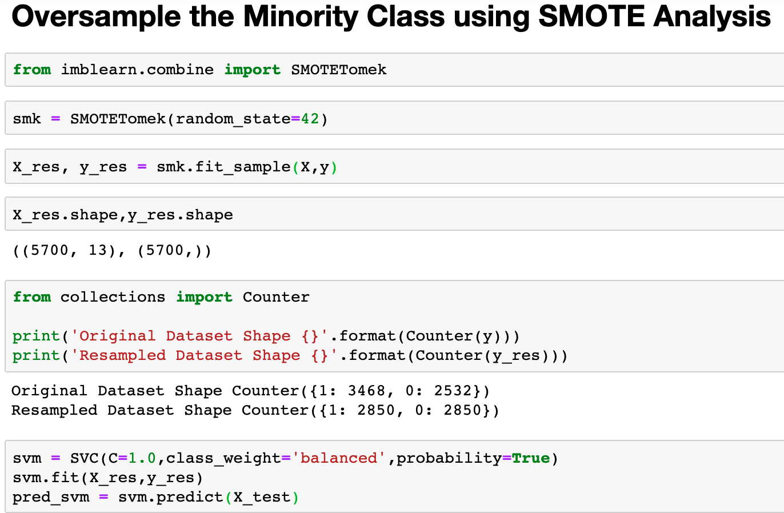
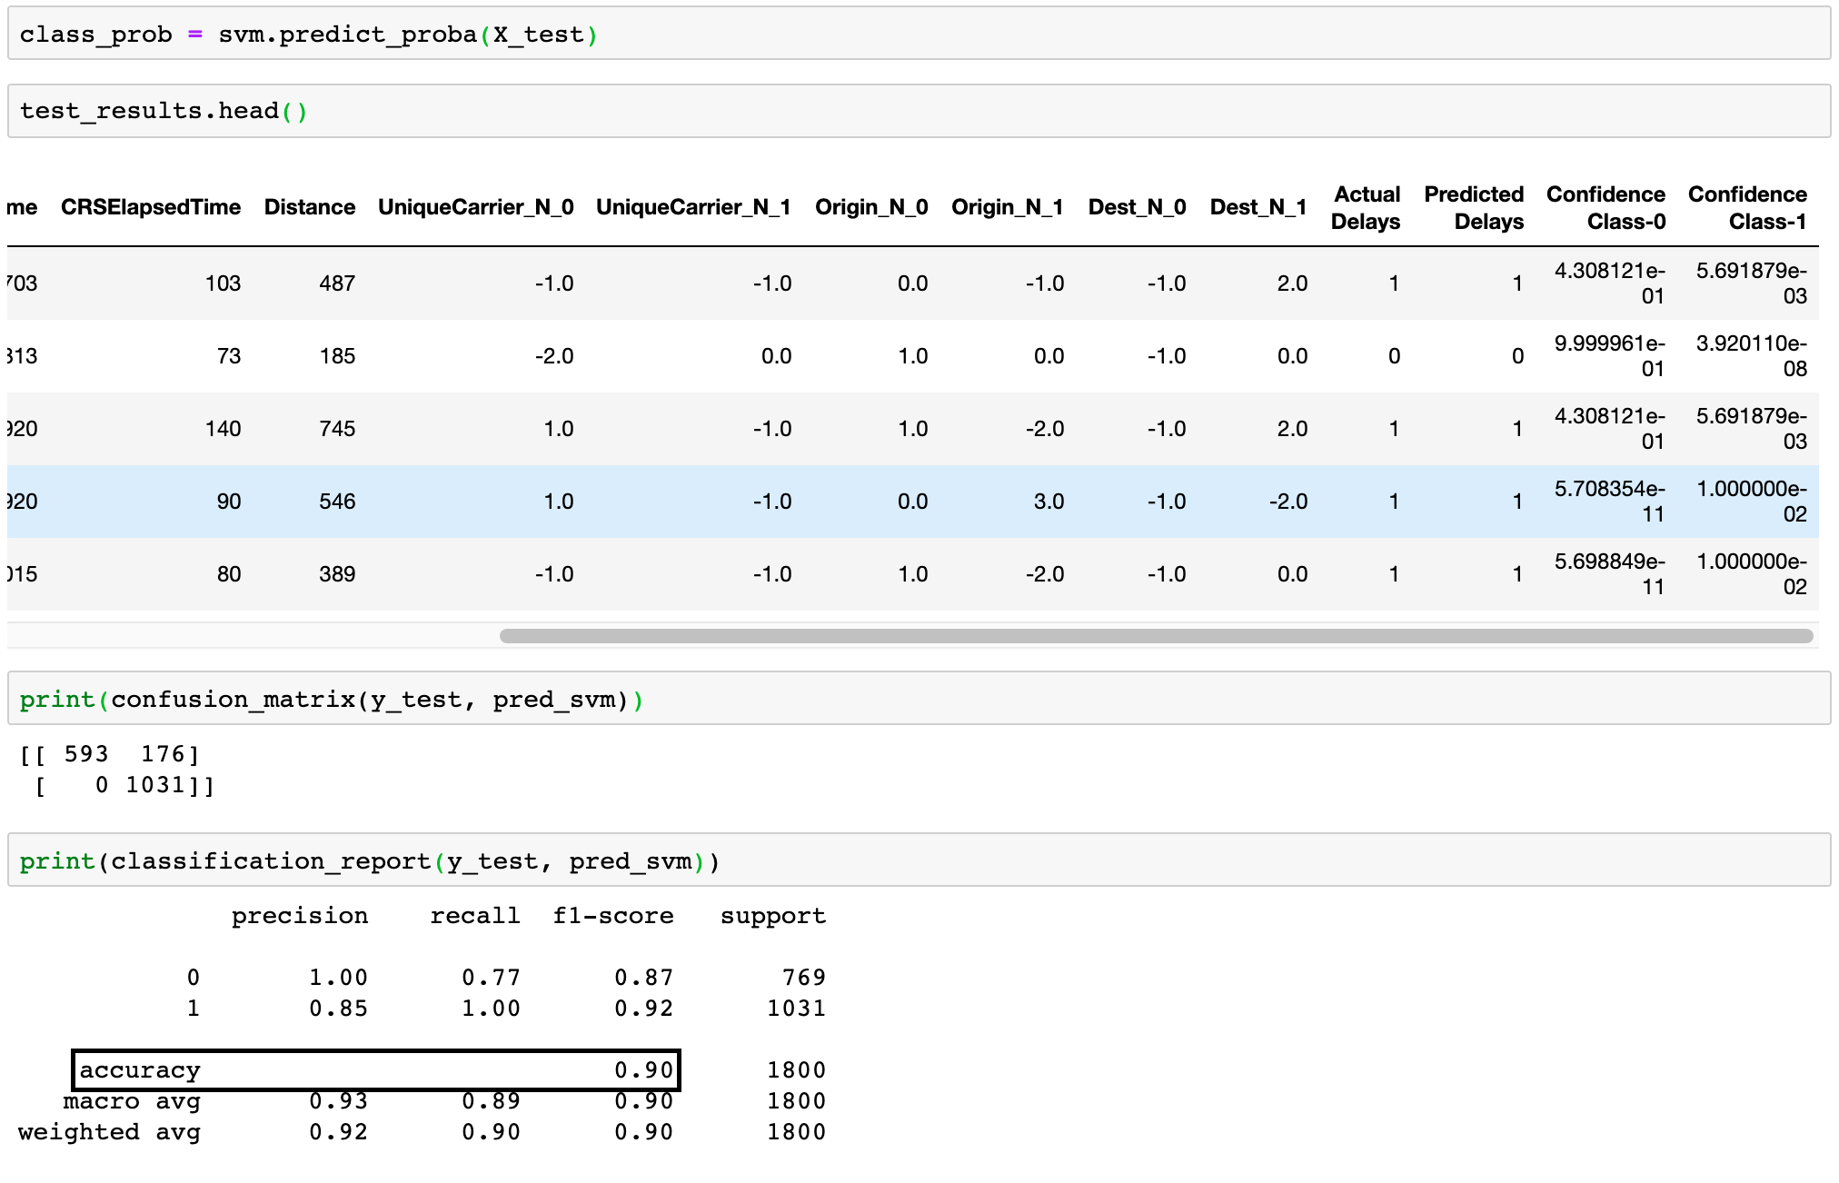
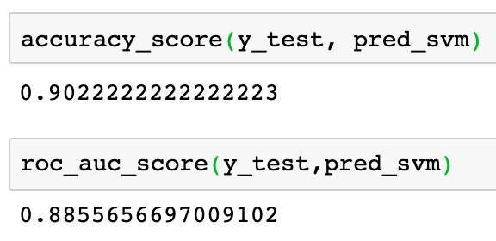
Oversampling Technique - SMOTE Analysis
Training Model – Support Vector Machine
Akshay Dattatray Jadhav

Slide 35
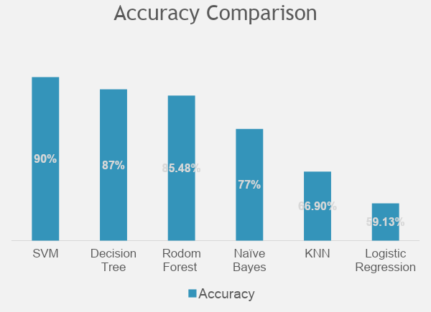
SVM has the highest accuracy in airline delay case.
Confusion Matrix
Recall and Precision
Why we are going for SVM over other classifiers?
One main reason is we got a good accuracy results among all other classifiers.
SVM is scalable while dealing with high-dimensional data.
In SVM, we can use a feature called 'L2 Regularization' which could be used to increase the generalization capabilities of the model which prevents the problem of overfitting.
Akshay Dattatray Jadhav

Slide 36




FeatureHasher boost the accuracy
Fast
Memory Efficient
Simple
Avoid the “curse of dimensionality”

Slide 37
Prediction

Slide 38
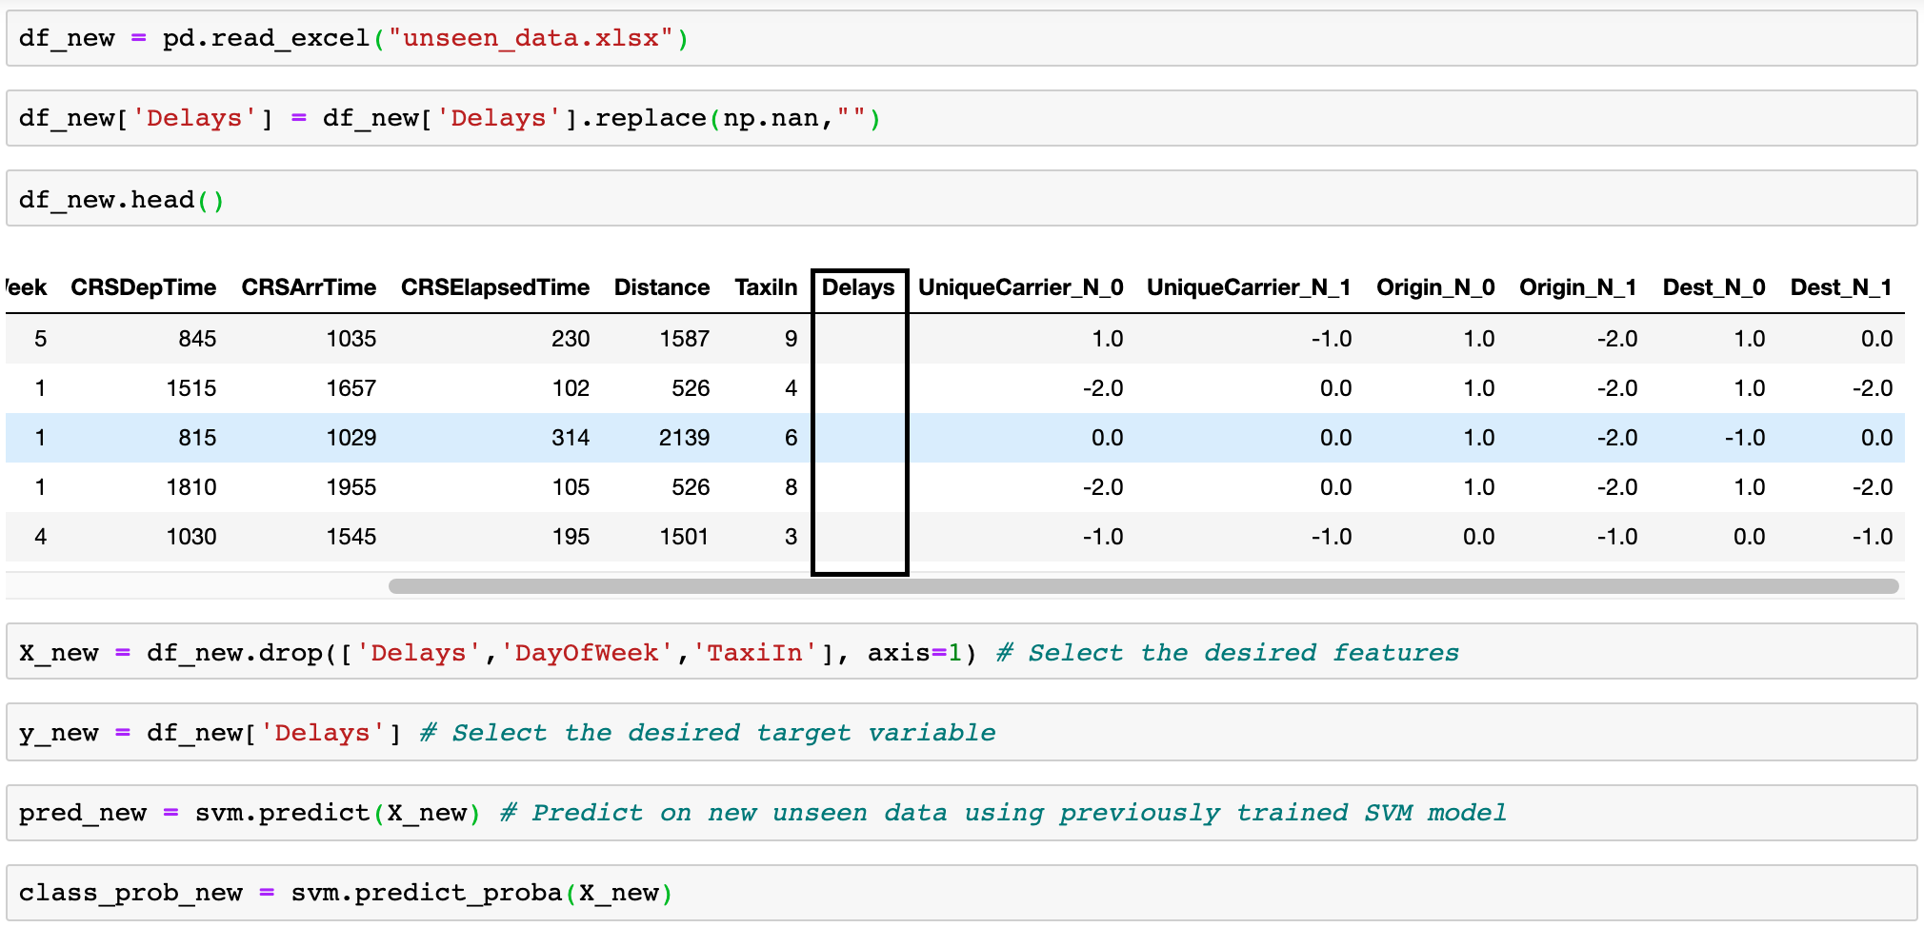
Prediction on New Unseen Dataset - SVM
Akshay Dattatray Jadhav

Slide 39
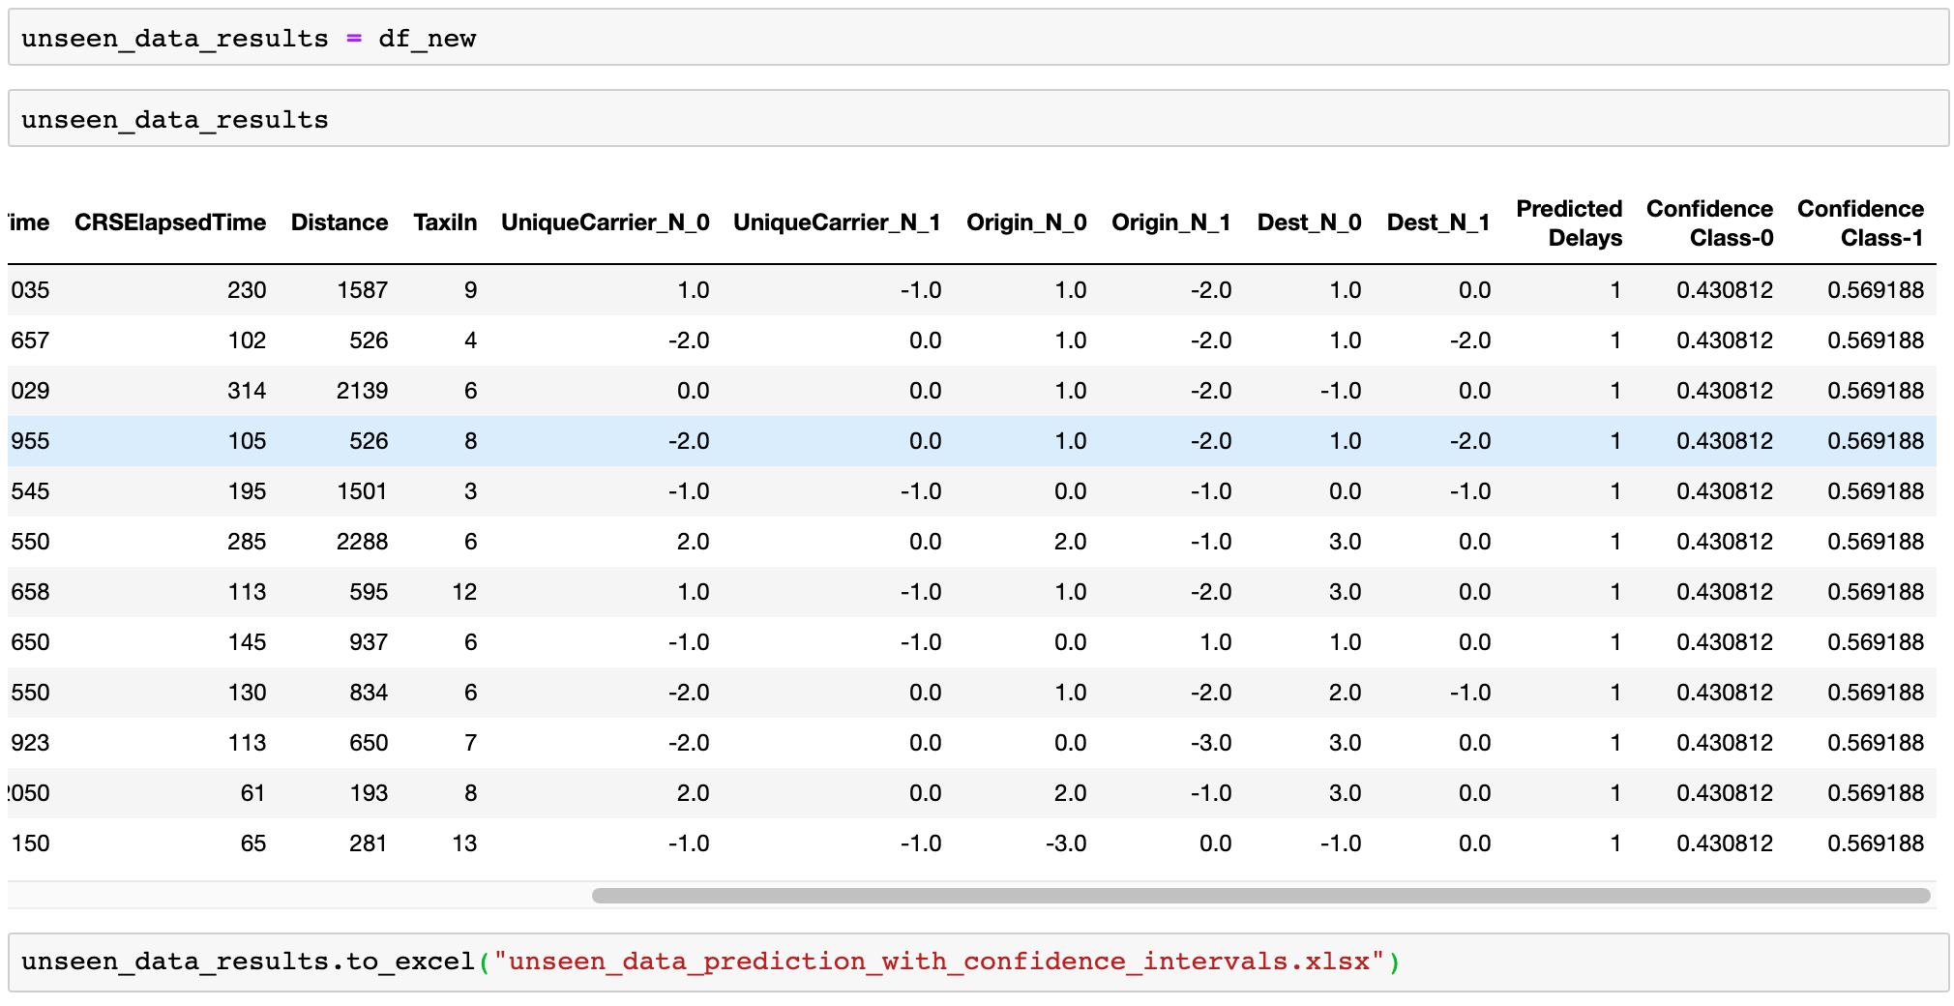
Prediction Results for New Unseen Dataset - SVM
Akshay Dattatray Jadhav

Slide 40
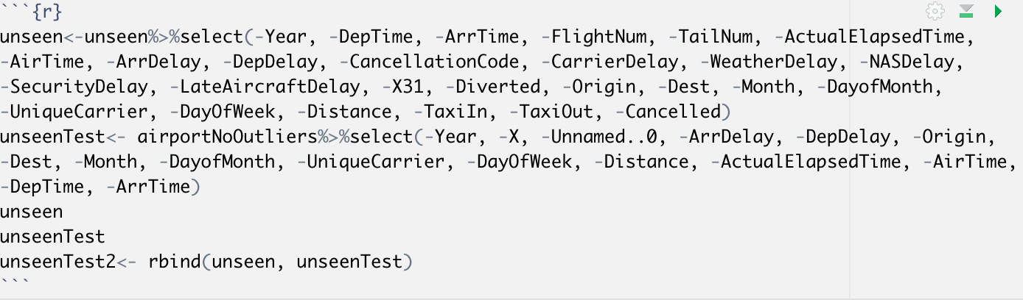

Prediction on New Unseen Dataset - KNN
Kayla Choothesa

Slide 41
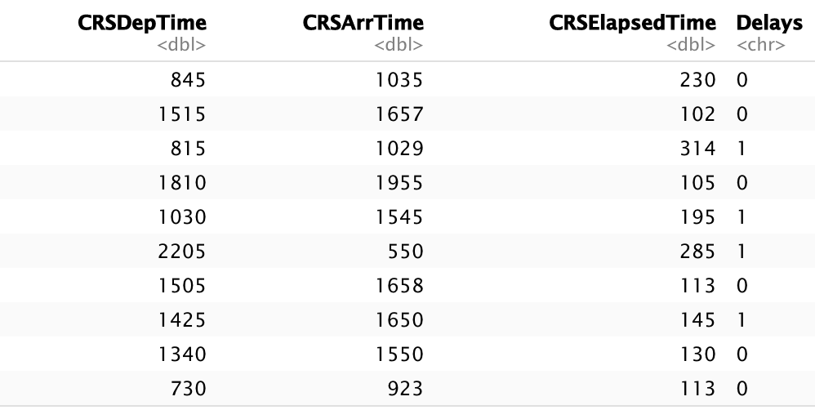
Prediction Results for New Unseen Dataset - KNN
Prediction for unseen data using the variables:
CRS Departure Time,
CRS Arrival Time,
CRS Elapsed Time
http://stat-computing.org/dataexpo/2009/supplemental-data.html
Kayla Choothesa

Slide 42
Summary

Slide 43
Summary
After careful training and observing testing results from 6 classification models, we have come to make the conclusion that
KNN would be a best generalized model according to the prediction results on our unseen data with considerable accuracy rate.
The best model – KNN used CRS Departure Time, CRS Arrive Time, CRS Elapsed Time as independent variables
The final prediction for new 12 record showed as below
0 means non –delay
1 means delay
Akshay Dattatray Jadhav

Slide 44
Thank You!

