Slide 1

AdBlockchain

Slide 2
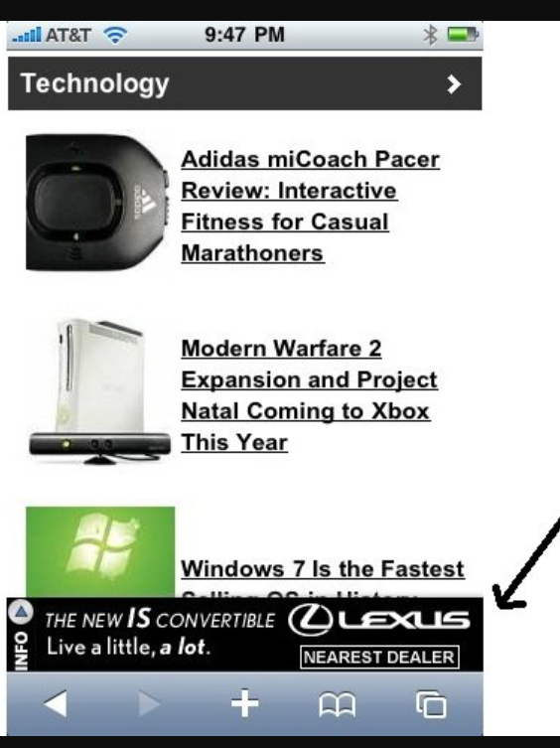
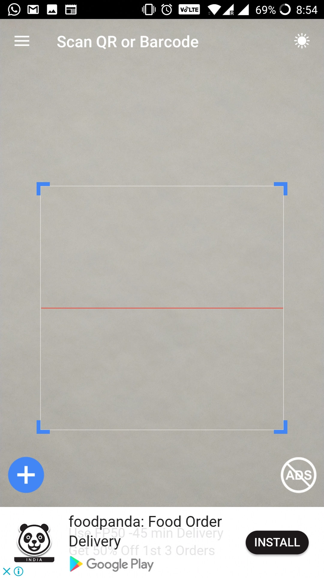
Ad Platform on Blockchain
For Display Ads

Slide 3

AD PLATFORMS TODAY..
Mobile Users
Advertiser 1
Publisher 1
Advertiser 2
Ad Exchange
Publisher 2
Mobile Users
AdStore
Advertiser n
Flow of Ads
Ad is created by an Advertiser and stored at AdExchange
Publisher shows one of those Ads to some users
AdExchange takes up the responsibility of evaluating the ads (Adult content, spam etc)
Payment
Payment is routed through AdExchange to the publishers.

Slide 4
The need.
Central marketplace: Trust issues?
One party owning all operations on the Ad
Judging the ad
Analytics
Routing payments…

Slide 5
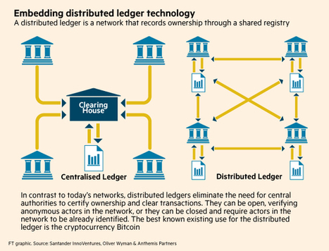

Slide 6
AdBlockchain: Ad Platform on Blockchain
Currently Ads are served by a central ad marketplace with advertisers and publishers. AdBlockchain, is an effort at creating an Ad platform on top of Blockchain (technology underlying bitcoins), thus eliminating the need for a central marketplace entity.
Advertiser: Can create Ads and make payment when Ad is shown to somebody
Publisher: Can read Ads from blockchain, push it to Mobile apps and earn payment directly from Advertiser
Evaluator: Can read any Ad, validate it for content and provide a rating. Publisher can make use of these ratings and can be incentivized to prefer Ads with ratings over others.
Many advertisers / publishers view Ad marketplaces as opaque middlemen who have the power of controlling how much advertisers pay, or publishers are paid and which Ads are shown to the users.
For introduction to bitcoins and blockchains:
About bitcoins: https://www.youtube.com/watch?v=oSP-taqLWPQ
Where do bitcoins come from? https://www.youtube.com/watch?v=GmOzih6I1zs
Blockchain: https://www.youtube.com/watch?v=lD9KAnkZUjU
Potential Applications of Blockchain: https://www.youtube.com/watch?v=G3psxs3gyf8

Slide 7
BLOCKCHAIN SCENARIO
Creates an Ad
Shows Ad to Mobile Apps
Advertiser 1
AdStore
Mobile Users
Publisher 1
Advertiser 2
AdStore
AdStore
AdStore
AdStore
Judges an Ad
Evaluator 1
Publisher 2
Mobile Users
Advertisers, Evaluators and Publishers together constitute blockchain
Ad is created by an Advertiser and stored at every node of blockchain
Publisher picks an Ad to show to mobile app users
Payment: Payment is routed from the Advertiser who creates the Ad to
Publisher who pushes Ads to mobile apps
Evaluator who evaluates the Ad (making it servable)

Slide 8



DEMO SETUP
Android App
Java Web Service to
Create Ad
Evaluate Ad
Java Web Service to
1. Retrieve Ad
Advertiser
Evaluator
Publisher
Ubuntu VM
- Installed Blockchain
Ubuntu VM
- Installed Blockchain
Ubuntu VM
- Installed Blockchain
Ad stream
Ad stream
Ad stream

Slide 9
LIFECYCLE OF AN AD
May be evaluated multiple times, updating score everytime
Advertiser
Evaluator(s)
Publisher
Created
Evaluated
Displayed
Score threshold crossed
Contains
Score
Metrics (Clicks / Impressions)
Critical evaluation failed
Example: Adult Ads
Archived

Slide 10
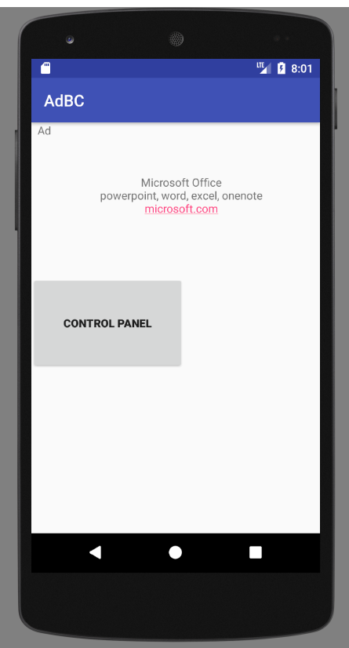
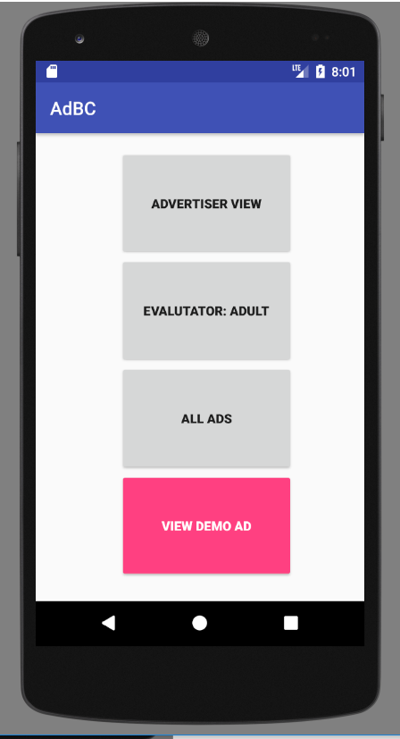
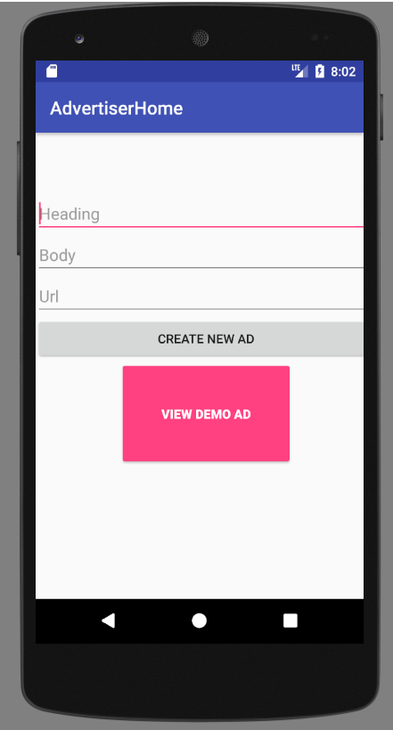
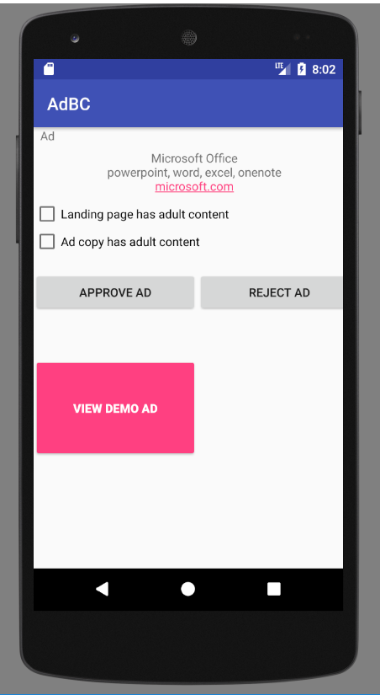
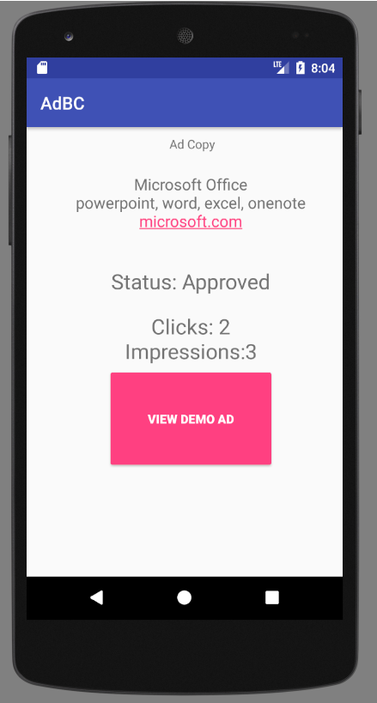
Screenshots

Slide 11
DEMO

Slide 12
THANK YOU

