Slide 1

Learning like humans with Deep Symbolic Networks
Hybrid Machine Learning Approaches and Applications Seminar
Akshay Joshi

Slide 2
Artificial Intelligence Representations
Symbolic AI (GOFAI)
Expert Systems
Planning, Inference, and Search Algorithms
Subsymbolic AI
Machine Learning
Supervised
Unsupervised
Reinforcement
Deep Learning
Bayesian Learning

Slide 3
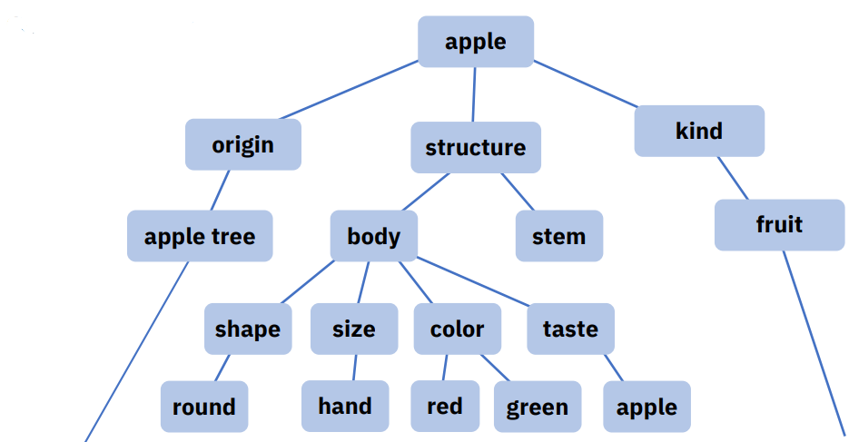
Symbolic AI
Based on ‘Symbolic’ (human-readable) representation of problems & logic.
Rules connect symbols in a relationship similar to an ‘if-then’ statement.
Symbols & rules are fed explicitly.
Symbolic AI [1]

Slide 4
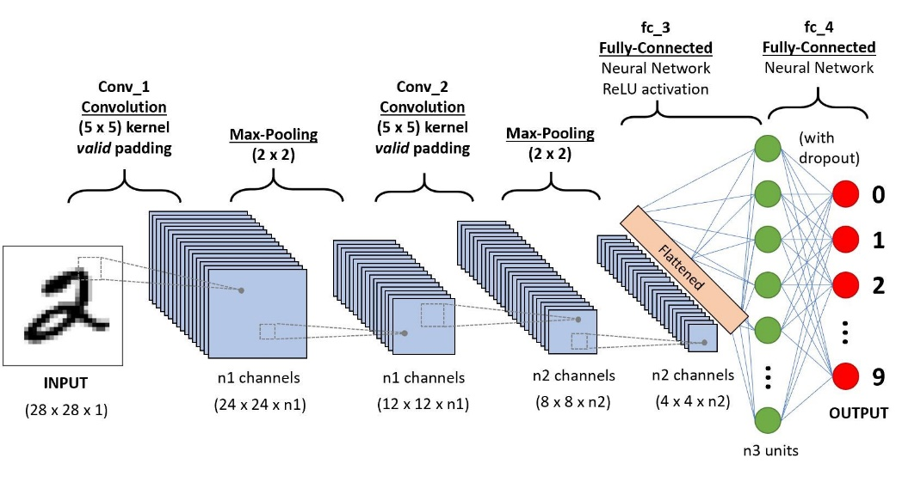
Subsymbolic AI (Deep Learning)
Inspired by the structure and function of neurons in the brain.
Automatic feature extraction from raw data.
A neuron receives information from its neighbors.
Processes received information.
Sends processed info to other neurons.
Continuously learn using objective functions.
Convolutional Neural Network [2]

Slide 5
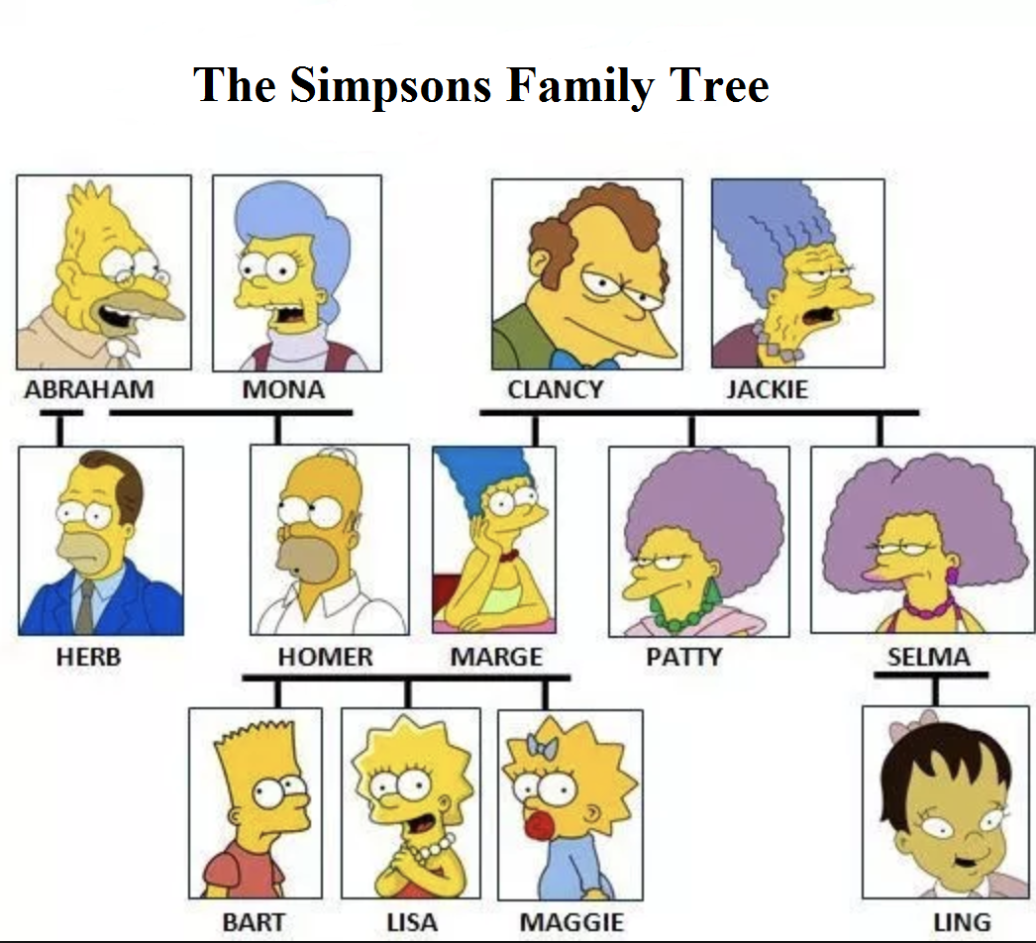
The Problem
Symbolic Methods
Advantages:
Excellent Reasoning & Logical Inferences.
Explainable decisions.
Can easily redefine propositional logic.
Expert Systems – can be deployed in critical environments.
Disadvantages:
Heavy reliance on rules & explicit symbolic representations.
Common sense knowledge problems.
Difficult to instil learning capabilities.
Information represented as symbols & rules [3]

Slide 6
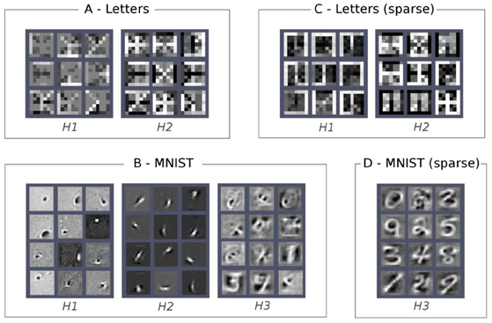
Subsymbolic Methods (Deep Learning)
Advantages:
Less upfront knowledge required.
Robust against noise.
Easier to scale.
Better performance on complex problems.
Disadvantages:
Require huge amounts of training data.
Computationally expensive.
Blackbox – risky to deploy in critical environments.
Feature Maps at Hidden Layers [4]

Slide 7
Motivation
Integrate Symbolic & Subsymbolic representations.
Develop whitebox version of Deep Neural Networks (DNN).
Learn representations of real-world objects like humans.
Robust adaptation to both unstructured (data) and abstract problems.
Learn with relatively small amounts of data.

Slide 8
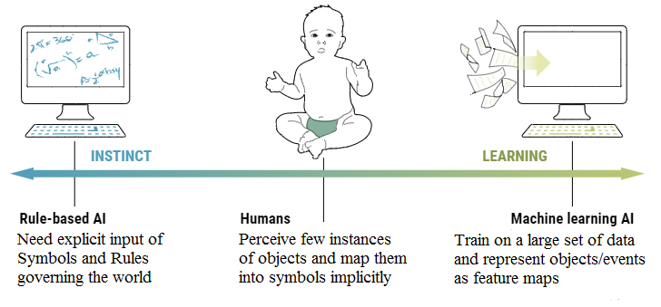
What Does ‘learn like humans’ Mean?
In real-world, data is compositional (representable hierarchically).
Humans learn to conceptualize knowledge as symbols and relations between them.
Does not need thousand labelled instances of an object to recognize it.
Strong Reasoning and Causal Inference.
Learning like human child [5]

Slide 9
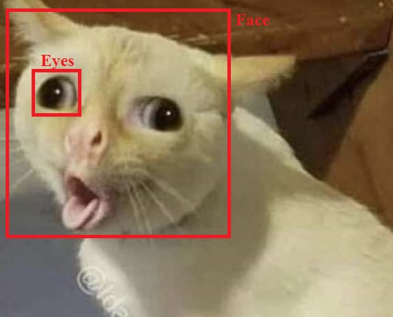

Why do we need it?
Implicit understanding of hierarchical representations in data.
Less risk of Bias/Catastrophic failures.
Reasoning and learning models of the world.
Low reliance on expensive annotated datasets.
Facial features of a cat
Car driving off a cliff

Slide 10
Overview
Deep Symbolic Networks (DSN)
Structure & Properties
Training
Uses
Summary
Limitations

Slide 11
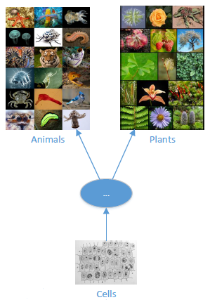
Deep Symbolic Networks
Develop a recursive hierarchical structure (like DNN) to represent any knowledge of the world as symbols.
Learn these symbols automatically using naturally occurring singularities (separators).
Transparent representation of symbols.
Refine the knowledge using optimization methods.
Hierarchical structure of symbols

Slide 12
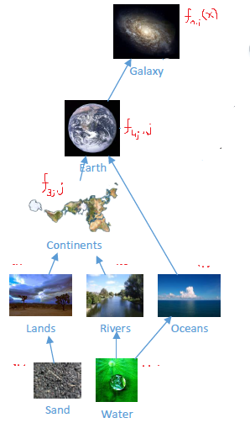

The Recursive Hierarchical Model
Matter at higher layer is composed of matter at lower layers.
No part of an object is made of itself.
Identifying operators determine the symbol for new objects.
Deep Symbolic Network (DSN) formulation:
Let ‘x’ be space the symbol occupies.
f(x) approximates details at each point in space occupied.
State parameters a, b, c represent magnitude, place & size.
Deep Hierarchical Structure of Universe

Slide 13
Structure & Properties
Deep Symbolic Networks has the following features:
Links between symbols
By Composition.
By Inheritance.
By Causality.
By Abstraction.
Interactions between symbols
Dynamics of symbols
Processes

Slide 14
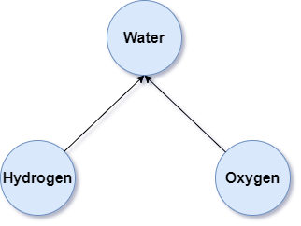
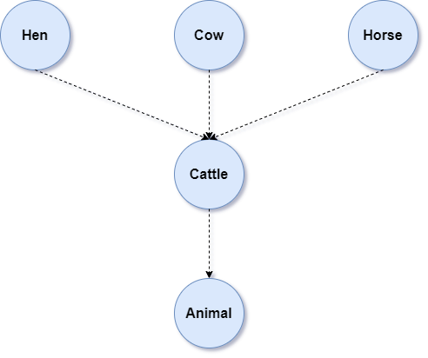
Links between the symbols
By Composition: Indicates the building blocks of higher-level symbols.
By Inheritance: Portrays that one kind of symbol belongs to another broader kind.
Composition
Inheritance

Slide 15
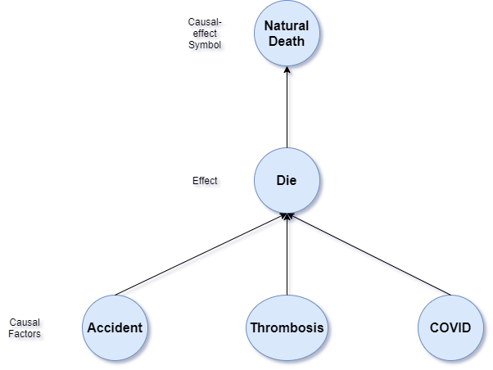
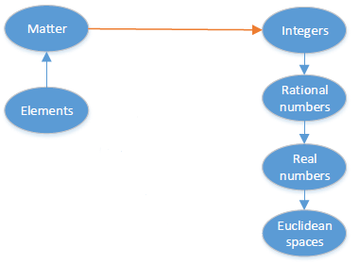
By Causality: Generate a new symbol based on the pair of causal-effect symbols.
By Abstraction: Parent symbol can be abstracted to a combination of child symbol.
Abstraction
Causality

Slide 16
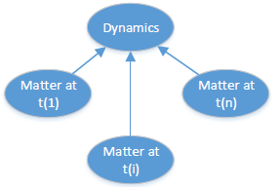
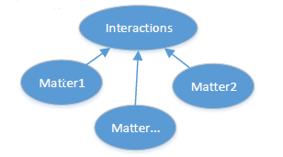
Interactions: has participants, outcomes and is linked with some dynamics.
Dynamics: represented by a symbol with its states changing with time.
Dynamics
Interaction

Slide 17
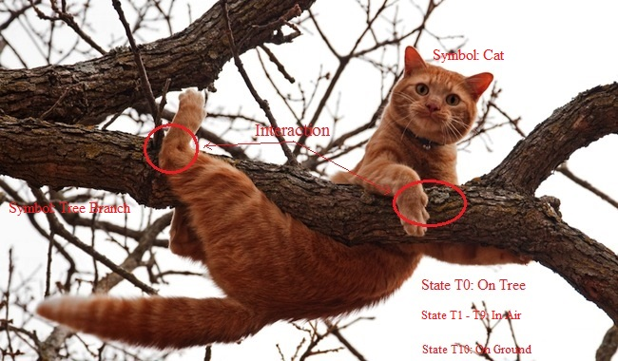
Process: Produce output through a series of interactions & dynamics.
An illustration of interactions and dynamics between symbols

Slide 18
Training Deep Symbolic Networks
The training process involves 2 steps:
Identifying Operators
Identify Singularities.
Extract First Layer Symbols.
Extract Higher Level Symbols.
Unsupervised Learning
Cluster First Layer Symbols.
Cluster Higher Layer Symbols.

Slide 19
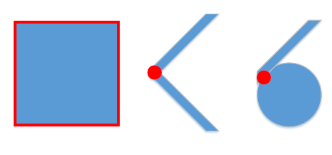
Identify Singularities
Discontinuity in the color space.
Discontinuity in the slopes.
Discontinuity in the curvatures.
Examples of singularities separating different instances of different symbols.

Slide 20
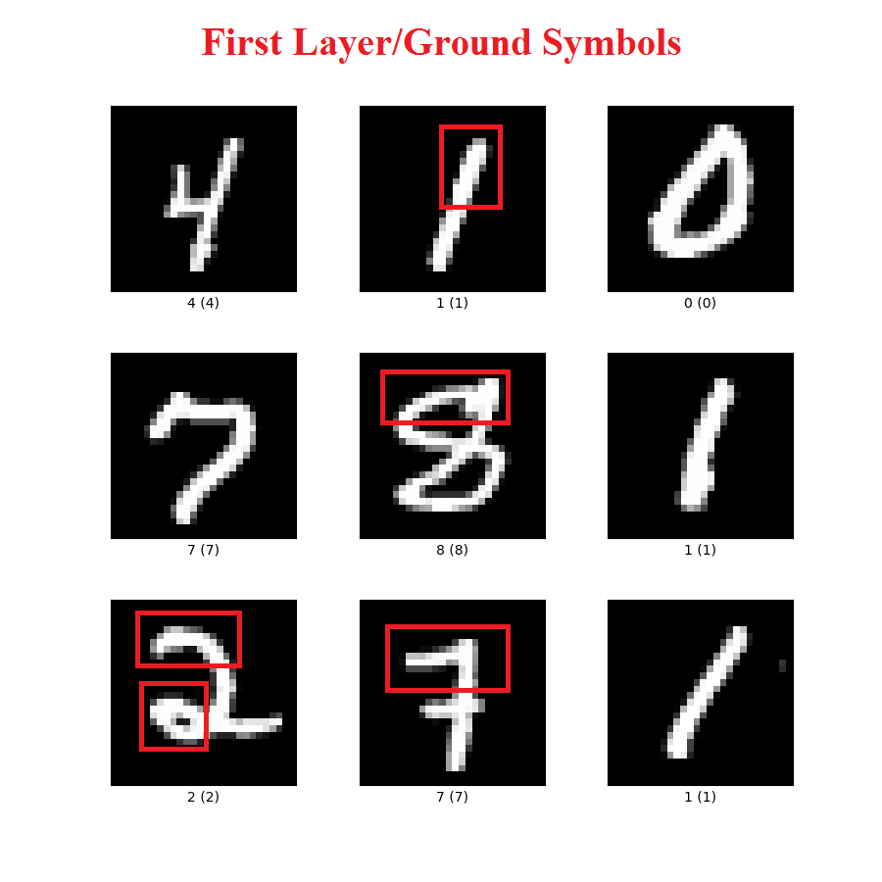
Extract First Layer Symbols
Form the base of symbol space.
Use themselves (normalized) as identifying operator.
Identifying operator returns cosine similarity.
Symbol selected if score above threshold.
Digit images from MNIST [6]

Slide 21
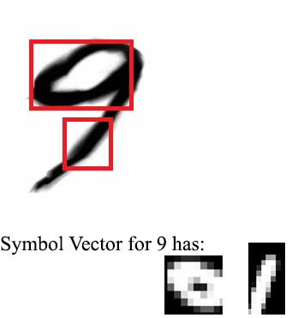
Extract Higher Level Symbols
Represented by a set of first layer symbols.
Use symbol vector (normalized) as identifying operator.
Identifying operator returns cosine similarity.
Symbol selected if score above threshold.
Use State Parameter Identifier (ex: 6 & 9).
Higher-level symbol composition vector [6]

Slide 22
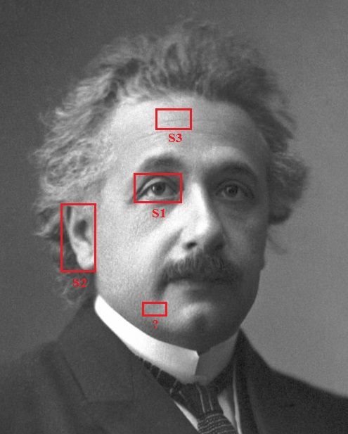
Unsupervised Learning
First Layer Symbols
Detect singularities at all scales.
Extract data pieces using singularity bounding box.
Initially, add a data piece to new cluster.
Insert cluster into cluster list.
Generate identifying operator (kernel) to find ground symbol.
Match new data piece with existing clusters.
Threshold value to control number of clusters.
Lower-level facial symbols

Slide 23
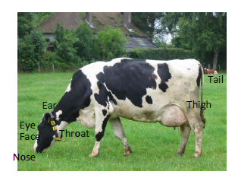

Higher Layer Symbols
Data pieces represented by set of known ground symbols.
Repeat previous slide steps but at a bigger visual scope.
Decrease multi-layer noise.
Improve cluster accuracy with state parameter identifier.
Continue until no new symbols are identified.
Estimate best values of $λ$, µ.
Add composition links between symbols.
Record prior and posterior probabilities.
Lower levels symbols in a Cow symbol

Slide 24
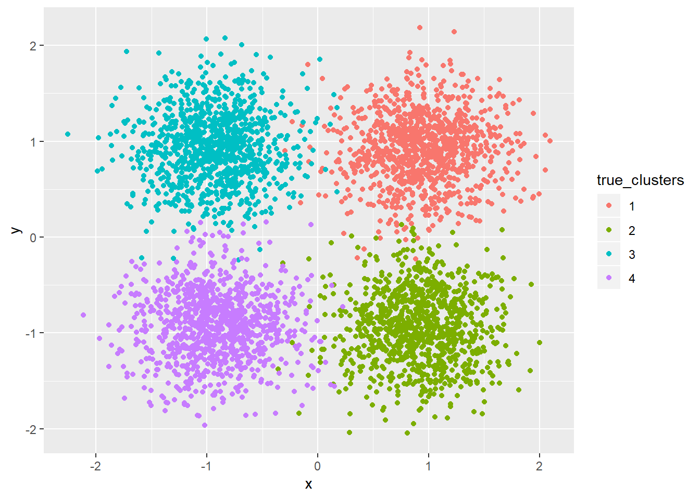
Supervised Learning
Use Unsupervised learning to generate clusters as done previously.
Employ Supervised learning to find best values of cluster parameters: λ, µ.
Improve by optimizing the objective function.
Clustering objects into symbol classes [7]

Slide 25
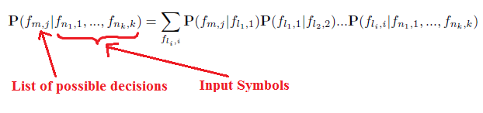
Uses of Deep Symbolic Networks
Bayesian Decision Making
Searching paths between links to find required output symbols.
Ex: From which direction does the Sun rise?
Argmax(Answers)
East
Direction
Rise
Sun

Slide 26
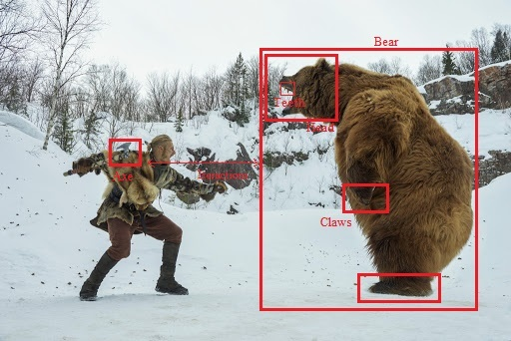
Cognitive tasks in critical environments
Use existing deep symbolic network aggregating all knowledge of the world.
DSN for perception and reasoning about the environment.
Ex: Hunter encountering a wild Bear.
Man fighting with a bear in the wild

Slide 27
Summary
Develop whitebox versions of Deep Neural Networks
Represent deep hierarchical structures of the world in a human comprehensible format
Automatically learn knowledge representations from fuzzy and unstructured data
Singularities isolate symbols and naturally create symbol dictionary

Slide 28
Limitations
Training with Unsupervised Learning
Unsupervised Learning assumes linear separability of symbols.
Performs poorly with high amplitude of noises.
Computationally intensive to estimate right cluster parameters.
Training with Supervised Learning
Partial utilization of Supervised learning’s benefits.
No information about the training dataset.
Incomplete information about evaluation metrics & model performance in both cases.

Slide 29
References
Symbolic AI Symbol Representations
Convolution Neural Networks
Symbolic AI Symbols and Rules
Deep Learning Feature Maps
Learning like Human Child
MNIST Dataset Samples
Cluster Analysis & Parameter Approximation

Slide 30

Questions?

