Slide 1
Lending Club Case Study
Akshay
Sagar

Slide 2
Problem Definition
Lending company is the largest online loan marketplace, facilitating personal loans, business loans, and financing of medical procedures. Borrowers can easily access lower interest rate loans through a fast-online interface.
Lending loans to ‘risky’ applicants is the largest source of financial loss (called credit loss).If one can identify these risky loan applicants, then such loans can be reduced thereby cutting down the amount of credit loss.
The company wants to understand the driving factors (or driver variables) behind loan default, i.e. the variables which are strong indicators of default.
Identification of such applicants using EDA is the aim of this case study.

Slide 3
Approach
Analyzing each attribute
Observing distribution & value counts
Categorizing continuous variables
Plotting percentage distributions
Understanding correlation and trend between two attributes.
Plotting trend line, Heat map for Bi/multi variable analysis
Reading the data
Data Sourcing
Data Cleaning
Univariate Analysis
Segmented Analysis
Bivariate Analysis
Recommendations
Null value correction
Formatting data
Removing excess data
Creating derived columns
Segmenting attributes against loan status
Plotting percentage distribution against “Charged Off” cases.
Recommendation for categorization of “Risky” applications, based on attributes and correlations.

Slide 4
Data Understanding
Data loss incurred after data cleaning accounts to 8 ~ 8.5%.
Applications with loan status “Current” are ignored, as it will not add value to decision making for default candidate.
All the analysis is performed against the “loan status” attribute to understand the trend for risky applicants.
Available Attributes can be classified as –
Significant Attributes
Information available at application screening stage.
Will contribute to make decision, risky/not risky profile.
Other (less-significant) Attributes
Information which do not impact on decision making during screening.
Variables which are generated after screening is done.
Notes:
In following slides we will study few attributes which have highest impact on decision making for categorizing default candidate.

Slide 5
Attributes
Sr. No. | Significant Attributes
1 | Term
2 | Number of Public Record Bankruptcies
3 | Funded amount
4 | Inquiry Count
5 | Total Credit Lines
6 | DTI
7 | Employee Length
8 | Home Ownership
9 | Annual Income
10 | Income Verification Status
11 | Number of Credit Lines Available
12 | Purpose
13 | State
14 | Earliest Credit Line Date
15 | Employee Title
16 | Derogatory Public Records
Sr. No. | Other Attributes
1 | Issue Date
2 | Sub-Grade
3 | Grade
4 | Delinquency Count (in Last 2 Years)
5 | Interest Rate
6 | Revolving Balance
7 | Revolving Utilization Rate

Slide 6
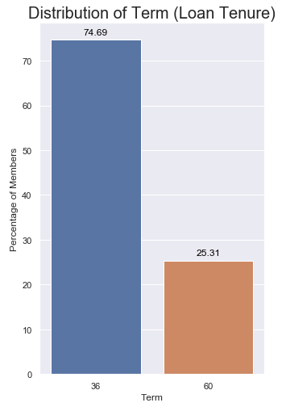
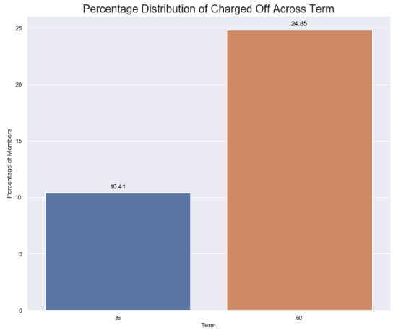
Significant Attribute Analysis - Term
Population distribution
Percentage charged off in each bin
~75% of population have 36 months term
~25% applicants have defaulted in 60 months term and ~10% in 36 months term.
Recommendation – Do not Lend or Charge higher interest rate (considering other attributes) for applicants with 60 months term.

Slide 7
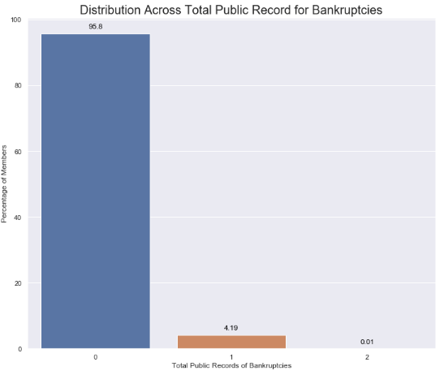
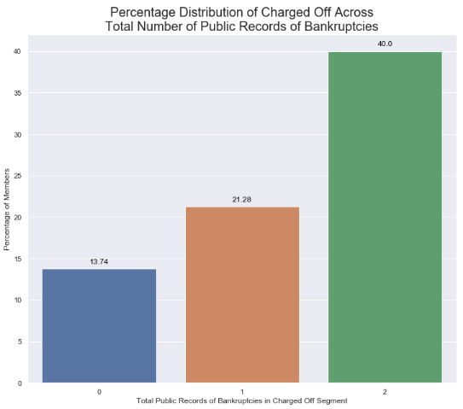
Significant Attribute Analysis - Public Records of Bankruptcies
Population distribution
Percentage charged off in each bin
Most applicants, ~96%, have no Public Records of Bankruptcies
Percentage charged off graph shows even single record of Public Bankruptcies increases the chances of default significantly. Trend is 0.97.
Recommendation – Do not Lend or Charge higher interest rate (considering other attributes) for applicants who have even single Public Record of Bankruptcies.

Slide 8
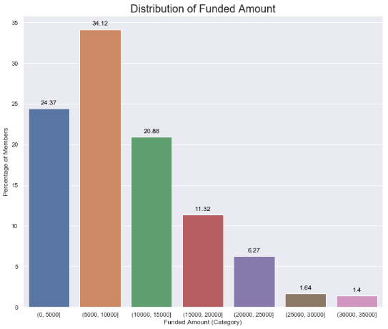
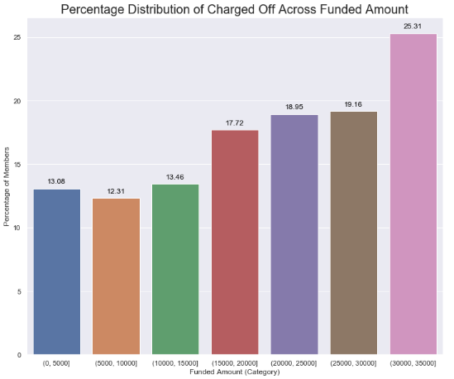
Significant Attribute Analysis - Funding Amount
Population distribution
Percentage charged off in each bin
Percentage charged off graph shows as Funding Amount increases chances of default increases significantly, trend is 0.93.
Recommendation – Do not Lend or Charge higher interest rate (considering other attributes) for applicants who have applied for loan amount more than 15000.

Slide 9
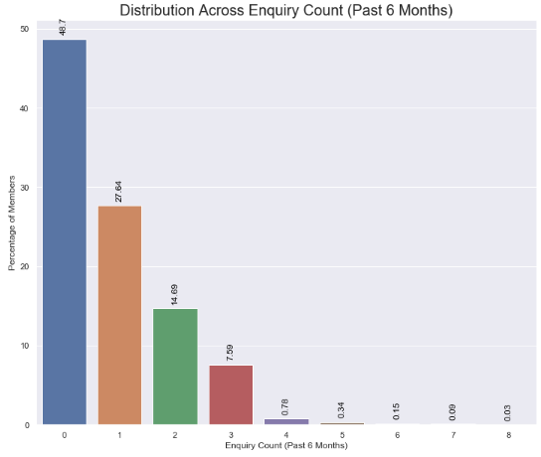
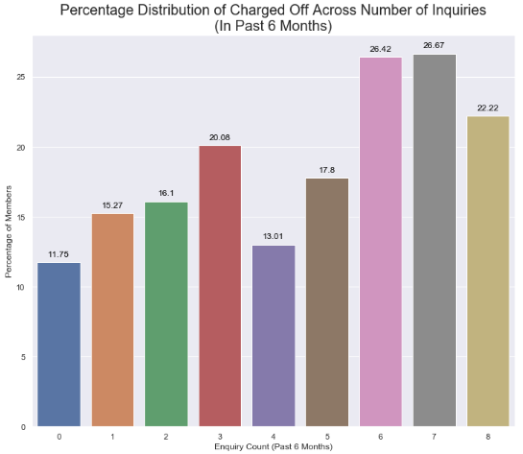
Significant Attribute Analysis - Inquiry Count (In Last 6 Months)
Population distribution
Percentage charged off in each bin
Most applicants, ~49%, have no Inquiry count (In Last 6 Months)
Percentage charged off graph shows as Inquiry count (in last 6 months) increases chances of default increases significantly, trend is 0.79.
Recommendation – Do not Lend or Charge higher interest rate (considering other attributes) for applicants who have 6 or more inquiry count (in last 6 months).

Slide 10
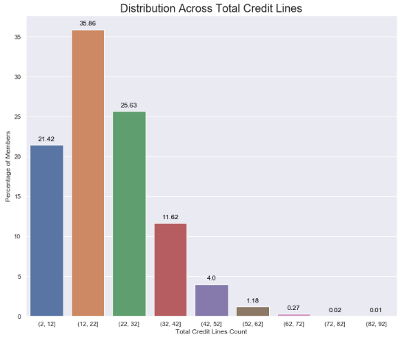
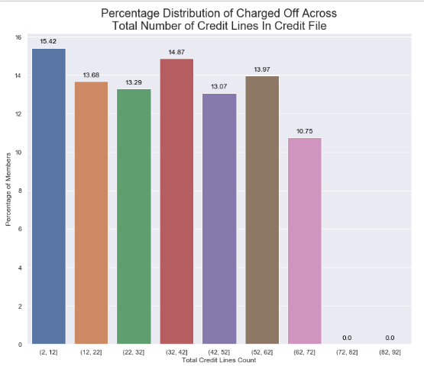
Significant Attribute Analysis - Total Credit Lines
Population distribution
Percentage charged off in each bin
Percentage charged off graph shows as Total Credit Lines increases chances of default decreases, trend is -0.70. after ignoring (72-82] and (82-92] bins.
Recommendation – Do not Lend or Charge higher interest rate (considering other attributes) for applicants who have a smaller number of Total Credit Lines available.

Slide 11
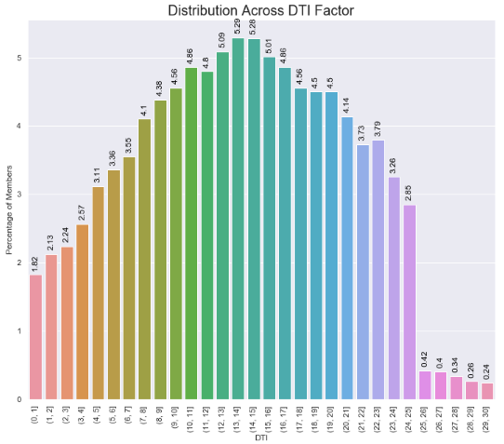
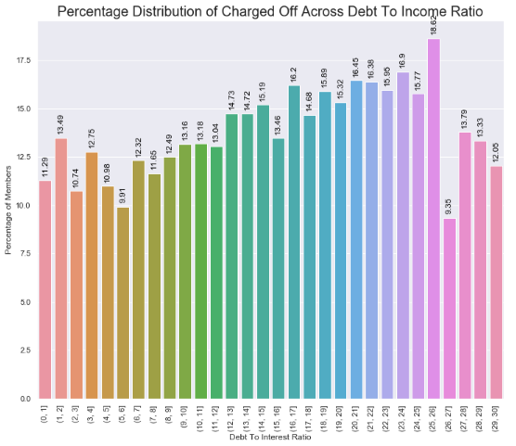
Significant Attribute Analysis - Debt to Income Ratio
Population distribution
Percentage charged off in each bin
Percentage charged off graph shows as Debt to Income Ratio increases chances of default increases, trend is 0.49.
Recommendation – Do not Lend or Charge higher interest rate (considering other attributes) for applicants who have more DTI.

Slide 12
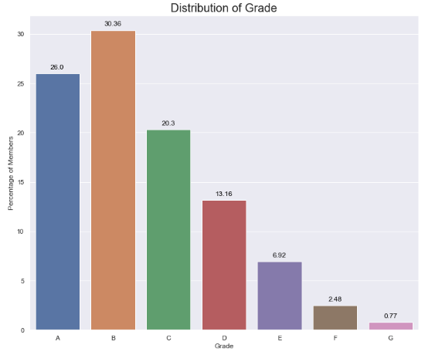
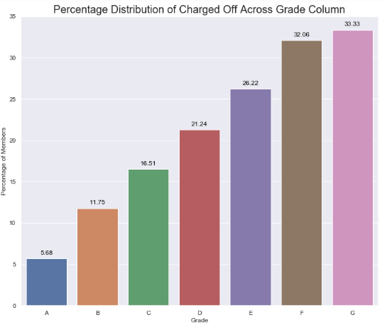
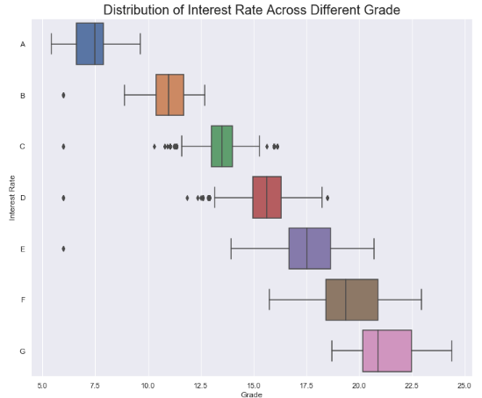
Other Attribute Analysis - Grade
Population distribution
Percentage charged off in each bin
Grade VS Interest Rate
Grade, LC’s methodology to segregate the applicants with respect to risk associated, from A-G.
From Grade vs Interest rate graph it is evident that as grade increases from A-G, interest rate charged also increases.
Percentage charged off graph shows increase in default rate as grade moves from A-G, this implies that LCs grading methodology is working well to segregate the risky candidates.
Do not Lend or Charge higher interest rate (considering other attributes) for applicants who are categorized D and above.

Slide 13
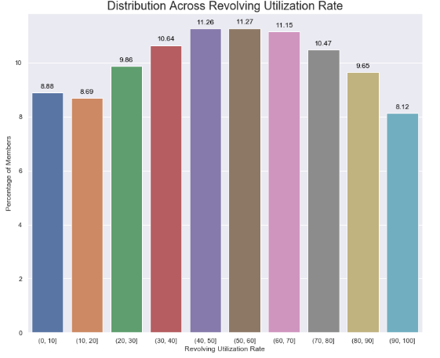
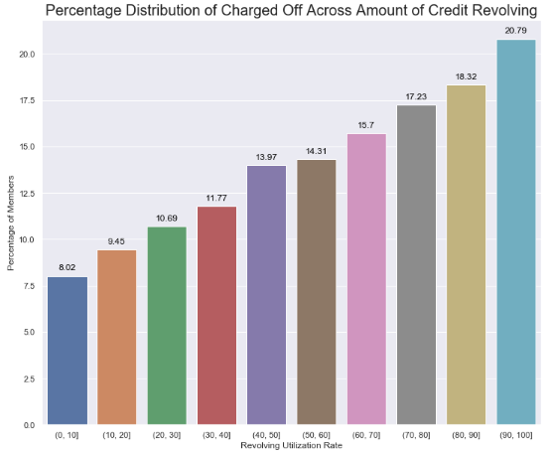
Other Attribute Analysis - Revolving Utilization Rate
Population distribution
Percentage charged off in each bin
Population distribution shows most distribution in bins 40-50, 50-60, 60-70.
Percentage charged off in each bin graph shows as Revolving Utilization Rate increases chances of default increases significantly.
Do not Lend or Charge higher interest rate (considering other attributes) for applicants having higher Revolving Utilization Rate.

Slide 14
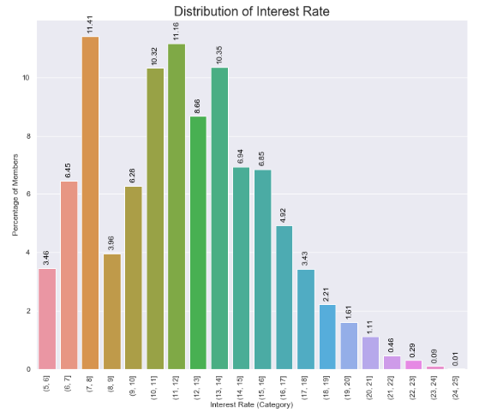
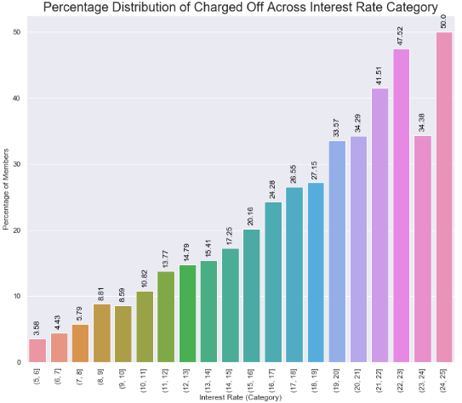
Other Attribute Analysis - Interest Rate
Population distribution
Percentage charged off in each bin
As the risk on application increases LC charges more interest rate to give benefits to investors.
Same could be inferred from percentage charged off graph, as interest rate increases percentage of default increases, as risk associated with application increases.
Charge higher interest rate (considering other attributes) for applicants who have more risk associated.

Slide 15
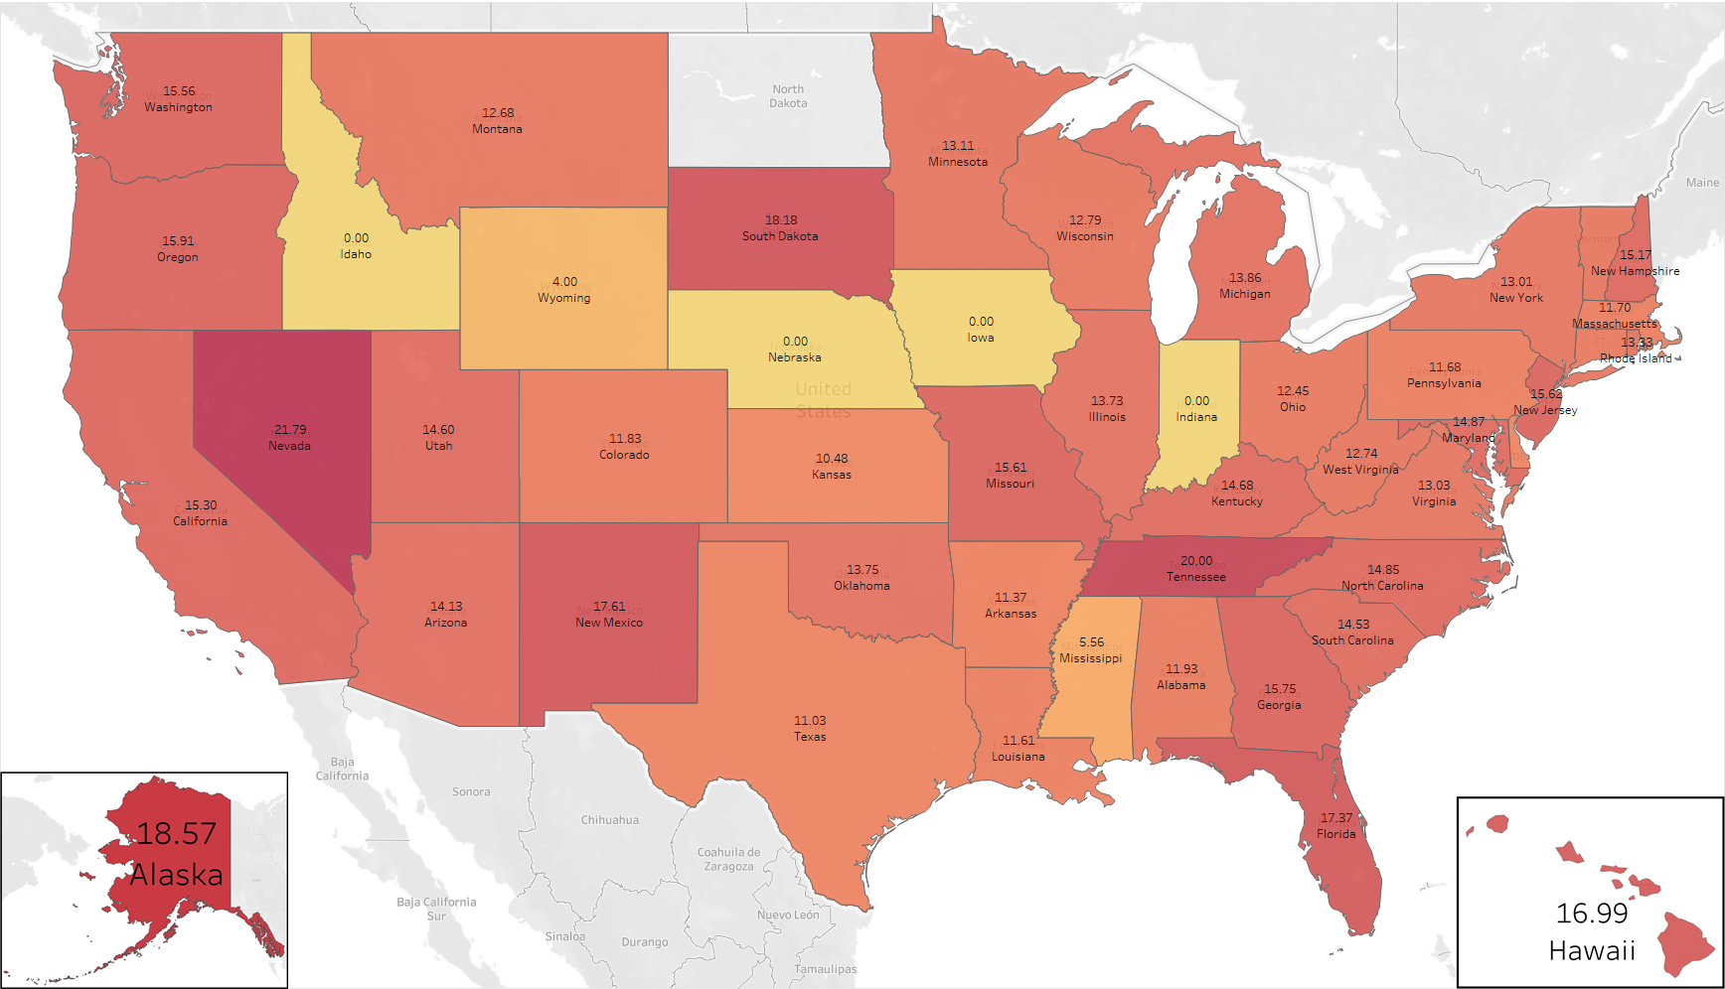
State-Wise Percent Distribution of Charged Off

Slide 16
Recommendations
Sr. No. | Significant Attributes | Trend | Recommendation [Do not Lend or Charge higher interest rate (considering other attributes) for applicants who have mentioned]
1 | Term | NA | 60 months term
2 | Number of Public Record Bankruptcies | 0.97 | Even single record
3 | Derogatory Public Records | 0.94 | Even single record
4 | Funded amount | 0.93 | Applied for loan amount more than 15000
5 | Inquiry Count | 0.79 | 6 or more inquiry count (in last 6 months)
6 | Total Credit Lines | -0.70 | Less number of Total Credit Lines available
7 | DTI | 0.49 | More DTI
8 | Earliest Credit Line Date | 0.46 | Recent Earliest Credit Line Date
9 | Employee Length | 0.41 | Employee length on higher side
10 | Annual Income | -0.39 | Annual Income on lower side
11 | Open Credit Line Count | 0.29 | Open Credit Line Count on lower side
12 | Purpose | NA | Purpose as Small Business, Renewable Energy, Educational
13 | State | NA | State as Nevada, Tennessee, Alaska
14 | Employee Title | NA | Employee title as Marriott International, USMC, Macys
15 | Home Ownership | NA | Home ownership status Other

Slide 17
Thank you!

