Slide 1
AI Stock Market Assistant
ASSIGNMENT 1.1
A multi-agent system built with LangChain + LangGraph
LangChain
LangGraph
RAG
Multi-Agent
Streamlit
Presented by: Akshay
Notes:
Introduce the project: an AI assistant that analyses stocks, reads financial news using RAG and gives a simulated Buy/Sell/Hold recommendation. It is built as a multi-agent system with LangChain and LangGraph and deployed as a Streamlit web app.

Slide 2




What the assistant does
Analyse stock data
RAG news analysis
LLM insights
Buy / Sell / Hold
Real-time and historical prices, technical indicators and company fundamentals from Yahoo Finance
Latest news is indexed in a FAISS vector store; relevant chunks are retrieved to judge sentiment
An analyst agent reasons over price trends, fundamentals and news to explain what matters
A simulated recommendation with a confidence score, justification and key risks
Design idea: each task is handled by a specialised agent, and LangGraph coordinates them through a shared state.
Notes:
The four objectives from the assignment brief. The key design decision is to split the work across specialised agents instead of one big prompt.

Slide 3








Technology stack
LangChain
LangGraph
Groq · gpt-oss-20b
yfinance
LLM integration, prompt templates, tools, chains and output parsers
Multi-agent graph, shared state, conditional edges, memory
Fast LLM inference through ChatGroq
Price history, fundamentals and news from Yahoo Finance
HuggingFace MiniLM
FAISS
Tavily (optional)
Streamlit + Plotly
Free local embeddings: all-MiniLM-L6-v2
Vector store used for news retrieval (RAG)
Web news search added to the RAG knowledge base
Deployable web app with interactive charts
Notes:
LangChain provides the building blocks, LangGraph orchestrates the agents. Groq serves the open-weights gpt-oss-20b model. Embeddings run locally, so the only required API key is Groq.

Slide 4
LangGraph workflow
START
news only
no recommendation needed
Query Router
Market Data
News (RAG)
Analyst
Recommendation
Report Generator
not a stock / bad ticker
price check
Invalid Request
END
Normal edge
Conditional edge
7 nodes · 3 conditional edges · InMemorySaver checkpointer
Notes:
Every question enters at the Query Router. Three routing functions decide the path: after the router (full / news only / invalid), after market data (price check skips news, bad ticker goes to invalid), and after the analyst (only full analysis goes to the recommendation agent).

Slide 5


Six specialised agents
1. Query Router
2. Market Data
3. News (RAG)
Turns the question into ticker, company, intent and period
Calls tools for price history, technical indicators and fundamentals
Fetches news, builds a FAISS index, retrieves chunks and scores sentiment
Writes: QueryPlan (Pydantic)
Writes: market_data
Writes: news_insight
4. Analyst
5. Recommendation
6. Report Generator
LLM reasoning across technicals, fundamentals and news sentiment
Simulated BUY / SELL / HOLD with confidence, reasons and risks
Compiles the final markdown report shown in the app
Writes: analysis
Writes: recommendation
Writes: final_report
Notes:
Each agent is a LangGraph node: a Python function that reads StockState and returns only the fields it updates. 'Writes' shows which state field each agent fills.

Slide 6




State management
Shared state
class StockState(TypedDict):
messages: Annotated[list, add_messages]
user_query: str
ticker: str
company_name: str
intent: str
period: str
error: str
market_data: dict
news_articles: list
news_insight: dict
analysis: str
recommendation: dict
final_report: str
agent_log: list
Every agent reads from and writes to the same StockState dictionary
add_messages reducer
Appends each question and report to the conversation history
InMemorySaver checkpointer
Keeps memory per thread_id, so each user session has its own history
Fresh state per query
make_initial_state() resets old results before each new question
Notes:
StockState is a TypedDict. Only 'messages' uses a reducer (add_messages), so chat history accumulates; all other fields are overwritten. The checkpointer gives short-term memory per thread_id.

Slide 7

LangChain building blocks
Prompt templates
Tools (@tool)
Chains & runnables
PromptTemplate – Query Router
ChatPromptTemplate – Analyst
ChatPromptTemplate – Recommendation
ChatPromptTemplate – News (RAG)
get_price_history
calculate_technical_indicators
get_company_fundamentals
get_stock_news
router_chain = prompt | llm | PydanticOutputParser
analyst_chain = prompt | llm | StrOutputParser
rag_chain = RunnableParallel | prompt | llm | parser
LLM: ChatGroq(model="openai/gpt-oss-20b", temperature=0.2) · structured outputs with Pydantic models
Notes:
All LLM calls use LCEL chains with the pipe operator. Pydantic output parsers make the router, news sentiment and recommendation outputs structured and reliable. The four tools are LangChain @tool functions invoked by the agents.

Slide 8
RAG pipeline for financial news
INGESTION
RETRIEVAL & GENERATION
1
2
3
4
5
6
7
Fetch
Documents
Split
Embed
Store
Retrieve
Generate
Yahoo Finance news + Tavily (optional)
Title, date, publisher and summary
RecursiveCharacter, 500 chars / 75 overlap
all-MiniLM-L6-v2 (HuggingFace)
FAISS vector store
Top 6 most relevant chunks
LLM → structured NewsInsight
Why RAG?
Output: NewsInsight
The LLM's knowledge is out of date. RAG grounds the answer in today's news, and the prompt tells it to answer only from the retrieved context.
sentiment: Positive | Negative | Neutral | Mixed
sentiment_score: -1.0 … +1.0
key_themes: [3-5 catalysts]
summary: what the news means
Notes:
The same pattern as our QA chatbot: load documents, split, embed, store in FAISS, retrieve and generate. Here the documents are fresh news articles, so a new index is built for each stock request.

Slide 9
Conditional edges: one graph, four paths
Request type | Example question | Agents that run
Full analysis | Should I buy Apple stock? | Router → Market Data → News (RAG) → Analyst → Recommendation → Report
Price check | How has TCS performed in the last 3 months? | Router → Market Data → Analyst → Report
News only | Latest news about Tesla | Router → News (RAG) → Analyst → Report
Invalid / error | What is the weather in Delhi? | Router → Invalid Request
route_after_router()
route_after_market_data()
route_after_analyst()
Routes to: market data · news only · invalid
Routes to: news · analyst (price check) · invalid
Routes to: recommendation · report
Notes:
The assignment needs at least one conditional edge; this graph has three. Only the agents that the question needs are executed, which saves LLM calls and time.

Slide 10
From indicators to a recommendation
Signals the agents use
Decision guidelines
SMA 20 / 50
RSI (14)
BUY
Trend and momentum positive, news positive or neutral, valuation reasonable
Trend: price vs moving averages
Momentum: >70 overbought, <30 oversold
HOLD
Signals are mixed or there is not enough evidence
MACD (12, 26, 9)
Volatility
Bullish or bearish crossover
Annualised risk from daily returns
SELL
Trend and momentum negative with negative news, or a serious risk
+ fundamentals (P/E, margins, growth, debt) and RAG news sentiment
Confidence (0-100%) reflects how strongly the signals agree with each other
Notes:
Indicators are calculated in Python, not by the LLM, so the numbers are exact. The recommendation agent then applies these guidelines and returns a structured Recommendation object.

Slide 11
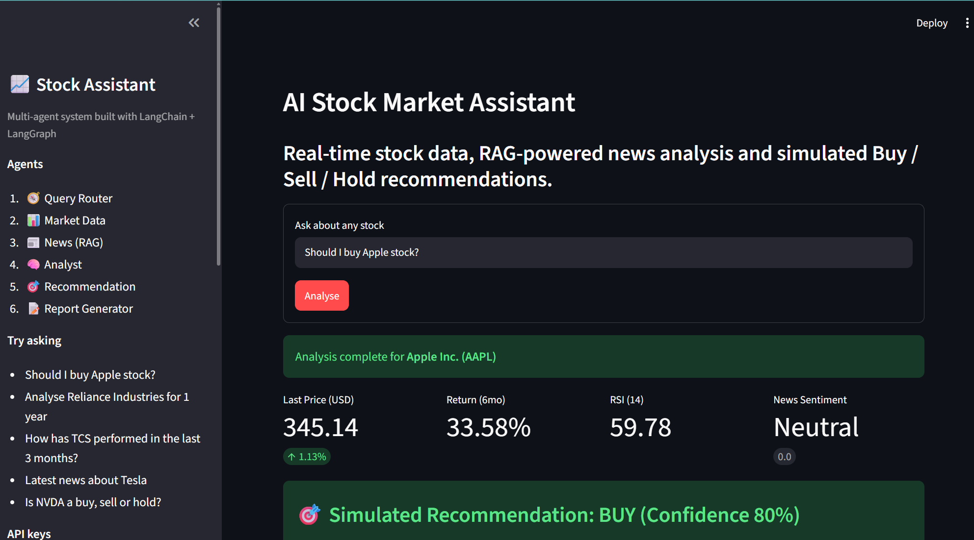




Deployable Streamlit application
Live agent progress while the graph runs
Quick-pick example questions
Interactive chart: 1M to 5Y / Max, line or candlestick, SMA 20/50/200, volume
Tabs for indicators, RAG news, analysis, report and agent trace
Download the report (.md) and price data (.csv)
Recent analyses kept in the sidebar
Live run: "Should I buy Apple stock?"
Notes:
Demo the app here. Steps 1 to 10 of the Python file are the same code as the notebook; Step 11 adds the Streamlit interface. Graph streaming shows each agent finishing in real time.

Slide 12
Assignment requirements: all met
Requirement | Implementation
LangChain – LLM integration | ChatGroq with openai/gpt-oss-20b | ✓
LangChain – Prompt templates | PromptTemplate and ChatPromptTemplate for every agent | ✓
LangChain – Tools / chains / runnables | 4 @tool functions, LCEL chains, RunnableParallel, RunnableLambda | ✓
RAG on financial news | HuggingFace embeddings + FAISS retriever + LLM | ✓
LangGraph – Multi-agent workflow | 6 specialised agents + invalid-request handler | ✓
LangGraph – State management | StockState TypedDict, add_messages, InMemorySaver | ✓
LangGraph – Nodes, edges, conditional edge | 7 nodes, 5 normal edges, 3 conditional edges | ✓
Deliverables | Jupyter notebook (.ipynb) + deployable Streamlit app (.py) | ✓
Notes:
A direct mapping from each constraint in the assignment brief to where it is implemented in the code.

Slide 13


How to run and deploy
Run locally
Deploy on Streamlit Community Cloud
1. Install packages
1. Push to GitHub
pip install -r requirements.txt
The .py file, requirements.txt and the notebook (not .env)
2. Add API keys to .env
2. Create the app
GROQ_API_KEY=... (TAVILY optional)
share.streamlit.io → New app → choose the .py file
3. Open the notebook
3. Add secrets
jupyter notebook stock_market_assistant.ipynb
GROQ_API_KEY (and TAVILY_API_KEY) under Advanced settings
4. Start the app
4. Deploy
streamlit run stock_market_assistance.py
You get a public URL to share
Notes:
Only a Groq API key is required. Embeddings run locally and Yahoo Finance needs no key. The first run downloads the small embedding model.

Slide 14

Limitations and future scope
Current limitations
Future scope
Yahoo Finance data can be delayed or rate-limited
News coverage is limited to recent headlines
The LLM may pick the wrong ticker for lesser-known companies
Memory is in-memory and resets when the app restarts
Recommendations are simulated, not financial advice
Compare several stocks or track a portfolio
Backtest the recommendation logic on past data
Persistent memory with a SQLite or Postgres checkpointer
Add earnings call transcripts and annual reports to RAG
Price alerts and scheduled daily reports
Notes:
Be honest about limitations; the future scope items show how the same graph could be extended with more agents or a persistent checkpointer.

Slide 15
Thank you
6 agents coordinated by LangGraph
News grounded with RAG (FAISS)
Explainable, simulated Buy / Sell / Hold
Disclaimer: all recommendations are simulated for educational purposes only and are not financial advice.
Notes:
Close with the three takeaways, then switch to the live Streamlit demo and take questions.

