Slide 1
PROJECT PRESENTATION | GROUP 6
Industrial Anomaly Detection via Diffusion Reconstruction
Shrikanth Vilvadrinath | Sivram Sahu · Kevin Rathod | Akshay Kamkhalia
DATA-MSML 612 Deep Learning
University of Maryland

Slide 2
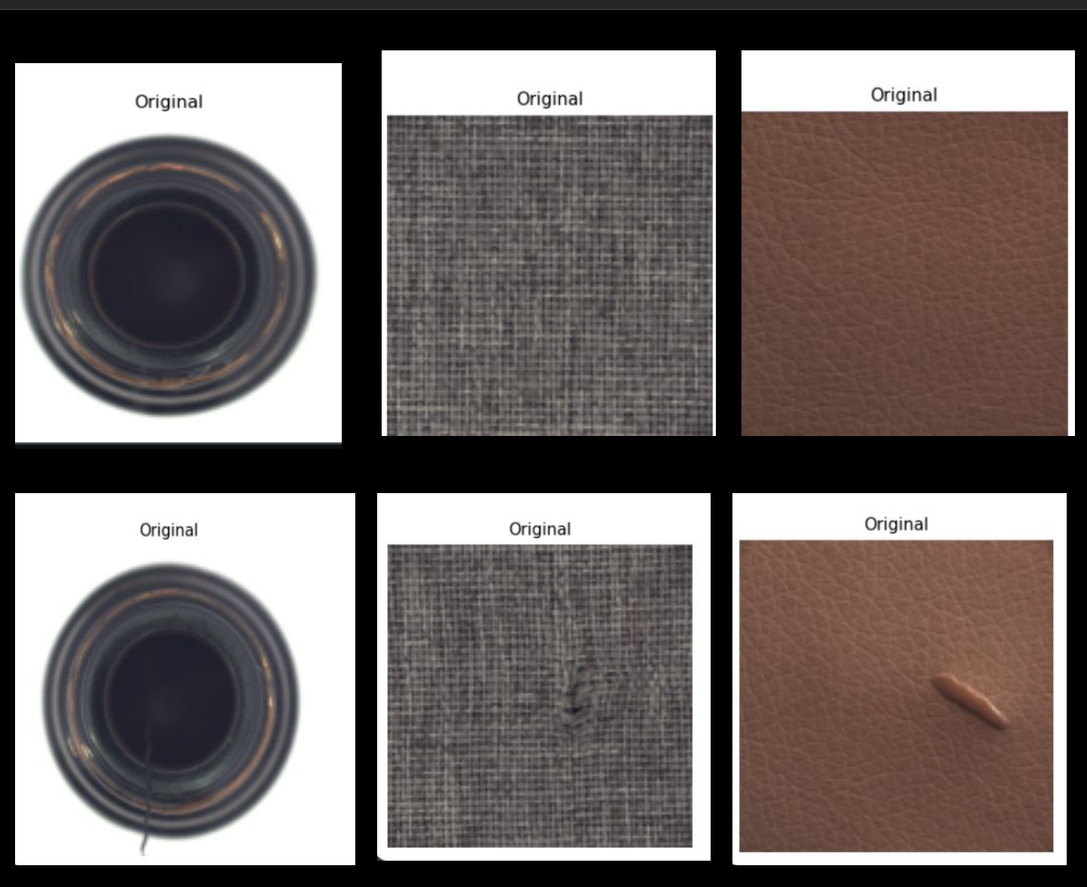
INTRODUCTION
Project Overview
Industrial anomaly detection aims to identify product defects using image data. In real manufacturing settings, normal samples are abundant while defective samples are rare, which makes standard supervised learning difficult.
We study whether a Diffusion Transformer (DiT-Tiny) can learn the appearance of normal products from the MVTec AD dataset and use reconstruction mismatch to detect anomalies.
Our system
learns only from normal images
detects whether a test image is anomalous
localizes the defect region using an anomaly map

Slide 3
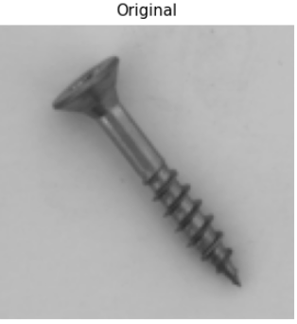
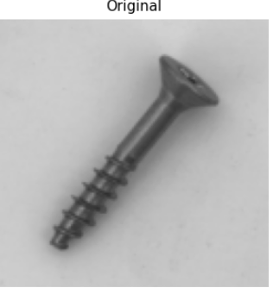
INTRODUCTION
Problem Statement
Manual visual inspection is expensive, slow, and difficult to scale. Even small visual differences, such as the tip variation in these two screw images can indicate a defect.
Defect datasets are usually:
Normal
small and highly imbalanced
expensive to label
diverse across categories and defect types
This motivates unsupervised anomaly detection, where the model is trained only on normal data and must recognize deviations at test time.
Anomalous
Two tasks together
Image-level detection - is this product anomalous?
Pixel-level localization - where is the defect?

Slide 4
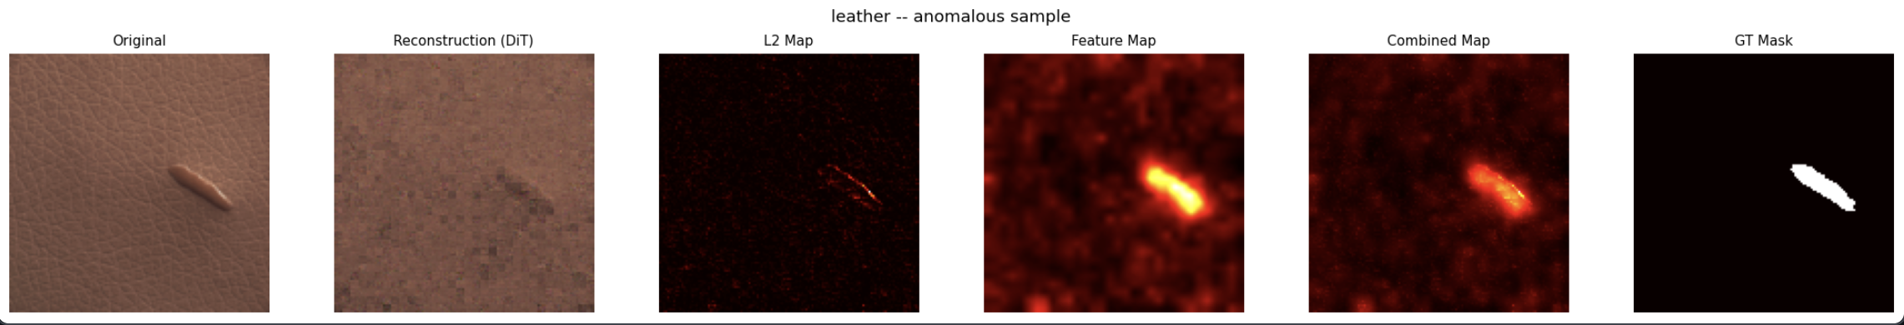
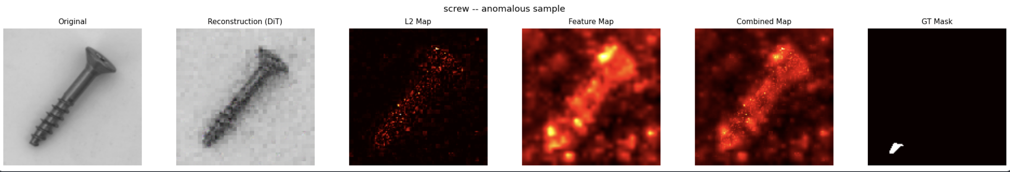
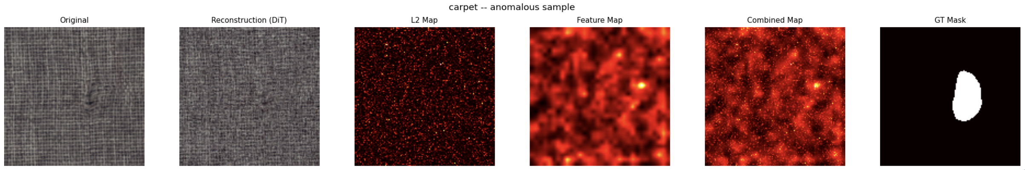
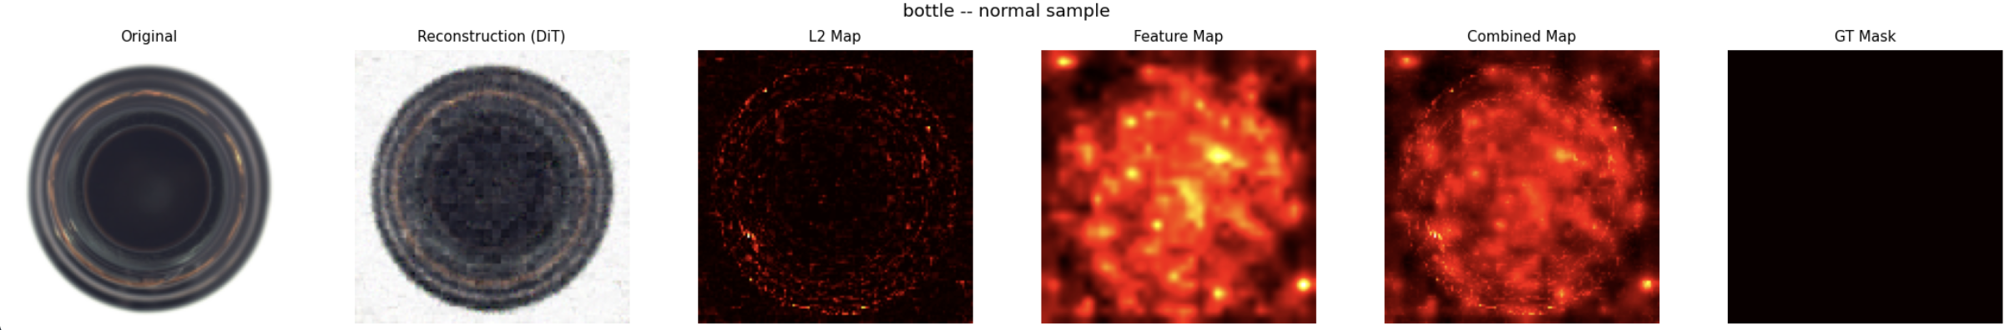
APPROACH
Solution Overview
We train a DiT-Tiny diffusion model only on normal images. At inference, a test image is partially noised, reconstructed using DDIM, and compared with the original input.
Detection pipeline
Input test image
Partial noising to a selected timestep
Reconstruction with DiT-Tiny + DDIM
Pixel-wise L2 anomaly map
Max aggregation for image-level anomaly score
4 / 13

Slide 5
STACK
Tools and Technologies
Modeling
Data & Evaluation
Experimentation
Python
MVTec AD
Google Colab T4
PyTorch
NumPy
Kaggle
Diffusion Models
Pandas
Jupyter Notebooks
DiT-Tiny
scikit-learn
LaTeX
DDIM
Matplotlib
JSON / CSV outputs
5 / 13

Slide 6

MODEL
End-to-End Diffusion Anomaly Detection Pipeline
DATA + TRAINING PIPELINE
INFERENCE + OUTPUT PIPELINE
01
Input Images
05
Reconstruction Inference
MVTec product images normal training + test inputs.
Partially noise test image and reconstruct with DDIM.
02
Data Loading
06
Anomaly Scoring
Load category-wise images and ground-truth masks for evaluation.
Compute anomaly map and image-level score from reconstruction error.
03
Preprocessing
07
Evaluation
Resize, RGB conversion, normalization, augmentation.
Measure image-level and pixel-level AUROC.
04
Diffusion Training
08
Output
Train DiT-Tiny on normal-only images.
Show verdict, score, heatmap, and Streamlit visualization.

Slide 7
MODEL
Training vs Inference Workflow
TRAINING PHASE
INFERENCE PHASE
1. Normal Images Only
Train on defect-free MVTec product images.
1. Test Image Input
Provide unknown product image.
2. Add Gaussian Noise
Sample timestep and inject noise.
2. Partial Noising
Noise image to selected timestep.
Learns normal patterns
3. DiT Predicts Noise
DiT-Tiny estimates the injected noise.
3. DDIM Reconstruction
Recover image via reverse diffusion.
Detects deviations
4. Optimize MSE Loss
Minimize error and update weights.
4. Residual Comparison
Compare reconstructed image with the original input
.
5. Save Checkpoint
Store trained model weights.
5. Heatmap + Verdict
Generate score and decision.
OUTPUT: Trained Diffusion Checkpoint
OUTPUT: Heatmap + Score + Verdict

Slide 8
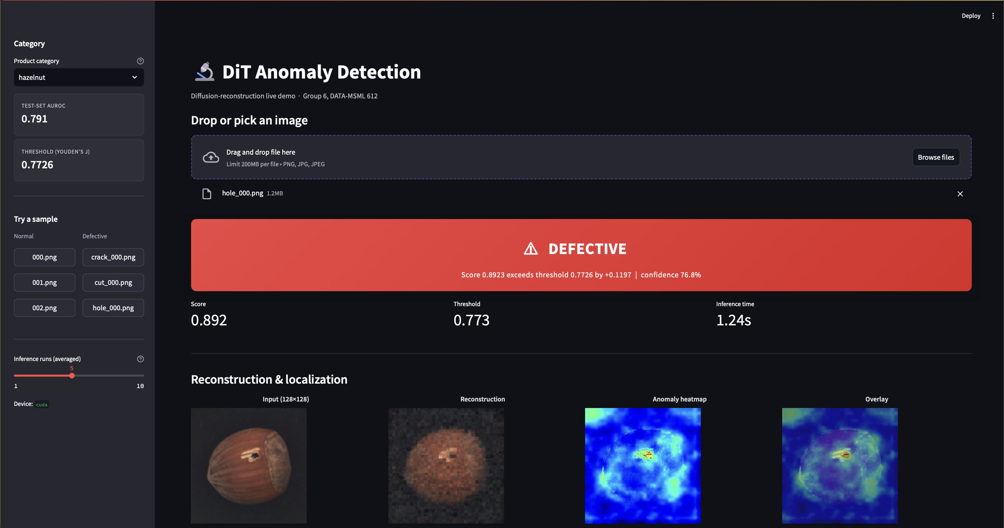
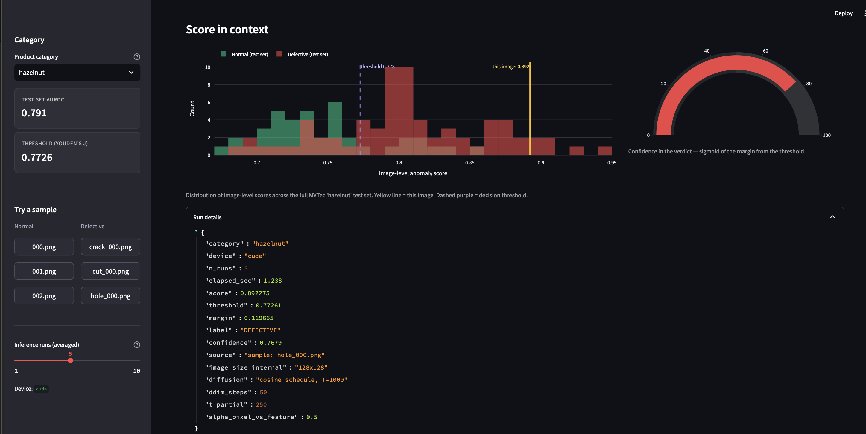
WALKTHROUGH
Live Demo
What is demonstrated
Loading a test image from MVTec
Partial noising and DDIM reconstruction
Generation of the pixel + feature anomaly heatmap
Image-level anomaly score
Qualitative defect localization
What the demo shows
End-to-end pipeline behavior
Image level anomaly score
Difference between normal and anomalous inputs
How the model highlights defective regions

Slide 9
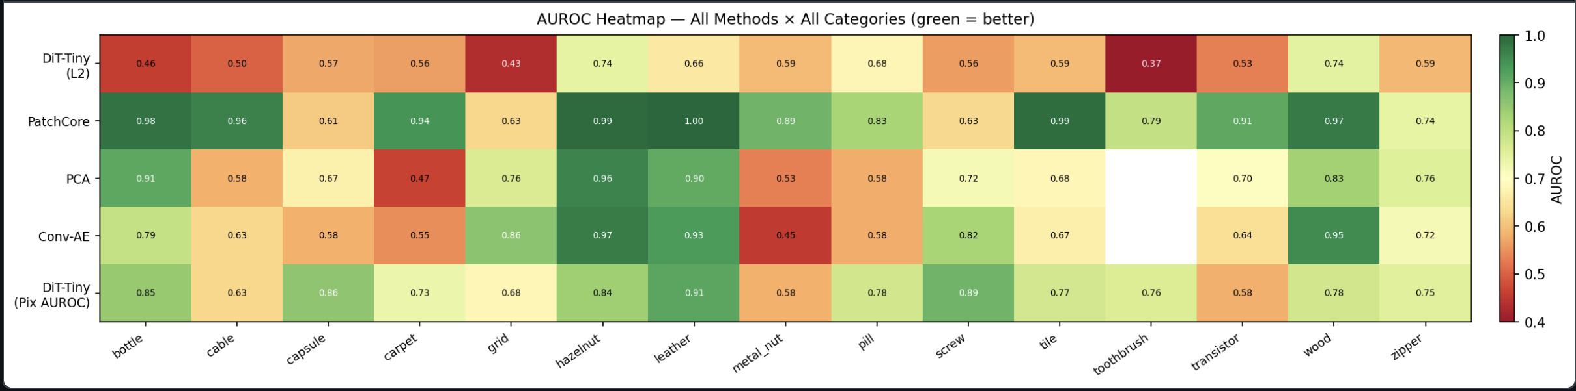
EVALUATION
Performance Metrics
Both image-level and pixel-level metrics, evaluated across all 15 MVTec categories.
Image-level AUROC - separates normal from anomalous images
Pixel-level AUROC - measures alignment with defect regions
Coverage - 15 MVTec categories
DiT-Tiny shows a consistent gap between image-level and pixel-level performance, suggesting it localizes defect regions better than it classifies entire images.
Although PatchCore remains the strongest overall baseline, DiT-Tiny is relatively more competitive on texture-heavy categories such as hazelnut, leather, and wood.
Ablations on
Scoring method | Partial noise timestep | Backbone comparison

Slide 10
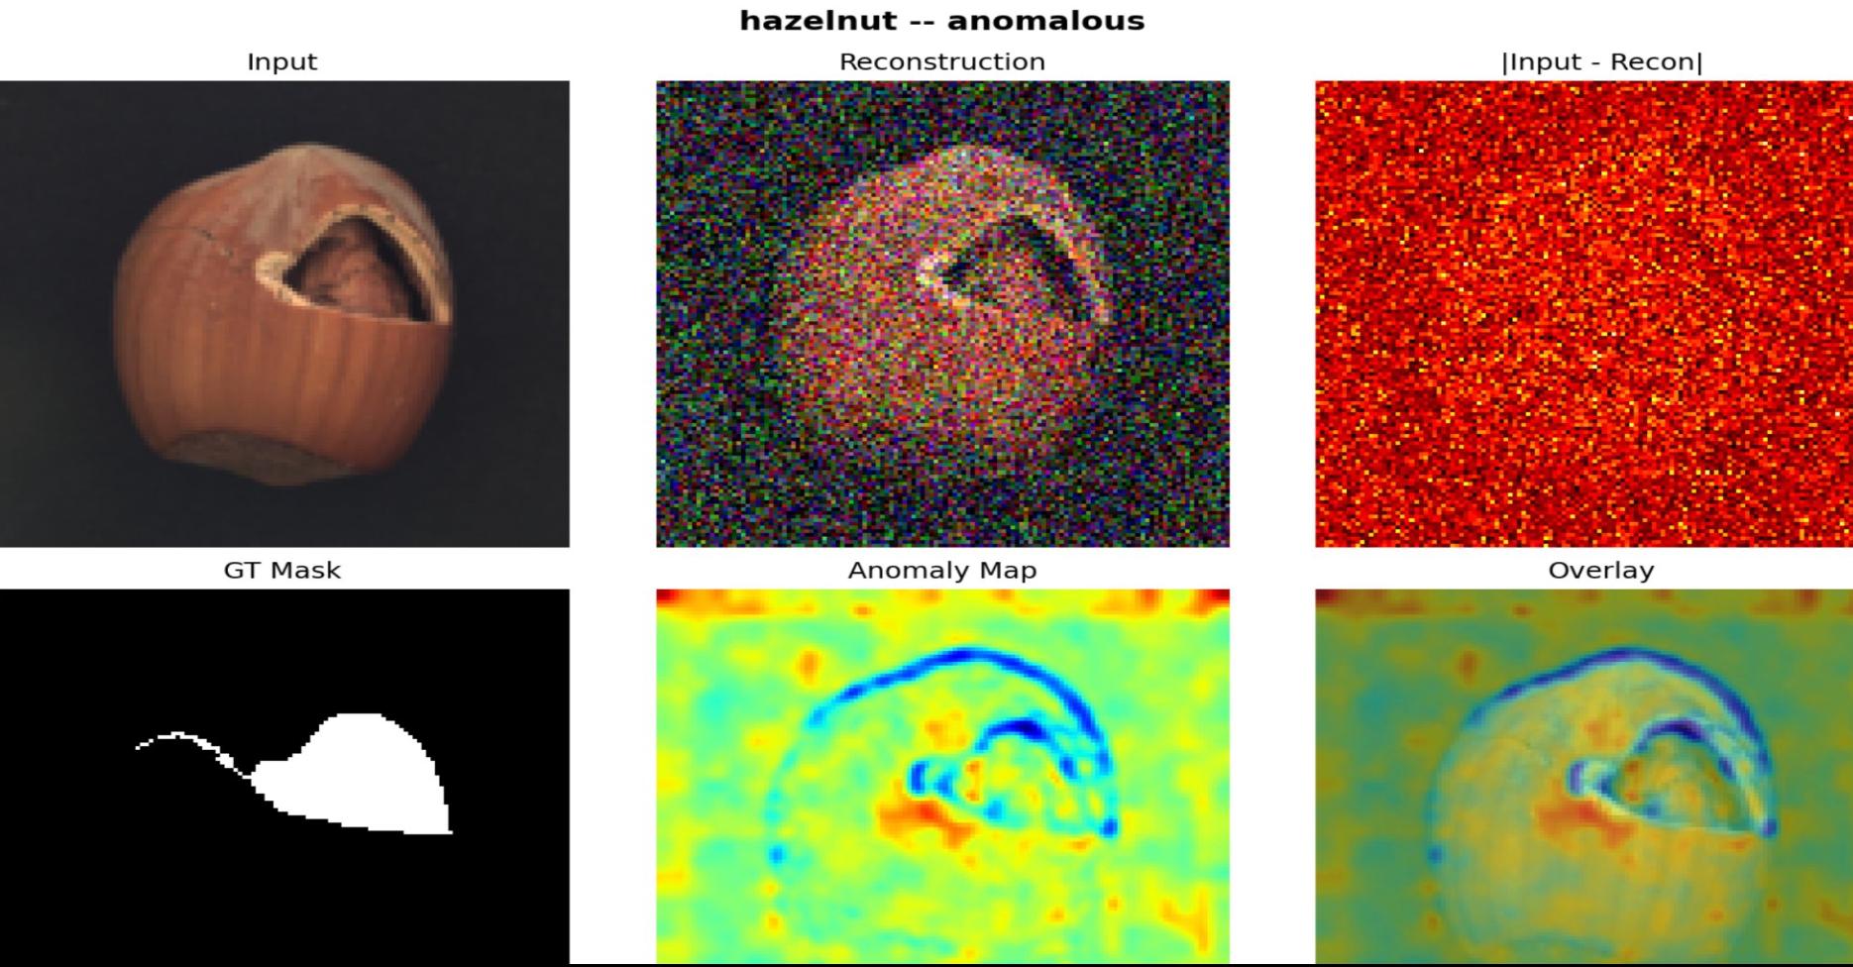
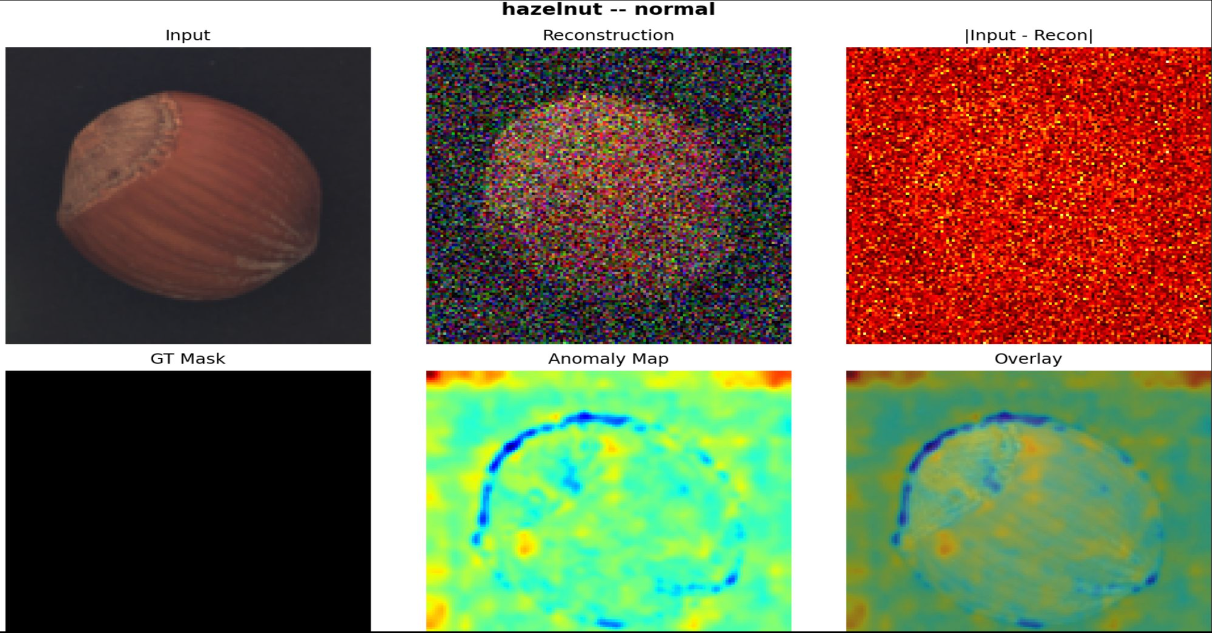
RESULTS
Qualitative Examples
Anomalous hazelnut sample
Normal hazelnut sample
Anomalous samples produce stronger reconstruction-based anomaly responses, with highlighted regions aligning well with the ground-truth mask. Normal samples show weaker responses and lower false positives.
Input is the original image, reconstruction is the model’s normal version, the anomaly map highlights suspicious regions, the overlay shows them on the image, and the GT mask is the true defect area for visual comparison.

Slide 11
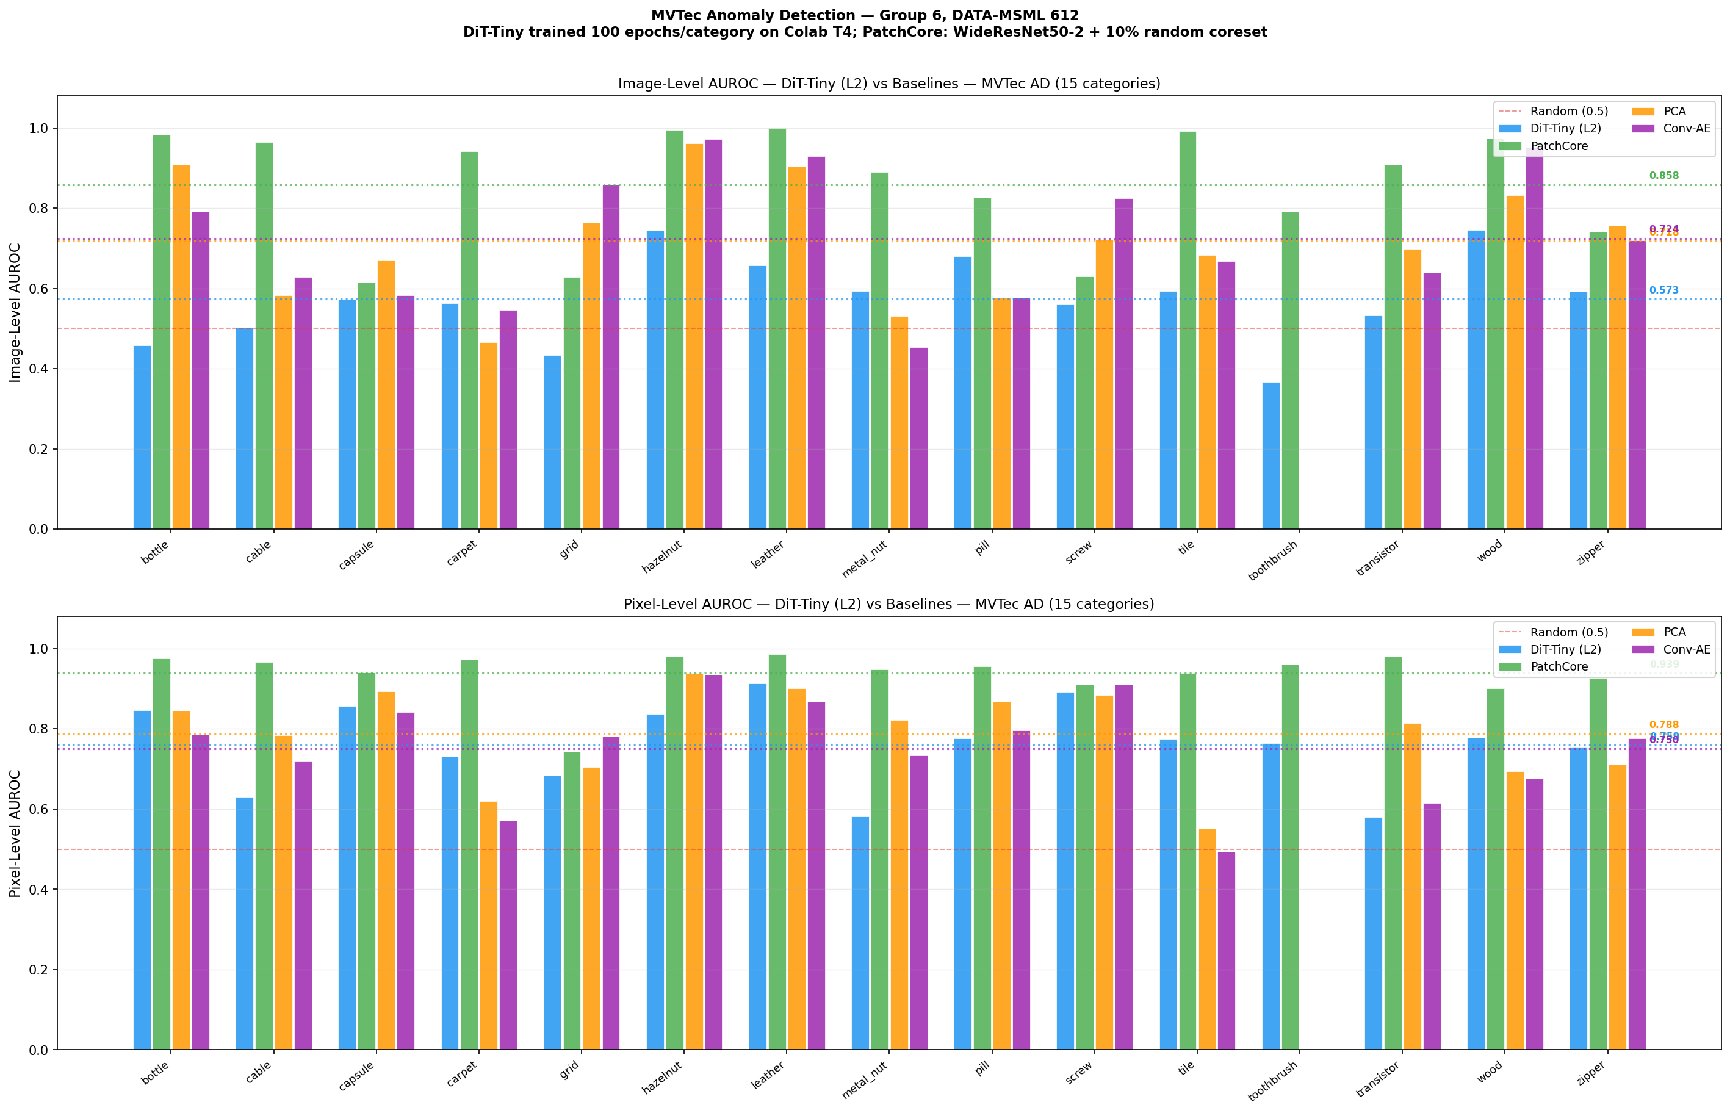
RESULTS
Quantitative Performance
0.573
0.759
Mean image-level AUROC
Mean pixel-level AUROC
Key observations
Strongest on texture-heavy categories: hazelnut, wood, leather
Weaker on more structurally complex categories
PatchCore stronger overall, but uses pretrained ImageNet features
model is trained from scratch on normal-only data

Slide 12
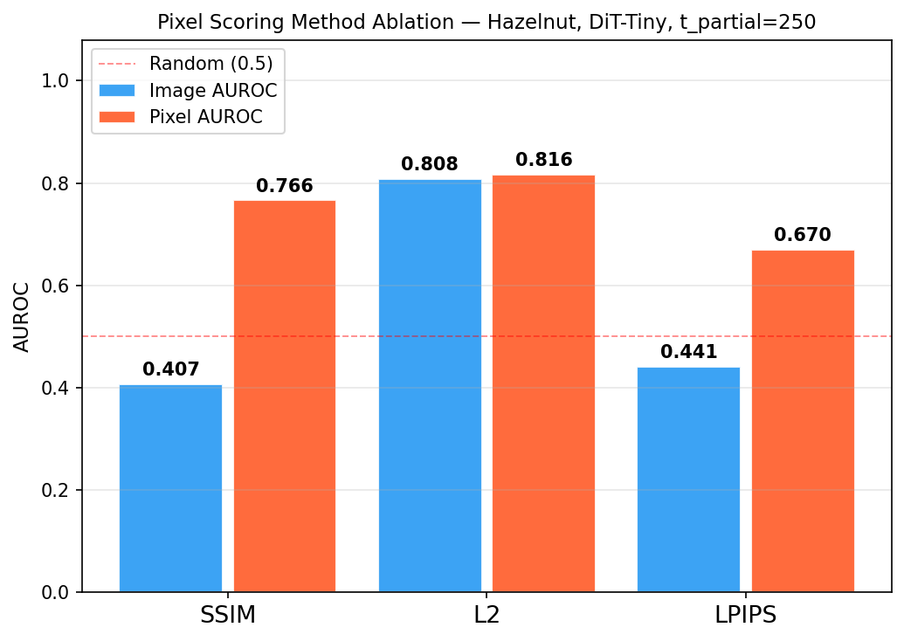
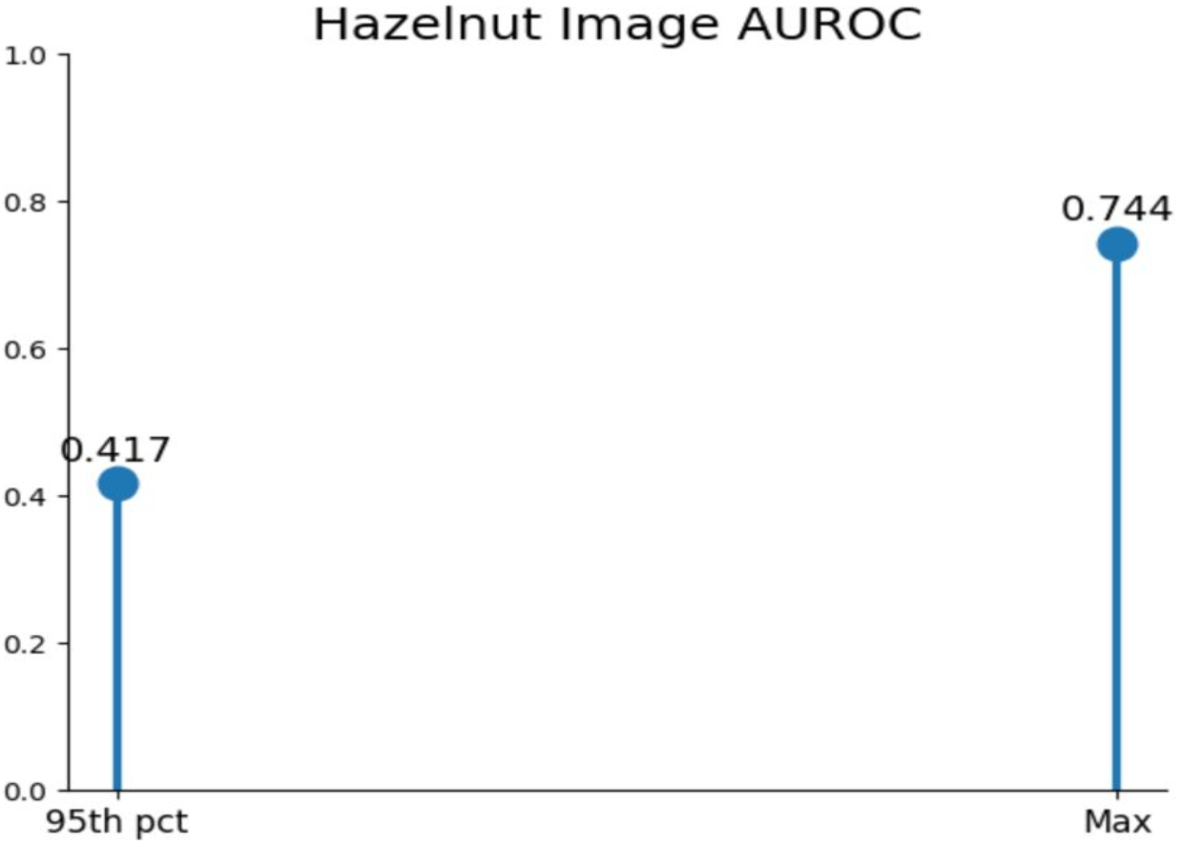
INSIGHT
Scoring Design Matters
One of the strongest findings: scoring design dominates final detection quality - even without retraining.
Hazelnut scoring comparison image level
SSIM: 0.407
L2 (combined scoring): 0.808
Aggregation fix on Hazelnut
Switching from 95th-percentile to max score
Hazelnut image AUROC: 0.417 to 0.744

Slide 13
OUTLOOK
Limitations & Future Scope
Current limitations
Future scope
Training resolution limited to 128 × 128
256 × 256 higher-resolution training
Weaker on structurally complex categories
DiT-Small architecture scaling
Trained from scratch (no large-scale pretraining)
Pretrained initialization
Overall performance still below PatchCore
PRO metric and DDIM speed benchmarking

Slide 14
INSIGHT
Conclusion
Developed a DiT-Tiny solution for anomaly detection
0.759 pixel level AUROC achieved
Final performance improved significantly through better scoring and aggregation
The model shows stronger localization than image-level classification.
Approach - Learned normal visual patterns first, then detected defects by measuring how much the reconstruction deviated from the original image
Overall, diffusion-based reconstruction proved to be a promising solution for this task

Slide 15
Thank You
Group 6 | DATA-MSML 612 | University of Maryland

