Slide 1

UK Trade Analysis

Slide 2

Introduction To Project
In international trade, where economic dynamics meet global competitiveness, making informed decisions is vital.
This presentation details a project leveraging advanced time series analysis for the UK's trade dynamics, using a rich 2017-2022 dataset from the Office for National Statistics.
The project aims to illuminate import/export trends, empowering the Department of International Trade.

Slide 3
Objective for Project
The core question is, "How can this analysis enhance accurate decisions, fostering economic growth and trade competitiveness?"
Through data exploration, cleansing, modeling, and visualization, the project influences policy and economic strategy, providing a navigational chart for economic factors.
This project unveils a user-friendly dashboard, merging theoretical frameworks with practical time series analysis in international trade.

Slide 4

Important Trading Terms

Slide 5

Gross Domestic Product
Gross Domestic Product is the gross market value of the total goods and services produced within the domestic boundaries of a country during a given period.
GDP = C + I +X - M
Where:
C – Consumer Expenditure
I – Investment Expenditure
X – Total Exports
Y – Total Imports

Slide 6

Net Exports
(X - Y)in the above equation represents net exports
Net exports are the estimation of the total value of a country’s exports minus the total value of its imports.

Slide 7

Explanation of Visuals

Slide 8
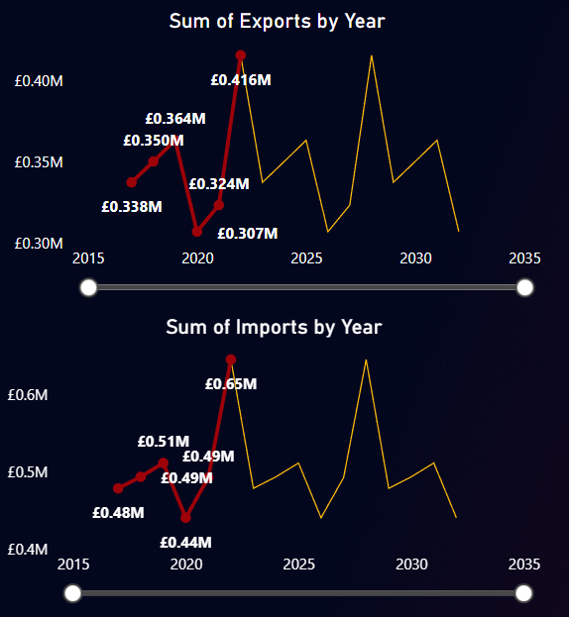
Line Chart
Line chart used to visually represent exports and imports volume over years.
Enables concurrent time series analysis within one graphical representation.
Line charts are crucial for discerning seasonal fluctuations, long-term trends, and cyclic patterns.
Highly effective for understanding variable evolution over time.
Particularly useful for highlighting correlations and continuity between data points.
The slope between two points on the chart provides pertinent information.

Slide 9
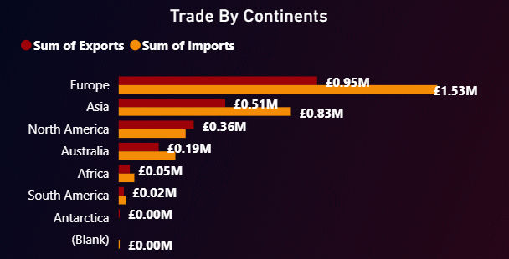
Clustered Bar Chart
Clustered Bar Chart used for visualizing total import and export from the UK to various countries.
Chosen for its unparalleled relevance in comparing data of similar nature.
Explains the decision against using two separate pie charts for import and export data due to increased dashboard space.
Opted for the efficiency and clarity of the Clustered Bar Chart over the less optimal choice of two distinct pie charts.

Slide 10
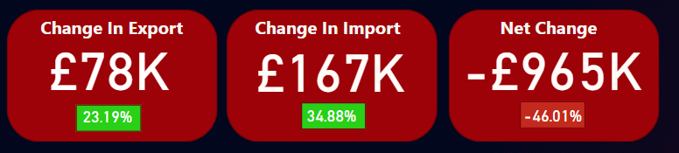
KPIs in Card View
Simple Card View utilized for displaying Key Performance Indicators.
Serves as a succinct snapshot of targeted data for swift and effortless analysis.
Enables the creation of interactive dashboards.
Facilitates seamless sharing of key metrics and insights with colleagues across the organization.

Slide 11
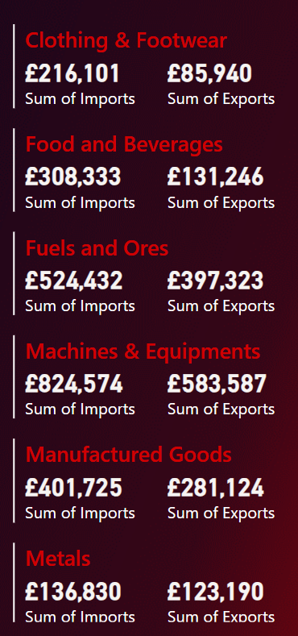
Multi-Row Card
Used Multi-Row Card for highlighting the contribution of diverse industries in total import and export.
Multi-Row Card facilitates the display of multiple values in a unified format.
Streamlines the summarization and comparison of distinct metrics within a singular visual representation.
Enhances accessibility of insights by presenting various metrics or Key Performance Indicators in a succinct and well-organized manner.

Slide 12
Dashboard
Click here to view dashboard.

Slide 13
Results and Conclusion
Net Export value is negative which implies United Kingdom is in trade deficit.
The forecast for exports/imports shows that exports/imports in future will remain almost equal.
It will be difficult to beat inflation.
There should be a change in trade policies.
Significant steps should be taken to increase exports.
Deep analysis based on Industry type and countries can be carried out using this dashboard to frame trade policies.

Slide 14

Thank You

