Slide 1


Digital Transformation Journey
12

Slide 2
12
AGENDA
1
Client Introduction
2
Digital Transformation Use Cases
3
Client Issue
4
Salesforce Benefits
5
Proposed Solution
6
Architecture
7
Impact

Slide 3
12
INTRODUCTION
Since launching in early 2015, Jerry’s has grown and adapted their setup to form tight-knit team that is running the day to day operations of the brewery. Their motto is to never stop improving; they’re always learning and tweaking the beer designs to create the best beer they possibly can, packaged into only kegs and cans to optimise freshness and keep the beer tasting as fresh as it does from the source.
Our passion is to create hop-forward, modern styles of beer; with an emphasis on freshness. We’ve developed and grown our Originals range, the core of our output since day one, to a high level of consistency. From this we’ve been able create the Augment range – the next step in our brewing journey. Our journey doesn’t stop here though; we are always looking to push ourselves, exploring new styles and brewing techniques to test ourselves as brewers – our next port of call being our first ever barrel-aging project.

Slide 4



12
USE CASES
Digital
Experience
Demand
Generation
Orchestration /
Marketing Automation
Journey-based Content Personalization
Re-targeting on Alternate Channels
Suppression: Omni-channel experience
Cross-sell based on Product Ownership
Buyers Journey: Email steps post specific interest
Re-engage Prospects
Automated Journeys
Scoring & routing
Realize Digital Potential and Drive Digital Advantage

Slide 5
12
ISSUE
Jerry’s Brew Co has struggled to connect with its consumers across all digital touch points (i.e. email, web, social and mobile) and are lagging behind competitors in the realm of media optimization, marketing analytics, and data-driven customer experiences.
The company wanted to implement a scalable Marketing automation solution to enable its brands to interact with customers more
meaningfully. The goal was to ensure that consumers’ multi-channel communication needs would be met both today and in the future.

Slide 6
12
Why Salesforce?
By integrating Salesforce Marketing Cloud and Salesforce Audience Studio with their existing digital channels, Jerry’s Brew Co will be able to
Drive 1-1 multi channel customer journeys from Journey Builder by creating custom journey activities that allow for user flow based on loyalty membership
Enable Social listening to understand the brand sentiment using Social Studio
Capture user attributes and behavior data using Audience Studio
User segmentation in Audience Studio is activated using Ad Studio in SFMC and personalized user targeting is done
Real time personalization based on the asset metadata and asset performance data using the Content Builder SDKs

Slide 7


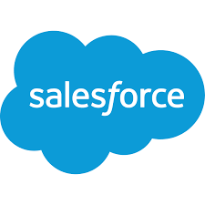

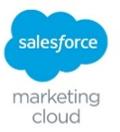
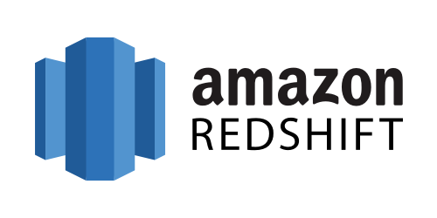




12
New Systems
New Integration
SOLUTION DESIGN
Existing Integration
Existing Systems
via. Tag Management Solution / analytics tracking pixels
website
CMS + DAM
Online Data Collection
AEM Server
Personalized
Content
Data feed
Landing
Page
API Integration
CRM
PAID MEDIA
(SEARCH, DISPLAY, SOCIAL)
MARKETING AUTOMATION
Lead create / update
Outbound Marketing
Data feed
Data
Cleansing /
Touch
Governance
AWS REDSHIFT DB
EMAIL
Outbound Email
Data Input
DMP
Data feed
Reporting Layer
Outbound Activation Channels
2nd Party
3rd Party

Slide 8
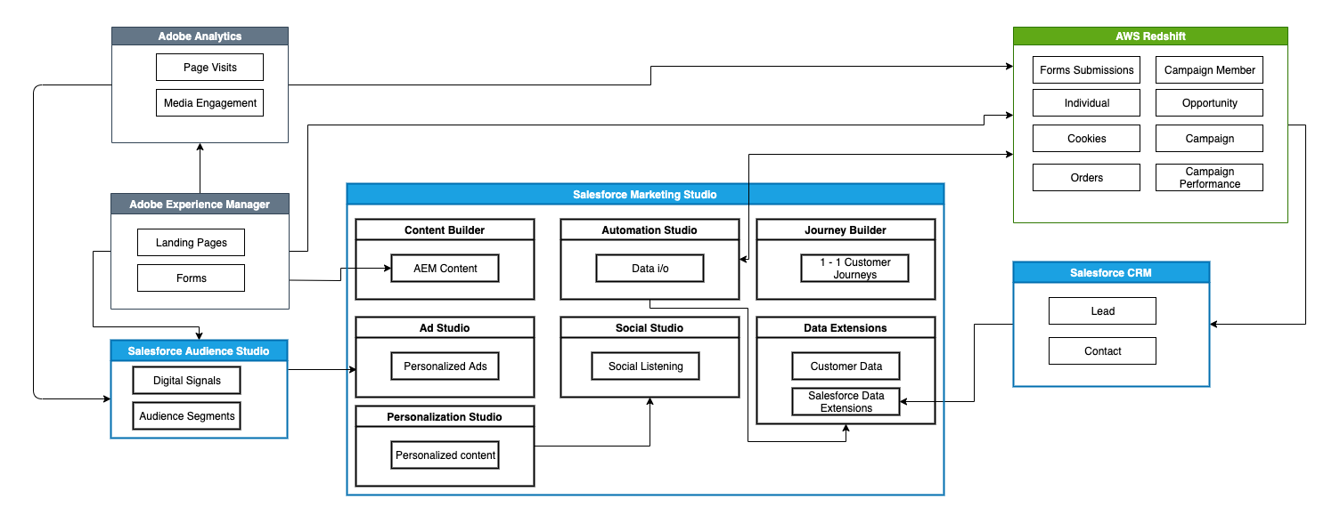
12
SYSTEM ARCHITECTURE

Slide 9
12
IMPACT
The proposed solution will allow Jerry’s Brew Co to orchestrate multi-channel communication initiatives for its consumers through a single platform. This will enable them to efficiently scale digital marketing efforts, reduce advertising waste, lessen unnecessary marketing costs, and facilitate remarketing expansions.

Slide 10

12

Slide 11
Thank You

