Slide 1

Bicycle Crowd Evaluation
Quality Match- Bicycle Crowd Evaluation
By: AKSHAY KATYAL
Date: 20th September 2021

Slide 2

Table of Contents
Task1
Task 1a
Task 1b
Task 1c
Task 1d
Task 2
Task 3
Task 4

Slide 3
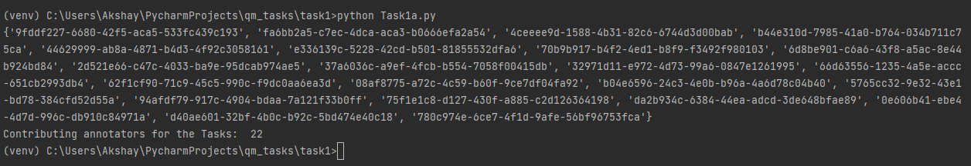
Task- 1a
The total number of the annotators are 22
These are given as by id:
Each annotator has a unique-ID

Slide 4
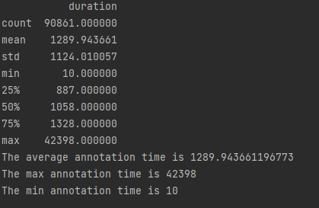
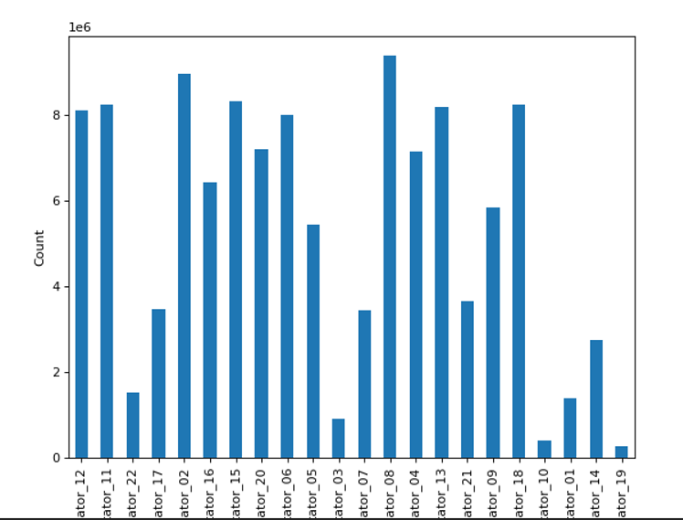
Task- 1b
Getting the avg, min, and max durations
The data here has negative duration that is not possible. So cleaning the data first.
Annotations Time plot using the user-id

Slide 5
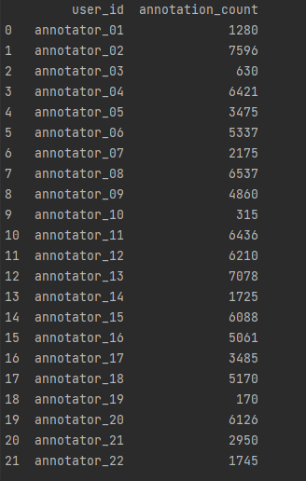
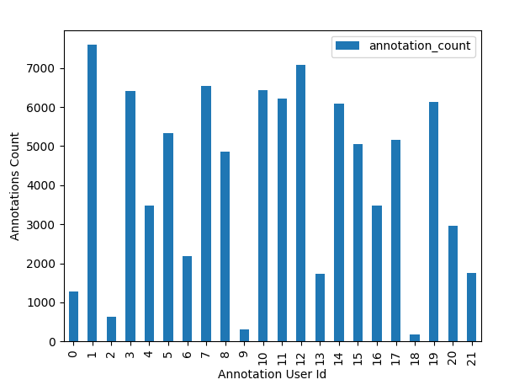
Task- 1c
Getting annotators result
Checking the difference- There is a difference in each annotations
Annotations plot difference

Slide 6
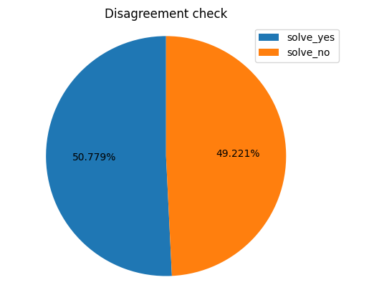
Task- 1d
Checking disagreement
Yes there are some questions for disagreement given by pie chart
There are 49% questions for disagreement

Slide 7
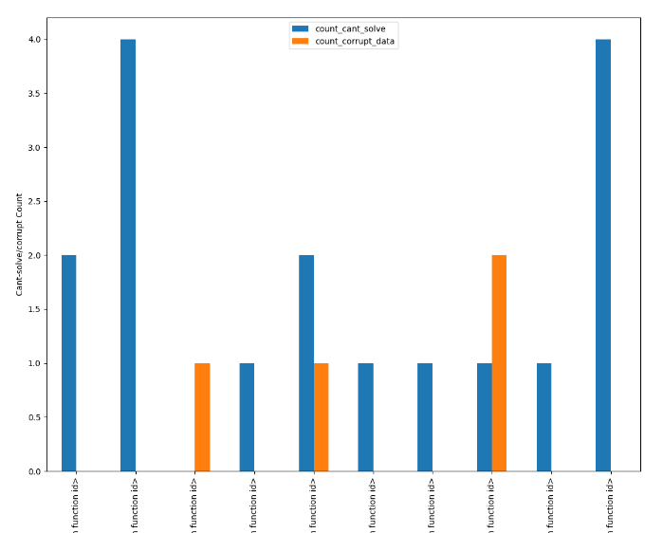
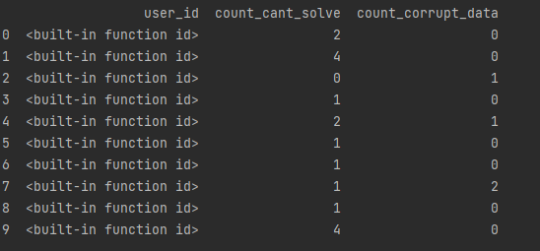
Task-2
Checking for can’t solve and corrupt data
Plot for can’t solve and corrupt data- the amount of corrupt data is less
Each sample is unique

Slide 8
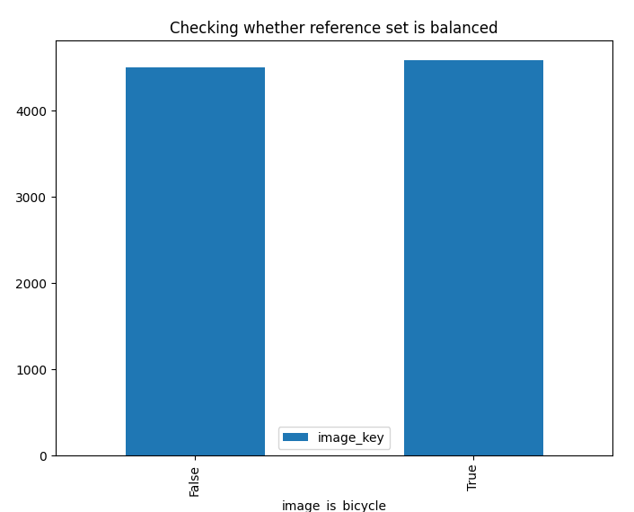
Task-3
The data set has:
False: 4501
True: 4586
Conclusion: Dataset is balanced

Slide 9
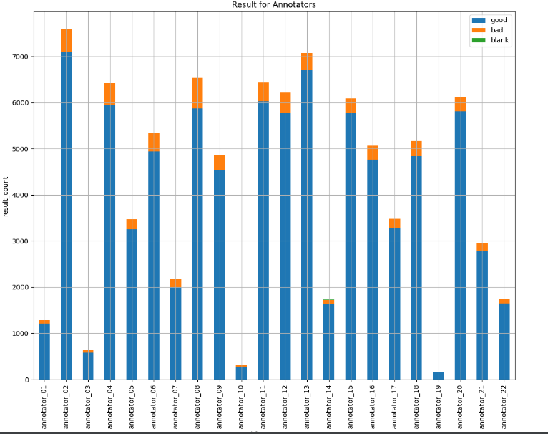
Task-4
Getting the good and bad annotators
The good annotators are 02, 13, 20 as their average is high
The bad annotator here is the annotator 08 it has low accuracy

Slide 10
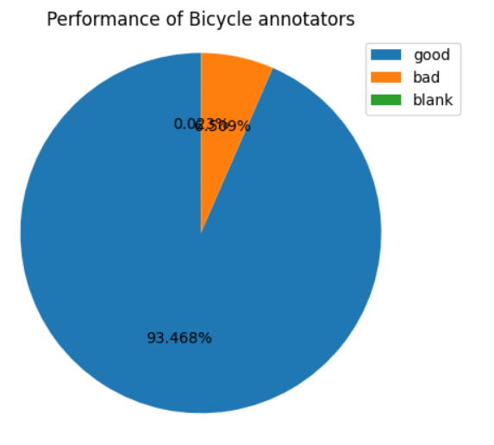
Task-4
Mean performance for annotators:
93.468% are good annotators
6.5% are bad annotators

Slide 11
Thank you for your Attention!
Questions??

