Slide 1


Wealth Management Platform
Hackdata 2.0
BACKEND FUNCTIONALITY USING:
HASURA

Slide 2

Wealth Management Technology That Helps You See and Manage the Big Picture
Importance of Wealth Planning:

Slide 3
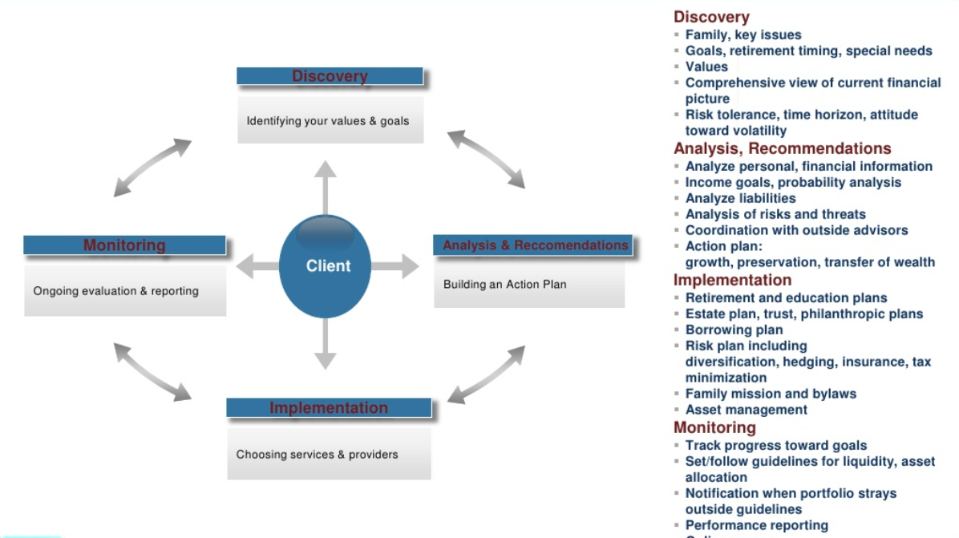

Slide 4
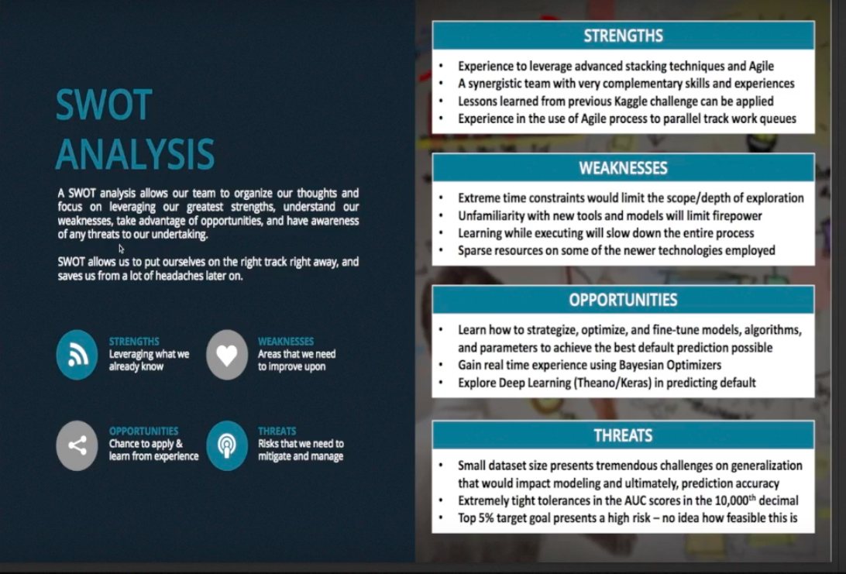
Add a Slide Title - 1

Slide 5
OUR MAIN FEATURES:
Loan Prediction
Training a model using Decision Tree
Plan and Manage your Wealth
Set Goals and automaticaly know which you can achieve.
Get Recommedations on how to fund left out goals.
Get Instant Answers from out CHATBOT
A well trained CHATBOT.
Reduction of Raw data Using ApachePIG
Clear all queries relating to insurance to get maximim benefit.

Slide 6
LOAN PREDICTION
The Importance Of Your Credit Rating
People have become increasingly dependent on credit. Therefore, it's crucial that you understand personal credit reports
and your credit rating (or score). Here we'll explore what a credit score is, how it is determined, why it is important and,
finally, some tips to acquire and maintain good credit.

Slide 7
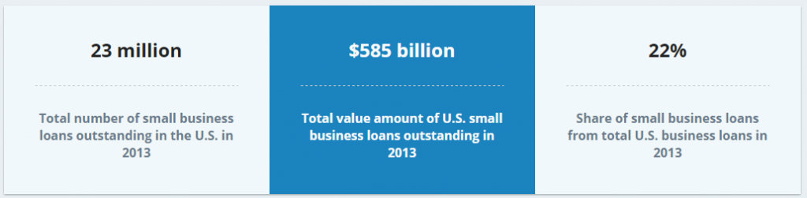
IMPORTANCE OF LOAN PREDICTION:
Your Chances of Getting a Small Business Loan
Based on some data from Fundivo, there are 23 million business loans outstanding in the US totaling nearly $600 billion in outstanding loan balances. But the problem is that for every small business that is able to get a small business loan there are probably several that can’t! According to a report from Biz2Credit the average loan approval rate for small business loan applications was just under 12% in 2015, so clearly many small business owners wast a lot of time applying for loans that they ultimately don’t get.

Slide 8
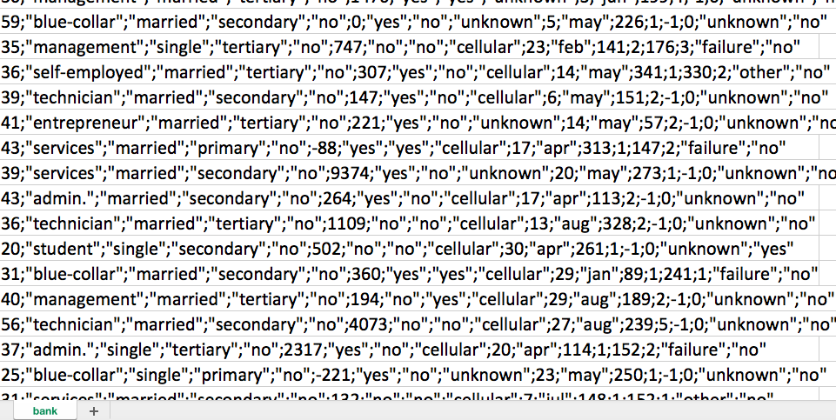
STEPS IN OBTAINIG A USEFUL DATA SET USING APACHE PIG COMMANDS AND GET DATA TO UNDERSTANDABLE FORM USING PIG UDF’s:
FIRSTLY ,
WE MOVE THE RAW DATA SET TO HDFS.
THEN WE RUN THE FOLLOWIG COMMANDS TO OBTAIN A SUBSET OF IT.
FINALLY OUR UDF REMANES THE VARIABLES SO THAT WE CAN EASILY ANALYSE THE RQUIRED DATA USING PYTHON.
UNPROCESSED DATA

Slide 9

FINAL CLEANED DATASET
So rather than spend days gathering all of your company documents,
financial statements, tax returns, etc in order to apply for
a small business loan, just to get denied, why don’t you spend
A few minutes with us predicting your chances of approval with our
LOAN PREDICTING SYSTEM.

Slide 10
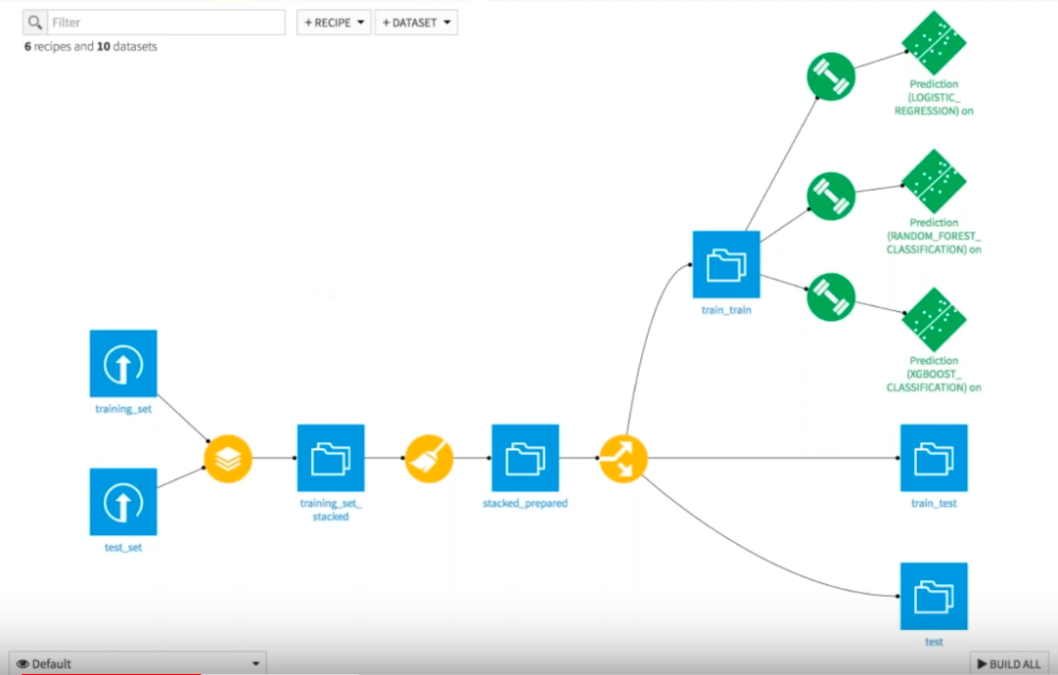

Slide 11
DIFFERENT MODELS WHICH WE TRIED TO PREDICT LOAN GRANT:
FACTORS CONSIDERED:
GENDER
MARRIED
EDUCATION
LOAN AMOUNT
CREDIT HISTORY
PROPERTY AREA
TOTAL INCOME (APPLICANT+COAPPLICANT)
MODEL | ACCURACY | CROSS VALIDATION SCORE
LOGISTIC REGRESSION | 79 | 69
RANDOM FOREST | 85 | 68
DECISION TREE | 88 | 85

Slide 12

IMPORTANCE OF EASY DATA COLLECTION:
Monitoring and evaluation is important for project management and maintaining (for example by demonstrating impact). Here's how to make data collection easy in any organisation.
Technology Imitates Art
SO WE MAKE USE OF : The conversational user interface [CUI]
USING TYPEFORM

Slide 13



Slide 14
Add a Slide Title - 5

