Slide 1
The Case For
moving Congestion Control
Out Of the Datapath
Akshay Narayan, Frank Cangialosi, Prateesh Goyal, Srinivas Narayana, Mohammad Alizadeh, Hari Balakrishnan
MIT CSAIL
Notes:
what capabilites does the datapath need to support?
what are the limitations of sending the datapaths UDFs?

Slide 2
Congestion Control
DCQCN
TIMELY
DCTCP
pFabric
Hybla
NV
RC3
Algorithms
Westwood
FAST
RCP
Sprout
ABC
EBCC
Binomial
XCP
Illinois
Remy
Vegas
Eifel
Veno
LEDBAT
PRR
PCC
NewReno
Compound
BIC
H-TCP
Cubic
BBR
1987
Kernel
netFPGA
netmap
QUIC
2017
Datapaths
SmartNICs
mTCP (DPDK)
Notes:
So, congestion control has now been a thing for 30 years - you can take this opportunity to either be awed, or recoil in horror - but either way, people still keep working on it. In fact this is the first of four consecutive talks you’re going to hear on the subject.
Meanwhile, of course, what I’m going to refer to for the rest of this talk as the “datapath” - the transport layer and below - they haven’t been standing still. This makes sense - applications have different requirements, and just using the send syscall was never going to work for everybody.
So before we had just the operating system, now we have hardware acceleration (I’m going to gray out netFPGA, netmap, and SmartNICs because as far as I know, they haven’t been used to implement application-facing datapaths, but you could imagine them being used this way), google’s UDP-based quic, and the recent mTCP work based on DPDK.
However, as we’ll see, the support matrix of algorithms to datapaths is rather sparse.
By the way, this diagram is neither to scale nor exhaustive :)

Slide 3
Congestion Control
DCQCN
TIMELY
DCTCP
pFabric
Hybla
NV
RC3
Algorithms
Westwood
FAST
RCP
Sprout
ABC
EBCC
Binomial
XCP
Illinois
Remy
Vegas
Eifel
Veno
LEDBAT
PRR
PCC
NewReno
Compound
BIC
H-TCP
Cubic
BBR
1987
Kernel
netFPGA
netmap
QUIC
2017
QUIC
Datapaths
SmartNICs
mTCP (DPDK)
mTCP (DPDK)
Notes:
The Linux kernel datapath has been around the longest, and most applications use it. So, it makes sense that many algorithms have been implemented on it.
However, there are some notable absences. If you want to run Compound, you’re out of luck unless you use Windows. Similarly, recent proposals like Remy are absent, and only exist in UDP form.
BBR, of course, exists - but we don’t all have google’s implementation resources, nor do we necessarily have the patience to deal with upstreaming anything into linux.

Slide 4
Congestion Control
DCQCN
TIMELY
DCTCP
pFabric
Hybla
NV
RC3
Algorithms
Westwood
FAST
RCP
Sprout
ABC
EBCC
Binomial
XCP
Illinois
Remy
Vegas
Eifel
Veno
LEDBAT
PRR
PCC
NewReno
Compound
BIC
H-TCP
Cubic
BBR
1987
Kernel
netFPGA
netmap
QUIC
2017
Datapaths
SmartNICs
mTCP (DPDK)
Notes:
Speaking of google’s implementation resources, on QUIC you have even less choice.

Slide 5
Congestion Control
DCQCN
TIMELY
DCTCP
pFabric
Hybla
NV
RC3
Algorithms
Westwood
FAST
RCP
Sprout
ABC
EBCC
Binomial
XCP
Illinois
Remy
Vegas
Eifel
Veno
LEDBAT
PRR
PCC
NewReno
Compound
BIC
H-TCP
Cubic
BBR
1987
Kernel
netFPGA
netmap
QUIC
2017
Datapaths
SmartNICs
mTCP (DPDK)
Notes:
And if you use mTCP, a recent datapath implemented on top of DPDK, you have no choice - only NewReno is supported.
Of course, this isn’t the fault of either the datapath developers or the congestion control algorithm developers - in practice, new datapaths implement only a few algorithms because it’s hard to do so.
As an example, the BBR QUIC implementation started after the Linux implementation was done, and took several months.
Now consider a similar effort to bring a new congestion control algorithm to a hypothetical FPGA datapath - the work adds up.
Ultimately, the unfortunate effect of this is that as new datapaths emerge, its developers will tend to bake-in a few select algorithms.
On the congestion control side, researchers usually don’t take on the difficult task of writing a full Linux kernel or QUIC implementation of their fancy new algorithm, because it’s difficult to do so.

Slide 6
Narrow Waist
Congestion Control
RTT
Rates
Header Information
Windows
Rates
Datapaths
Notes:
What we’re therefore proposing is an API for congestion control that removes it from the datapath.
Our argument is that a few control primitives such as window and rate enforcement, and a fixed set of primitives to compute per-packet measurements, are enough for a diverse variety of congestion control algorithms.
This API could then become the “narrow waist” of congestion control, allowing independent evolution of algorithms and datapaths.
Importantly, in this architecture, writing a congestion control algorithm is a one-time effort. Implementations are reusable across datapaths.

Slide 7
Primitives
Signal | Protocols
ACKs | Cubic, DCTCP, NewReno
Loss | Cubic, DCTCP, NewReno, PCC
RTT | BBR, Remy, Sprout, TIMELY, Vegas
Rates | BBR, PCC, Remy, Sprout
ECN | ABC, DCTCP
Notes:
To convince you that the waist is actually narrow, this is a list of some recent protocols.
All these protocols use some function of ACK clocking, RTT, and loss, (yes, DCTCP also uses ECN).
And of course, all of them enforce either a congestion window or a rate.

Slide 8
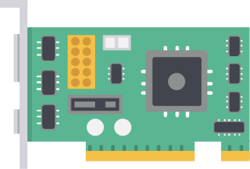
congestion control plane Design
Off Datapath
Asynchronous
BBR
Application
Reno
Cubic
Data
CCP Algorithm
API
CCP Datapath
API
Datapath
Data
Without compromising performance
Notes:
So, the key feature of our architecture is that congestion control is off the datapath.
We call this distinct module a “congestion control plane”.
However, this comes with an obvious tradeoff - there’s now latency involved in receiving information from and sending decisions to the datapath.
There are two potential downsides here: first, the behavior of your algorithm might be compromised, and second, you might get less performance.
To address the performance question, we use the standard trick of batching information. Now, it’s reasonable to expect uncompromised performance because congestion control is happening asynchronously: communication happens only once or twice per RTT, *not* upon every packet.
Furthermore, once or twice an RTT happens to be the natural timescale of congestion control - since once you send a packet, it takes one RTT to observe what happened to it. So, intuitively, algorithm behavior should be unaffected, and I can show you a graph to this effect later in the talk.
For the rest of the talk, I’ll discuss our idea of the structure of these two APIs, and end with some open questions.

Slide 9
Algorithm API
Event Handler
fn OnMeasurement(m: Info) {
}
Notes:
The API to implement a congestion control algorithm consists of two primary event handlers: OnMeasurement and OnUrgent.
An Urgent event is something defined by the datapath, possibly in a programmable way, as needing a reaction as soon as possible.
An OnMeasurement event is for handling the common-case batch of measurements.
I’ll walk through an example OnMeasurement function for TCP NewReno’s congesiton avoidance mode.

Slide 10
Algorithm API
Event Handler
fn OnMeasurement(m: Info) {
}
State Update
newlyAcked = m.Ack - lastAck;
cwnd += newlyAcked / cwnd;
Notes:
In an event handler, an algorithm can access measurement information, and update internal state accordingly.
Here, Reno performs an additive increase to its view of the congestion window.

Slide 11
Algorithm API
Event Handler
fn OnMeasurement(m: Info) {
}
State Update
newlyAcked = m.Ack - lastAck;
cwnd += newlyAcked / cwnd;
run_on_datapath(
SetCwnd(cwnd) => WaitRtts(1.0) => Report()
);
Decision
Notes:
Finally, an algorithm specifies what the datapath should do using a control pattern.
Here, we tell the datapath to set the congestion window, gather measurements for an RTT, then send that next batch of measurements after the wait time has elapsed.
This is the control loop of our algorithm: we process a measurement, update state, and tell the datapath when to send the next measurement.
Here, the idea of specifying a sequence of instructions to the datapath when making a decision is important because it allows users to specify the duration over which measurements should be made, and also specify sending patterns.
For example, BBR uses rate pulses, in which it sends at a high rate for one RTT, a low rate for the next RTT, then its estimate of the bottleneck rate for the following 6 RTTs. Using a control sequence, a BBR implementation in CCP can express this behavior directly without extra involvement from the CCP.

Slide 12
Difficulty of datapath Programming
fn OnMeasurement(m: Info) {
}
let K = pow(max(0, WlastMax - cwnd) / 0.4), 1/3)
cwnd = WlastMax + 0.4 * pow(t - K, 3)
net/ipv4/tcp_cubic.c
175 /* calculate the cubic root of x using a table lookup followed by one
176 * Newton-Raphson iteration.
177 * Avg err ~= 0.195%
178 */
179 static u32 cubic_root(u64 a) // 40 lines of code
Notes:
Because CCP is not part of the datapath, we can put it where we want.
And importantly, locating things in the kernel means that developers are beholden to the kernel upstreaming process - which is, to say the least, annoying.
So we propose locating CCP in userspace.
This has the key advantage of being far easier to program - the linux kernel implementation of TCP Cubic can’t perform floating point operations, and must hack around that limitation, while the CCP implementation is much simpler.
More broadly, locating congestion control algorithm implementations away from the datapath enables both the use of popular libraries (like neural nets), and reduces the implementation’s performance requirements since decisions are made infrequently.

Slide 13
Datapath Api
BBR
Application
Reno
Cubic
Data
CCP Algorithm
API
CCP Datapath
API
Datapath
Data
How to collect measurements?
Notes:
Now let’s move on to the datapath API.
The interesting question here is measurement collection; before, this was unnecessary because the algorithm had access to all datapath state.
Instead, we now have to pick a selection of things we’re going to provide as inputs.
Of course, as with everything, there are tradeoffs here. I’m going to present two options: the first provides more flexibility, the second more performance.

Slide 14
Vector Batching
BBR
Application
Reno
Cubic
Data
CCP Algorithm
API
CCP Datapath
API
Datapath
Pkt1|PKT2|…
Store per-packet information
Send vector of measurements to CCP
Compute RTT, Rates, etc in CCP
Notes:
We call this first option “vector batching”.
Basically, the datapath keeps track of send and receive times per packet, as well as relevant header information like whether there was an ECN.
This vector of information is then shipped to CCP when requested, and higher-level measurements (such as the RTT and receive rate) are re-constructed there.
From the algorithm’s perspective, this is great: you get access to all the information you had access to before, except it’s provided in a structured way and after a slight delay.
And from the datapath’s perspective, the logic is simple: just store some information. The main problem, of course, is that the datapath must store per-packet information, which might be prohibitively expensive.
vectors:
Batch per-packet send and receive times in the datapath
Re-construct flow measurements from packet log in CCP
Equivalent to adding a small amount of latency to the connection
Datapath must store per-packet information

Slide 15
In-Datapath Aggregation
BBR
Application
Reno
Cubic
Data
CCP Algorithm
API
CCP Datapath
API
Datapath
State
fold(state, pkt)
PKT
Expose primitives to user-defined fold
Compute state aggregate in datapath
Notes:
The second way is what we call “in-datapath aggregation”. Here, the algorithm supplies to the datapath an initial state, and a function which tells the datapath how to update that state given the arrival of a new packet’s worth of measurements.
Because this method requires the datapath to run user-defined code specifying the measurements, the datapath is a little more complicated than in the previous option: it must expose some measurement primitives to the fold function.
Thankfully, these measurement primitives already exist in datapaths today: the same RTT, Rate, and packet header information we know and love.
Meanwhile, a big advantage of this scheme is it only asks the datapath for a constant amount of per-*flow* memory - just enough to store the measurement state.
folds:
Store a small amount of per-flow state in the datapath
Specify how to mutate this state in response to new data
Datapath must expose some primitives
“in-datapath aggregation”
explain separately the need for batching vs the memory savings of using a fold

Slide 16
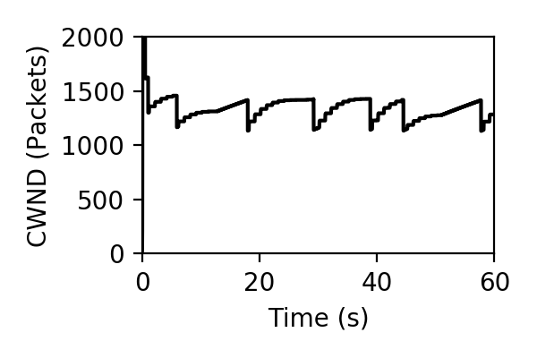
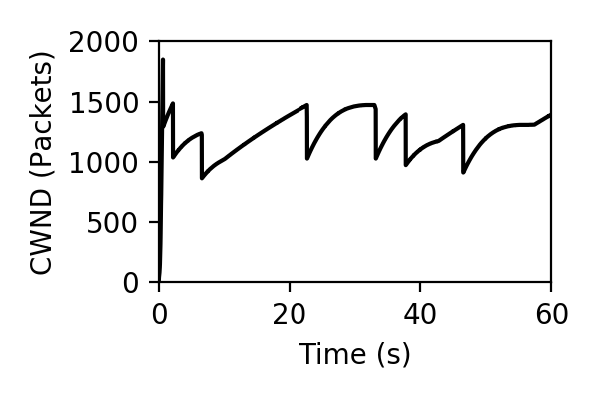
congestion window dynamics
CCP
Linux
Overall, the window evolution is similar
Notes:
Now, what could have gone wrong with this design? The main tradeoff we’re making is that we make decisions infrequently, so maybe the algorithm behavior changes.
In fact, our implementation of Cubic, which operates once an RTT, matches the overall evolution of Linux when we run both on the same real path.
And, you can see the paper for some more results comparing the reactivity dynamics and performance at link rates up to 10G.

Slide 17
IMplications
Velocity of congestion control research
New algorithms
Flexibility need not preclude performance
Notes:
Overall, we see two main benefits of the CCP architecture.
On the congestion control side, I’ve argued that CCP makes it easier to develop, test, and deploy new algorithms. Is PCC in fact better than Remy? Instead of reading Alexander Hamilton and Aaron Burr argue about it in a hotnets paper, we think both algorithms could be implemented and run in real life. This should be a method of evaluation available to people who happen to not be employed at Google.
On the datapath side, our argument is that if you pay a little extra development cost in your datapath, you can reap significant gains in supporting new congestion control algorithms.

Slide 18
Open Questions
BBR
New algorithms?
Hardware support for CCP primitives?
Low-RTT paths
Make decisions less frequently?
APP
Reno
Cubic
Data
Algorithm
API
Datapath
API
Datapath
Data
github.com/mit-nms/ccp
Notes:
Moving forward, we see three interesting questions that I’d like to use to frame the discussion.
First, now that algorithms are freed of the datapath, what new tricks can we play? Can we do more complicated processing to extract more from the network?
Second, I mentioned SmartNICs and netFPGA at the beginning of this talk - can we build fast datapath using hardware acceleration with support for CCP primitives?
And finally, there’s the question of low-rtt paths. The tradeoff CCP makes starts becoming important here - if datapath to CCP communication has the typical IPC latency of around a few microseconds, then this assumption we’ve made of once-an-rtt control starts breaking down in, for example, datacenter environments.
One way to adapt to this environment is to decide that your algorithm absolutely needs a fast control loop (like with RDMA, where there’s sometimes no software involved at all).
You give up some flexibility, and pay attention to the next talk where Mina has been working on a way to make your algorithm run on a programmable NIC directly.
However, we think that for many algorithms, we can make decisions even less often than once-an-RTT, and still use CCP.

