Slide 1
PORTFOLIO PROJECT · DATA ANALYTICS
PlayWave Customer Churn Analysis
Turning 221 subscriber records into a revenue-at-risk model that tells Retention exactly who to save first — and why they're really leaving.
35.29% churned · escalation–churn correlation just r = 0.08 · $1,715.22/mo in revenue already lost
Akshay Kolte | Data Analyst
SQLite · SQL · Python (pandas) · Matplotlib · Seaborn
PlayWave is a fictional company created for this portfolio project. Dataset is synthetic; any resemblance to a real company is coincidental.

Slide 2
WHY I BUILT THIS
Business Context & Problem
Business Context
Problem Statement
I modeled this project on PlayWave, a subscription streaming platform across India and Nepal offering Basic, Standard, and Premium tiers on Monthly and Annual contracts, acquiring subscribers through paid marketing, organic search, and referrals.
It's the kind of business where cancellations fluctuate quarter to quarter with no single, unified view of who's leaving or why.
Without a consolidated view, retention, support, and pricing decisions get made without evidence. I designed this project to answer, with numbers:
• Which plans & geographies are highest-risk?
• How much MRR is exposed?
• Is the top complaint driver something support can actually fix?
Here's the end-to-end analysis I built to answer all three.
PlayWave Churn Analysis · Akshay Kolte
2 / 10

Slide 3
HOW I GOT THERE
Data & Methodology
1
2
3
4
Extract
Clean
Join & Engineer
Analyze & Visualize
Loaded 3 SQLite tables (Customer Master, Subscription, Support) into pandas via SQL queries.
Renamed columns, dropped irrelevant fields, fixed date dtypes, standardized categories, imputed missing country from state.
Deduplicated support records, joined all sources into 221 customer records, engineered churn_flag, tenure_days, and Low/Med/High churn-risk tiers.
Computed KPIs via groupby/pivot tables; visualized with Matplotlib & Seaborn — trend lines, bar charts, boxplots, a correlation heatmap, pairplot, and catplot.
Data sources joined on customerid: Customer Master · Subscription · Customer Support
PlayWave Churn Analysis · Akshay Kolte
3 / 10

Slide 4
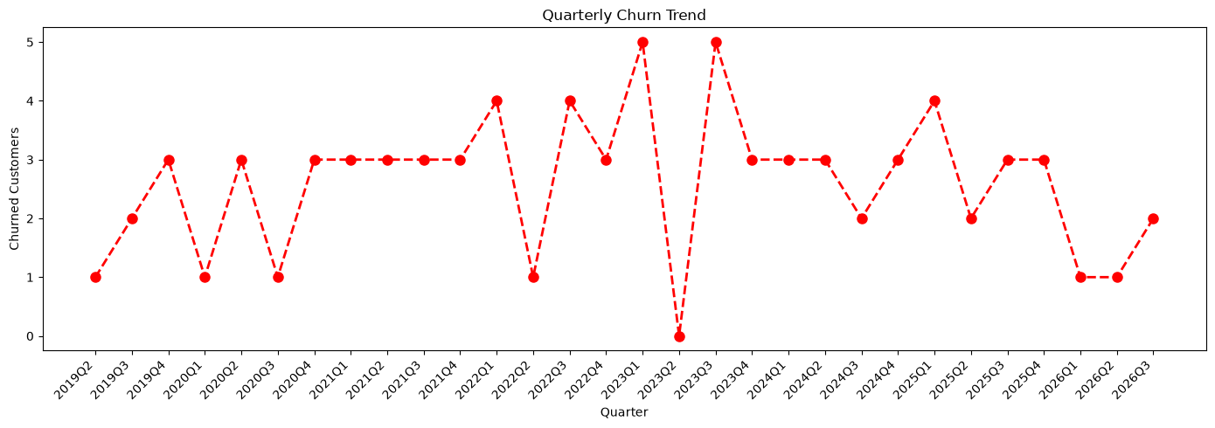
QUESTION 1
Churn & Retention Snapshot
35.29%
64.71%
221
78
Churn Rate
Retention Rate
Customers Analyzed
Churned Customers
So what
Roughly 1 in 3 subscribers has cancelled. Quarterly churn is noisy with no single dominant spike — consistent with ongoing price/content friction rather than a one-off event.
PlayWave Churn Analysis · Akshay Kolte
4 / 10

Slide 5
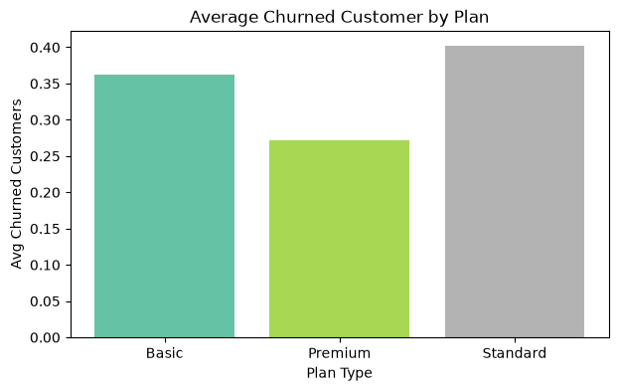
QUESTION 2
Churn by Plan & Contract Type
Standard 40.24%
Basic 36.25% · Premium 27.12%
Annual 37.38%
vs. Monthly 33.33%
So what: Standard-plan, Annual-contract subscribers are the highest-value group to protect — enough churn to feel it, enough tenure left to make retention worthwhile.
PlayWave Churn Analysis · Akshay Kolte
5 / 10

Slide 6
QUESTION 3
Why Customers Say They're Leaving
Quick Win
18 customers
forgot to cancel their trial.
That's a process fix, not a product problem — a pre-conversion reminder and a one-click cancel path is the fastest, cheapest win in this dataset.
PlayWave Churn Analysis · Akshay Kolte
6 / 10

Slide 7
QUESTION 4
Revenue at Risk
$1,715.22
$21.94
$3,134.57
$1,439.62
Revenue Lost / mo
ARPU
MRR (Active Users)
Avg. CLTV
Revenue at Risk by Plan × Churn-Risk Tier (monthly charges)
Plan | Total Charges at Risk | High-Risk Tier
Standard | $1,891.18 | $685.73
Basic | $1,843.20 | $514.75
Premium | $1,115.41 | $217.84
So what: Standard plan carries the single largest high-risk exposure — the first stop for proactive retention outreach.
PlayWave Churn Analysis · Akshay Kolte
7 / 10

Slide 8
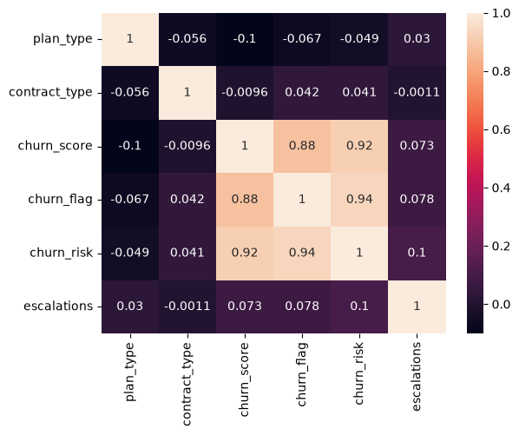
QUESTION 5
Support Isn't the Churn Driver
r = 0.08 escalation ↔ churn correlation
Escalation rate 13.12% · Avg CSAT 49.46 · Avg complaints/user 0.46
So what
Support quality is effectively unrelated to whether someone churns. The heatmap confirms churn_score (r = 0.88–0.94) — not escalations or CSAT — is what actually tracks with cancellation. Retention budget belongs in pricing and content, not support headcount.
PlayWave Churn Analysis · Akshay Kolte
8 / 10

Slide 9
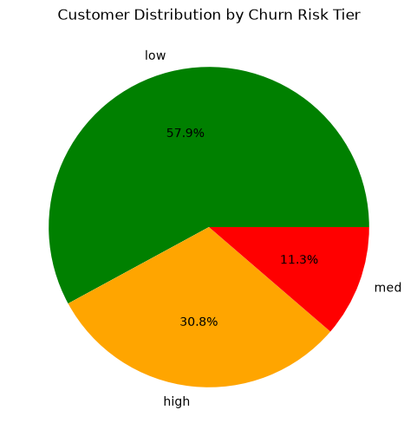
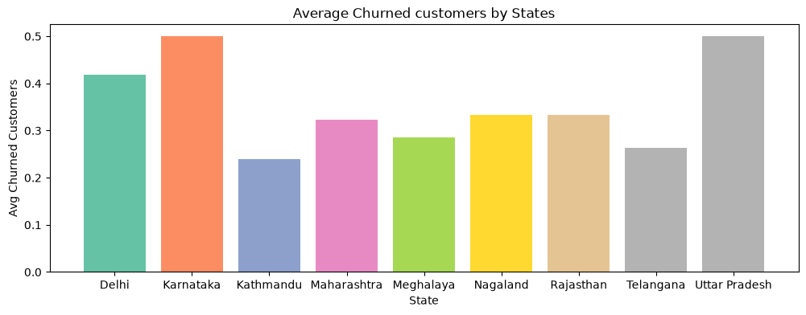
QUESTION 6
High-Risk Segments & Geography
Karnataka (50.00%) and Delhi (41.86%) churn highest; Kathmandu (24.00%) is the most stable market.
30.8% of customers already sit in the High-Risk tier.
Acquisition channel: Referral 38.81% · Paid 37.50% · Organic 30.49% — organic subscribers churn least.
PlayWave Churn Analysis · Akshay Kolte
9 / 10

Slide 10
WHAT TO DO NEXT
Recommendations
1
Prioritize Standard-plan, Annual-contract outreach
Highest churn (40.24%) and largest high-risk exposure ($685.73) — reach out proactively before renewal.
2
Fix the trial-cancellation flow first
18 cases lost to a process gap — add a pre-conversion reminder and one-click cancel. Fastest win available.
3
Redirect budget from support to price & content
Escalation-churn correlation is only 0.08 — "too expensive" and "not enough content" are the real levers.
4
Sequence High-Risk outreach by revenue
30.8% of customers are High-Risk — work Standard, then Basic, then Premium, in that order.
5
Pilot fixes in Karnataka & Delhi first
These states churn well above the 35.29% baseline — the fastest place to prove a fix works.
Prepared by Akshay Kolte · Data Analyst

