Slide 1
PORTFOLIO PROJECT • DATA ANALYTICS
Customer Shopping
Behavior Analysis
Turning 3,900 transactions into customer insight and business recommendations
PYTHON
SQL / POSTGRESQL
POWER BI
Data Analytics Portfolio Project

Slide 2





WHAT THIS PROJECT COVERS
From Raw Data to Business Decisions
The Business Problem
01
Why the company needed this analysis
The Approach
02
Python data prep → SQL analysis → Power BI dashboard
Key Findings
03
Ten SQL queries answering real business questions
Interactive Dashboard
04
A self-service Power BI view for stakeholders
Recommendations
05
Five concrete, data-backed next steps
02

Slide 3
BUSINESS PROBLEM
Why This Analysis Matters
A leading retail company noticed shifting purchase patterns across demographics, product categories, and channels. Leadership needed to know which factors — discounts, reviews, seasonality, payment preferences — actually drive purchases and repeat business.
"
How can the company leverage consumer shopping data to identify trends, improve customer engagement, and optimize marketing and product strategies?
MY ROLE
Clean & model the raw data (Python)
Design & run the SQL analysis
Build the Power BI dashboard
Report findings & recommendations
— THE OVERARCHING BUSINESS QUESTION
03

Slide 4


THE APPROACH
A Three-Layer Analytics Pipeline
PYTHON
SQL
POWER BI
Data Preparation
→
Structured Analysis
→
Visualization
Cleaned 3,900 rows, imputed ratings by category median, engineered age_group & purchase_frequency_days fields.
Loaded into PostgreSQL; wrote 10 queries answering targeted revenue, loyalty & product questions.
Built an interactive dashboard with slicers so stakeholders can self-serve without writing queries.
04

Slide 5
DATA PREPARATION
Getting the Data Analysis-Ready
3,900
18
37
Transaction Rows
Original Columns
Missing Ratings Imputed
KEY CLEANING STEPS (PYTHON / PANDAS)
Filled missing review ratings using each product category's median (not a global average)
Standardized column names to snake_case; renamed purchase amount field for consistency
Engineered age_group via quantile binning and purchase_frequency_days from text labels
Dropped promo_code_used after confirming it duplicated discount_applied
Loaded the cleaned DataFrame into PostgreSQL via SQLAlchemy for SQL analysis
05

Slide 6




KEY METRICS
The Business at a Glance
3.9K
$59.76
3.75 / 5
27%
Customers Analyzed
Avg. Purchase Amount
Avg. Review Rating
Subscribed to Loyalty Program
Source: Power BI dashboard, built from the cleaned & queried customer dataset
06

Slide 7
FINDING 01
Revenue Skews Heavily Male
68%
of revenue comes from male customers — more than double the female share (32%).
This is the single sharpest revenue split in the dataset — wider than any age-group difference. Worth a follow-up query on customer counts by gender to see if it's a spend gap or a headcount gap.
07

Slide 8
FINDING 02
Repeat Buyers Aren't Being Converted
72%
of proven repeat buyers (2,518 of 3,476 with 5+ purchases) are still not subscribed.
This is the highest-priority opportunity in the data — a warm, low-effort audience for a targeted subscription campaign. Note: subscribers currently spend slightly less per order than non-subscribers, so the pitch should lead with perks, not bigger baskets.
08

Slide 9
FINDING 03
Top-Rated Products Also Lean on Discounts
TOP 5 BY REVIEW RATING
HIGHEST DISCOUNT-DEPENDENCY
Hat appears on both lists — a highly-rated product that still relies on discounting for half its sales, a strong candidate for a full-price test.
09

Slide 10
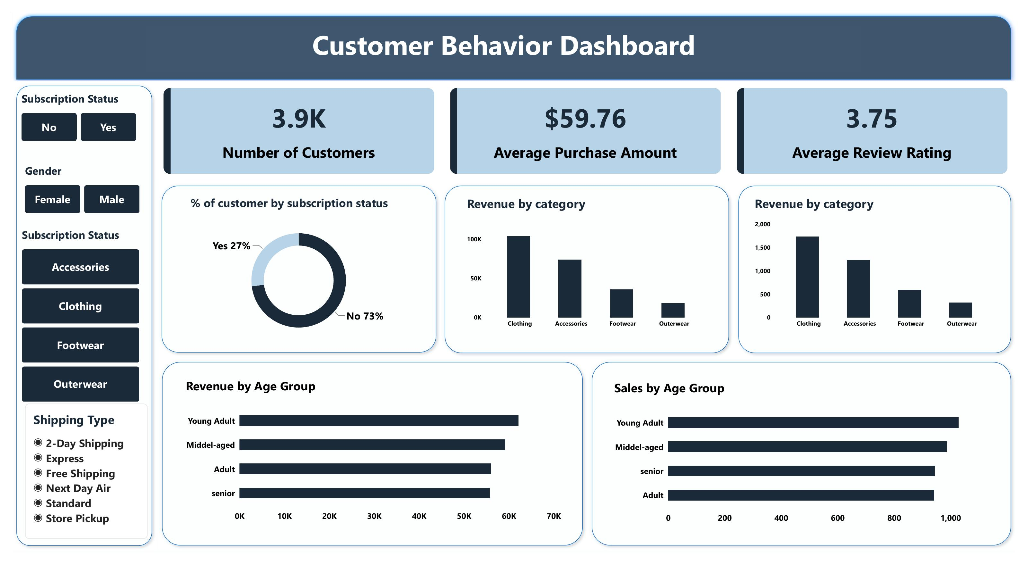
VISUALIZATION
Interactive Power BI Dashboard
Slicers for subscription status, gender, category & shipping type let stakeholders self-serve without writing a query.
10

Slide 11
RECOMMENDATIONS
Five Data-Backed Next Steps
Convert repeat buyers to subscribers
Investigate the gender revenue gap
Target the 2,518 non-subscribed customers with 5+ purchases first.
Pull customer counts by gender to find a spend-gap vs. count-gap.
Fix discount-dependent products
Close the acquisition gap
Test full-price or bundled offers on Hat, Sneakers, Coat, Sweater, Pants.
Only 2% of customers are "New" — audit top-of-funnel marketing spend.
Keep marketing broad by age
Revenue is nearly flat across age groups — segment by loyalty, not age.
11

Slide 12

PORTFOLIO SUMMARY
Skills Demonstrated
Python / pandas
SQL / PostgreSQL
Power BI
Communication
Data cleaning & imputation
Feature engineering
SQLAlchemy DB integration
Aggregations & subqueries
Window functions (ROW_NUMBER)
CTEs for segmentation
Interactive slicers & filters
KPI cards & DAX measures
Stakeholder-ready dashboards
Executive-ready reporting
Data storytelling
Actionable recommendations
12

Slide 13
Thank You
Full technical write-up, SQL scripts, Python notebook & dashboard file available on request.

