Slide 1
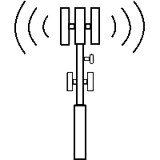
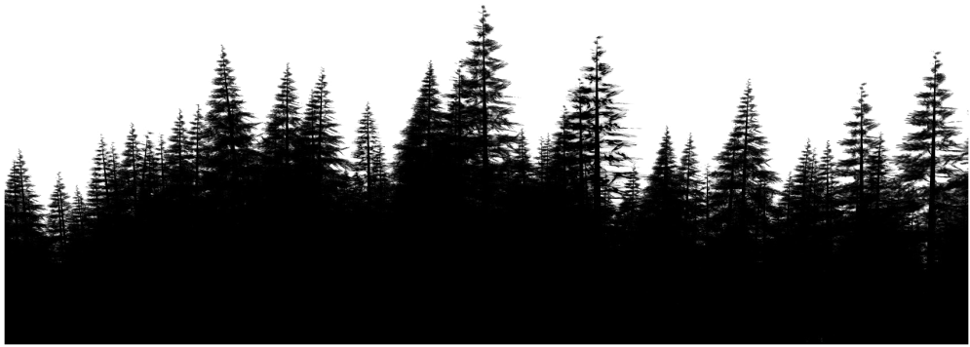

ADCDD Signal Direction and Distance Prediction
Find the signal transmitter
Research and Project By
Shivam Kumar, 17BCS4168
Deepak, 17BCS4172
Chirag, 17BCS4174
Deepanshu Chauhan, 17BCS4145
Deepak Verma, 17BCS4157

Slide 2
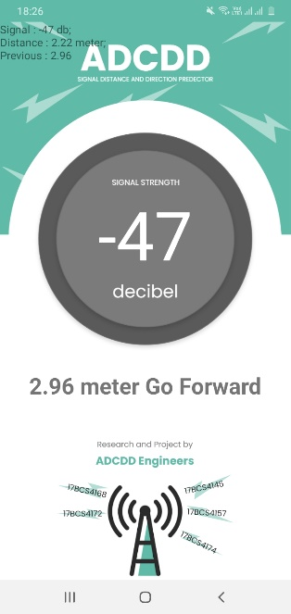

Motto
Detect receiver device distance and direction from transmitter using an external device called SDR and an app.
Transmitter sends signal to a range R. Our system captures the signals get it RSSI and predict signal distance and direction.

Slide 3
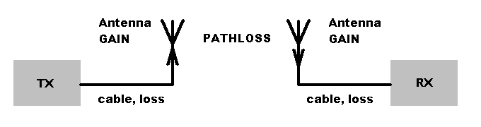
Approach for Distance
To find distance we simply use SDR or Wi-Fi receiver(for prototype) to read a signal of some frequency (for Wi-Fi it is 2.4Ghz). From that received signal we calculate its received power. By some calculations we get the distance of signal transmitter from the receiver. No doubt distance is not exact but it’s approx. because of loss of power due to obstacles like walls, tree, plants, wood, water etc.
Formula we used for calculation
Distance = 10^((27.55-(20*log10(frequency)) + signalLevel)/20)

Slide 4
Approach for Direction
When receiver moves from one direction to another direction, we store the different distance values from the movement and after an interval of time we check if our current distance is smaller than previous distance then we are on the correct direction else we should try movement in different direction.
Formula we used for calculation
If CURRENT_DISTANCE < PREVIOUS_DISTANCE Then Go_Forward()
Else Change_Direction()
Current Distance
Previous Distance

Slide 5
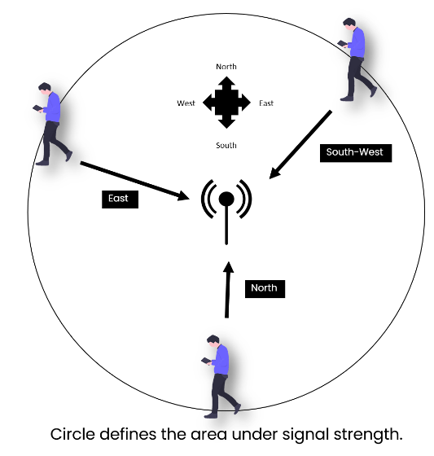
Problem Solving or Applications
Defence by using our mechanism a user can find the distance and direction of enemy radio signal transmitter in very low amount as compared to existing devices.
Augmented Reality Games by using our mechanism anyone can develop AR games and simple games also that consist of movement between of players which is connected with same Wi-Fi network.
Intranet Auto Vehicle by using our mechanism a user can develop intranet automatic vehicle system which only moves in the direction with which server it is connected.

Slide 6
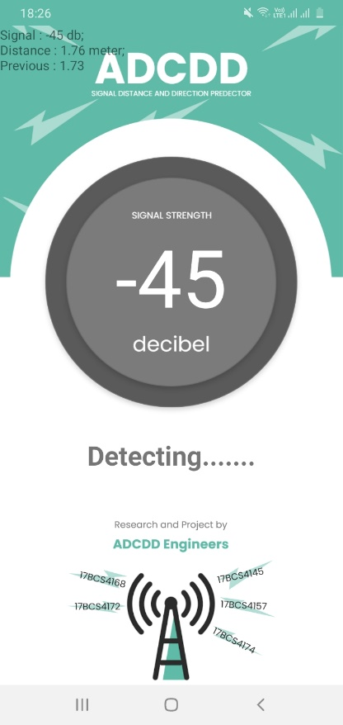
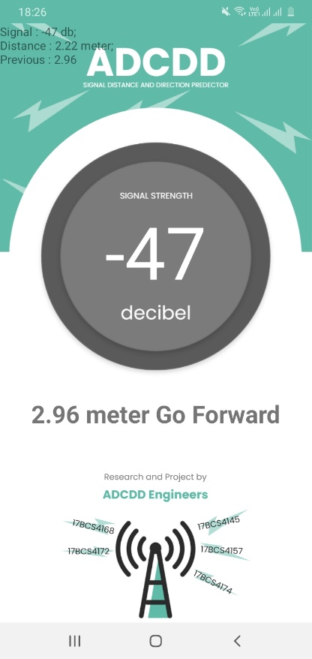
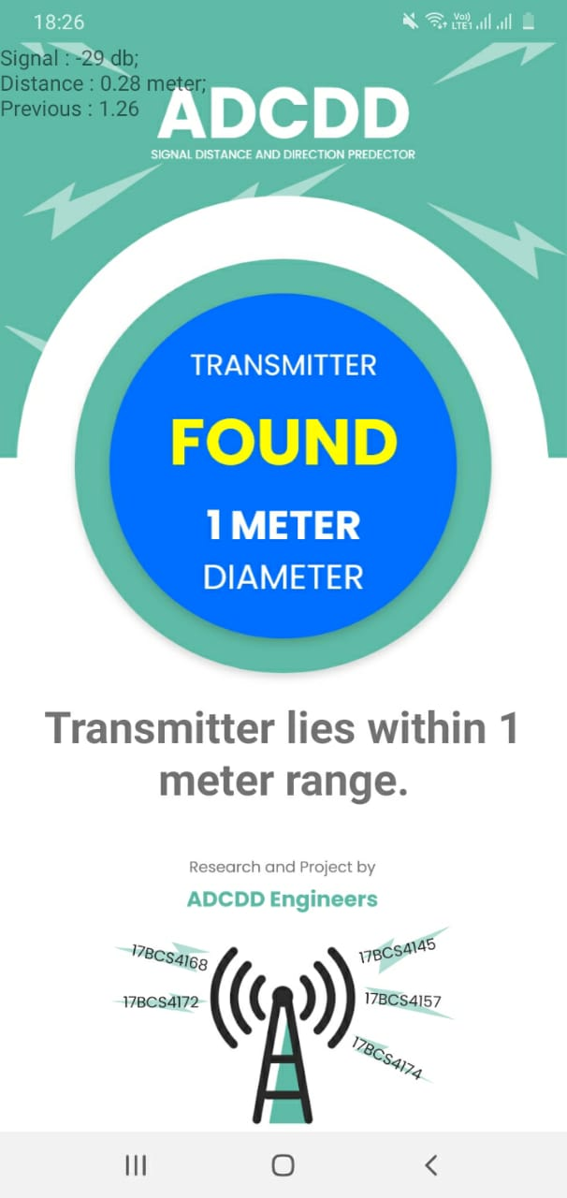
Our App
We made a prototype app which helps user to detects any Wi-Fi distance and direction from where they are. It works upon the same phenomenon as connected with SDR. To make it easily usable to everyone we implement it with android inbuilt wifi receiver and a home router transmitter.

Slide 7
Thank You
Research and Project By
Shivam Kumar, 17BCS4168
Deepak, 17BCS4172
Chirag, 17BCS4174
Deepanshu Chauhan, 17BCS4145
Deepak Verma, 17BCS4157

