Slide 1
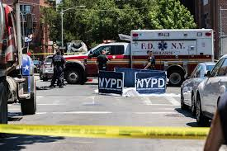
Brooklyn Vehicle Collision Analysis

Slide 2
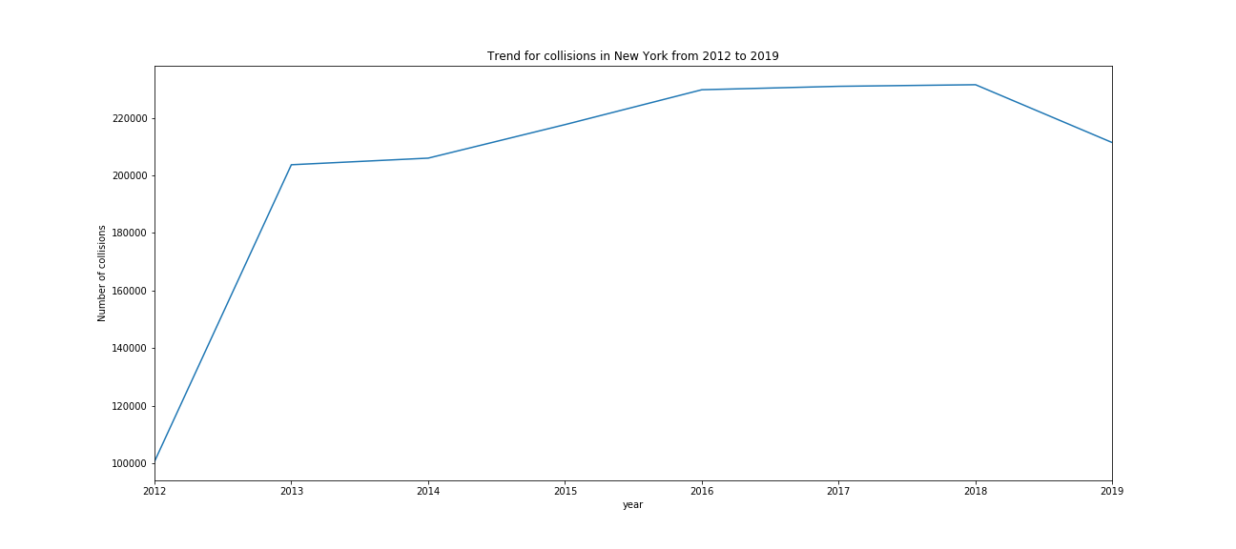
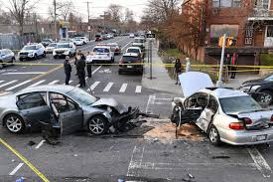
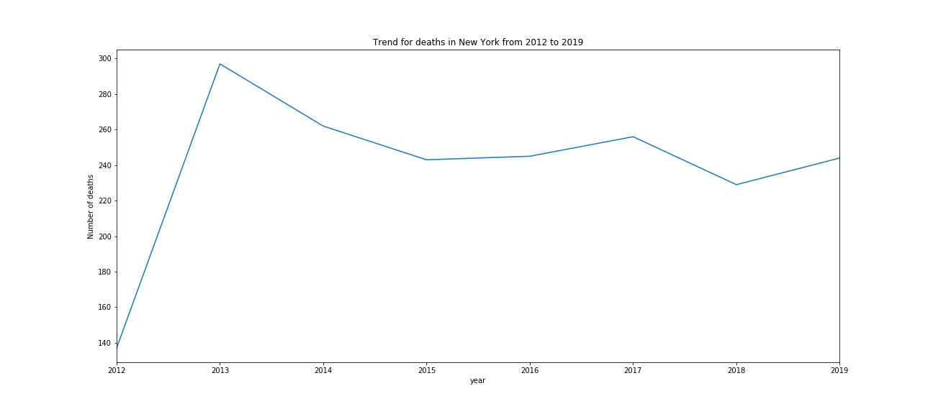
Vehicle collisions have been rising in New York over the past years.
And, so have been the deaths due to collision especially since 2018.

Slide 3
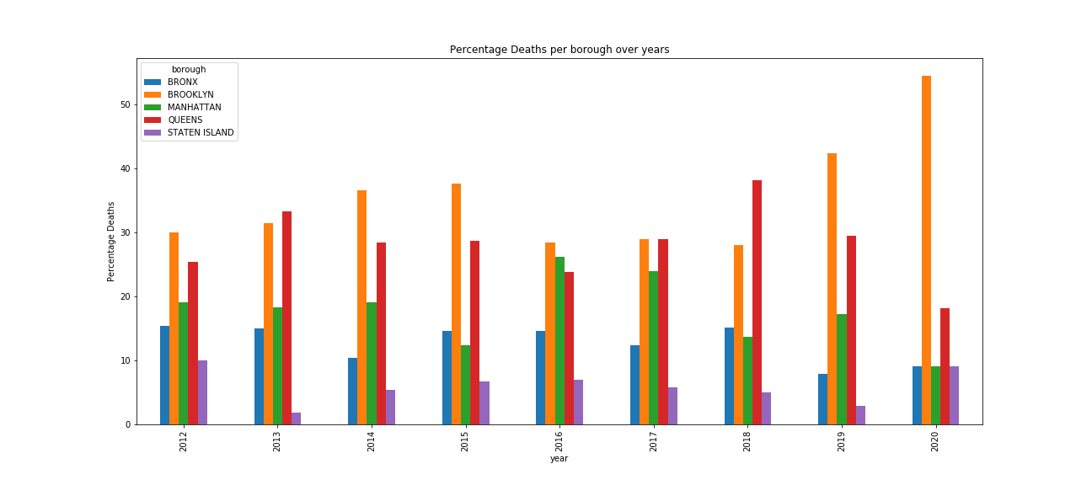
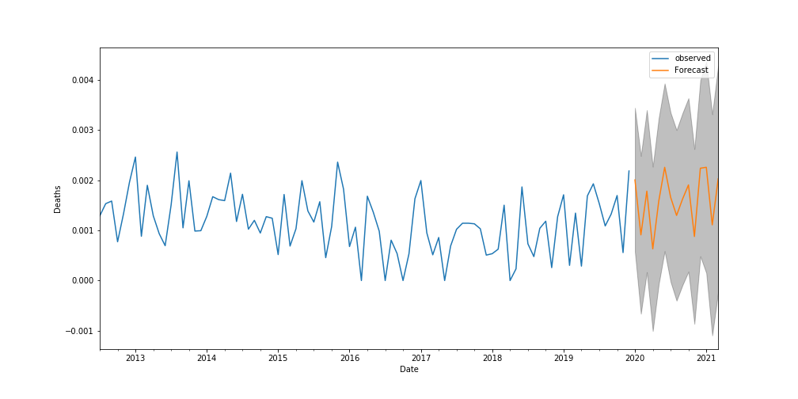
Brooklyn has experienced a significant portion of deaths due to collision (amongst all the boroughs) over the past few years and for this year, the death toll is already at 54%(out of all the boroughs) with 6 deaths in just one month, the highest among all boroughs for 2020.
As per the data, deaths due to collision in Brooklyn are forecasted to increase by 15% by next year.

Slide 4
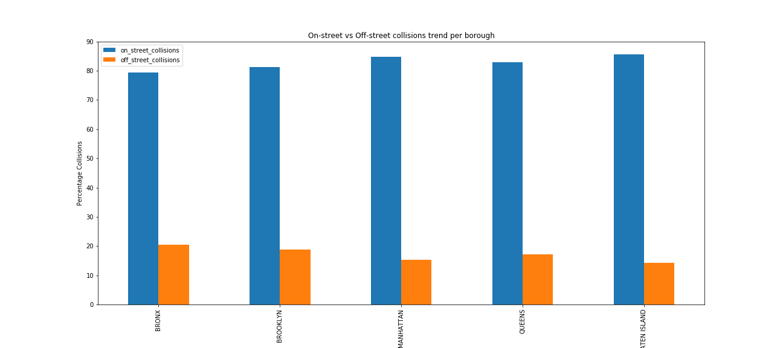
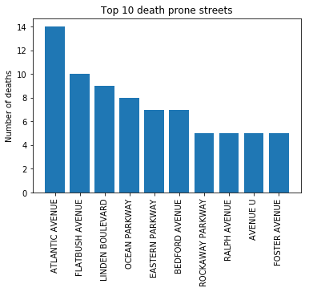
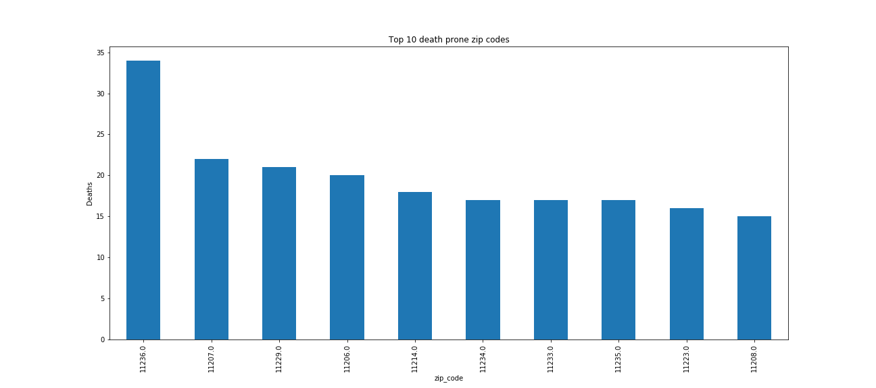
- Over 80% of collisions since 2012 have been on-street for all the boroughs including Brooklyn! - Atlantic Avenue and Flatbush Avenue have experienced over 10 deaths due to collisions since 2012 while zip-codes (11263,11207,11229 and 11206) have experienced over 20 deaths due to collisions since 2012.

Slide 5
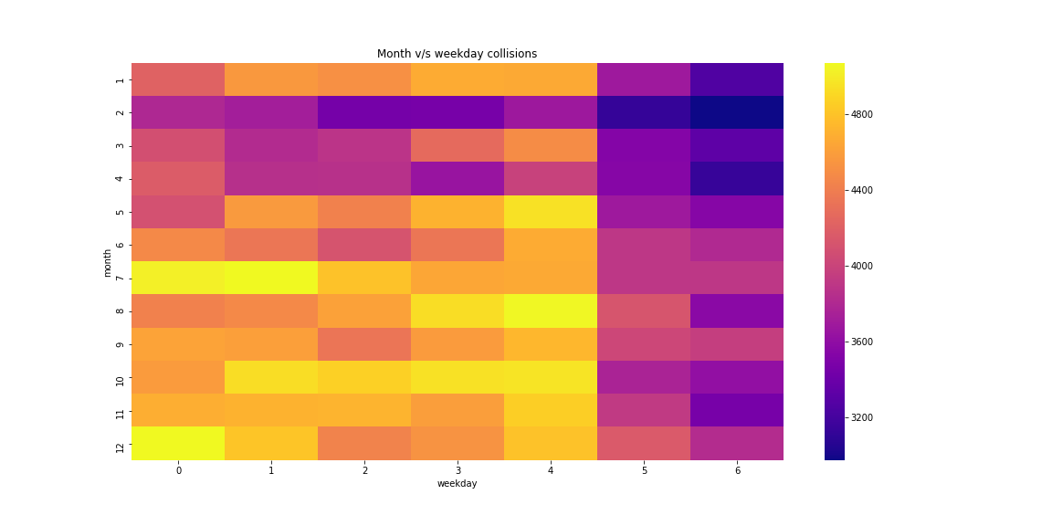
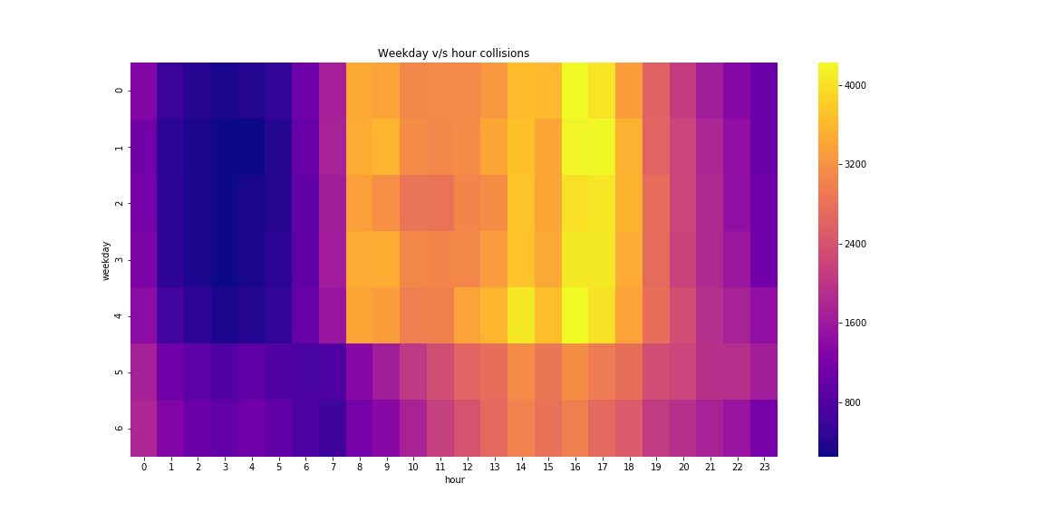
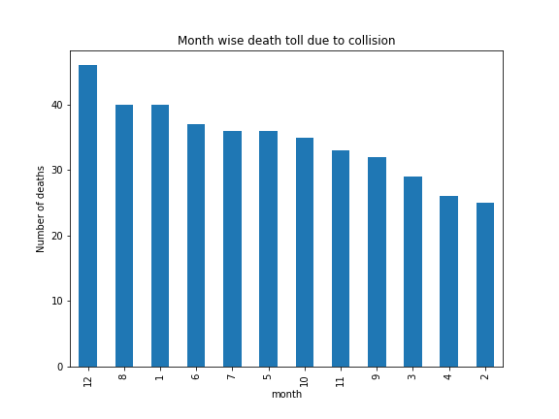
Most number of collisions occur in Fall (Aug-Dec) on weekdays (Mon-Fri), during peak hours (7 AM-9 AM and 2 PM – 5 PM) experience most number of collisions, with, December, August and January having an average of 40 deaths each, the highest among all months

Slide 6
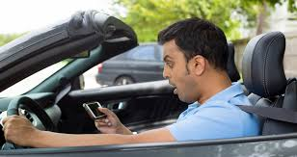
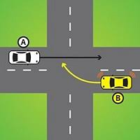
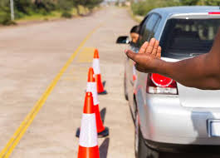
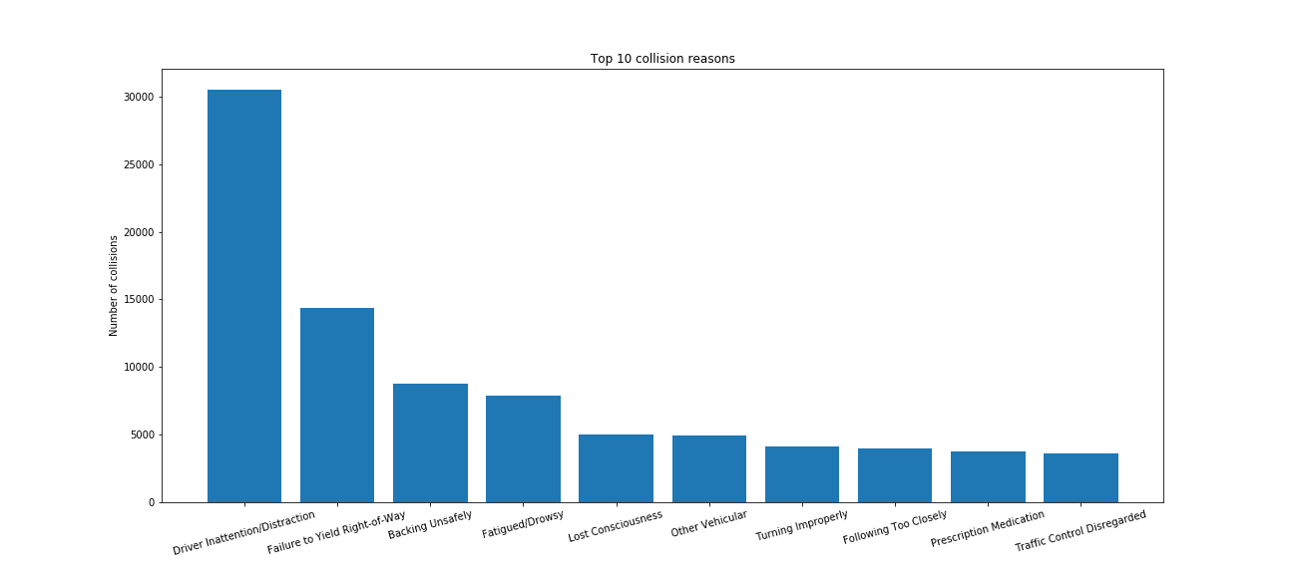
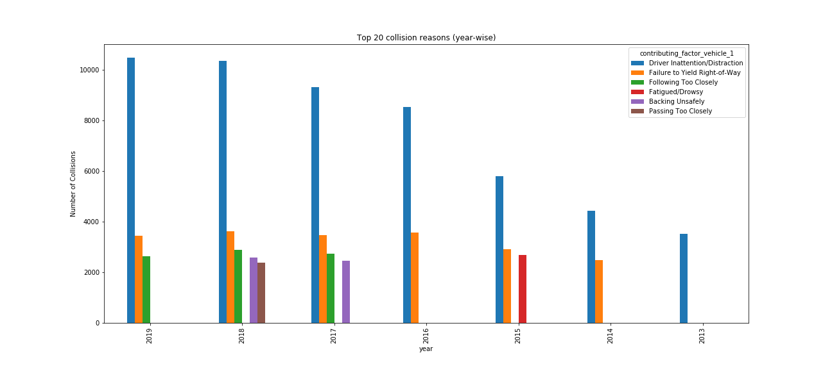
Driver Inattention/Distraction, Failure to Yield Right of Way, and Backing Unsafely have been the major reasons for collisions since 2012, with Driver Inattention being responsible for around 30000 collisions!

Slide 7
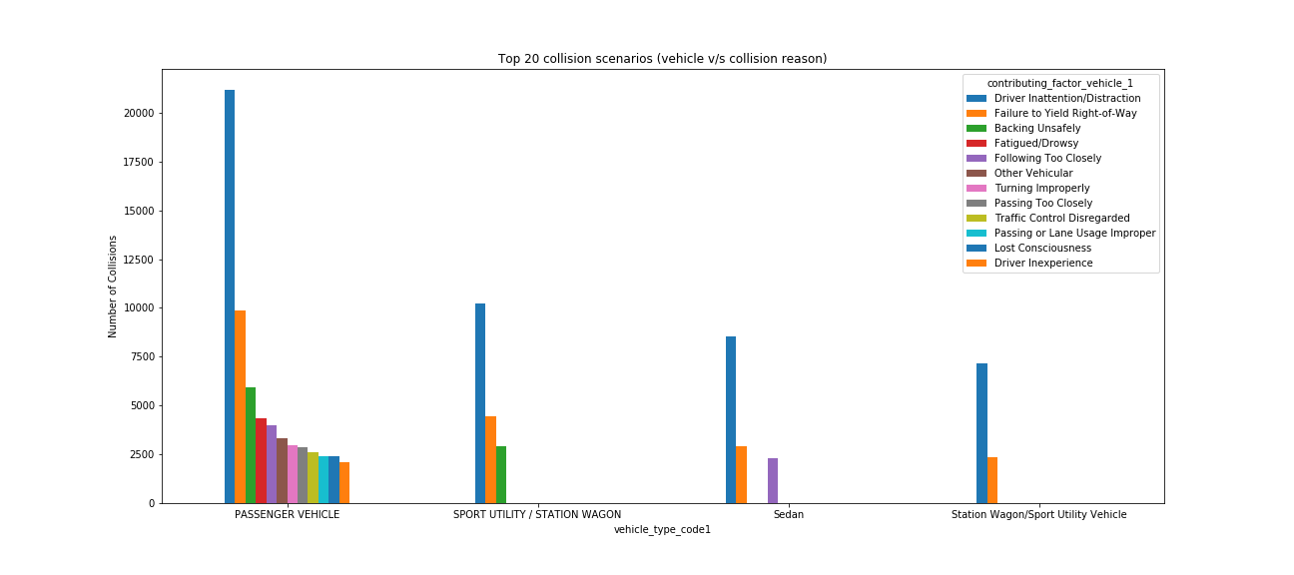
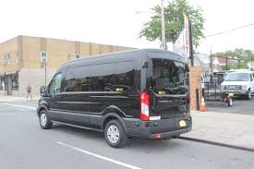
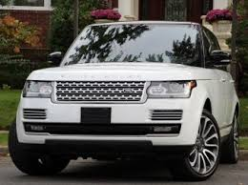
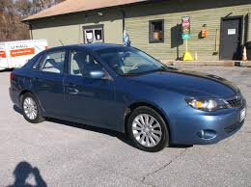
Passenger Vehicles, Sport Utility/Station Wagons and Sedans are the top 3 vehicles with highest number of collisions since 2012 with passenger vehicles being the highest contributor (160000 collisions) and Driver Inattention and Failure to Yield Right of Way being the main reasons.

Slide 8

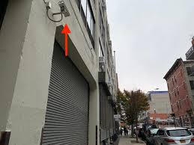
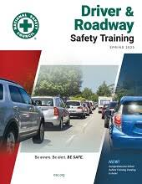
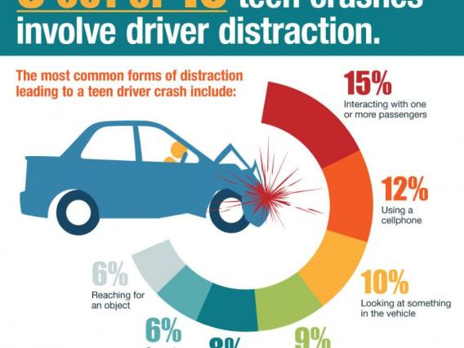
Recommendations:
Police and security camera surveillance can be increased in collision prone streets as per the analysis like Atlantic Avenue and Flatbush Avenue, and the aforementioned zip codes especially during peak hours.
Since most of the collisions occur due to passenger vehicles during peak work hours , employers should introduce road safety/safe driving programs/trainings focusing on the top collision reasons (Driver Inattention, Right of Way, Backing Safely) to spread awareness.

Slide 9
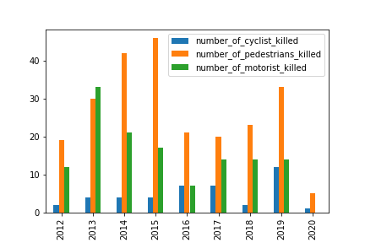
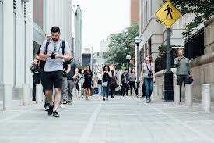
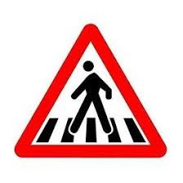
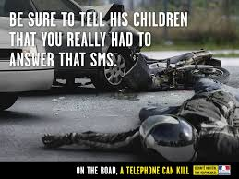
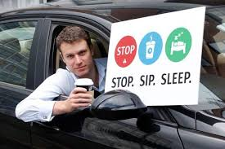
Since, pedestrians are the most affected by vehicle collisions with over 30 deaths last year, followed by motorists with over 10 deaths, targeted safety campaigns (for affected streets and zip codes) via social media, television, radio, print ads, billboards should be introduced to spread awareness on the basis of statistics presented in the report.

