Slide 1
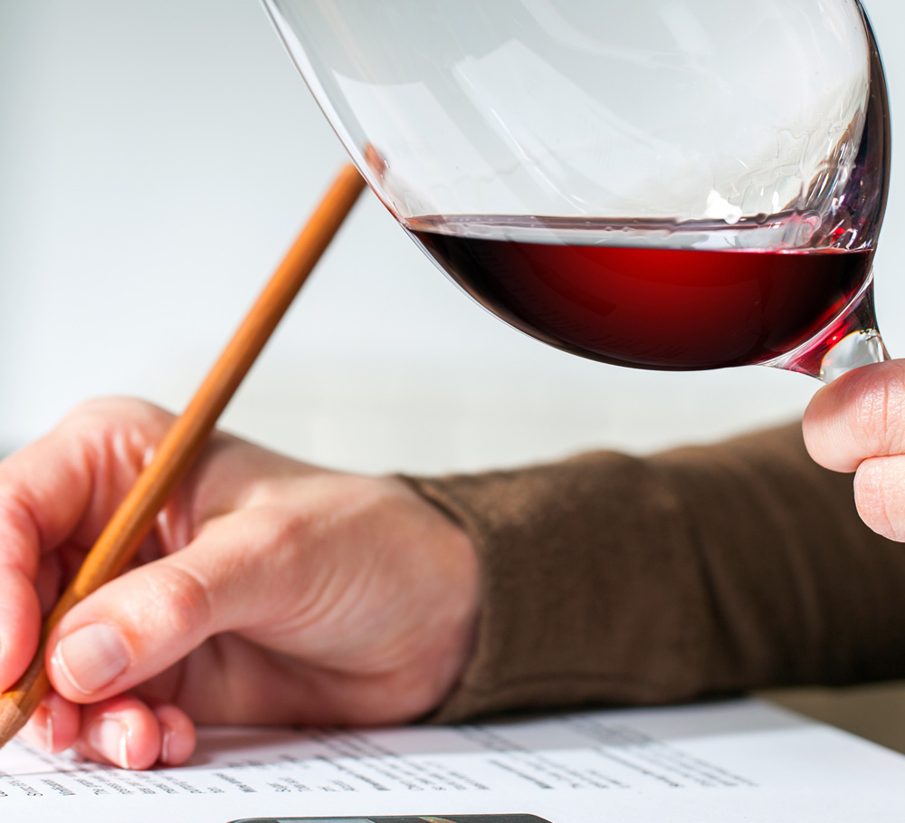
Wine Quality Prediction using Machine Learning
Akshay Kumar Nagabandi UMBC – Data Science

Slide 2
Index
Introduction
Problem Statement
Project Objectives
Dataset Overview
Features & Target Variable
Data Preprocessing
Exploratory Data Analysis (EDA)
Model Building
Model Comparison
Final Model & Evaluation
Streamlit Application
Results & Conclusion
Future Work

Slide 3

Problem Statement
Wine quality is traditionally evaluated by human experts
This process is subjective and may vary between tasters
It is time-consuming and not scalable for large production
Need for an automated and consistent prediction system

Slide 4
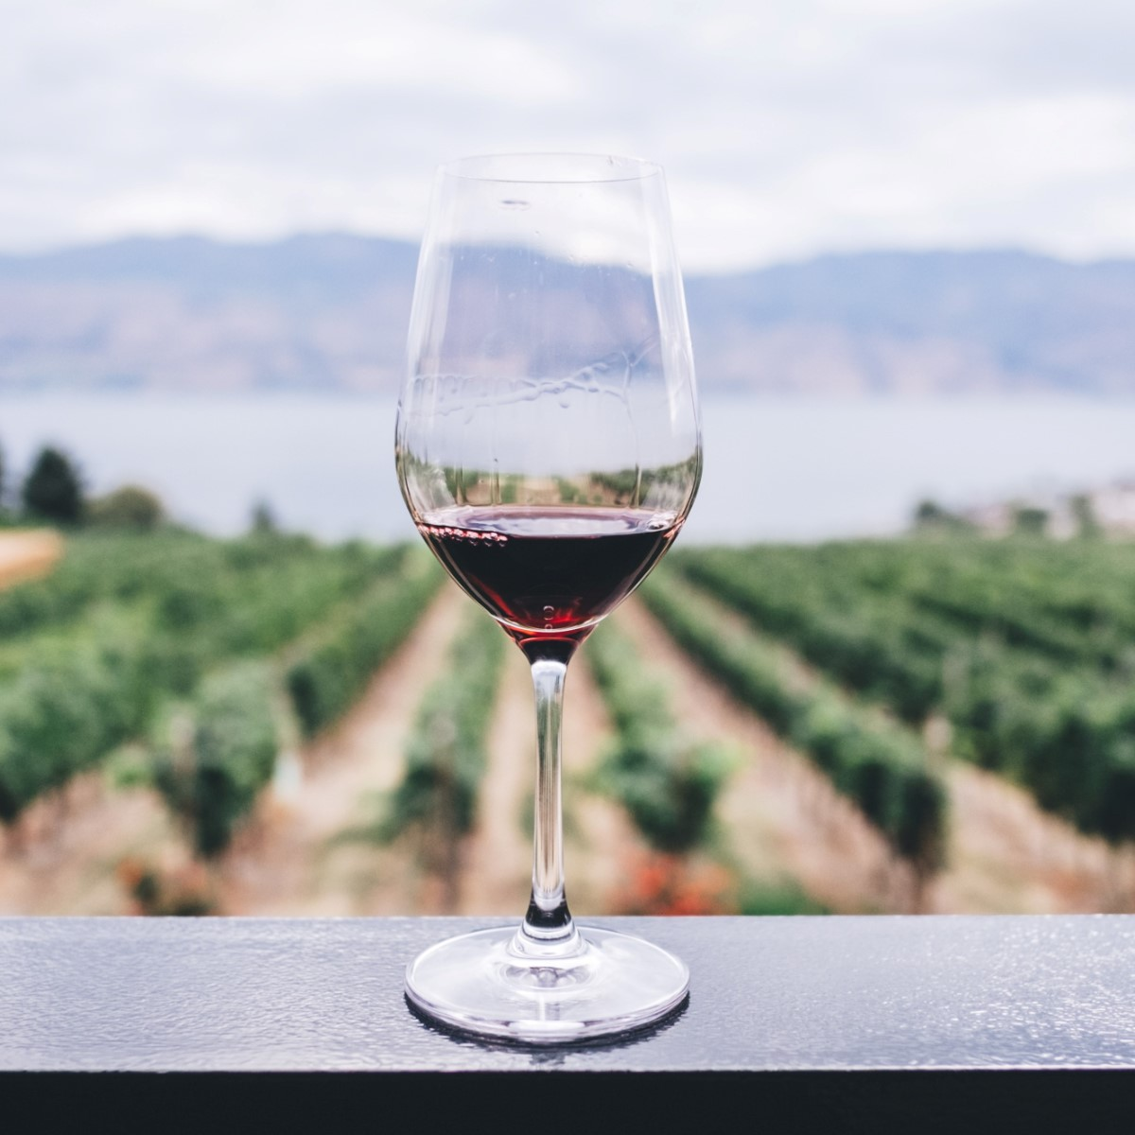
Project Objective
Build a machine learning model to predict wine quality
Convert quality into a classification problem
Compare multiple models to find the best performer
Develop an interactive application for real-time prediction

Slide 5
Dataset Overview
Red Wine Quality Dataset (UCI / Kaggle)
Contains 1599 wine samples
Each sample has 11 chemical features
Output variable is quality score (0 to 10)
Real-world dataset collected from Portuguese wines

Slide 6
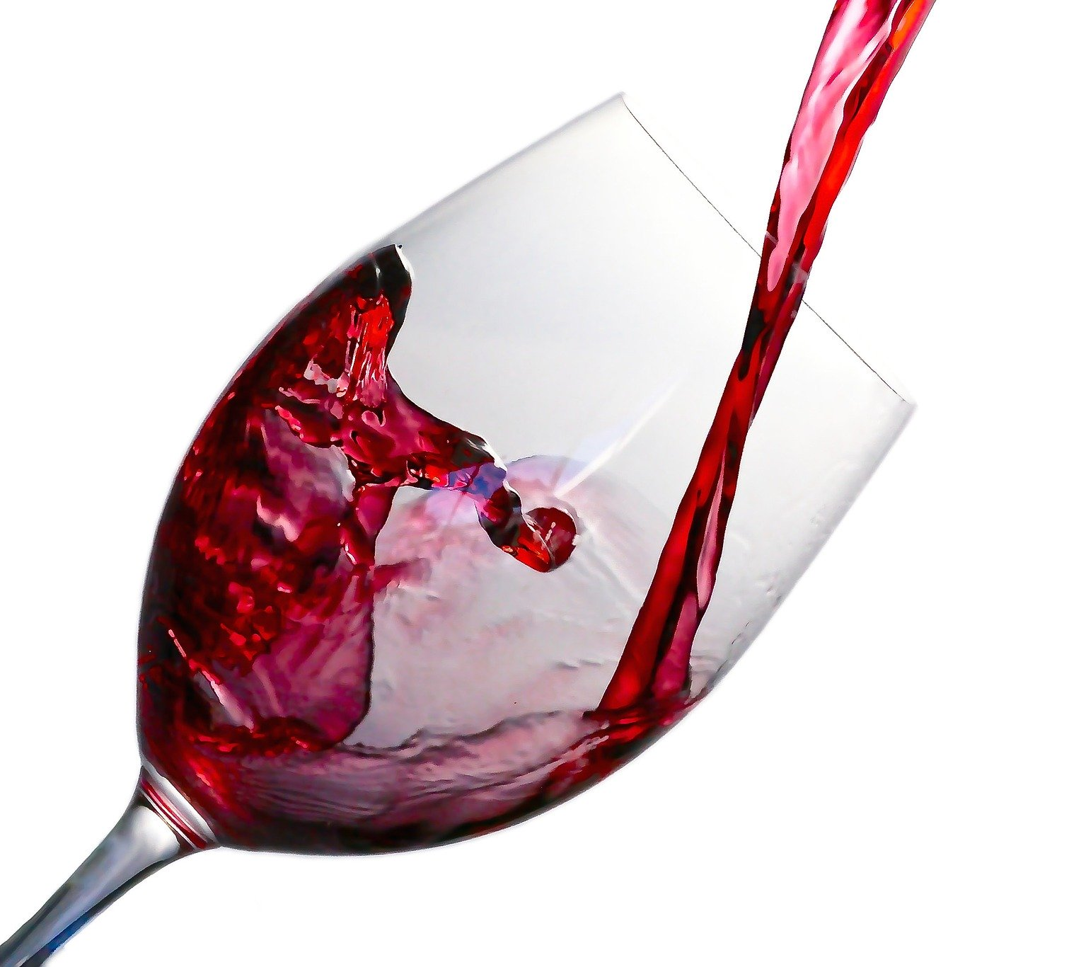
Input Features
Chemical properties affecting wine taste
Fixed acidity, volatile acidity, citric acid
Residual sugar, chlorides
Free and total sulfur dioxide
Density, pH, sulphates, alcohol
These features are measurable and objective

Slide 7
Target Variable
Original target: Quality score (0–10)
Converted into binary classification
Good Quality → quality ≥ 7 Not Good Quality → quality < 7
Simplifies prediction and improves model performance

Slide 8
Data Preprocessing
Checked for missing values (none found)
Created new column: goodquality
Split data into training and testing sets
Used 70% training and 30% testing
Prepared data for model training

Slide 9
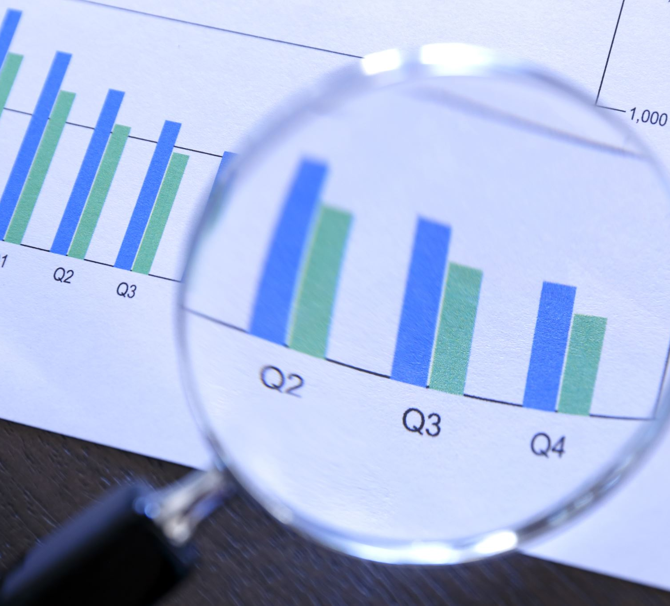
Exploratory Data Analysis (EDA)
Performed initial data analysis
Checked data distribution
Identified patterns and relationships
No missing values in dataset
Data is clean and structured

Slide 10
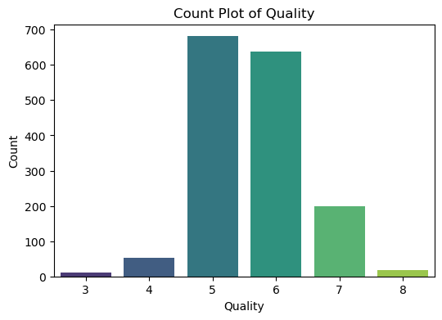
EDA-Quality Distribution (Chart)
Most wines fall in mid-quality range (5–6)
Very few samples are high quality (7–8)
Dataset is slightly imbalanced
This affects model prediction behavior

Slide 11
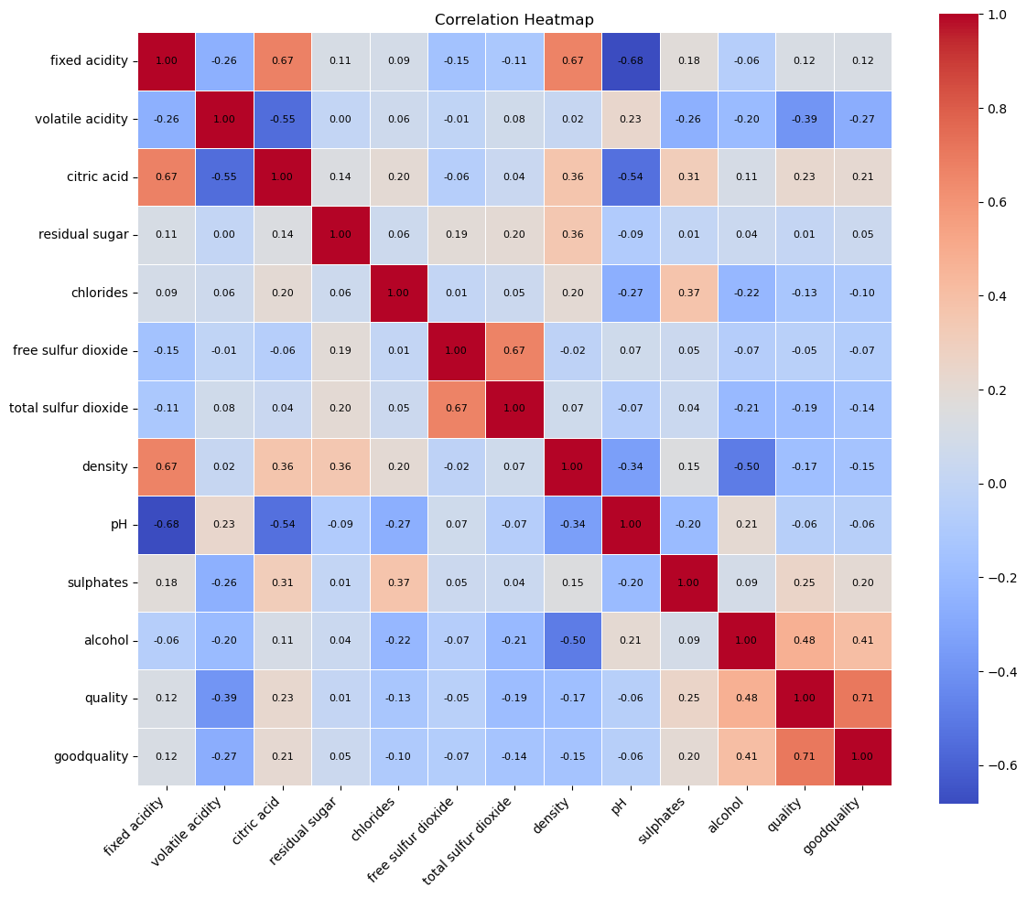
EDA-Correlation Analysis (Chart)
Alcohol has strong positive correlation with quality
Volatile acidity has negative correlation
Some features show weak relationships
Helps identify important variables

Slide 12
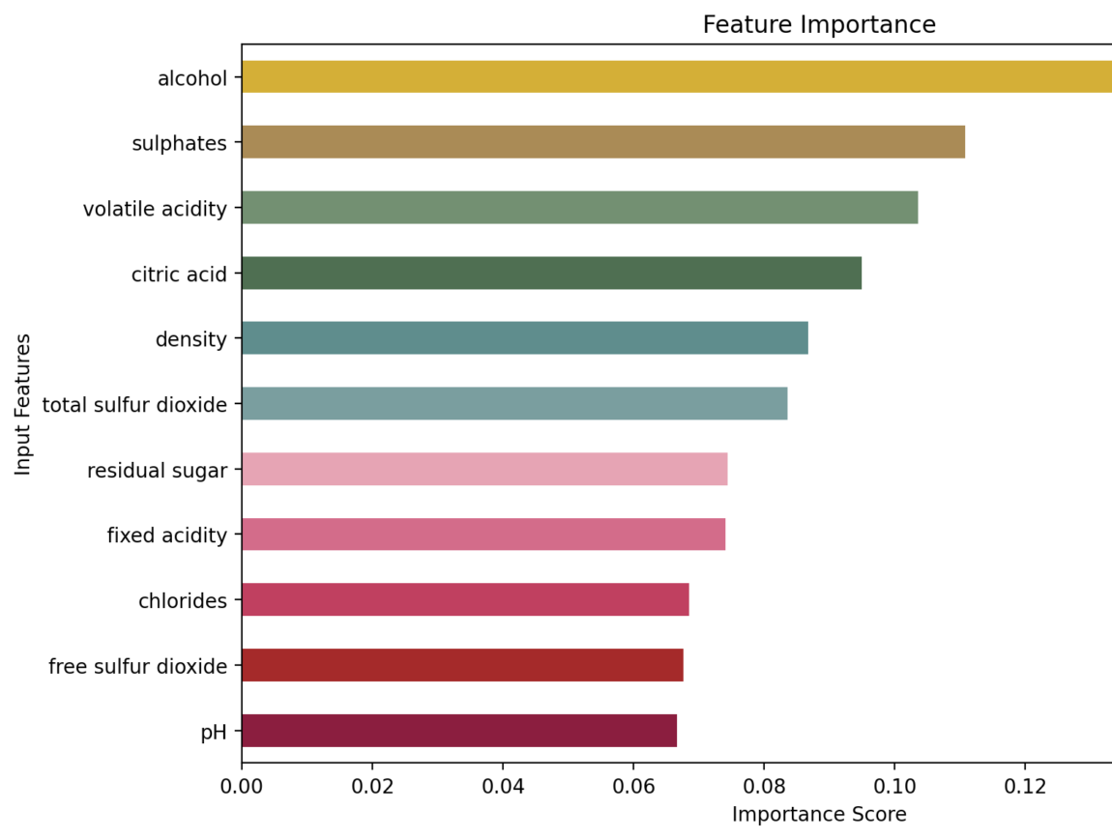
EDA-Feature Importance (Chart)
Alcohol is the most influential feature
Sulphates and citric acid also important
Chlorides and density have lower impact
Feature importance helps improve model design

Slide 13
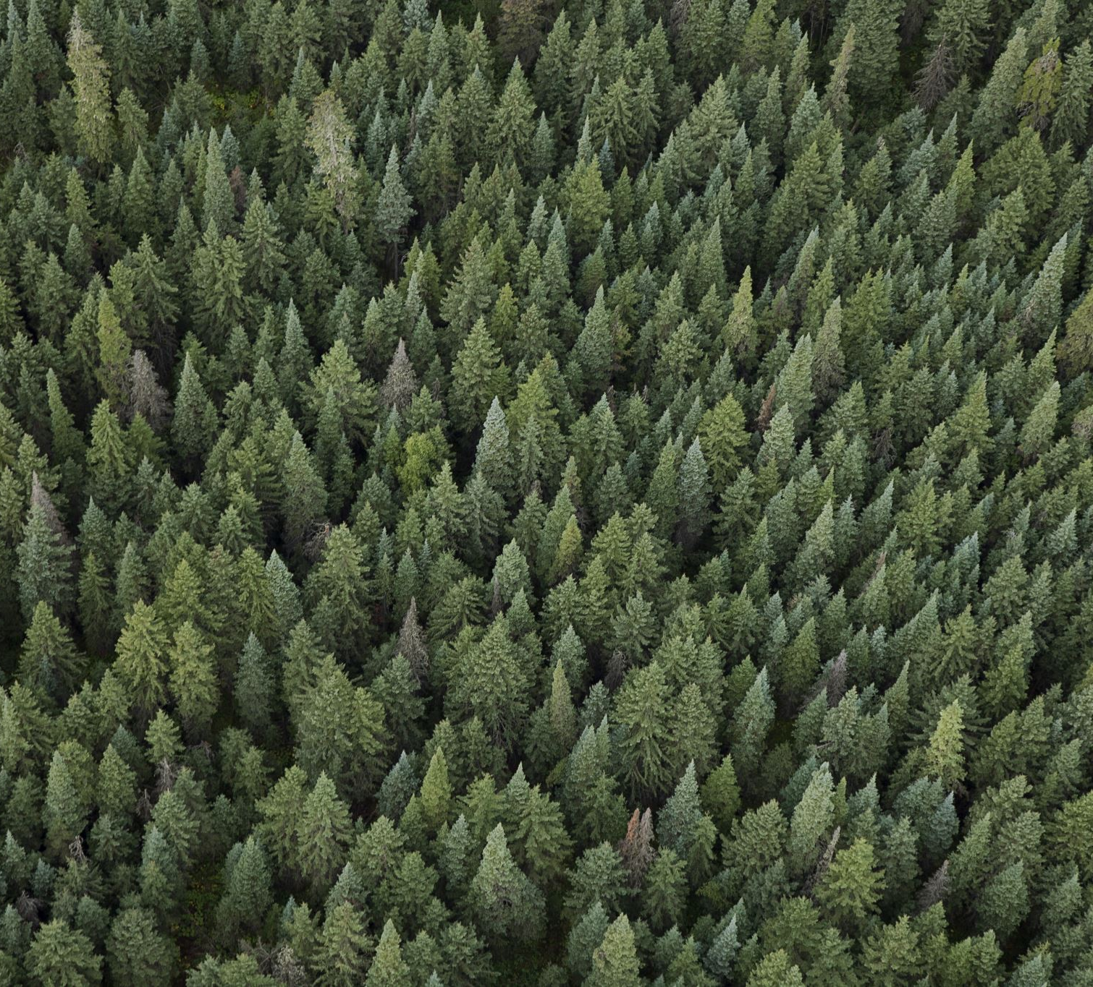
Models Used
Random Forest Classifier
Decision Tree Classifier
K-Nearest Neighbors (KNN)
All models trained on same dataset
Performance compared using accuracy

Slide 14
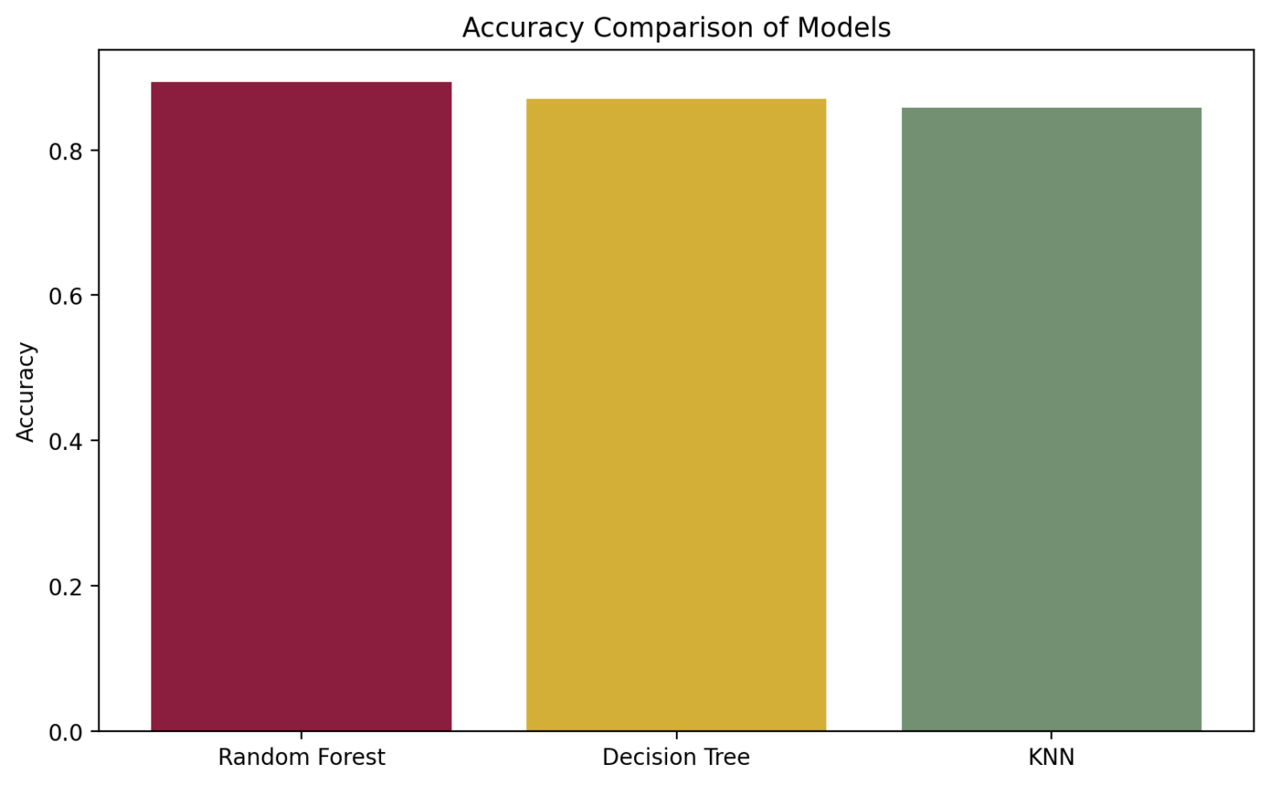
Model Comparison (Chart)
Compared accuracy across models
Random Forest achieved highest accuracy
Decision Tree showed moderate performance
KNN performed relatively lower

Slide 15
Final Model
Selected Random Forest Classifier
Handles non-linear relationships well
Reduces overfitting using multiple trees
Provides better generalization

Slide 16
Model Evaluation
Used confusion matrix for evaluation
Measured precision, recall, and F1-score
Model performs well on both classes
Provides reliable predictions

Slide 17
Streamlit Application
Built using Streamlit framework
User enters wine chemical values
Model predicts quality instantly
Displays probability of prediction
Option to download results

Slide 18
Results
Model successfully classifies wine quality
High accuracy achieved using Random Forest
Important features identified clearly
Application provides real-time usability

Slide 19
Conclusion:
Machine learning can automate wine quality prediction
Chemical properties are strong indicators
Random Forest is the most effective model
Interactive UI enhances user experience

Slide 20
Thank you

