Slide 1

Predicting Churning Customers
By: Akshay Kumar Pydi
https://www.linkedin.com/in/akshaykumarpydi/

Slide 2
Agenda
Problem Statement
Dataset Description
Data Modeling
1
3
5
2
4
6
Project Objective
Data Exploration
Business Recommendations

Slide 3

Problem Statement
Churn Prediction is detecting customers who are likely to cancel a subscription to a service
Churn is a problem for many industries like banks because it is more expensive to acquire a new customer than to keep your existing one from leaving
Customer Attrition significantly impacts company’s revenue and its long-term growth
Losing customers will require extra spending on things like marketing or staffing

Slide 4

Project Objective
To predict customers who are at high risk of churning
Highlight the main factors influencing customer Attrition
Use Machine Learning Algorithms to build Prediction models and evaluate the accuracy and performance of these models
Finding out the best model for business case and recommending solutions to reduce customer churn

Slide 5
Dataset Description
Column Name | Description
CLIENTNUM | Unique identifier for the customer holding the account
Attrition_Flag | Status of Customer- Existing/Attrited (Target Variable)
Customer_Age | Age of Customer
Gender | Gender of Customer (M/F)
Dependent_count | Number of people dependent on card holder
Education_level | Educational Qualification of the account holder
Marital_Status | Customer Marital Status (Married, Single, Divorced, Unknown)
Income_category | Annual income category of the account_holder
Card_category | Type of card (Blue, Silver, Gold, Platinum)
Months_on_book | Period of relationship with the bank
Total_Relationship_Count | Total number of cards held by the customer
Months_Inactive_12_mon | Number of months inactive in the last 12 months
Contacts_count_12_mon | Number of contacts in the last 12 months
Credit_Limit | Credit limit on the credit card
Total_Revolving_Bal | Total Revolving balance on the credit card
Avg_Open_To_Buy | Open to buy credit lines (average in last 12 months)
Total_Amt_Chng_Q4_Q1 | Change in transaction amount( Quarter4 over Quarter 1)
Total_Trans_Amt | Total transaction amount (last 12 months)
Total_Trans_Ct | Total Transaction Count (last 12 months)
Total_Ct_Chng_Q4_Q1 | Change in Transaction Count (Q4 over Q1)
Avg_Utilization_Ratio | Average Card Utilization Ratio
Data retrieved from Kaggle
Bank customer data (credit cards)
Dataset contains 10,127 rows and 21 columns
Binary target variable - Attrition Flag (Existing customer/ Attrited customer)
5 Categorical and 15 continuous variables
Split: 70% Train, 30% Test

Slide 6
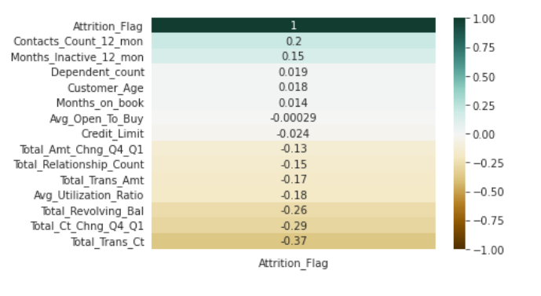
Data Exploration
No missing values
Heatmap for correlation of Target variable with other variables.
Most significant variables are Total transaction count, Total transaction amount, Total revolving balance, Total count change from Q4 to Q1 Boxplots for distribution of continuous variables with respect to target variable
Bar plots to see distribution of Attrited/Existing customers in all categories

Slide 7
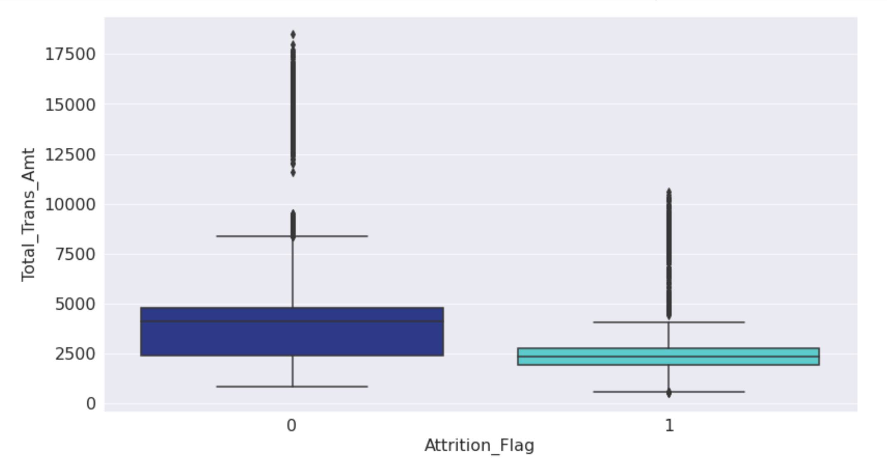
Does Transaction amount impact customer churn ??
Transaction amount < 2500 - Customer at high risk of churning
Transaction amount > 2500 - More probability of customer remaining loyal to the bank

Slide 8
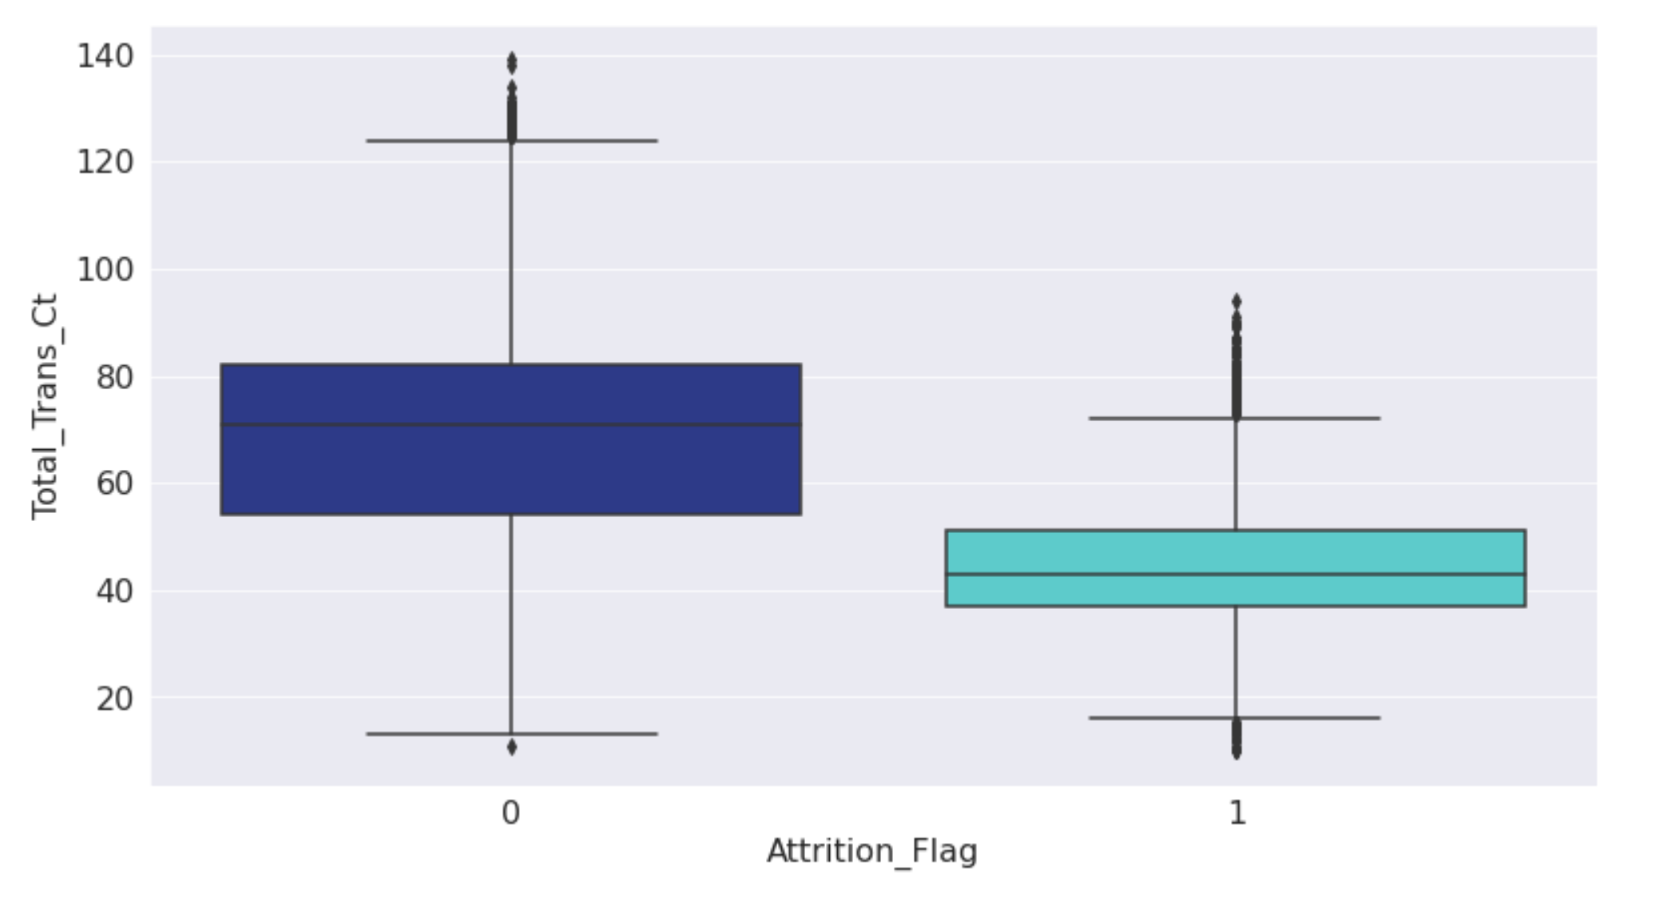
Does a customer with more transactions churn or leave ?
Customer with low transaction count are at high risk of churning. On seeing the numbers, customers with transaction count less than 57 are likely to discontinue the services.
8

Slide 9
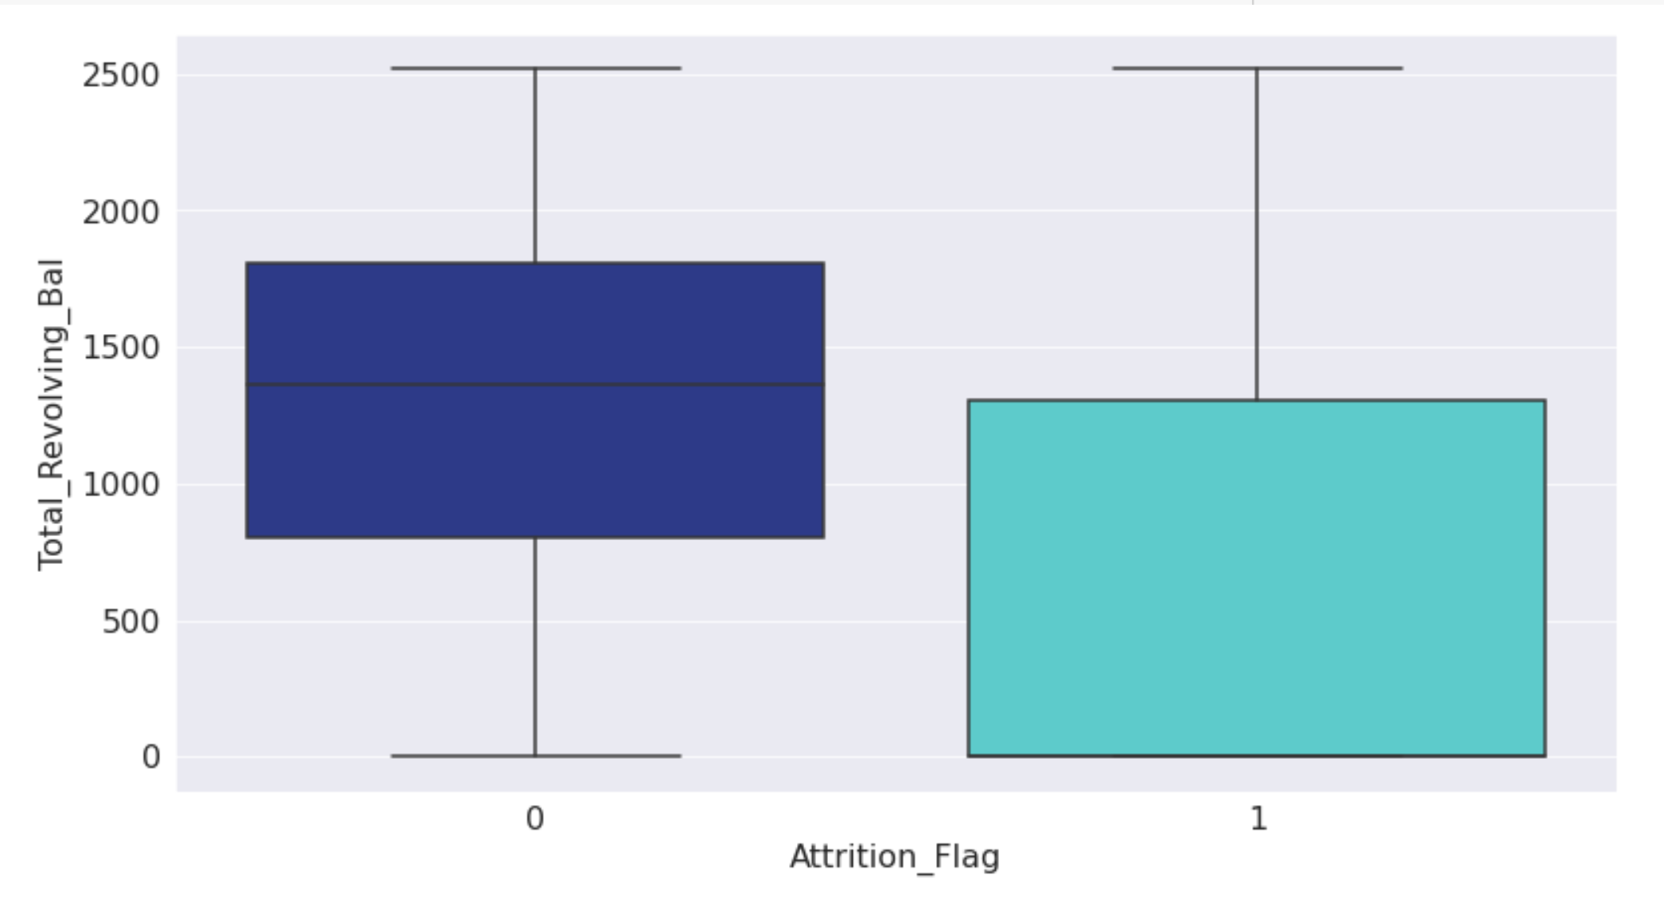
Does revolving balance play key role in customer churn??
Customers with 0 or low revolving balance have high probability of getting churned. Inversely, customers with greater revolving balance are more likely to stay loyal to the bank.
9

Slide 10
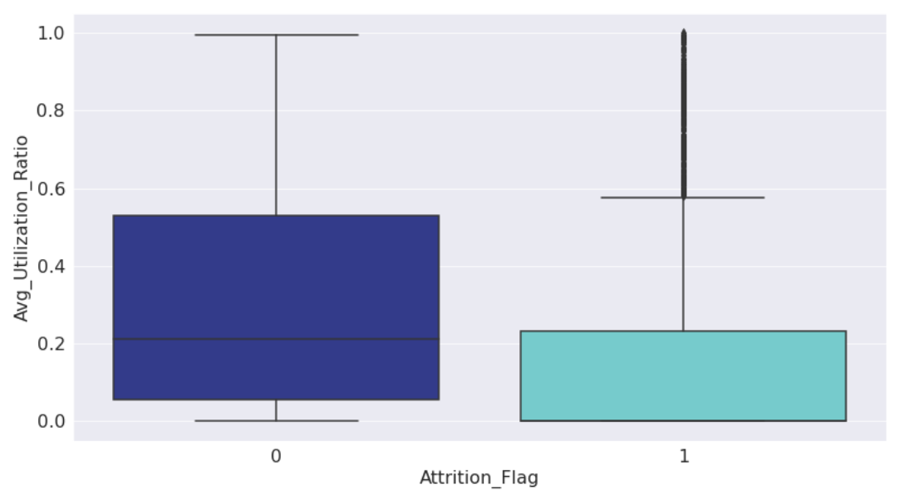
What about the Credit card Utilization Ratios ??
The average credit utilization ratio for most of the customers is very low i.e., below 10%. This indicates that most customers are not utilizing the credit limit provided to them
10

Slide 11
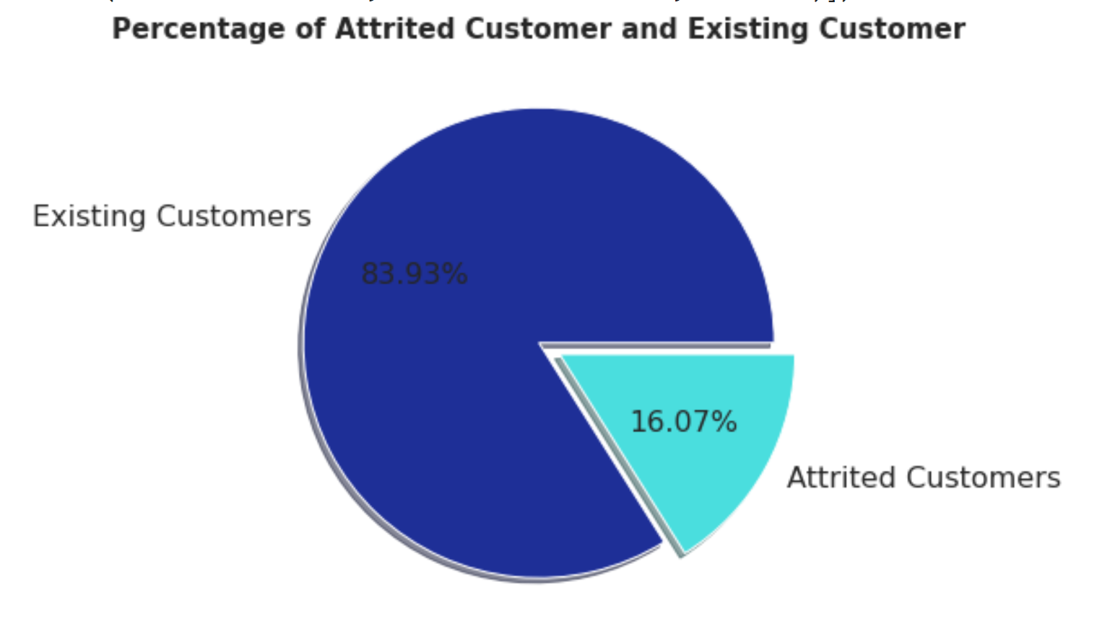
Imbalanced Target Variable
The imbalance in the distribution can lead to a high accuracy just by predicting the majority class, but fail to capture the minority class, which is the class of interest and the point of creating the model in the first place. Thus, there is a need to balance the data before modeling.

Slide 12
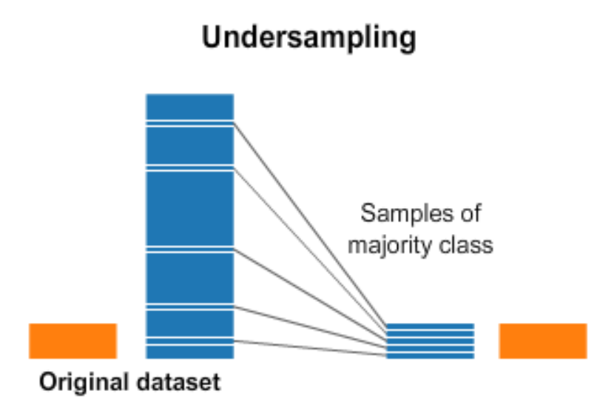
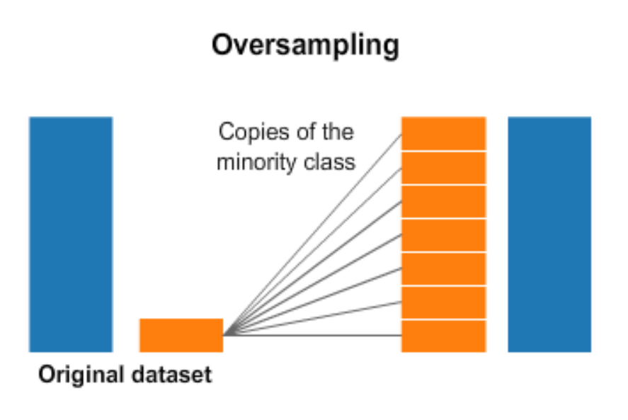
Handling the Imbalance
Technique 1
Technique 2 (preferred here)
In under-sampling, removing random records from the majority class can cause loss of information as it does not have millions of records.
SMOTE randomly picks a point from the minority class and computes k-nearest neighbors. These points are added between the chosen point and its neighbors thereby creating synthetic data for the minority class.

Slide 13
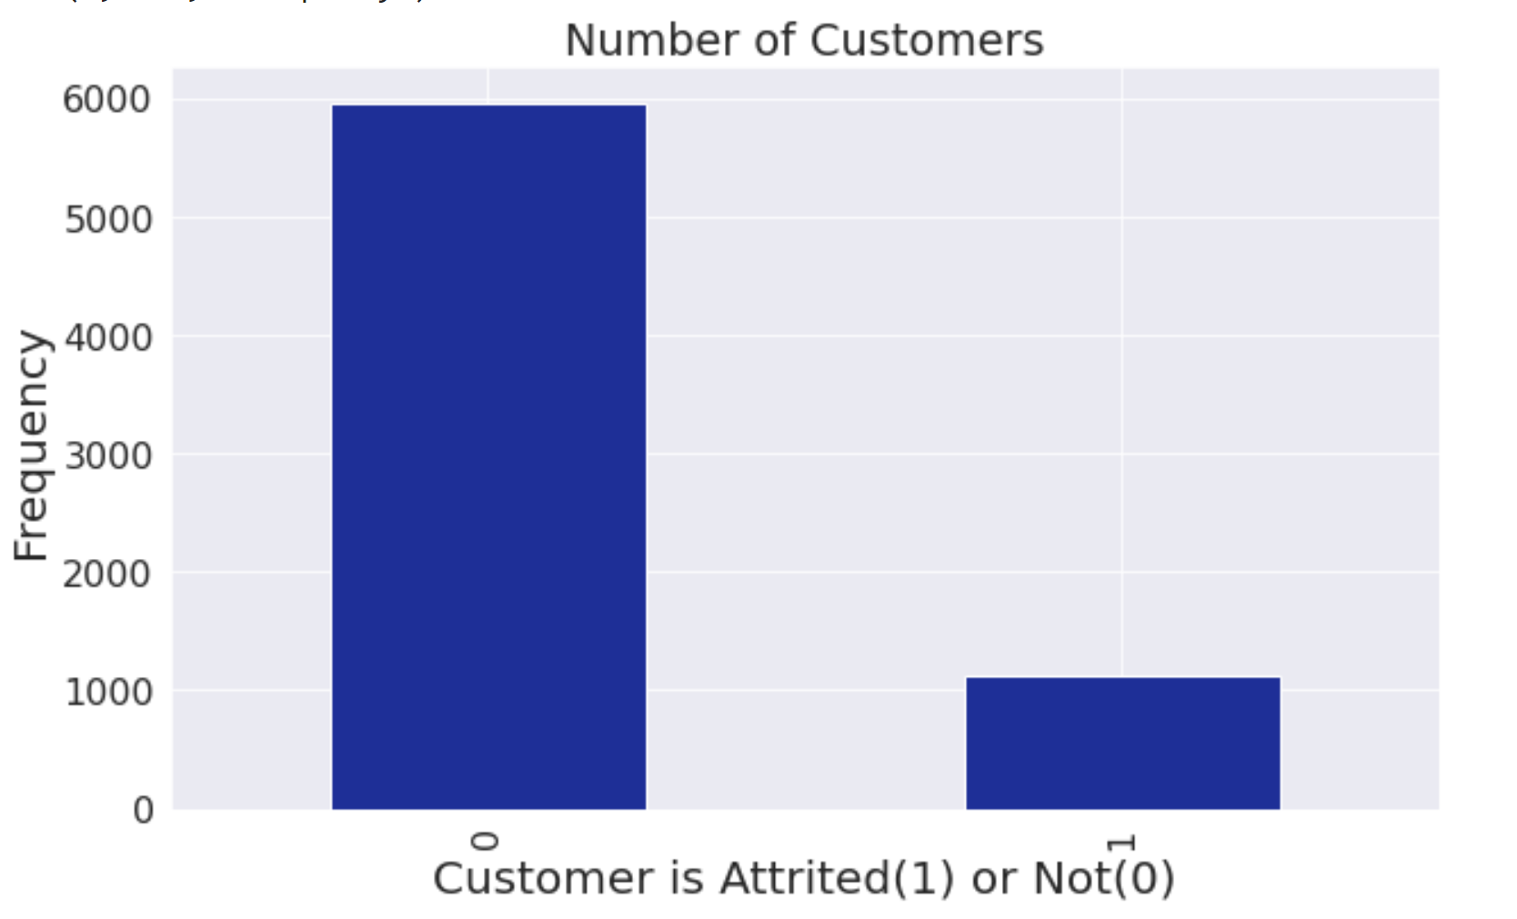
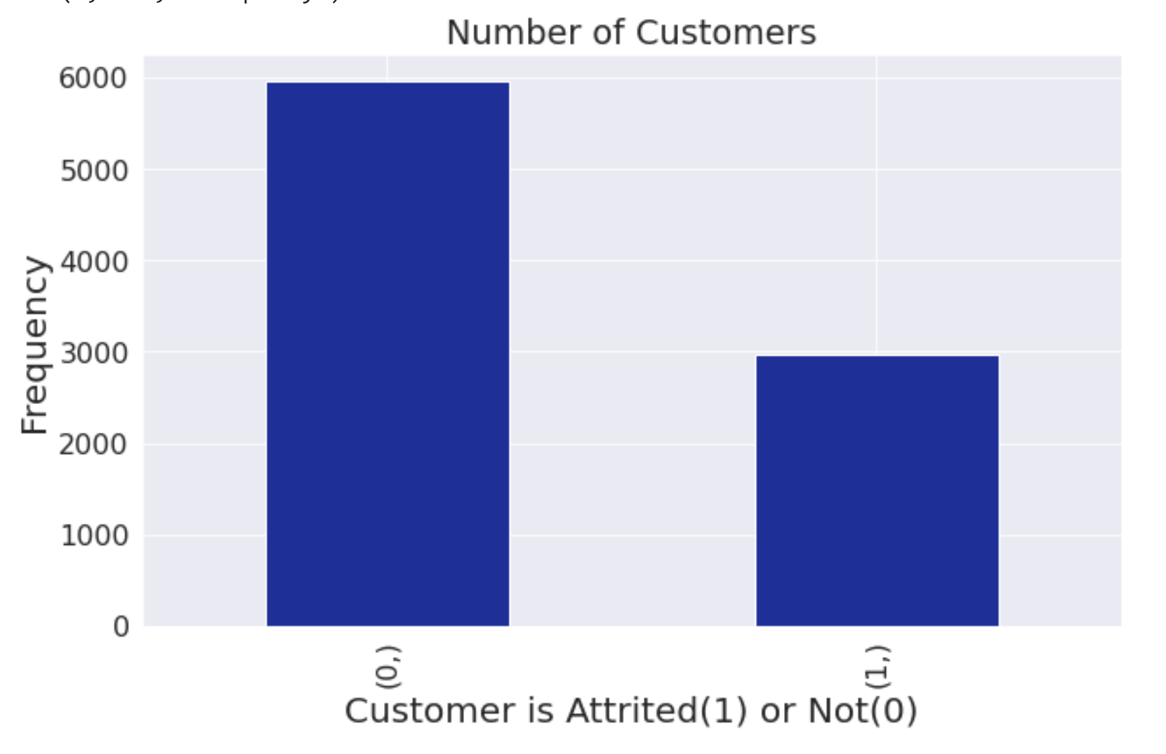
Data Modification
Before SMOTE
After SMOTE
Oversampling strategy applied is 50% and not 100% as we did not want to generate too much synthetic data and to avoid overfitting.
‘0’ - 6000
‘1’ - 3000
Imbalance between the two classes of the Target Variable can be seen.
‘0’ - 6000
‘1’ - 1088

Slide 14
Data Conditioning
Dropped Insignificant Variables
Recoded Significant Variables
Recoded Target Variable
Months_on_book
Customer_Age
Credit_Limit
Avg_Open_To_Buy
Education_Level
Avg_Utilization_Ratio
Dependent_count
Total_Relationship_Count
Months_Inactive_12_mon
Total_Revolving_Bal
Total_Amt_Chng_Q4_Q1
Total_Trans_Amt
Total_Trans_Ct
Total_Ct_Chng_Q4_Q1
Gender
Marital_Status
Income_Category
Card_Category
Converted ‘Attrition_Flag’ to binary variable
‘0’ - existing customer
‘1’ - attrited customer

Slide 15
Model Comparisons
 | Accuracy in % | Recall | Precision
Logistic Regression | 88.45 | 0.74 | 0.62
Decision Tree | 93.12 | 0.81 | 0.78
KNN | 87.13 | 0.73 | 0.59
AdaBoost Classifier | 95.56 | 0.86 | 0.86
Random Forest | 95.52 | 0.81 | 0.91
Extra Trees Classifier | 92.73 | 0.60 | 0.93
Gradient Boosting | 95.72 | 0.83 | 0.90
Perceptron | 86.15 | 0.59 | 0.57

Slide 16
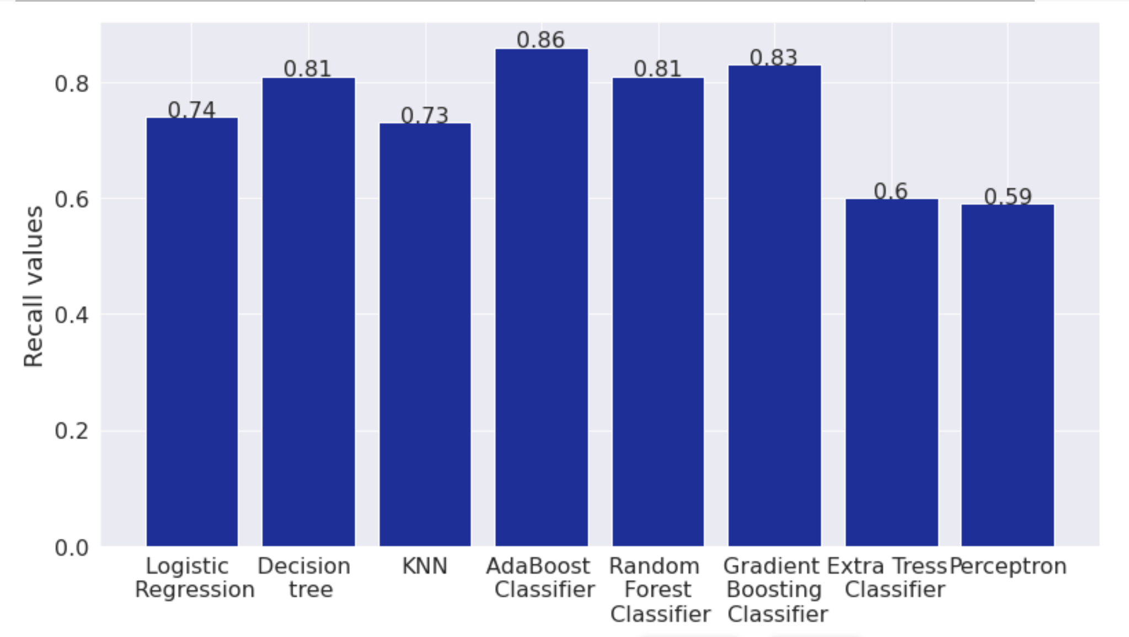
Recall Comparisons
Recall of Decision Tree, AdaBooster and Gradient Boosting are the best

Slide 17
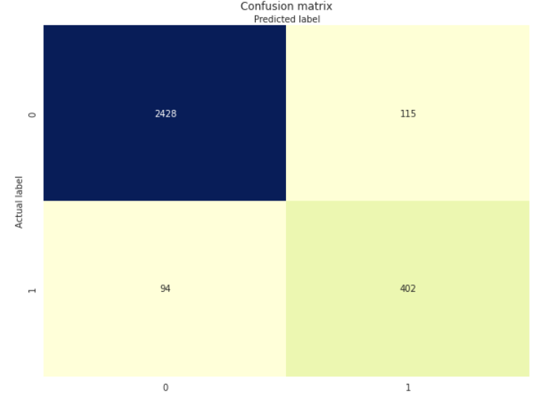
Best Model – Decision Tree
Number of Splits = 10
Assessment Parameters:
Accuracy = 93.12%
Recall = 0.81
Interpretability
Advantages of taking Decision Tree Model:
Considered a white box type of ML algorithm, the acquired knowledge from a data set can be easily extracted in a readable form.
Due to its simplicity, anyone can code, visualize, interpret, and manipulate simple decision trees.
The decision tree is distribution-free and does not depend on probability distribution assumptions.

Slide 18
Key insights based on Best Model
Total Transactions Count – Less than 57
Total Revolving Balance – A value of Less than $630
Total Relationship count – Less than 3
Total Count change Q4 to Q1 – Less than 1
Income category of Unknown
Dependent count - Less than 4
Card Category of Silver

Slide 19
Business Recommendations
Incentives to increase number of transactions
Key Predictor: Transaction Count
Rewards for transaction count of 60 and above
Electronic Alerts to decrease inactivity
Key Predictor: Months Inactive
Better ways to promote and give notifications without annoying customer
Targeted rewards based on family size
Key Predictor: Dependent Count
Targeted to Small Families for new Customers
Targeted offers for established families for current Customers
Investigate current offer attributes
Key Predictor: Card Category
Investigate Silver Card Category
Promote Revolving Benefits
Key Predictor: Total Revolving Balance
Good for them, good for us!

Slide 20
Tools used in this Project
Programming Language: Python in Google Collab

Slide 21
Thank You

