Slide 1
OPIM 5671 – Data Mining and Business Intelligence
Amazon Electronics Review
By Team 6
Akshay Kumar Pydi
Amulya Boinapalli
Divya Sai Teja Pamarthi
Jessica Tattersall
Mayank Patidar

Slide 2


Problem Statement
Electronics in Amazon is one of the highest revenue-generating departments.
With the increase in the number of electronic products, the authenticity of the product is determined by the ratings given by previously purchased customers.
With the increase in the number of reviews coming daily there should be a check on the genuineness of the ratings and review comments.
For example: in few scenarios, the rating was given as 5 out of 5 but the review title and body have negative comments with many cons on a product.
Notes:
What we've chosen to do our project on is the authenticity/accuracy of Amazon electronic items reviews. In 2020, Amazon's total consolidated net revenue amounted to 386.06 billion U.S. dollars. Amazon’s consumer electronics retail business grew more than 18.5 percent in the past year! Amazon sells electronic items from sellers across the world in addition to their own produced electronics like the Fire tablet and Echo. We obtained a data set from Kaggle.com and noticed many conflicting reviews between the overall rating and the comments so we agreed that our reevaluation of these ratings and data modeling would better help business owners predict electronic items sales and trends.

Slide 3
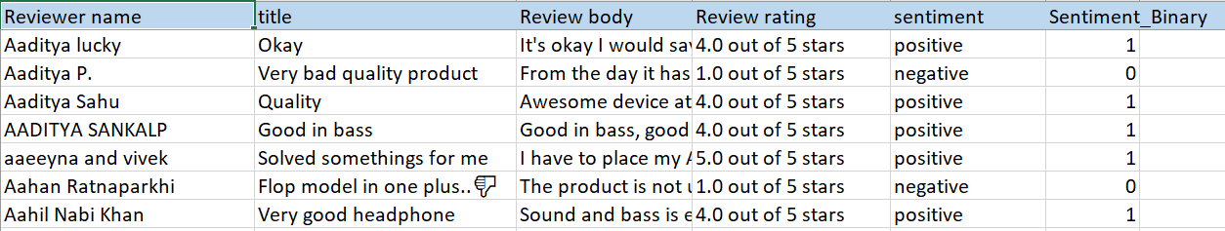
Sample
We have 6 columns in our dataset
Reviewer name is the person who has reviewed the electronic product
Title is the title for the actual review
Review body contains the whole comment of reviewer
Review rating is rating out of 5
Sentiment is either positive or negative
Sentiment Binary is the binary value of sentiment, 0 stands for negative and 1 for positive
Notes:
[Mayank Patidar]
We have selected the dataset with approximate 5lakh rows, there were mainly six columns in our dataset. The 1st column refers to the person who has posted the comment for the particular product. As the names suggests the title column has a short title for the review that is posted. The next column contains the full review of the user. Review rating consists of number of star out of 5 that a particular user has given for the product. Sentiment column is based on the review ratings, if the rating is either 4 or 5, the sentiment is positive else it is negative. And the last column is just the binary transformation of sentiments, positive is 1 and 0 stands for negative review.
For this project, reviewer name is not being used in our analysis[55 seconds]

Slide 4
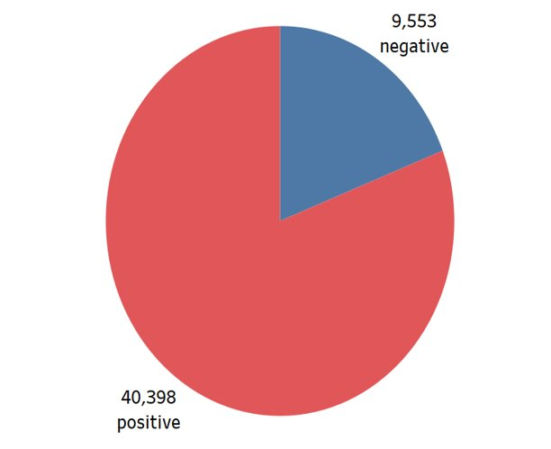
Data Exploration
There were approximately 50,000 records in the dataset.
The average length of reviews comes close to 230 characters, lengthier the review more helpful it is.
Majority of the records (40,000+) were Positive sentiments.
There were close to 9500+ rows with the sentiment as Negative.
Notes:
[Mayank Patidar]
After running few clustering and filter nodes, we found that processing 5 lakh rows is taking approximate 1 hour for every changes we made. So we decided to randomly pick 50 thousand rows for the modeling part. we mainly did the data exploration part on sentiment and review rating column.
We found that the average length of a review was close to 230 characters, as the number of character increases, more useful the review was in deciding the sentiment.
We also explored that close to 40 thousand rows have a positive sentiment and the rest were having a negative sentiment. [35 seconds]

Slide 5
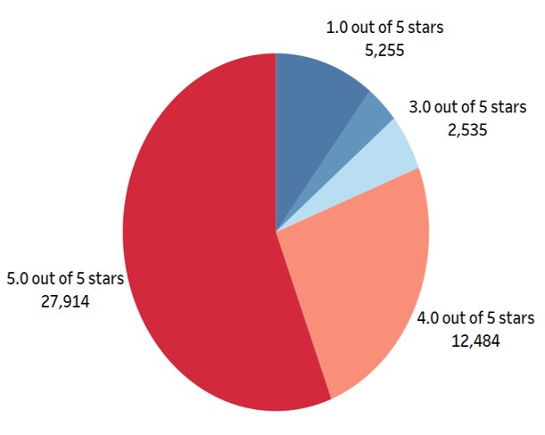
Data Exploration...
The ratings were given on a scale of 1 to 5. if the review rating.
A positive review is either 4 or 5 and negative review is either 1,2 or 3.
Majority of the records (40,000+) were either 4 or 5 out of 5.
The negative sentiment group has almost 9500+ records and consists of review rating of 1,2 or 3.
Notes:
[Mayank Patidar]
Further, we did our exploration on the review rating column and found that approximately 28 thousand rows were given a rating of 5 stars. Around 9500 rows were consisting of negative sentiments which is nothing but either 3,2 or a single star. And the rest of the rows were having 4 stars. After exploring the data we started building the models and now Akshay will take it from here, and he explain the modeling part.
[30 seconds]

Slide 6





Modeling – Review Body/Review Title Partition – 60:25:15

Slide 7
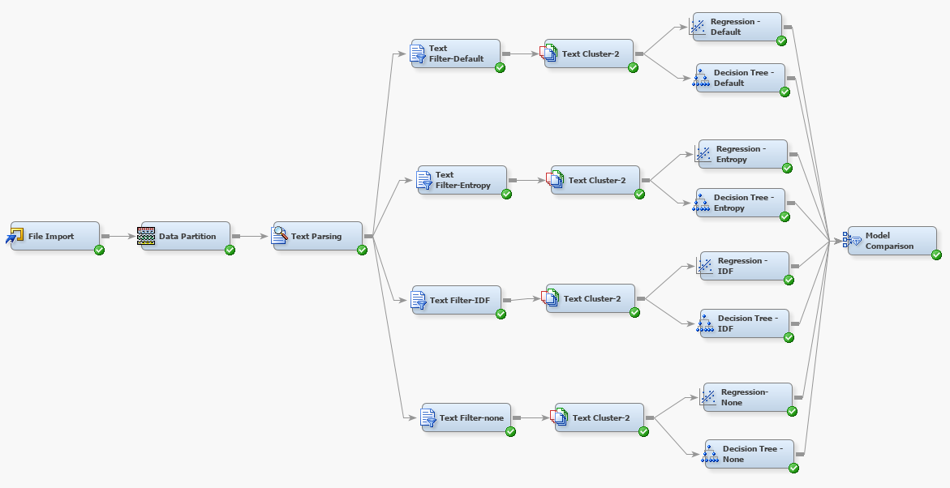
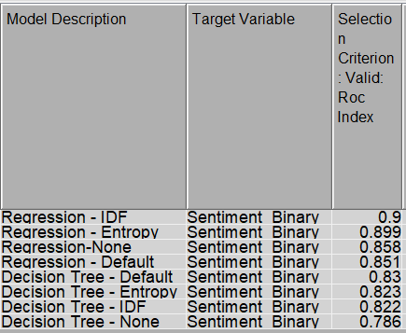
Text Parsing and Text Filter
Terms like not, can’t, won’t and other contraction words are removed from the stop list.
Inverse Document Frequency Term weight yields the best results in terms of ROC.
The minimum Number of terms in Document is validated and finally set as 50.

Slide 8
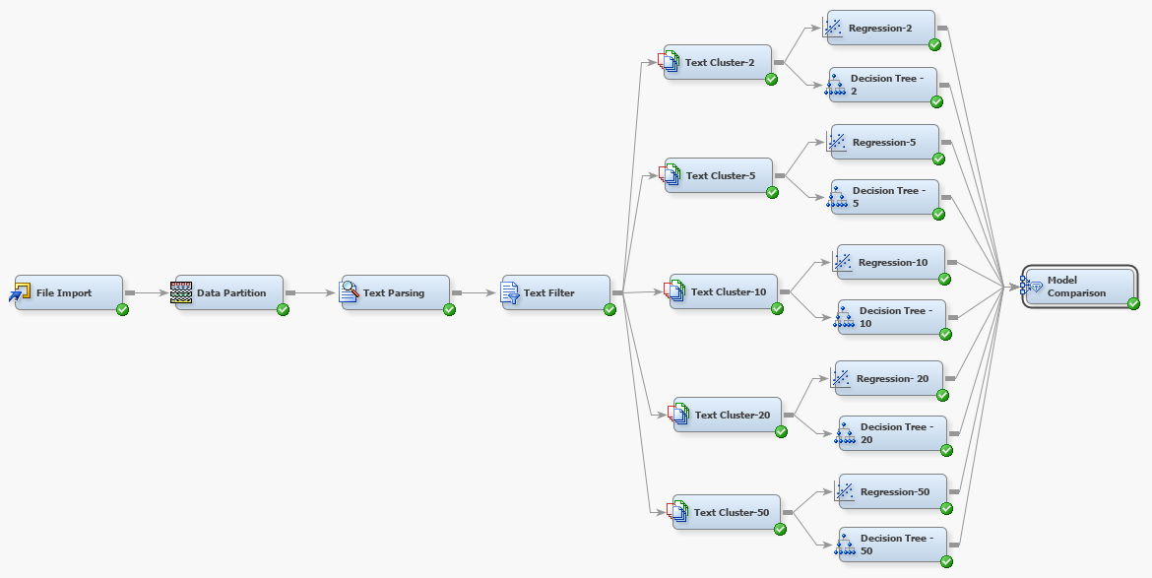
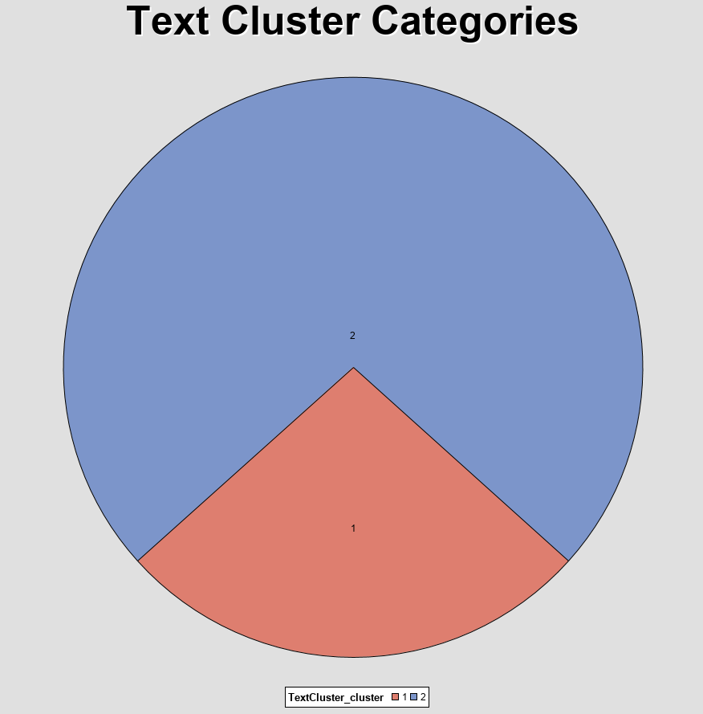
Text Cluster
We have tried for various clusters and could see out that the results remains consistent.
Text Cluster 2, with SVD Resolution = Low and Number of SVD Dimensions = 100 has the better ROC value.
Optimal Number of SVD variables created is 48

Slide 9
Text Topic
3 Different types of Analysis were done to make sure the grouping of Terms is done effectively.
Analysis 1
Interpretable model having the TextCluster_Prob and TextCluster_n variables set as Input
Analysis 2
Assigning of the Term and Document Cutoff based on the word's presence in the document
Analysis 3
Using Text Profile to cluster 15 most frequent terms for each category

Slide 10
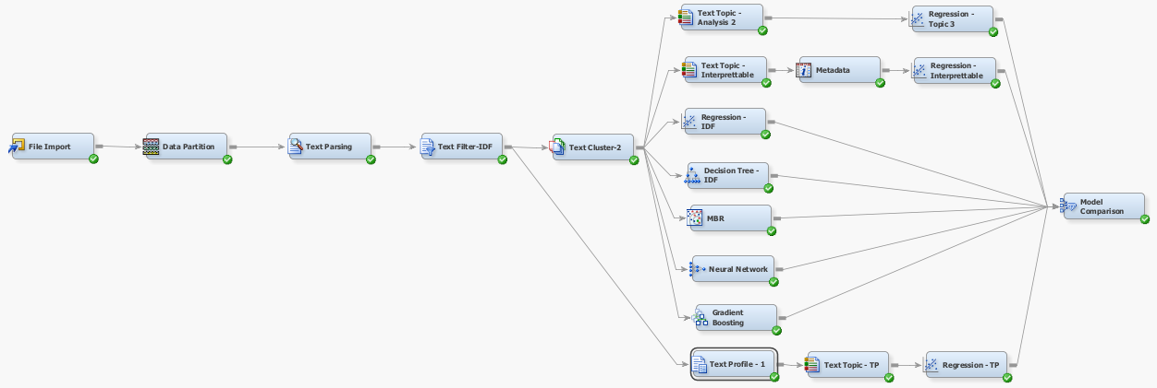
Diagram
Notes:
Note- touch upon the issue we faced with the nodes not working ?

Slide 11
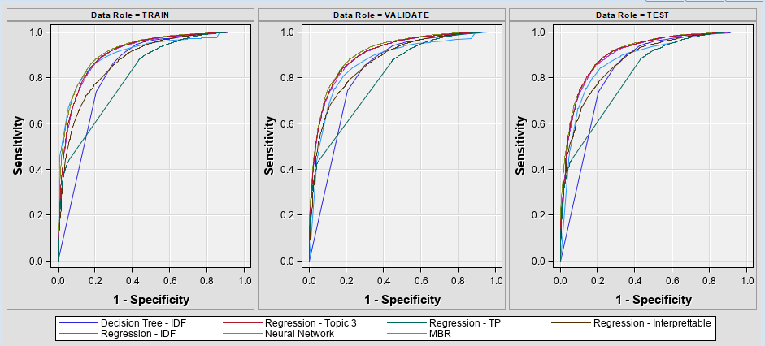
Top 3 Models – Review Body
Neural Network
ROC – 0.908
Regression Inverse Document Frequency
ROC – 0.9
Regression Text Topic
ROC – 0.902

Slide 12
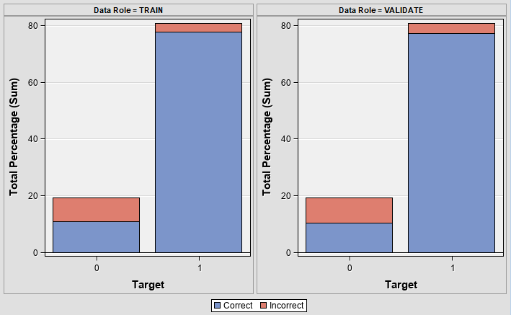
Best Model - Review Body
Neural model is a black box model and hence cannot be a good interpretable model.
Regression Model with Text Topic – Forward Selection and Validation Error Criteria
Term Frequency = IDF
Minimum Number of Documents = 50
Optimal Number of Clusters = 2
Optimal SVD variables = 48
Text Topics – 10 Multi Term
ROC = 0.902
Misclassification Rate = 0.117

Slide 13
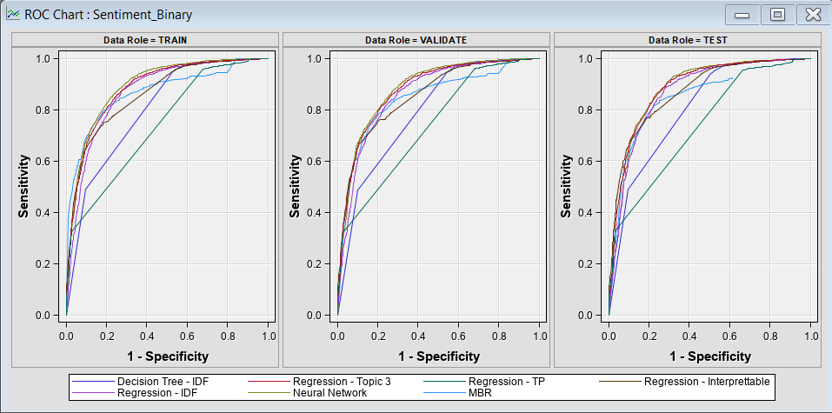
Top 3 Models – Review Title
Neural Network
ROC – 0.88
Gradient Boosting
ROC – 0.863
Regression Topic 3
ROC – 0.875

Slide 14
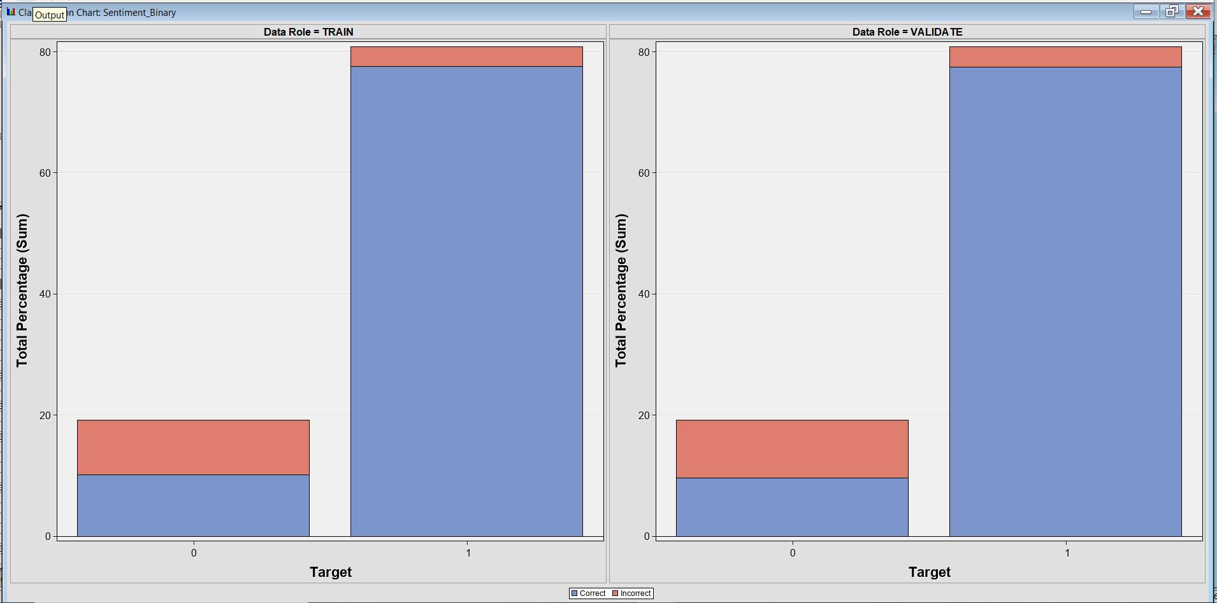
Best Model – Review Title
Neural model is a black box model and hence cannot be a good interpretable model.
Regression Model – Forward Selection and Validation Error Criteria
Term Frequency = IDF
Minimum Number of Documents = 4
Optimal Number of Clusters = 2
Optimal SVD Variables = 43
Text Topics – 10 Multi Term
ROC = 0.875
Misclassification Rate = 0.123

Slide 15
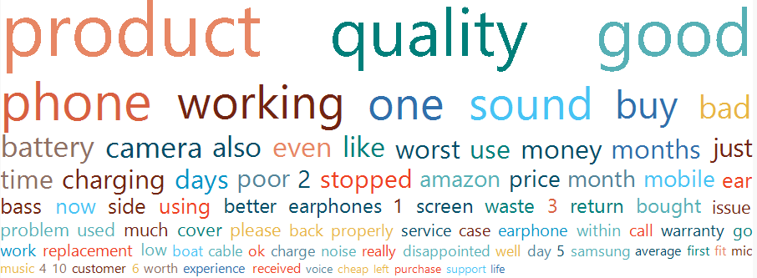
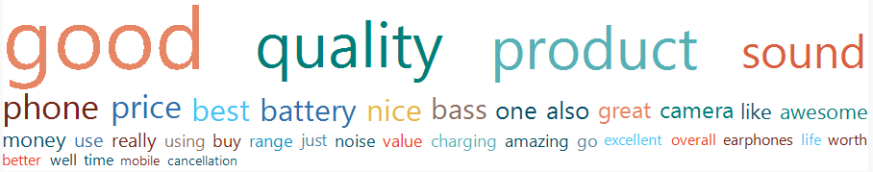
Key Findings
The word cloud shows that most of the words in the review body column are good, product, quality, sound, battery.
This shows that most of the products in the dataset were either cellular phones, speakers, headset, and cameras.
Most of the comments are related to battery and quality of sound and camera for the products.
Negative Review Body Word Cloud
Positive Review Body Word Cloud

Slide 16
Key Findings..
Phones
Review Title (vs) Review Body
We see that the terms of occurrence of Review body and Review title are similar and showing the same category of Positive or Negative Sentiment.
Rating 3
There are 2535 rows having Rating as 3 which mostly have a mixed sentiment that involved users mentioning positive and negative review comments.
Negative Sentiment Misclassification
There is more misclassification of the negative sentiment due to ratings of mark 3 and because of the mixed reviews by the users.
From the data, we know that most of the review comments pertain to the phones category where customers express their perspective on the pros and cons of the respective products.

Slide 17
Recommendations
Having a dropdown with most common good and negative reasons would improve user experience. Feature-based dropdowns can be implemented for enhanced model.
Having a pre-defined "Title" selection dropdown(Best, Good, Moderate, Worst), so that users can directly trust the title if they are not willing to read the whole comment.
Display the most useful reviews alongside the product images.
Amazon should monitor vendor who attempts to lift up average product review by providing fake positive reviews either by verified or unverified or compensated-review purchases
Vet the users rigorously before giving free products for them to give honest reviews on.
Manufacturers can incorporate and review product attributes when a product is launched and over time correct product issues, understand customer requirements, and maintain customer satisfaction.

Slide 18


