Slide 1
BREAST CANCER PREDICTION
TEAM BLITZ

Slide 2
WHAT’S THE PROBLEM?
Breast cancer is the most type of cancer in women.
It requires efficient early detection.
Existing technologies aren’t very accurate and efficient.
Screening tests done using mammograms i.e. X-ray images of breasts, is difficult for analyse.
Some women have dense breasts which leads to incorrect results.

Slide 3
OUR APPROACH- MACHINE LEARNING
Dataset is created by:
fluid samples, taken from patients with solid breast masses and
an easy-to-use graphical computer program called Xcyt.
Xcyt uses a curve-fitting algorithm, to compute ten features from each one of the cells in the sample.
It also calculates the mean value, extreme value and standard error of each feature for the image, returning a 30 real-valuated vector.
In our dataset we have the outcome variable or Dependent variable i.e. diagnosis having only two set of values, either M (Malign) or B(Benign).
So we will use Classification algorithm of supervised learning.

Slide 4
The attributes computed on this basis are:
radius (mean of distances from center to points on the perimeter)
texture (standard deviation of gray-scale values)
perimeter
area
smoothness (local variation in radius lengths)
compactness (perimeter² / area — 1.0)
concavity (severity of concave portions of the contour)
concave points (number of concave portions of the contour)
symmetry
fractal dimension (“coastline approximation” — 1)
The mean, standard error and “worst” or largest (mean of the three largest values) of these features were computed for each image, resulting in 30 features.

Slide 5
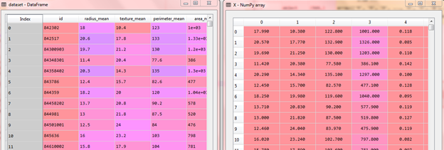
DATA EXPLORATION
We will be using Python to work on this dataset. We will first go with importing the necessary libraries and import our dataset to Python:

Slide 6
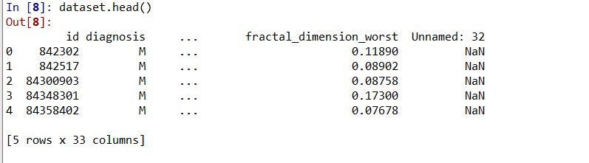
We can examine the data set using the pandas’ head() method.
Top 5 data of our dataset

Slide 7

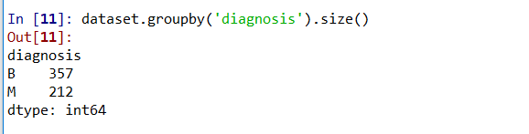
We can find the dimensions of the data set using the panda dataset ‘shape’ attribute.
‘Diagnosis’ is the column which we are going to predict , which says if the cancer is M = malignant or B = benign. 1 means the cancer is malignant and 0 means benign.

Slide 8
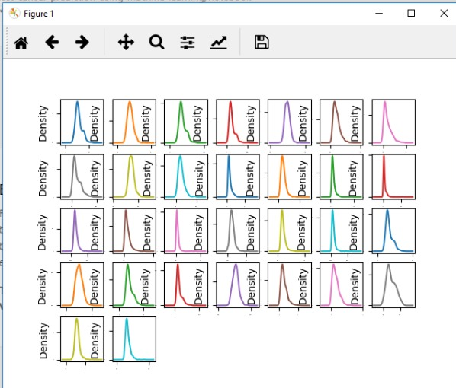
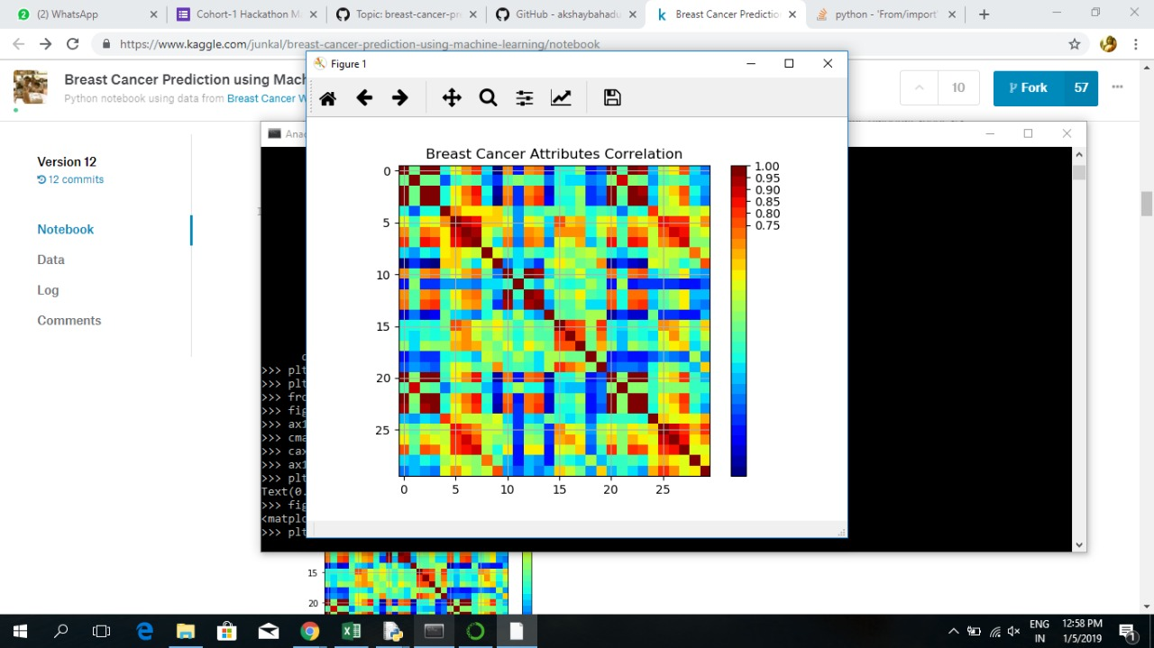
CORRELATION BETWEEN THE ATTRIBUTES
The red around the diagonal suggests that attributes are correlated with each other. The yellow and green patches suggest some moderate correlation and the blue boxes show negative correlations.

Slide 9
MACHINE LEARNING ALGORITHMS USED:
CLASSIFICATION AND REGRESSION TREE ALGORITHM(CART)
SUPPORT VECTOR MACHINE(SVM)
NAÏVE BAYES(NB)
K NEAREST NEIGHBOURS(KNN)

Slide 10
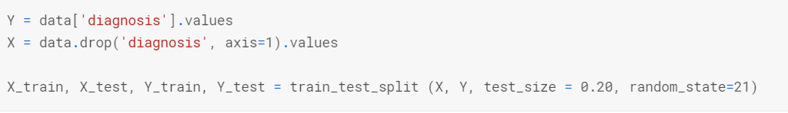
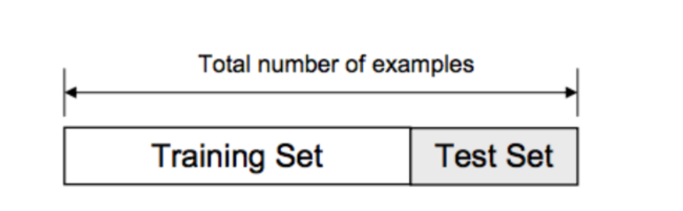
SPLITTING THE DATASET

Slide 11
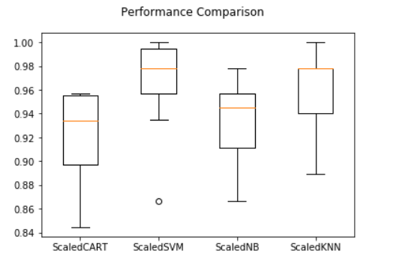
PERFORMANCE COMPARISION
After standardizing the data i.e. rescaling the distribution of values so that the mean of observed values is 0 and the standard deviation is 1. Thus we observe that SVM shows the best performance so we will use this model .

Slide 12
After applying the different classification models, we have got below accuracies with different models:
Nearest Neighbor — 95.1%
Support Vector Machines — 99.1%
Naive Bayes — 91.6%
Decision Tree Algorithm — 95.8%
So finally we have built our classification model and we can see that Support Vector Machines algorithm gives the best results for our dataset.

Slide 13
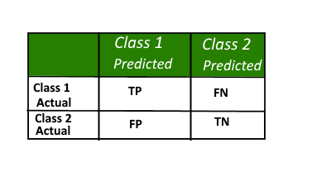
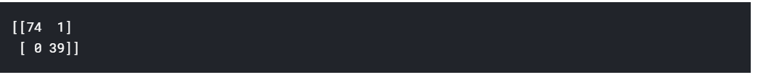
CONFUSION MATRIX
A confusion matrix is a table that is often used to describe the performance of a classification model (or "classifier") on a set of test data for which the true values are known.
print((confusion_matrix(Y_test, predictions))
THE CONFUSION MATRIX OF SVM

Slide 14

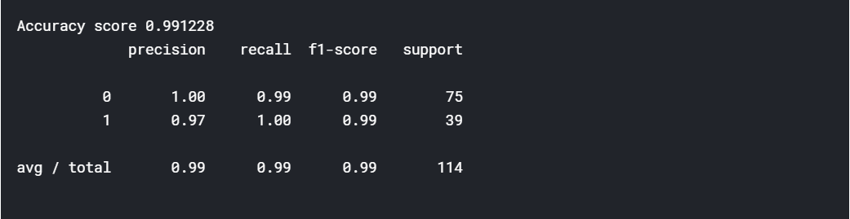
ACCURACY
Thus S.V.M shows 99.1% precision

Slide 15
Future Scope of Our Project
We have done the binary classification of the records i.e. if its malignant or benign.
Therefore, we can exceed this to multiclassification as well, by also predicting the deterioration of the cancer the patient is suffering from.

Slide 16
THANK YOU!

