Slide 1
FACTORS AFFECTING GREENHOUSE GAS EMISSIONS
Piyush Shinde
Rahul Raghatate
Akshay Kumar Vikram

Slide 2

What’s the first thing that pops to your mind when you hear Greenhouse Gas Emissions?
Fossil Fuel Consumption
The true causes of greenhouse gases are much more complex than just fossil fuel consumption.

Slide 3
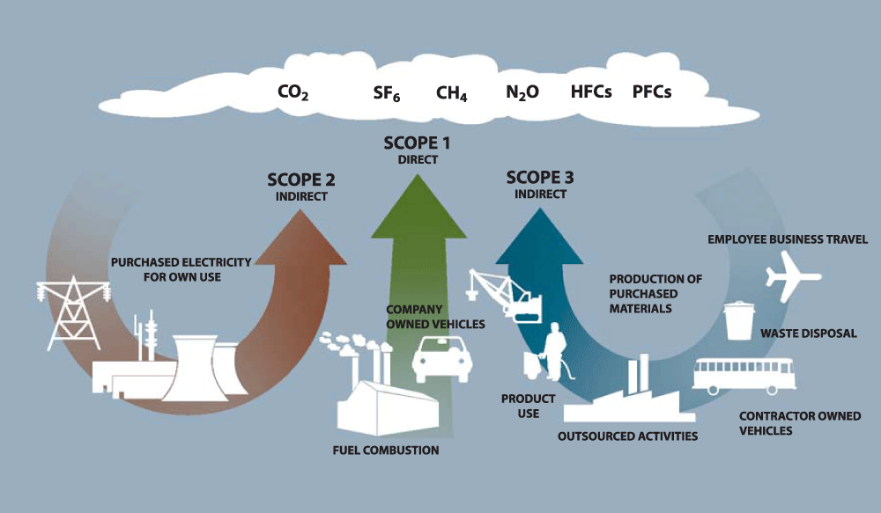
HOW ARE HUMAN ACTIVITIES INCREASING GREENHOUSE GASES?

Slide 4

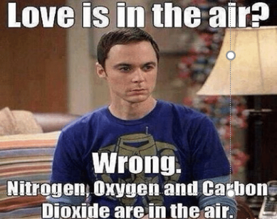
MAJOR CO₂ SOURCES
Cement Production
Export Activities
Fisheries Production
Electric Power Consumption
Air Transport
Agriculture

Slide 5
Regression Model
Dependent Variable: Total Greenhouse Gas Emissions
Independent Variables:
Air Transport
Electric Power Consumption
Agricultural Land
Cement Production
Export Activities
Total Fisheries Production

Slide 6
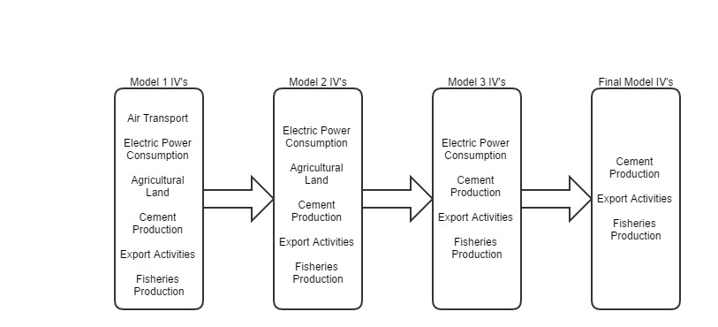
FLOW OF REGRESSION ANALYSIS

Slide 7
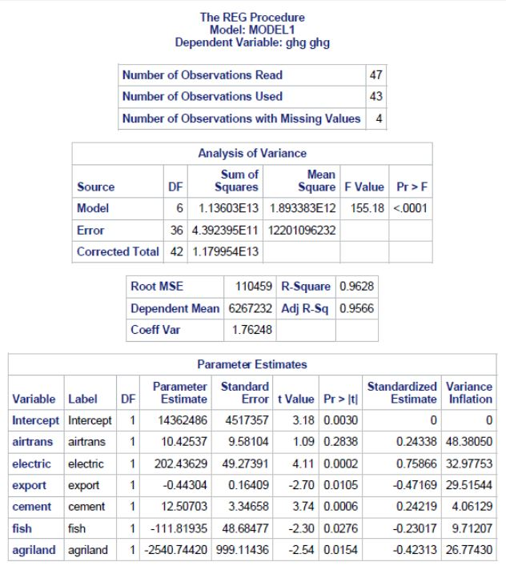
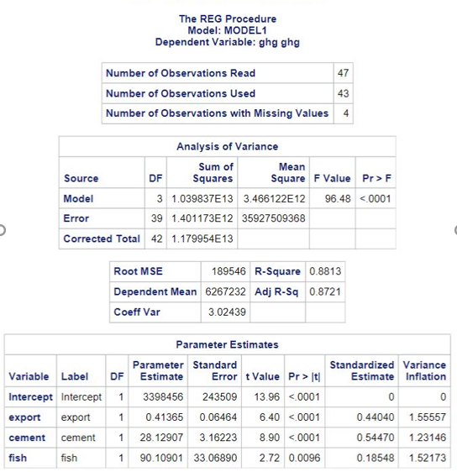
MODEL COMPARISION

Slide 8
MULTICOLLINEARITY IN VARIABLES
Number of observations = 43, relatively small dataset.
Data range: Year =>1970 to 2012
In time series data, if the independent variables move in the same direction over time.
Based on the VIF, COLLIN and correlation data we found multicollinearity in was being caused by –
Air Transport
Agricultural Land
Electric power Consumption
GHG = 3398456 + 0.41365 * Exports + 28.12907 * Cement Prod + 90.10901 * Fisheries Prod
R-squared = 88.13
White test: No Heteroskedasticity

Slide 9
AUTOCORRELATION
Commonly seen in time series data.
Methods Used –
Cochrane-Orcutt Iterative Estimation (2 iterations of Rho parameter estimates)
Yule Walker Estimation
Yule Walker equation (Final):
GHGhat = 3610948 + 0.3482 * Exports + 24.7832 * Cement Prod + 105.72 * Fisheries Prod
R-squared = 87.92

Slide 10
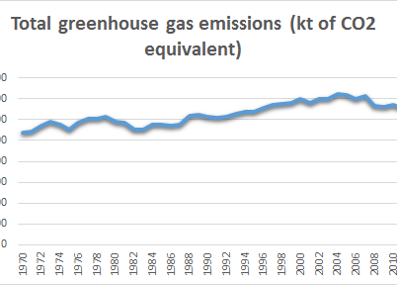
FINAL REGRESSION MODEL
Final Regression Equation:
GHGhat = 3610948 + 0.3482 * Exports + 24.7832 * Cement Prod + 105.72 * Fisheries Prod

Slide 11
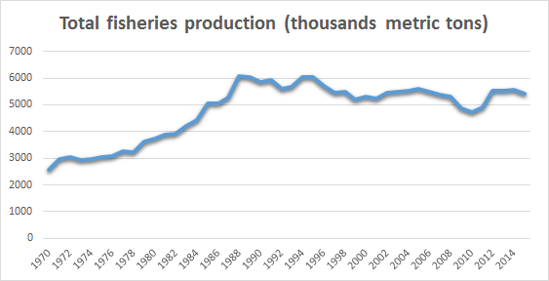
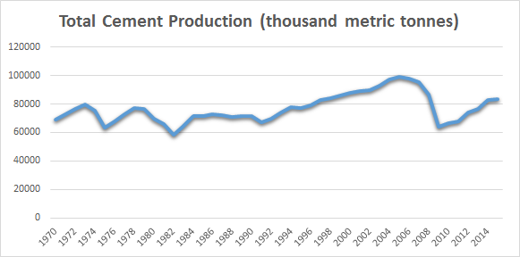
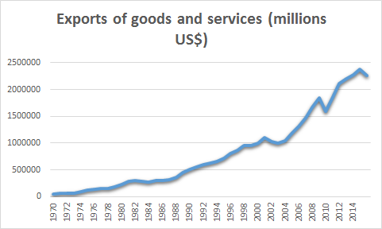
HOW ARE THESE FACTORS VARYING ANNUALLY

Slide 12
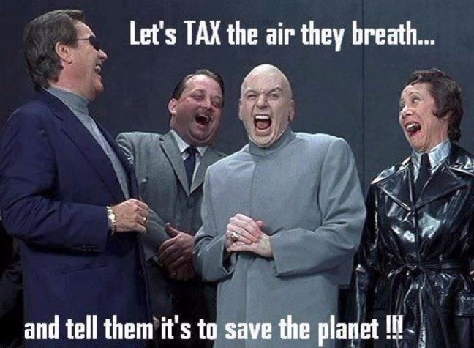
Conclusions
Existing Policies:
Clean Air Act
Ambient Air Quality Standards
Targeted approach for cement production and export activities
Planned: Government 220 GHG projections (17% decrease compared to 2005)

Slide 13
QUESTIONS???

