Slide 1
CSE 512: Distributed and Parallel Data Systems
Lecture 2
Instructor: Mohamed Sarwat

Slide 2
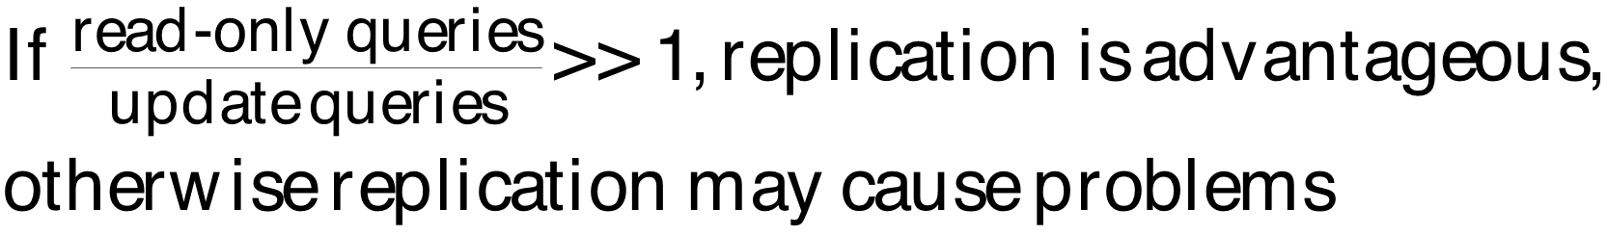
Allocation Alternatives
Non-replicated
partitioned : each fragment resides at only one site
Replicated
fully replicated : each fragment at each site
partially replicated : each fragment at some of the sites
Rule of thumb:

Slide 3
Correctness of Fragmentation
Completeness
Decomposition of relation R into fragments R₁, R₂, ..., R_{n} is complete if and only if each data item in R can also be found in some R_{i}
Reconstruction
If relation R is decomposed into fragments R₁, R₂, ..., R_{n}, then there should exist some relational operator ∇ such that
R = ∇_{1≤i≤n}R_{i}
Disjointness
If relation R is decomposed into fragments R₁, R₂, ..., R_{n}, and data item d_{i} is in R_{j}, then d_{i} should not be in any other fragment R_{k} (k ≠ j ).

Slide 4
How do we get completeness and disjointness?
(1) Check it “manually”!
e.g., F1 = σ sal<10 E ; F2 = σ sal≥10 E

Slide 5
How do we get completeness and disjointness?
(2) “Automatically” generate fragments
with these properties
Desired simple predicates ⇒ Fragments

Slide 6
Predicates
Simple predicates: Given R[A₁, A₂, …, A_{n}], a simple predicate p_{j} is
p_{j} : A_{i} θ Value where θ ∈ {=,<,≤,>,≥,≠}, Value ∈ D_{i} and D_{i} is the domain of A_{i}.
For relation R we define Pr = {p₁, p₂, …,p_{m}}
Example :
PNAME = "Maintenance"
BUDGET ≤ 200000
Minterm predicates : Given R and Pr = {p₁, p₂, …,p_{m}}
define M = {m₁,m₂,…,m_{r}} as
M = { m_{i} | m_{i} = ∧_{pj∈Pr} p_{j}* }, 1≤j≤m, 1≤i≤z
where p_{j}* = p_{j} or p_{j}* = ¬(p_{j}).

Slide 7
PHF – Information Requirements
Example
m₁: PNAME="Maintenance" ∧ BUDGET≤200000
m₂: NOT(PNAME="Maintenance") ∧ BUDGET≤200000
m₃: PNAME= "Maintenance" ∧ NOT(BUDGET≤200000)
m₄: NOT(PNAME="Maintenance") ∧ NOT(BUDGET≤200000)

Slide 8
Example of generation
Say queries use predicates:
A<10, A>5, Loc = SA, Loc = SB
Next: - generate “minterm” predicates
- eliminate useless ones
Employee relation E (#,name,loc,sal,A,…)
Integer Value
SA
SB

Slide 9
Minterm predicates (part I)
(1) A<10 ∧ A>5 ∧ Loc=SA ∧ Loc=SB
(2) A<10 ∧ A>5 ∧ Loc=SA ∧ ¬(Loc=SB)
(3) A<10 ∧ A>5 ∧ ¬(Loc=SA) ∧ Loc=SB
(4) A<10 ∧ A>5 ∧ ¬(Loc=SA) ∧ ¬(Loc=SB)
(5) A<10 ∧ ¬(A>5) ∧ Loc=SA ∧ Loc=SB
(6) A<10 ∧ ¬(A>5) ∧ Loc=SA ∧ ¬(Loc=SB)
(7) A<10 ∧ ¬(A>5) ∧ ¬(Loc=SA) ∧ Loc=SB
(8) A<10 ∧ ¬(A>5) ∧ ¬(Loc=SA) ∧ ¬(Loc=SB)

Slide 10
Minterm predicates (part I)
(1) A<10 ∧ A>5 ∧ Loc=SA ∧ Loc=SB
(2) A<10 ∧ A>5 ∧ Loc=SA ∧ ¬(Loc=SB)
(3) A<10 ∧ A>5 ∧ ¬(Loc=SA) ∧ Loc=SB
(4) A<10 ∧ A>5 ∧ ¬(Loc=SA) ∧ ¬(Loc=SB)
(5) A<10 ∧ ¬(A>5) ∧ Loc=SA ∧ Loc=SB
(6) A<10 ∧ ¬(A>5) ∧ Loc=SA ∧ ¬(Loc=SB)
(7) A<10 ∧ ¬(A>5) ∧ ¬(Loc=SA) ∧ Loc=SB
(8) A<10 ∧ ¬(A>5) ∧ ¬(Loc=SA) ∧ ¬(Loc=SB)

Slide 11
Minterm predicates (part I)
5 < A < 10
(1) A<10 ∧ A>5 ∧ Loc=SA ∧ Loc=SB
(2) A<10 ∧ A>5 ∧ Loc=SA ∧ ¬(Loc=SB)
(3) A<10 ∧ A>5 ∧ ¬(Loc=SA) ∧ Loc=SB
(4) A<10 ∧ A>5 ∧ ¬(Loc=SA) ∧ ¬(Loc=SB)
(5) A<10 ∧ ¬(A>5) ∧ Loc=SA ∧ Loc=SB
(6) A<10 ∧ ¬(A>5) ∧ Loc=SA ∧ ¬(Loc=SB)
(7) A<10 ∧ ¬(A>5) ∧ ¬(Loc=SA) ∧ Loc=SB
(8) A<10 ∧ ¬(A>5) ∧ ¬(Loc=SA) ∧ ¬(Loc=SB)
A ≤ 5

Slide 12
Minterm predicates (part II)
(9) ¬(A<10) ∧ A>5 ∧ Loc=SA ∧ Loc=SB
(10) ¬(A<10) ∧ A>5 ∧ Loc=SA ∧¬(Loc=SB)
(11) ¬(A<10) ∧ A>5 ∧¬(Loc=SA) ∧ Loc=SB
(12) ¬(A<10) ∧ A>5 ∧¬(Loc=SA) ∧¬(Loc=SB)
(13) ¬(A<10) ∧¬(A>5) ∧ Loc=SA ∧ Loc=SB
(14) ¬(A<10) ∧¬(A>5) ∧ Loc=SA ∧¬(Loc=SB)
(15) ¬(A<10) ∧¬(A>5) ∧¬(Loc=SA) ∧ Loc=SB
(16) ¬(A<10) ∧¬(A>5) ∧¬(Loc=SA) ∧¬(Loc=SB)

Slide 13
Minterm predicates (part II)
(9) ¬(A<10) ∧ A>5 ∧ Loc=SA ∧ Loc=SB
(10) ¬(A<10) ∧ A>5 ∧ Loc=SA ∧¬(Loc=SB)
(11) ¬(A<10) ∧ A>5 ∧¬(Loc=SA) ∧ Loc=SB
(12) ¬(A<10) ∧ A>5 ∧¬(Loc=SA) ∧¬(Loc=SB)
(13) ¬(A<10) ∧¬(A>5) ∧ Loc=SA ∧ Loc=SB
(14) ¬(A<10) ∧¬(A>5) ∧ Loc=SA ∧¬(Loc=SB)
(15) ¬(A<10) ∧¬(A>5) ∧¬(Loc=SA) ∧ Loc=SB
(16) ¬(A<10) ∧¬(A>5) ∧¬(Loc=SA) ∧¬(Loc=SB)
A ≥ 10

Slide 14
Final fragments:
F2: 5 < A < 10 ∧ Loc=SA
F3: 5 < A < 10 ∧ Loc=SB
F6: A ≤ 5 ∧ Loc=SA
F7: A ≤ 5 ∧ Loc=SB
F10: A ≥ 10 ∧ Loc=SA
F11: A ≥ 10 ∧ Loc=SB

Slide 15
Primary Horizontal Fragmentation
Definition :
R_{j} = σ_{Fj}(R), 1 ≤ j ≤ w
where F_{j} is a selection formula, which is (preferably) a minterm predicate.
Therefore,
A horizontal fragment R_{i} of relation R consists of all the tuples of R which satisfy a minterm predicate m_{i}.
⬇
Given a set of minterm predicates M, there are as many horizontal fragments of relation R as there are minterm predicates.
Set of horizontal fragments also referred to as minterm fragments.

Slide 16
Correctness of Fragmentation
Completeness
Decomposition of relation R into fragments R₁, R₂, ..., R_{n} is complete if and only if each data item in R can also be found in some R_{i}
Reconstruction
If relation R is decomposed into fragments R₁, R₂, ..., R_{n}, then there should exist some relational operator ∇ such that
R = ∇_{1≤i≤n}R_{i}
Disjointness
If relation R is decomposed into fragments R₁, R₂, ..., R_{n}, and data item d_{i} is in R_{j}, then d_{i} should not be in any other fragment R_{k} (k ≠ j ).

Slide 17
Primary Horizontal Fragmentation
Definition :
R_{j} = σ_{Fj}(R), 1 ≤ j ≤ w
where F_{j} is a selection formula, which is (preferably) a minterm predicate.
Therefore,
A horizontal fragment R_{i} of relation R consists of all the tuples of R which satisfy a minterm predicate m_{i}.
⬇
Given a set of minterm predicates M, there are as many horizontal fragments of relation R as there are minterm predicates.
Set of horizontal fragments also referred to as minterm fragments.

Slide 18
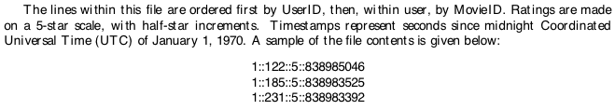
Assignment 1
Fragmentation

Slide 20
Derived Horizontal Fragmentation
Defined on a member relation of a link according to a selection operation specified on its owner.
Each link is an equijoin.
Pay
TITLE,
SAL
L₁
EMP
PROJ
ENO, ENAME, TITLE
PNO, PNAME, BUDGET, LOC
L₂
L₃
ASG
ENO, PNO,
RESP, DUR

Slide 21
DHF – Definition
Given a link L where owner(L)=S and member(L)=R, the derived horizontal fragments of R are defined as
R_{i} = R ⋉_{F} S_{i}, 1≤i≤w
where w is the maximum number of fragments that will be defined on R and
S_{i} = σ_{Fi} (S)
where F_{i} is the formula according to which the primary horizontal fragment S_{i} is defined.

Slide 22
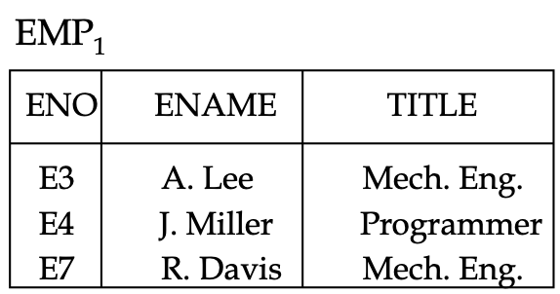
DHF – Example
Given link L₁ where owner(L₁)=PAY and member(L₁)=EMP
EMP₁ = EMP ⋉ PAY₁
EMP₂ = EMP ⋉ PAY₂
Where
PAY₁ = σ_{SAL≤30000}(PAY)
PAY₂ = σ_{SAL>30000}(PAY)
EMP₂
ENO
ENAME
TITLE
E1
J. Doe
Elect. Eng.
E2
M. Smith
Syst. Anal.
E5
B. Casey
Syst. Anal.
E6
L. Chu
Elect. Eng.
E8
J. Jones
Syst. Anal.

Slide 23
How to achieve Completeness and Disjointness?

Slide 24
To get
completeness
Need to enforce
referential integrity constraint:
join attr(#) of member relation
⇓
joint attr(#) of owner relation

Slide 25
To get
disjointness
Join attribute(#) should be
key of owner relation

Slide 26
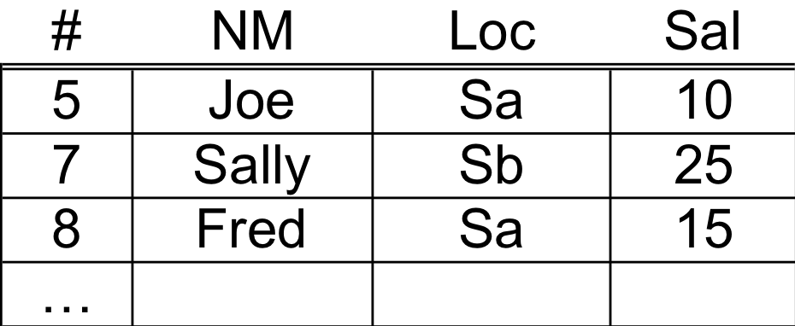
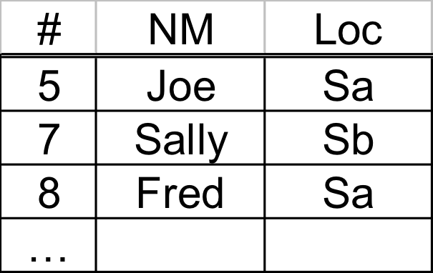
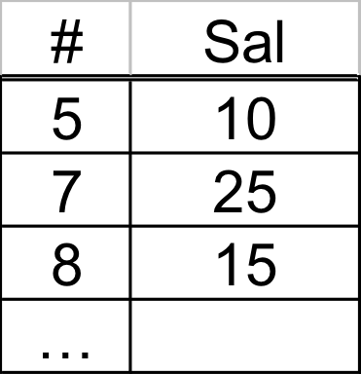
Vertical fragmentation
E
Example:
E1
E2

Slide 27
Vertical Fragmentation
More difficult than horizontal, because more alternatives exist.
Two approaches :
grouping
attributes to fragments
splitting
relation to fragments

Slide 28
Properties: R[T] ⇒ Ri[Ti]
(1) Completeness
U Ti = T
all i

Slide 29
(2) Disjointness
Ti ∩ Tj = ∅ for all i,j i≠j
E(#,LOC,SAL)
E1(#,LOC)
E2(SAL)

Slide 30
Ti ∩ Tj = ∅ for all i,j i≠j
E(#,LOC,SAL)
E1(#,LOC)
E2(SAL)
Not a desirable property!!
(could not reconstruct R!)

Slide 31
(3) Lossless join
Ri = R
all i
 One way to achieve lossless join:
Repeat key in all fragments, i.e.,
Key ⊆ Ti for all i

Slide 32
VF – Information Requirements
Application Information
Attribute affinities
a measure that indicates how closely related the attributes are
This is obtained from more primitive usage data
Attribute usage values
Given a set of queries Q = {q₁, q₂,…, q_{q}} that will run on the relation R[A₁, A₂,…, A_{n}],\
use(q_{i},•) can be defined accordingly
ì
1 if attribute A_{j} is referenced by query q_{i}
use(q_{i},A_{j}) =
í
î
0 otherwise

Slide 33
VF – Definition of use(q_{i},A_{j})
Consider the following 4 queries for relation PROJ
q₁: SELECT BUDGET q₂: SELECT PNAME,BUDGET
FROM PROJ FROM PROJ
WHERE PNO=Value
q₃: SELECT PNAME q₄: SELECT SUM(BUDGET)
FROM PROJ FROM PROJ
WHERE LOC=Value WHERE LOC=Value
Let A₁= PNO, A₂= PNAME, A₃= BUDGET, A₄= LOC
A₁
A₂
A₃
A₄
q₁
1
0
1
0
Attribute Usage Matrix
q₂
0
1
1
0
q₃
0
1
0
1
q₄
0
0
1
1

Slide 34
VF – Affinity Measure aff(A_{i},A_{j})
The attribute affinity measure between two attributes A_{i} and A_{j} of a relation R[A₁, A₂, …, A_{n}] with respect to the set of applications Q = (q₁, q₂, …, q_{q}) is defined as follows :
å
aff (A_{i}, A_{j}) =
(query access)
all queries that access A_{i} and A_{j}
å
access
query access =
access frequency of a query ∗
execution
all sites

Slide 35
Attribute affinity matrix
A1 A2 A3 A4 A5
A1 - - - - -
A2 50 - - - -
A3 45 48 - - -
A4 1 2 0 - -
A5 0 0 4 75 -
R1[K,A1,A2,A3] R2[K,A4,A5]
Notes:
Partitioning and Clustering

Slide 36
Hybrid Fragmentation
R
HF
HF
R₁
R₂
VF
VF
VF
VF
VF
R₁₁
R₁₂
R₂₁
R₂₂
R₂₃

Slide 37
Fragment Allocation
Problem Statement
Given
F = {F₁, F₂, …, F_{n}} fragments
S ={S₁, S₂, …, S_{m}} network sites
Q = {q₁, q₂,…, q_{q}} applications
Find the "optimal" distribution of F to S.
Optimality
Minimal cost
Communication + storage + processing (read & update)
Cost in terms of time (usually)
Performance
Response time and/or throughput
Constraints
Per site constraints (storage & processing)

Slide 38
Optimization problem
What is best placement of fragments and/or best number of copies to:
minimize query response time
maximize throughput
minimize “some cost”
...
Subject to constraints?
Available storage
Available bandwidth, power,…
Keep 90% of response time below X
...

Slide 39
Issues
Where do queries originate
What is communication cost? and size of answers, relations,…
What is storage capacity, cost at sites? and size of fragments?
What is processing power at sites?

Slide 40
Questions

Slide 41
Query Processing in a DDBMS
high level user query
query
processor
Low-level data manipulation
commands for D-DBMS

Slide 42
Query Processing Components
Query language that is used
SQL
Query execution methodology
The steps that one goes through in executing high-level (declarative) user queries.
Query optimization
How do we determine the “best” execution plan?

Slide 43
Selecting Alternatives
SELECT ENAME
FROM EMP,ASG
WHERE EMP.ENO = ASG.ENO
AND RESP = "Manager”
Strategy 1
P_{ENAME}(s_{RESP=“Manager”ÙEMP.ENO=ASG.ENO}(EMP×ASG))
Strategy 2
P _{ENAME}(EMP ⋈_{ENO} (s_{RESP=“Manager”} (ASG))
Strategy 2 avoids Cartesian product, so may be “better” Assume 20 Managers

Slide 44
What is the Problem?
Site 1
Site 2
Site 3
Site 4
Site 5
ASG₁=σ_{ENO≤“E3”}(ASG)
ASG₂= σ_{ENO>“E3”}(ASG)
EMP₁= σ_{ENO≤“E3”}(EMP)
EMP₂= σ_{ENO>“E3”}(EMP)
Result
Site 5
result= (EMP₁ ⋅ EMP₂)⋈_{ENO}σ_{RESP=“Manager”}(ASG₁× ASG₂)
ASG₁
ASG₂
EMP₁
EMP₂
Site 1
Site 2
Site 3
Site 4

Slide 45
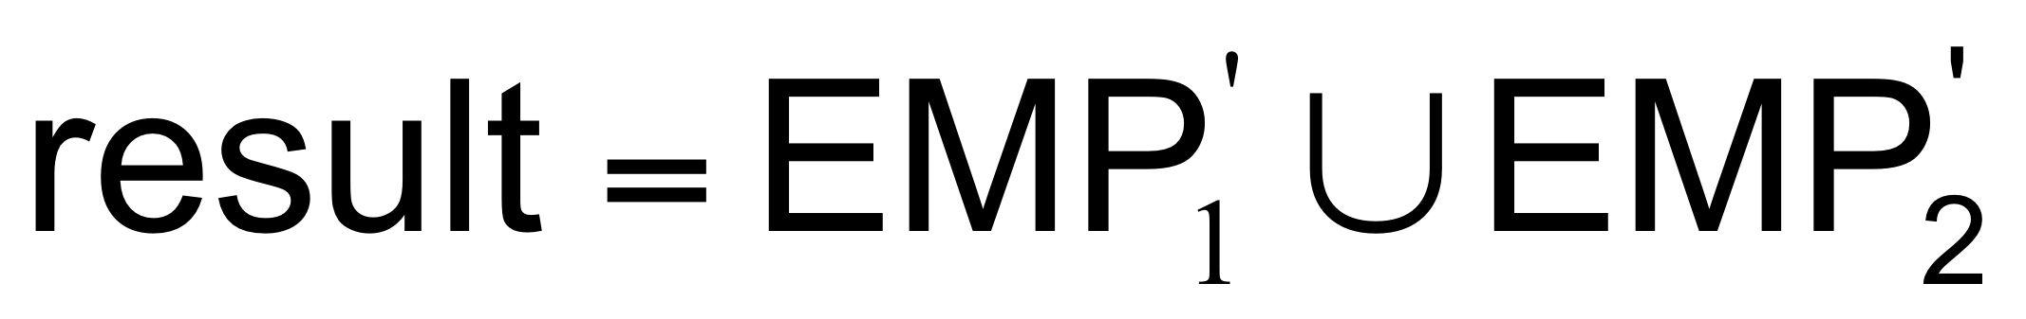

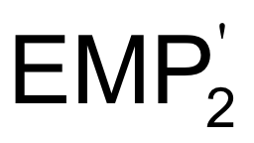




What is the Problem?
Site 1
Site 2
Site 3
Site 4
Site 5
ASG₁=σ_{ENO≤“E3”}(ASG)
ASG₂= σ_{ENO>“E3”}(ASG)
EMP₁= σ_{ENO≤“E3”}(EMP)
EMP₂= σ_{ENO>“E3”}(EMP)
Result
Site 5
Site 3
Site 4
EMP’₁=EMP₁ ⋈_{ENO} ASG’₁
EMP’₂=EMP₂ ⋈_{ENO} ASG’₂
Site 1
Site 2

Slide 46
What is the Problem?
Site 1
Site 2
Site 3
Site 4
Site 5
ASG₁=σ_{ENO≤“E3”}(ASG)
ASG₂= σ_{ENO>“E3”}(ASG)
EMP₁= σ_{ENO≤“E3”}(EMP)
EMP₂= σ_{ENO>“E3”}(EMP)
Result
Site 5
Site 5
result= (EMP₁ ⋅ EMP₂)⋈_{ENO}σ_{RESP=“Manager”}(ASG₁× ASG₂)
Site 3
Site 4
ASG₁
ASG₂
EMP₁
EMP₂
EMP’₁=EMP₁ ⋈_{ENO} ASG’₁
EMP’₂=EMP₂ ⋈_{ENO} ASG’₂
Site 1
Site 2
Site 3
Site 4
Assume
size(EMP) = 400
size(ASG) = 1000
20 Managers
tuple access cost = 1 unit;
tuple transfer cost = 10 units
Site 1
Site 2

Slide 47
What is the Problem?
Site 1
Site 2
Site 3
Site 4
Site 5
ASG₁=σ_{ENO≤“E3”}(ASG)
ASG₂= σ_{ENO>“E3”}(ASG)
EMP₁= σ_{ENO≤“E3”}(EMP)
EMP₂= σ_{ENO>“E3”}(EMP)
Result
Site 5
Site 5
result= (EMP₁ ⋅ EMP₂)⋈_{ENO}σ_{RESP=“Manager”}(ASG₁× ASG₂)
Site 3
Site 4
ASG₁
ASG₂
EMP₁
EMP₂
EMP’₁=EMP₁ ⋈_{ENO} ASG’₁
EMP’₂=EMP₂ ⋈_{ENO} ASG’₂
Site 1
Site 2
Site 3
Site 4
Assume
size(EMP) = 400
size(ASG) = 1000
20 Managers
tuple access cost = 1 unit;
tuple transfer cost = 10 units
Site 1
Site 2

Slide 48
Cost of Alternatives
Assume
size(EMP) = 400, size(ASG) = 1000
tuple access cost = 1 unit; tuple transfer cost = 10 units
Strategy 1
produce ASG': (10+10) ∗ tuple access cost 20
transfer ASG' to the sites of EMP: (10+10) ∗ tuple transfer cost 200
produce EMP': (10+10) ∗ tuple access cost ∗ 2 40
transfer EMP' to result site: (10+10) ∗ tuple transfer cost 200
Total Cost 460
Strategy 2
transfer EMP to site 5: 400 ∗ tuple transfer cost 4,000
transfer ASG to site 5: 1000 ∗ tuple transfer cost 10,000
join EMP and ASG': 400 ∗ 20 ∗ tuple access cost 8,000
Total Cost 22,000

Slide 49
Query Optimization Objectives
Minimize a cost function
I/O cost +
CPU cost +
Communication cost

Slide 50
Query Optimization Issues – Statistics
Relation
Cardinality
Size of a tuple
Fraction of tuples participating in a join with another relation
Attribute
Cardinality of domain
Actual number of distinct values
Common assumptions
Independence between different attribute values
Uniform distribution of attribute values within their domain

Slide 51
Query Optimization Issues – Decision Sites
Centralized
Single site determines the “best” schedule
Simple
Need knowledge about the entire distributed database
Distributed
Cooperation among sites to determine the schedule
Need only local information
Cost of cooperation
Hybrid
One site determines the global schedule
Each site optimizes the local subqueries

Slide 52
Distributed Query Processing
Calculus Query on Distributed Relations
Query
Decomposition
GLOBAL
SCHEMA
Algebraic Query on Distributed
Relations
CONTROL
SITE
Data
Localization
FRAGMENT
SCHEMA
Fragment Query
Global
Optimization
STATS ON
FRAGMENTS
Optimized Fragment Query
with Communication Operations
LOCAL
SITES
Local
Optimization
LOCAL
SCHEMAS
Optimized Local Queries

Slide 53
Query Processing
Decomposition
Localization
Optimization

Slide 54
Decomposition
Same as in centralized system
Normalization
Eliminating redundancy
Algebraic rewriting

Slide 55
Normalization
Convert from general language to a “standard” form (e.g., Relational Algebra)

Slide 56
Example
Select A,C
From R,S
Where (R.B=1 and S.D=2) or (R.C>3 and S.D.=2)
σ (R.B=1 v R.C>3) ∧ S.D.=2
R S
π
A, C
Conjunctive
normal
form

Slide 57
Also: Detect invalid expressions
E.g.: Select * from R where R.A =3 ➽ R does not have “A” attribute

Slide 58
Eliminate redundancy
E.g.: in conditions:
(S.A=1) ∧ (S.A>5) ⇒ False
(S.A<10) ∧ (S.A<5) ⇒ S.A<5

Slide 59
E.g.: Common sub-expressions
U U
S σcond σcond T S σcond T
R R R

Slide 60
Algebraic rewriting
E.g.: Push conditions down
σcond3
σcond
σcond1 σcond2
R S R S

Slide 61
After decomposition:
One or more algebraic query trees on relations
Localization:
Replace relations by corresponding fragments

Slide 62
Localization steps
(1) Start with query
(2) Replace relations by fragments
(3) Push ∪: up ()
π,σ : down
(4) Simplify – eliminate unnecessary operations

Slide 63
Notation for fragment
[R: cond]
fragment conditions its tuples satisfy

Slide 64
Example A
(1) σE=3
R
What if we have two Fragments [R1: E < 10] [R2: E ≥ 10]

Slide 66
(2) σE=3
∪
[R1: E < 10] [R2: E ≥ 10]

Slide 67
(3) ∪
σE=3 σE=3
[R1: E < 10] [R2: E ≥ 10]
Anything Wrong here?

Slide 68
(3) ∪
σE=3 σE=3
[R1: E < 10] [R2: E ≥ 10]
⇒ Ø

Slide 69
(4) σE=3
[R1: E < 10]

Slide 70
Rule 1
σC1[R: c2] ⇒ σC1[R: c1 ∧ c2]
[R: False] ⇒ Ø
A
B

Slide 71
In example A:
σE=3[R2: E≥10] ⇒ σE=3 [R2: E=3 ∧ E≥10]
⇒ σE=3 [ R2: False]
⇒ Ø

Slide 72
Example B
(1) A=common
attribute
R S
A
[R1: A<5] [R2: 5 ≤ A ≤ 10] [R3: A>10]
What if
[S1: A<5] [S2: A ≥ 5]

Slide 73
(2)
∪ ∪
A
[R1: A<5] [R2: 5 ≤ A ≤ 10] [R3: A>10]
[S1: A<5] [S2: A ≥ 5]

Slide 74
(3) ∪
[R1:A<5][S1:A<5] [R1:A<5][S2:A≥5] [R2:5≤A≤10][S1:A<5]
[R2:5≤A≤10][S2:A≥5] [R3:A>10][S1:A<5] [R3:A>10][S2:A≥5]
A
A
A
A
A
A

Slide 75
(3) ∪
[R1:A<5][S1:A<5] [R1:A<5][S2:A≥5] [R2:5≤A≤10][S1:A<5]
[R2:5≤A≤10][S2:A≥5] [R3:A>10][S1:A<5] [R3:A>10][S2:A≥5]
A
A
A
A
A
A

Slide 76
(4) ∪
[R1:A<5][S1:A<5] [R2:5≤A≤10][S2:A≥5]
A
A
A
[R3:A>10][S2:A≥5]

Slide 77
Rule 2
[R: C1] [S: C2] ⇒
[R S: C1 ∧ C2 ∧ R.A = S.A]
A
A

Slide 78
 In step 4 of Example B:
[R1: A<5] [S2: A ≥ 5]
⇒[R1 S2: R1.A < 5 ∧ S2.A ≥ 5 ∧ R1.A = S2.A ]
⇒[R1 S2: False] ⇒ Ø
A
A
A

Slide 79
Localization with derived fragmentation
Example C
(2)
∪ ∪
R1: R2: S1:K=R.K S2:K=R.K
A<10 A ≥10 ∧R.A<10 ∧R.A≥10
K

Slide 80
(3) ∪
[R1][S1] [R1][S2] [R2][S1] [R2][S2]
K
K
K
K

Slide 81
(4) ∪
[R1:A<10] S1:K=R.K [R2:A≥10] S2:K=R.K
∧ R.A<10 ∧ R.A≥10
K
K

Slide 82
 In step 4 of Example C:
[R1:A<10] [S2:K=R.K ∧ R.A≥10]
⇒ [R1 S2: R1.A<10 ∧ S2.K=R.K ∧ R.A≥10 ∧ R1.K= S2.K]
⇒ [R1 S2:False ] (K is key of R, R1)
⇒ Ø
K
K
K

Slide 83
(4) ∪
[R1:A<10] S1:K=R.K [R2:A≥10] S2:K=R.K
∧ R.A<10 ∧ R.A≥10
K
K
(4) simplified more: ∪
K
K
R1
R2
S2
S1

Slide 84
Localization with vertical fragmentation
Example D
(1) Π_{A} R1(K, A, B)
R R2(K, C, D)
How to process this query?

Slide 85
(2) Π_{A}
R1 R2
(K, A, B) (K, C, D)
K

Slide 86
(3) Π_{A}
Π_{K,A} Π_{K,A}
R1 R2
(K, A, B) (K, C, D)
K
not really
needed

Slide 87
(4) Π_{A}
R1
(K, A, B)

Slide 88
Rule 3
Given vertical fragmentation of R:
Ri = Π_{Ai} (R), Ai ⊆ A
Then for any B ⊆ A:
Π_{B} (R) = Π_{B} [ Ri | B ∩ Ai ≠ Ø ]
i

Slide 89
Localization with hybrid fragmentation
Example E
R1 = σ_{k<5} [Π_{k,A} R]
R2 = σ_{k≥5} [Π_{k,A} R]
R3 = Π_{k,B} R

Slide 90
Query: Π_{A}
σ_{k=3}
R

Slide 91
Reduced
Query: Π_{A}
σ_{k=3}
R1

Slide 92
Query Processing
Decomposition
Localization
Optimization

Slide 93
Cost-Based Optimization
Solution space
The set of equivalent algebra expressions (query trees).
Cost function (in terms of time)
I/O cost + CPU cost + communication cost
These might have different weights in different distributed environments (LAN vs WAN).
Can also maximize throughput
Search algorithm
How do we move inside the solution space?
Exhaustive search, heuristic algorithms (iterative improvement, simulated annealing, genetic,…)

Slide 94
Query Optimization Process
Input Query
Search Space
Generation
Equivalent QEP
Search
Strategy
Cost Model
Best QEP

Slide 95
Search Space
▷◁ _{PNO}
Search space characterized by alternative execution
Focus on join trees
SELECT ENAME,RESP
FROM EMP, ASG,PROJ
WHERE EMP.ENO=ASG.ENO
AND ASG.PNO=PROJ.PNO
▷◁ _{ENO}
PROJ
EMP
ASG
▷◁ _{ENO}
▷◁ _{PNO}
EMP
PROJ
ASG
▷◁ _{ENO,PNO}
×
ASG
PROJ
EMP

Slide 96
Search Space
▷◁ _{PNO}
▷◁ _{ENO}
PROJ
For N relations, how many equivalent join trees can be obtained by applying commutativity and associativity rules
EMP
ASG
▷◁ _{ENO}
▷◁ _{PNO}
EMP
PROJ
ASG
▷◁ _{ENO,PNO}
×
ASG
PROJ
EMP

Slide 97
Search Space
▷◁ _{PNO}
Search space characterized by alternative execution
Focus on join trees
For N relations, there are O(N!) equivalent join trees that can be obtained by applying commutativity and associativity rules
SELECT ENAME,RESP
FROM EMP, ASG,PROJ
WHERE EMP.ENO=ASG.ENO
AND ASG.PNO=PROJ.PNO
▷◁ _{ENO}
PROJ
EMP
ASG
▷◁ _{ENO}
▷◁ _{PNO}
EMP
PROJ
ASG
▷◁ _{ENO,PNO}
×
ASG
PROJ
EMP

Slide 98
Search Space
How to Reduce the Search Space ?

Slide 99
Search Space
Restrict by means of heuristics
Perform unary operations before binary operations
…
Restrict the shape of the join tree
Consider only linear trees, ignore bushy ones
Linear Join Tree
Bushy Join Tree
⋈
⋈
⋈
R₄
⋈
R₃
⋈
⋈
R₁
R₂
R₁
R₂
R₃
R₄

Slide 100
Search Strategy
How to “move” in the search space.
Deterministic
Start from base relations and build plans by adding one relation at each step
Dynamic programming, Greedy
Randomized
Search for optimalities around a particular starting point
Trade optimization time for execution time
Better when > 10 relations
Simulated annealing
Iterative improvement

Slide 101
Search Strategies
⋈
Deterministic
⋈
⋈
R₄
⋈
⋈
R₃
⋈
R₃
R₁
R₂
R₁
R₂
R₁
R₂
Randomized
⋈
⋈
⋈
R₃
⋈
R₂
R₁
R₂
R₁
R₃

Slide 102
Total Cost
How To Calculate the Total Cost of a Query Execution Plan (QEP)?

Slide 103
Total Cost
Summation of all cost factors
Total cost = CPU cost + I/O cost + communication cost
CPU cost = unit instruction cost ∗ no.of instructions
I/O cost = unit disk I/O cost ∗ no. of disk I/Os
communication cost = message initiation + transmission

Slide 104
Response Time
Elapsed time between the initiation and the completion of a query
Response time = CPU time + I/O time + communication time
CPU time = unit instruction time * no. of sequential instructions
I/O time = unit I/O time * no. of sequential I/Os
communication time = unit msg initiation time * no. of sequential msg
+ unit transmission time * no. of sequential bytes

Slide 105
Optimization Statistics
Primary cost factor: size of intermediate relations
Need to estimate their sizes
Make them precise ⇒ more costly to maintain
Simplifying assumption: uniform distribution of attribute values in a relation

Slide 106
Statistics
For each relation R[A₁, A₂, …, A_{n}] fragmented as R₁, …, R_{r}
length of each attribute: length(A_{i})
the number of distinct values for each attribute in each fragment: card(Π_{Ai}R_{j})
maximum and minimum values in the domain of each attribute: min(A_{i}), max(A_{i})
the cardinalities of each domain: card(dom[A_{i}])
The cardinalities of each fragment: card(R_{j}) Selectivity factor (SF) of each operation for relations
For joins
card(R ⋈S)
SF ⋈ (R,S) =
card(R) * card(S)

Slide 107
Intermediate Relation Sizes
Selection
size(R) = card(R) × length(R)
card(σ_{F}(R)) = SF_{σ}(F) × card(R)
S F_{σ}(A = value) =
?
length of each attribute: length(A_{i})
the number of distinct values for each attribute in each fragment: card(Π_{Ai}R_{j})
maximum and minimum values in the domain of each attribute: min(A_{i}), max(A_{i})
the cardinalities of each domain: card(dom[A_{i}])
S F_{σ}(A >value) =
?
S F_{σ}(A <value) =
?

Slide 108
Intermediate Relation Sizes
Selection
size(R) = card(R) × length(R)
card(σ_{F}(R)) = SF_{σ}(F) × card(R)
where
1
S F_{σ}(A = value) =
card(∏_{A}(R))
max(A) – value
S F_{σ}(A >value) =
max(A) – min(A)
value – min(A)
S F_{σ}(A <value) =
max(A) – min(A)
SF_{σ}(p(A_{i})∧ p(A_{j})) = SF_{σ}(p(A_{i})) × SF_{σ}(p(A_{j}))
SF_{σ}(p(A_{i}) ∨ p(A_{j})) = SF_{σ}(p(A_{i})) + SF_{σ}(p(A_{j})) – (SF_{σ}(p(A_{i})) × SF_{σ}(p(A_{j})))

Slide 109
Intermediate Relation Sizes
Cartesian Product
card(R × S) = ?
Union
upper bound: card(R ∪ S) = ?
lower bound: card(R ∪ S) = ?
Set Difference
upper bound: ?
lower bound: ?

Slide 110
Intermediate Relation Sizes
Cartesian Product
card(R × S) = card(R) * card(S)
Union
upper bound: card(R ∪ S) = card(R) + card(S)
lower bound: card(R ∪ S) = max{card(R), card(S)}
Set Difference
upper bound: card(R–S) = card(R)
lower bound: 0

Slide 111
Intermediate Relation Size
Join
Special case: A is a key of R and B is a foreign key of S
card(R ⋈_{A=B} S) = card(S)
More general:
card(R ⋈ S) = SF⋈ * card(R) × card(S)

