Slide 1


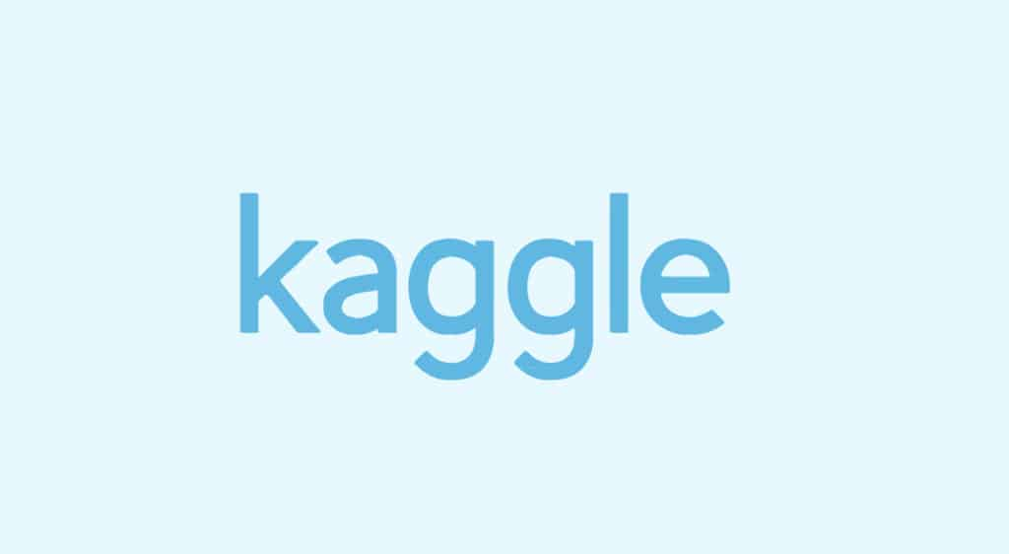
Business Analytics With R
BUAN 6356
Customer Churn Analysis
Using BI Techniques to Analyze Customer Behavior and Churn
Group - 4
Professor – Zhe Zhang
Group Members – Akshay Manchekar, Kaustubh Darange, Siddhida Hulwane, Ritika Namdeo
The University of Texas at Dallas

Slide 2


Agenda
BA With R
BUAN 6356
Introduction
Business Problem Statement
Objective
Data Overview
Steps of Project
Data Preprocessing
Exploratory Data Analysis
Modelling Processes
Logistic Regression, Decision Trees and Neural Networks
Feature Importance
Business Insights
Recommendations
Conclusion
Source: Kaggle

Slide 3
Introduction
BA With R
BUAN 6356
Objective
Business Problem Statement
To predict customer churn and identify key factors contributing to churn within a telecom company.
Use data mining concepts taught in class like -
Logistic Regression
Decision Trees
Neural Networks
Identify the most significant factors associated with churn.
Generate visualizations in R, to digest data easily.
Leverage insights from the data to reduce churn and improve customer retention strategies.
Why Churn Matters?
Churn matters because it induces:
Loss of recurring revenue streams.
Increased acquisition costs for new customers.
Reduced customer lifetime value (CLV).
Potential harm to brand reputation due to dissatisfaction.
Source: Kaggle

Slide 4
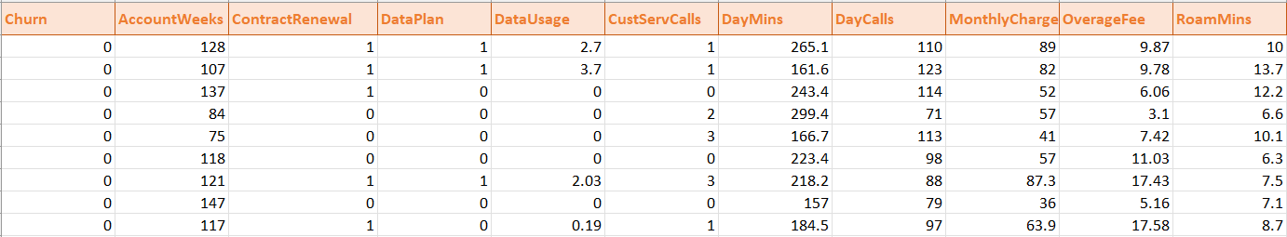
Data Overview
BA With R
BUAN 6356
This dataset is from a telecom company. It contains customer information and usage data. The dataset has 3,334 entries & 11 Column
Below are some of the main variables we’ll be focusing on:
Churn: Indicates if the customer left the company or stayed.
AccountWeeks: Number of weeks the customer has had an account.
ContractRenewal: Shows whether the customer recently renewed their contract.
DataPlan: Whether the customer has a data plan.
DataUsage: Amount of data used by the customer.
CustServCalls: Number of times the customer contacted customer service.
DayMins: Total minutes used during the day.
DayCalls: Number of calls made during the day.
MonthlyCharge: The customer’s monthly charge.
OverageFee: Charges for usage over the customer’s data plan.
RoamMins: Minutes spent on roaming.
Source: Kaggle

Slide 5
Steps of the Project
BA With R
BUAN 6356
Data Preprocessing
Exploratory Data Analysis
Modelling Processes
Loading the Dataset
Handling Missing Data
Data Type Conversion
Data Normalization
Summary Statistics
Bar Charts
Scatterplots
Density Plots
Histograms
Splitting Data
Logistic Regression
Decision Trees
Neural Networks
Source: Kaggle

Slide 6
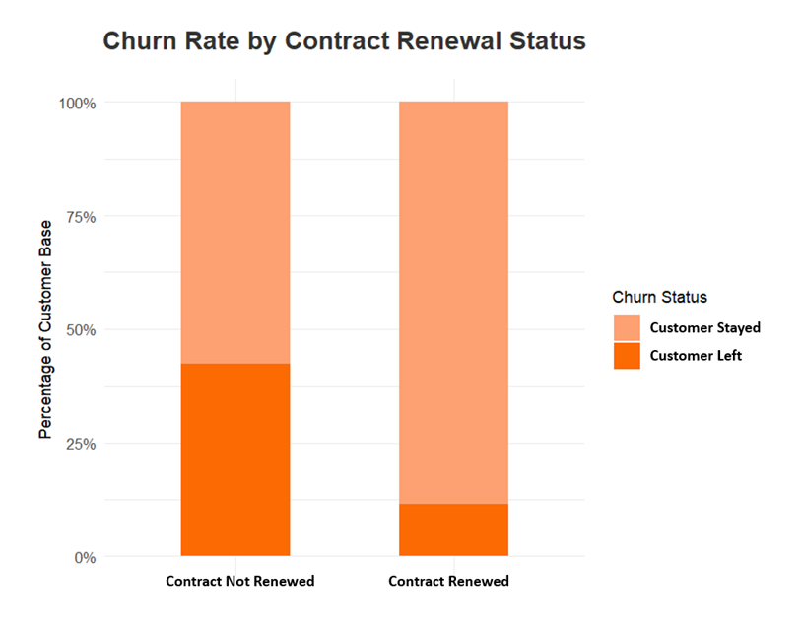
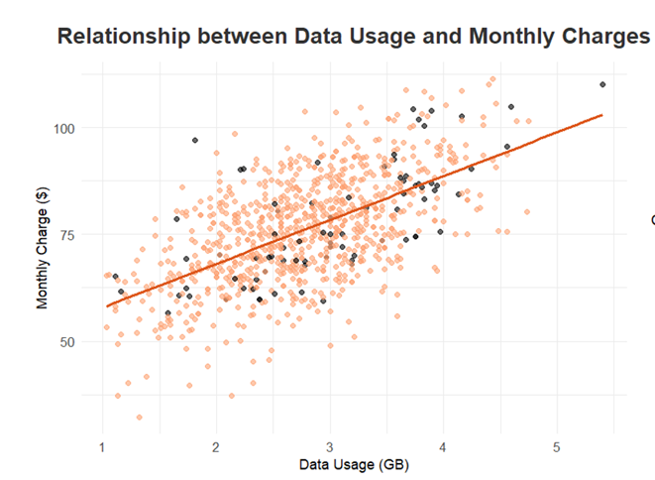
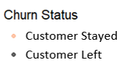
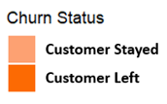
Exploratory Data Analysis
BA With R
BUAN 6356
A high churn rate (37%) of customers who did not renew their contract.
A high rate for customers who had data plan of 3-4 GB and had a monthly plan of $75+
Source: Kaggle

Slide 7
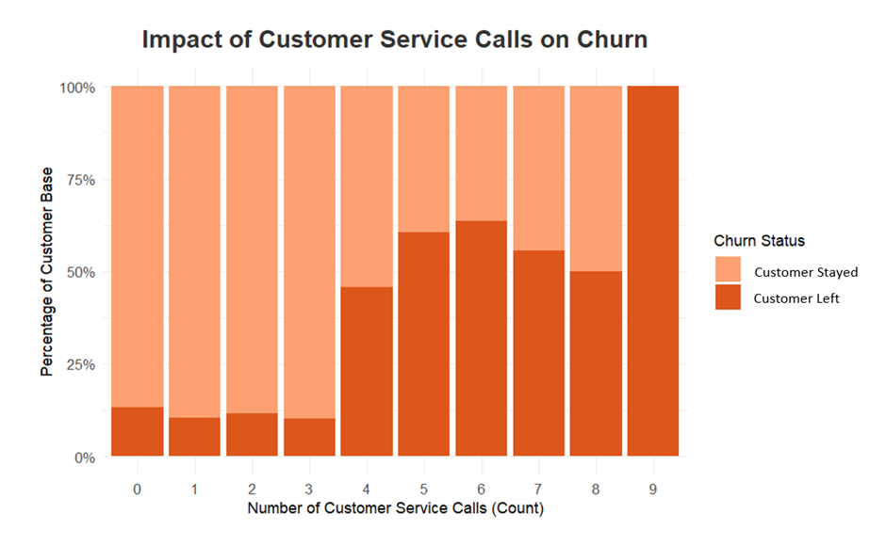

100% of Customers left who had 9 service calls
BA With R
BUAN 6356
Key Highlights
As the service calls increases, the likeliness that the customer would leave also increases.
Customers who received 9 service calls had a 100% churn rate.
Significant Churn After 4+ Calls.
For customers with 0-3 calls, the vast majority (over 90%) remained as customers.
The data suggests issues or dissatisfaction that prompts multiple service calls may be leading indicators of customer attrition.
The findings imply the importance of resolving customer issues efficiently to minimize repeated interactions and reduce the risk of churn.
Source: Kaggle

Slide 8
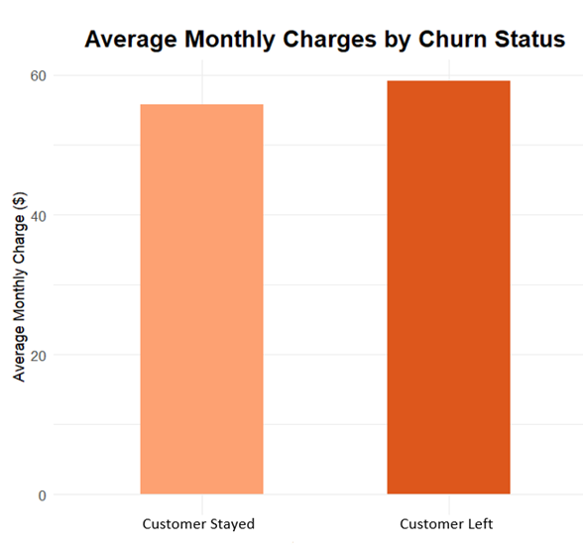
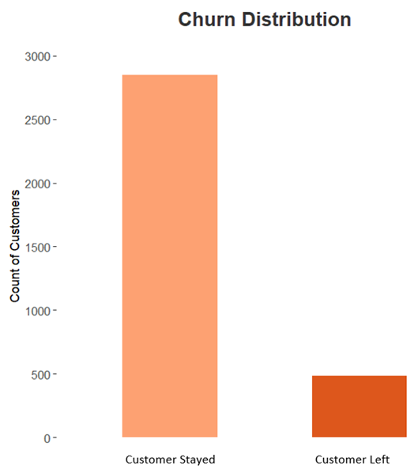
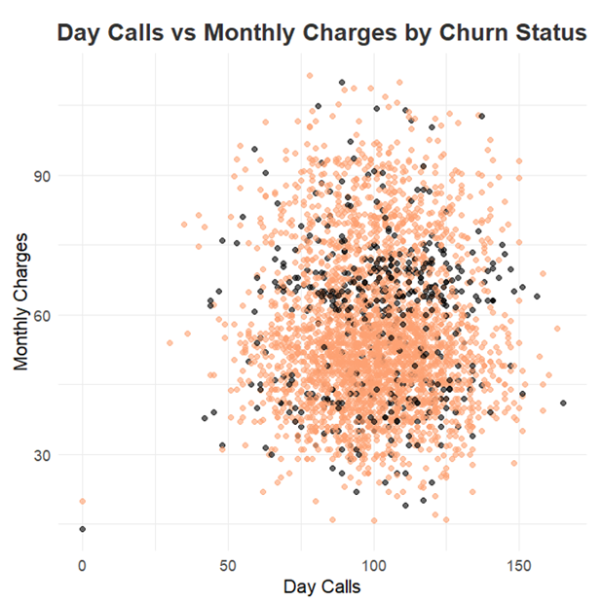
Dataset has a Churn Rate of 14.19%
BA With R
BUAN 6356
Customers who had a plan of $55+ had a high churn rate.
483 of out 3333 customers discontinued the service.
14.19% Churn Rate
Majority of the customers had 90-120 calls per day with a monthly charge of about $45.
Source: Kaggle

Slide 9
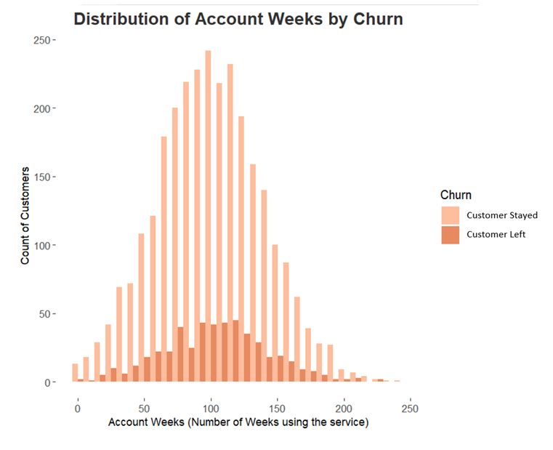
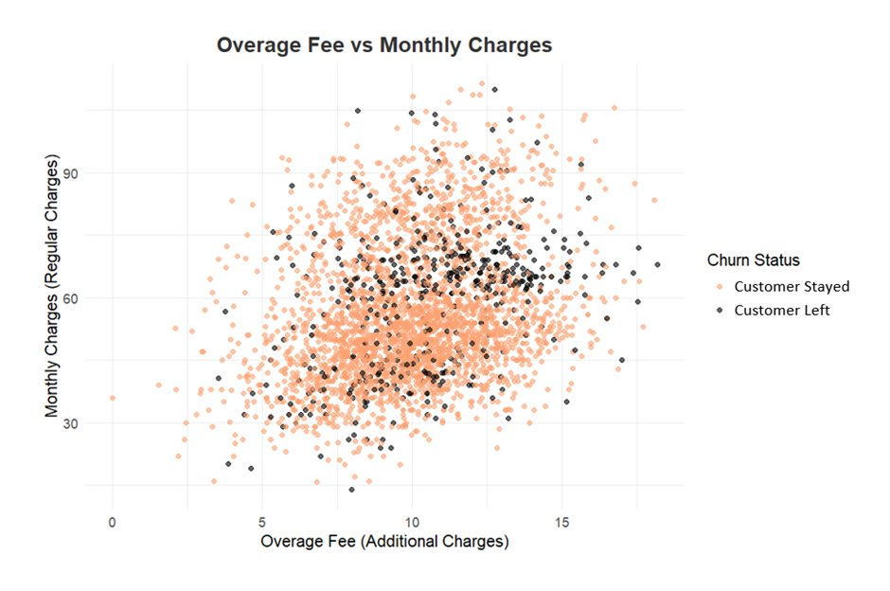
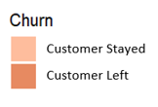
Customers who had overage fees left the service
BA With R
BUAN 6356
The visualization shows a positive relationship between monthly charges and overage fees, suggesting higher-spending customers may also incur more additional charges.
Customers who used the service between 90-130 weeks had a high churn rate.
Source: Kaggle

Slide 10
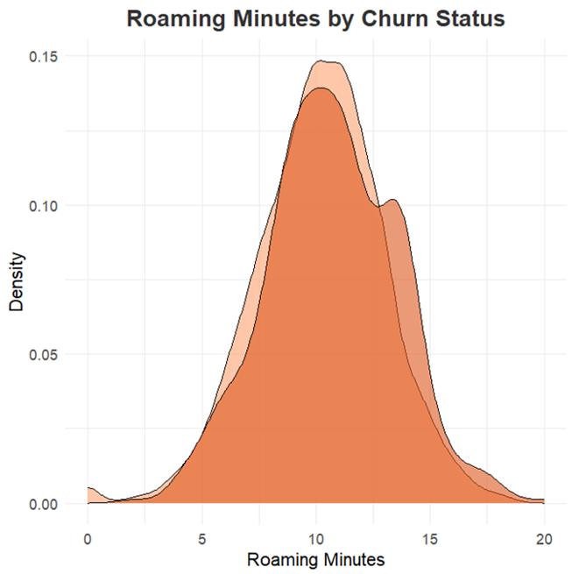
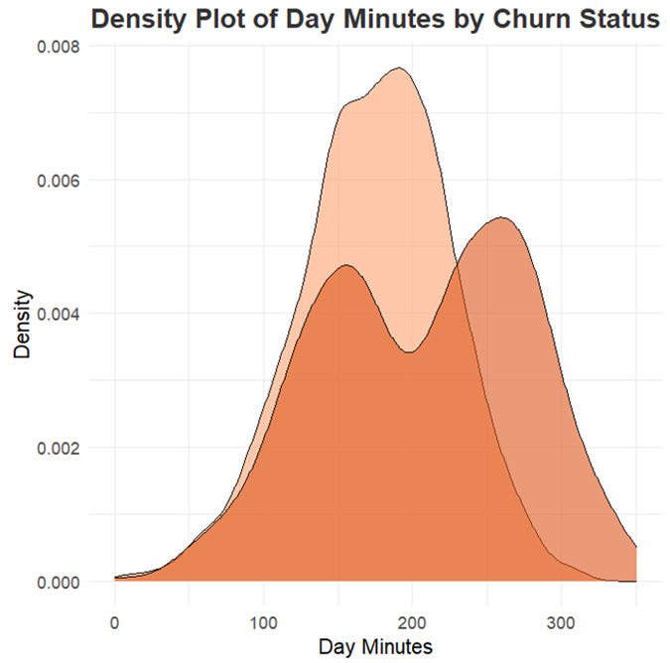
Customers who left did longer calls
BA With R
BUAN 6356
Customers who eventually churned had a bimodal distribution of day minutes, with a higher density of longer call durations compared to retained customers.
Customers who eventually churned had higher average roaming minutes compared to retained customers.
Source: Kaggle

Slide 11
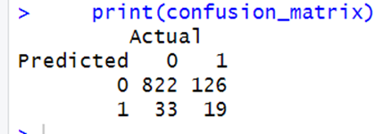
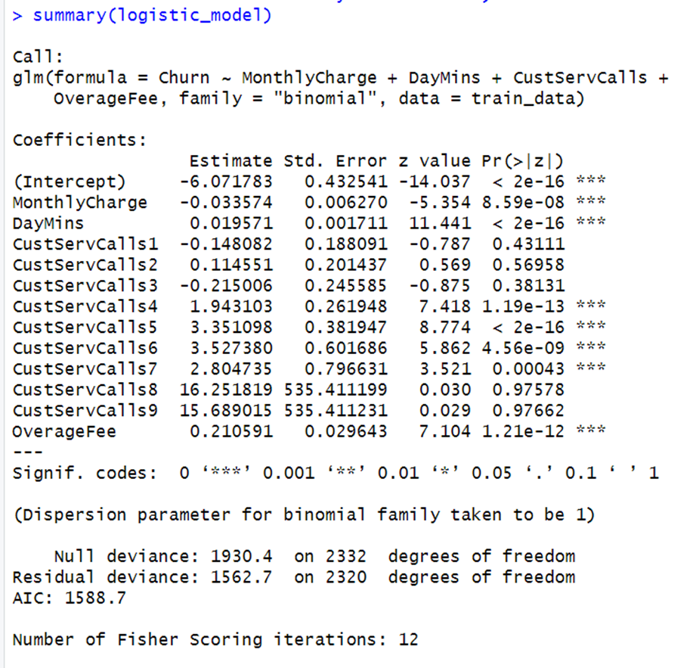
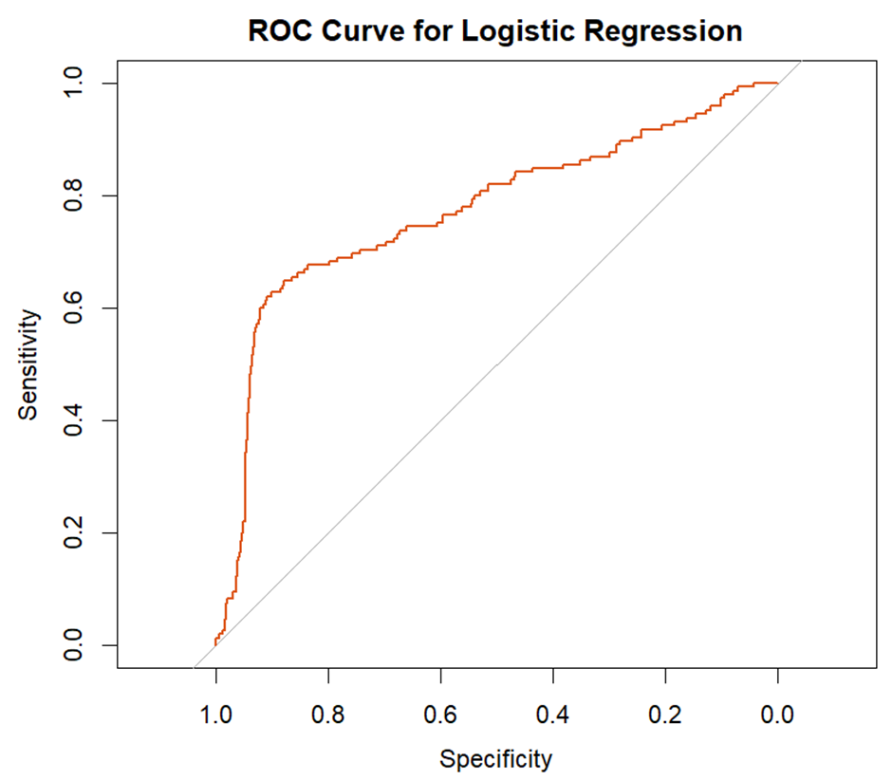

Logistic Regression
BA With R
BUAN 6356
Training Set Rows: 2333
Logistic Regression Summary
Test Set Rows: 1000
Findings
High overage fees strongly increase churn, while higher monthly charges slightly decrease it.
Increased daytime usage marginally raises churn risk.
Making 4+ service calls significantly increases churn, indicating dissatisfaction.
Source: Kaggle

Slide 12
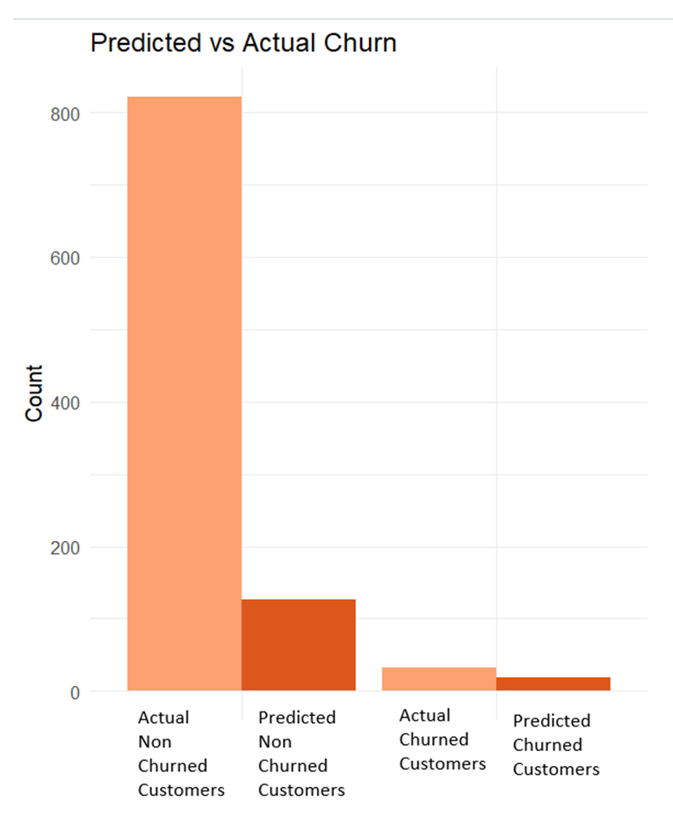
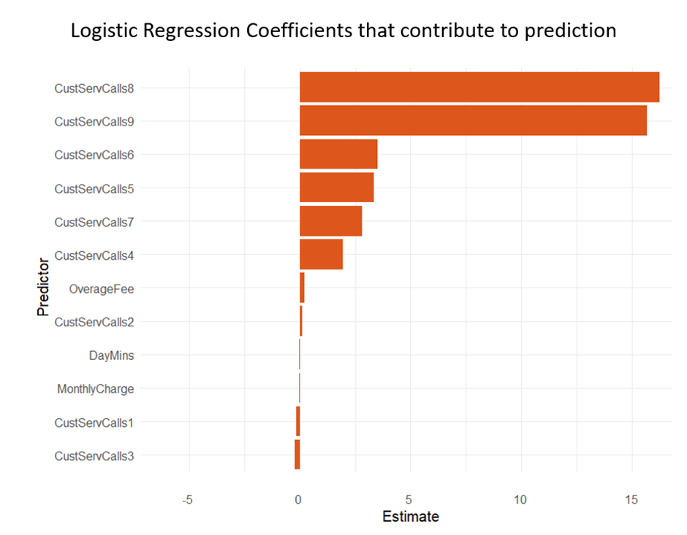
Logistic Regression - 2
BA With R
BUAN 6356
Source: Kaggle

Slide 13
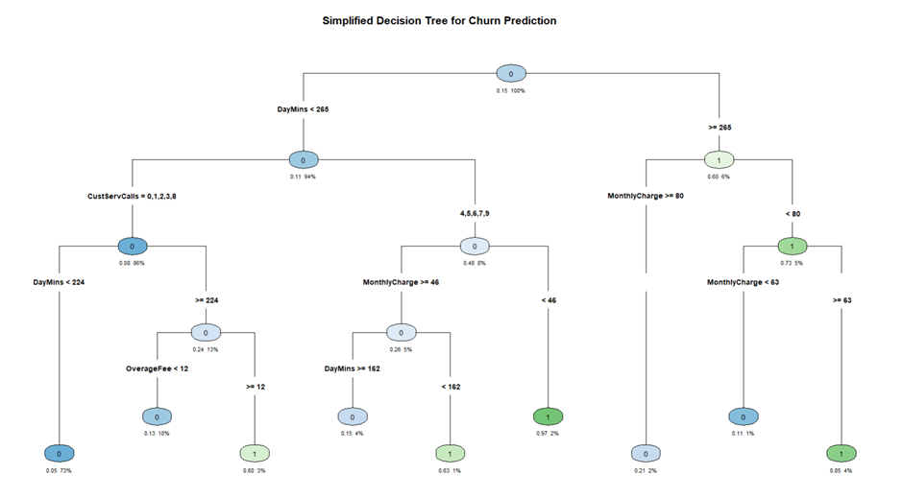
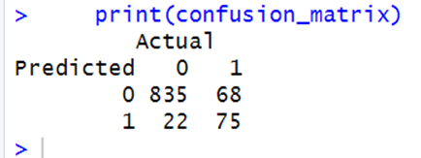

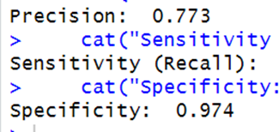
Decision Trees
BA With R
BUAN 6356
Split Based on:
DayMins
CustServCalls
MonthlyCharge
OverageFee
Source: Kaggle

Slide 14
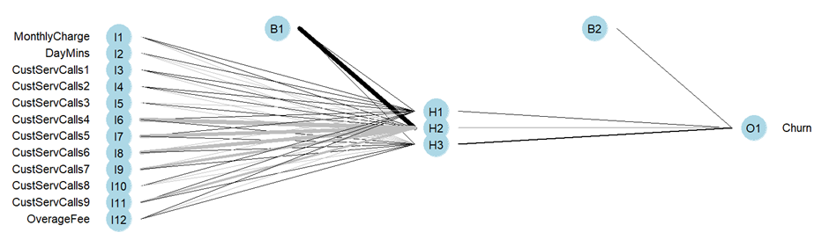
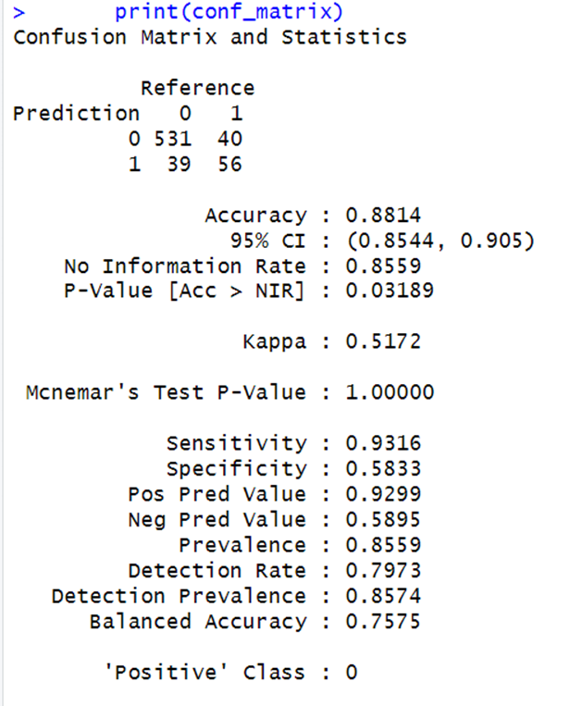
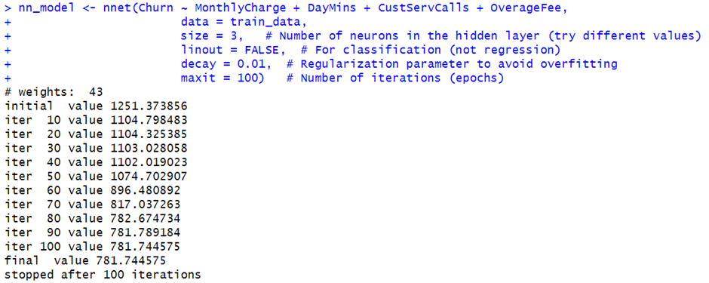
Neural Networks
BA With R
BUAN 6356
Source: Kaggle

Slide 15
Business Insights
BA With R
BUAN 6356
1.Churn Analysis Findings:
1.Customers with 4+ service calls had a significant churn rate, with those making 9 calls showing a 100% churn rate.
2.High overage fees were strongly linked to churn, indicating dissatisfaction with billing.
2.Customer Behavior Patterns:
1.High churn was observed among customers using plans costing $75+ or incurring overage fees.
2.Customers who stayed had fewer customer service calls and lower overage charges.
3.Usage Insights:
1.Churned customers had longer average roaming minutes and higher call durations.
2.A bimodal distribution of daytime minutes suggests two customer behavior clusters.
4.Predictors of Churn:
1.Logistic Regression, Decision Trees, and Neural Networks identified customer service calls, overage fees, and roaming minutes as critical churn indicators.
5.Revenue Impact:
1.High churn among long-term customers (90-130 weeks) highlights potential missed recurring revenue opportunities.
Source: Kaggle

Slide 16
Recommendations
BA With R
BUAN 6356
1.Enhance Customer Service:
1.Prioritize resolving issues for customers with repeated service calls (4+).
2.Provide better training for customer service teams to address root causes promptly.
2.Billing and Plan Adjustments:
1.Introduce transparent billing policies to minimize overage fees.
2.Offer tailored plans with affordable options to reduce dissatisfaction.
3.Proactive Customer Retention Strategies:
1.Identify and engage at-risk customers early using predictive models.
2.Provide loyalty incentives for long-term customers, such as discounted plans or added benefits.
4.Targeted Communication:
1.Focus on high-usage customers (day minutes and roaming) to offer personalized recommendations and plans.
5.Monitoring and Feedback:
1.Implement real-time churn monitoring dashboards for quick action.
2.Collect customer feedback to understand dissatisfaction and prevent churn triggers.
Source: Kaggle

Slide 17
Conclusion
BA With R
BUAN 6356
This project demonstrates the critical role of data-driven insights in addressing customer churn in the telecom industry. Key findings reveal that factors such as frequent customer service calls, high overage fees, and extended call durations significantly impact churn. Notably, customers who contacted customer service nine or more times showed a 100% churn rate, underscoring dissatisfaction as a major driver of attrition.
Advanced modeling techniques, including Logistic Regression, Decision Trees, and Neural Networks, have pinpointed the most influential predictors of churn, enabling the identification of at-risk customers with high accuracy. The bimodal distribution of day minutes and higher roaming usage among churned customers further emphasize the need for tailored interventions.
These insights empower the company to implement proactive strategies, such as enhancing customer service, addressing pain points promptly, and offering personalized plans to meet customer needs. By leveraging these findings, the company can reduce churn, strengthen customer loyalty, and drive sustainable growth.
Source: Kaggle

