Slide 1

Bansilal Ramnath Agarwal Charitable Trust's
Vishwakarma Institute of Technology
(An Autonomous Institute affiliated to Savitribai Phule Pune University)
Automation Software for Pharma Sector (B2B).
Presented By:
Group No .: TY 16
Roll No GR No Name
[11] [11910676] Akshay Matre
[26] [12020095] Bhagyashri Bagul
[69] [12020256] Samiksha Dhumal
[74] [12020191] Akshay Gade
Under the Guidance of: Prof. Kirti Korabu
‹#›
Department of Computer Engineering, Module 6, 2022

Slide 2

Outline
Problem Statement
Literature Survey
Market Research
How we overcome existing problem
Introduction
Objective
Proposed System
System Requirements
Future Scope
Work Distribution
Conclusion
References
Department of Computer Engineering, Module 6, 2022

Slide 3
Problem Statement
Pharmacy retailers has to Manage a very large medicines with their sales records on the billing papers which is a tedious task. As per data 10-15% medicines are expired because they couldn't manage their inventory. Ordering new stocks is being carried out in traditional way with the help of salesman’s & in backend with very large supply chain. Significant amount of money is provided to salesman’s by distributors who invents their time to order new stocks.
Department of Computer Engineering, Module 6, 2022

Slide 4
Literature Survey
Sr No | Paper Title | Year | Author | Summary
1 | Designing a Computerized Pharmacy Management System with Inventory Stock Alert System | 2016 | Asst.Lect. Asan Baker Kanbar, Hawbir Latif Abdulqadir, Rezhan Mohammad Ahmed | In this paper the system manage most pharmacy related activities in the pharmacy. The primary aim of its is to improve accuracy and enhance safety and efficiency in the pharmaceutical store. System included BAR CODE facility using the bar code reader,which will detect the expiry date and the other information about the related medicines.

Slide 5
Literature Survey
Sr No | Paper Title | Year | Author | Summary
2 | Design an Information Management System for a Pharmacy | 2018 | Hewa Majeed Zangana | In this paper the system is basically a computer based system which helps the Pharmacist to improve inventory management, cost, medical safety etc. The system allows the user to enter a manufacturing and expiry date for a particular product or drug during opening stock and sales transaction. The system will also give report showing the list of products expiry after a specified date before the product eventually expires. It also involves manual entry upon arrival of new batches of drugs and upon drug movement out of the pharmacy for a certain period.

Slide 6
Literature Survey
Sr No | Paper Title | Year | Author | Summary
3 | Building IT-based Pharmacy: Computerized Pharmacy Management | 2018 | B Kurniawan and M Ikhsan | This study aims to produce computer-based systems that allow pharmacists to perform their work in pharmaceutical management. This research used the descriptive method to analyze how pharmacies Cibadak Farma handled the drug supplied management activities, sales transactions, purchasing drugs, and reporting manually

Slide 7





Market Research:
Problem with D2C brands:
.
Department of Computer Engineering, Module 6, 2022

Slide 8




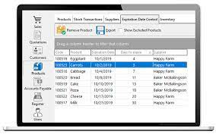
Market Research:
Problem with Retail Supply Chain:
.
Problem with the existing software systems:
Department of Computer Engineering, Module 6, 2022

Slide 9
How we solved Pharma industries problem ?
Employee Cost: It remove traditional business model which uses the salesperson , MR to sell their products.
Availability: It will make it fast, cost efficient, available (24*7)
Improves margin: Supplies medicines from manufacturer to retailer (no middle-man)
Removes Software & System cost: Make access to the data easy for the retailers
Time : one-click order will reduce their time.
All-in-One Solution: To provide automatic bill generator, inventory management, near expiry notifications, POS management on a single platform only for both retailers and distributors.
Department of Computer Engineering, Module 6, 2022

Slide 10
Introduction
Automation software for pharma sector is a B2B online cloud-based platform that sells various pharma products like ethical, surgical, generic, homeopathic products not directly to end users but to other businesses / (retail medical stores).
Also it will help them to manage their Inventory, Expiry, credits, billing system , sales data on a single platform.
Department of Computer Engineering, Module 6, 2022

Slide 11
Objective
To remove traditional flow
To remove the agency member or middle-man
To make it fast, cost effective, available (24*7)
To provide automatic bill generator, inventory management, near expiry notifications, etc
Department of Computer Engineering, Module 6, 2022

Slide 12
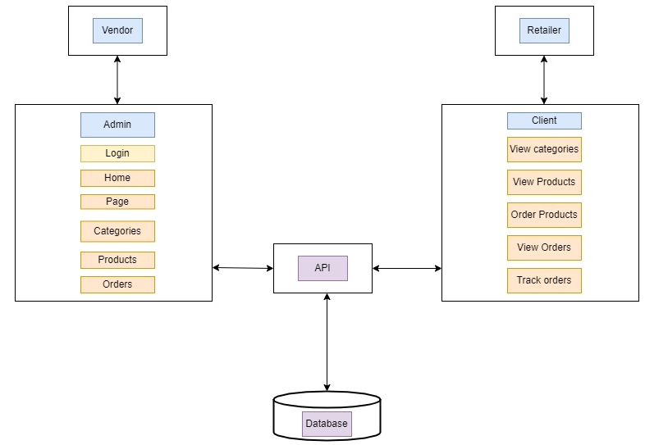
Proposed System
Department of Computer Engineering, Module 6, 2022

Slide 13
Tools & Technologies:
1. Operating System: Windows 10
2. IDE: Visual Studio Code
3. Frontend: React Js, HTML5, CSS3, Bootstrap5
4. Backend: NodeJS, Express JS etc.
5. Database: MongoDB
Department of Computer Engineering, Module 6, 2022

Slide 14
Future Scope
We will provide Android Application so they can scan product barcodes easily just by using mobiles camera.
Data Analytics & ML algorithms we will be using for targeting marketings & also for their business improvement
Department of Computer Engineering, Module 6, 2022

Slide 15
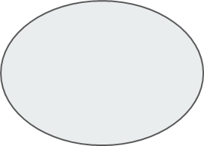
Work Distribution
Bhagyashri Bagul
(Front-end)
Samiksha & Akshay
(Backend)
Akshay Gade
(Front-end)
Samiksha & Akshay
(Backend)
Client
Admin
Akshay Matre
& Samiksha Dhumal
API
Database
Department of Computer Engineering, Module 6, 2022

Slide 16
Conclusion
This automation system will help retailers for refills stock quickly and simply with just a few clicks & they can easily manage their expiry, bills, credits & will improve their margin. & for distributors it saves employee ,software cost & provide data analytics. & for pharma companies it provides efficient targeted marketing.
Department of Computer Engineering, Module 6, 2022

Slide 17
References
1] Asst.Lect. Asan Baker Kanbar, Hawbir Latif Abdulqadir, Rezhan Mohammad Ahmed “Designing a Computerized Pharmacy Management System with Inventory Stock Alert System”International Journal of Emerging Trends & Technology in Computer Science,Volume 5, Issue 5, September - October 2016
[2] Hewa Majeed Zangana “Design an Information Management System for a Pharmacy ”International Journal of Advanced Research in Computer and Communication Engineering Vol. 7, Issue 10, October 2018
[3] Khaoula KHLIE,Abdellah ABOUABDELLAH “A study on the performance of the pharmacy information system within the Moroccan hospital sector,2019
[4] B Kurniawan* and M Ikhsan “Building IT-based Pharmacy: Computerized Pharmacy Management” IOP Conference Series: Materials Science and Engineering,2020
[5] Mahyuddin K. M. Nasution , Shahrul Azman Mohd Noah , Urip Harahap ”Overview of The Pharmacy Management System in a Hospital”,A multifaceted review journal in the field of pharmacy, Vol 11, Issue 11, Nov-Dec 2020
[6] Madhavi Mali, Sandhya Alibade,Rajdeep Parbhane, Aparna Awade, Aruna Yadav “Survey on Pharmacy Management System ”,International Research Journal of Modernization in Engineering Technology and Science”,Volume:03/Issue:12/December-2021
Department of Computer Engineering, Module 6, 2022

Slide 18
Thank You !
Department of Computer Engineering, Module 6, 2022

