Slide 1
LLM Guided
Protocol Fuzzing
Course:Computer Network Security (22CPT310)
Name: Akshay Kumar Mina
Student ID: 2023UCP1661
Batch: A3
1 / 17

Slide 2
What is Fuzzing?
Fuzzing is an automated software testing technique that sends massive numbers of random or semi-random inputs to a program, looking for crashes, hangs, or unexpected behaviour that reveal security vulnerabilities.
Automated
Crash-Driven
Coverage-Guided
No human needed — runs 24/7 generating inputs automatically.
When the program crashes, a bug is found. Crashes = vulnerabilities.
Smart fuzzers track which code paths were hit and try to reach new ones.
Analogy:
Like a robot pressing every button combination on a lock until it accidentally finds the one that opens the vault.
2 / 17

Slide 3
What is Protocol Fuzzing?
Protocol fuzzing tests networked applications by sending malformed or unexpected sequences of protocol messages, aiming to uncover vulnerabilities in how servers handle communication.
A Stateful FTP Session
CLIENT: USER admin\r\n
FTP Server
SERVER: 331 Password required
File Transfer Protocol
CLIENT: PASS secret\r\n
SMTP Server
Email Protocol
SERVER: 230 Logged in
SIP Server
CLIENT: LIST\r\n
VoIP Calling Protocol
SERVER: 150 File list...
RTSP Server
Streaming Protocol
CLIENT: RETR file.txt\r\n
SERVER: 200 OK, sending...
Messages must follow a strict ORDER and FORMAT
3 / 17

Slide 4
The Problem with Existing Protocol Fuzzers
Grammar Blindness
Seed Poverty
Coverage Plateaus
Fuzzers like AFLNet treat protocol messages as raw bytes. They randomly flip bits without understanding the protocol's structure (grammar). Result: most mutations produce malformed messages that are rejected immediately wasting precious fuzzing cycles.
Initial recorded sessions (seeds) only capture a small slice of all possible message types. For example, an FTP session might only have USER, PASS, LIST but FTP has 50+ commands. The fuzzer never even tries commands like SITE EXEC or RNFR that could be vulnerable.
After a while, the fuzzer discovers all 'easy' states and gets stuck in a loop. It keeps replaying the same code paths without being able to break into new, unexplored server states. This is the hardest problem in stateful fuzzing.
4 / 17

Slide 5
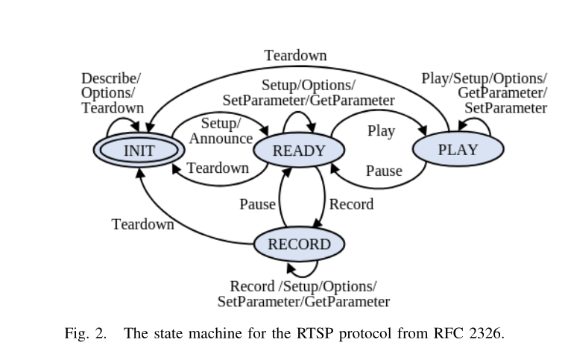

Slide 6
ChatAFL: LLM-Guided Protocol Fuzzing
Core Idea:
LLMs (like GPT / Llama) have been trained on RFC documents, protocol specs, and source code. ChatAFL harnesses this built-in knowledge to make the fuzzer smarter at every stage.
AFLNet
ChatAFL
Treats messages as raw bytes
Understands protocol grammar via LLM
Random bit-flip mutations
Structure-aware, valid mutations
No protocol understanding
Enriches seeds with new message types
Gets stuck at coverage plateau
Breaks out of stalls using LLM hints
Ignores protocol semantics
Semantic protocol understanding
5 / 17

Slide 7
Three LLM-Powered Strategies
Grammar Extraction
"What are all the message types in FTP?"
"What are the fields and formats for each?"
At startup, ChatAFL asks the LLM to produce a machine-readable grammar for the target protocol.
→ Fuzzer learns valid message structure
→ Mutations stay semantically valid
Seed Enrichment
"Here are my existing FTP messages…"
"What other messages could appear here?"
The LLM reviews existing seed messages and generates additional message types the fuzzer hasn't tried.
→ 50+ FTP commands instead of just 3
→ Much wider initial coverage
Stall Breaking
"I keep seeing state X. How do I get to Y?"
"What message triggers a new server state?"
When stuck in a coverage plateau, ChatAFL asks the LLM how to transition to a new server state.
→ Breaks out of dead-end coverage loops
→ Reaches deeper server logic
6 / 17

Slide 8
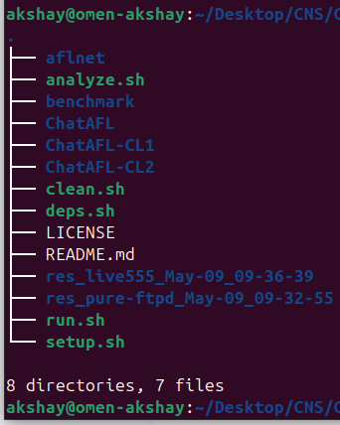
GitHub Repository Structure
ChatAFLndss / ChatAFL
chat-llm.c
Main fuzzer source (THE important one)
Most important file for our changes.
Handles all LLM API HTTP calls using libcurl.
We changed the URL and JSON format here.
Core fuzzing logic & LLM call triggers
All API calls to OpenAI / Groq
Model names, URLs, thresholds
Ablation: grammar only
chat-llm.h
Ablation: grammar + seed enrichment
Defines model names and API endpoints.
We changed model → llama-3.3-70b
and URL → api.groq.com
Modified baseline fuzzer
Docker setups for all target servers
Builds all Docker images (~40 min)
benchmark/subjects/
Runs fuzzing experiments
Docker config for each target server:
pure-ftpd, live555, kamailio, proftpd,
exim, lighttpd — all compiled with AFL.
Generates coverage graphs
Installs Docker, Python, libs
8 / 17

Slide 9
Experimental Setup
Infrastructure
Duration
Fuzzers Tested
Docker containers
Ubuntu Linux
Isolated per experiment
240 minutes (4 hours)
5 runs per fuzzer
Results averaged
ChatAFL (full)
ChatAFL-CL1 (grammar only)
ChatAFL-CL2 (grammar + seeds)
AFLNet (baseline)
Target Protocols
Server Name
Protocol
Description
pure-ftpd
FTP
File Transfer Protocol
proftpd
FTP
File Transfer Protocol (alternative)
live555
RTSP
Real-Time Streaming Protocol
kamailio
SIP
Session Initiation Protocol (VoIP)
exim
SMTP
Email Transfer Protocol
lighttpd
HTTP
Hypertext Transfer Protocol
11 / 17

Slide 10
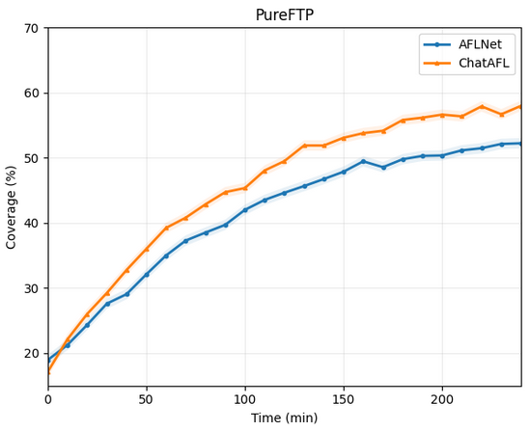
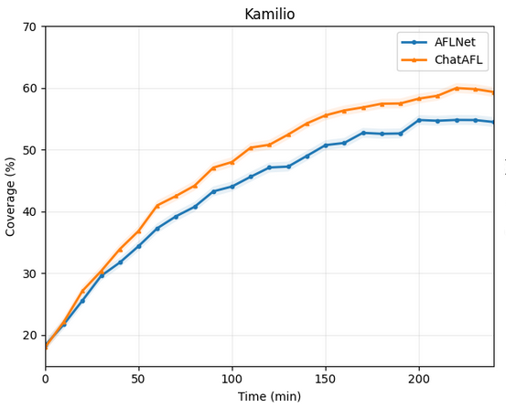
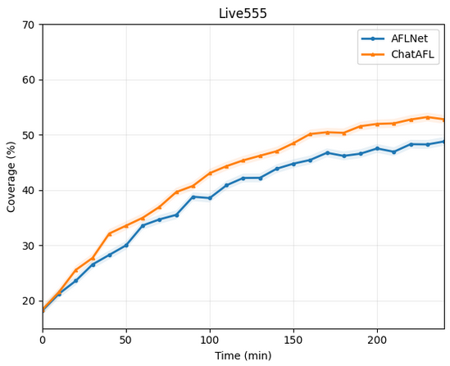
Result 1: Code Coverage (Branch Coverage)
ChatAFL achieves higher branch coverage than AFLNet across all tested servers. More branches covered = more code tested = more bugs found.
12 / 17

Slide 11
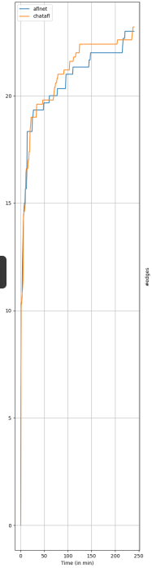
Result 2: State Coverage (Protocol States)
ChatAFL discovers more unique protocol states — meaning it exercises more distinct server behaviours and has a higher chance of finding state-specific vulnerabilities.
State coverage shows ChatAFL's LLM-guided stall-breaking enables it to explore deeper server logic
13 / 17

Slide 12
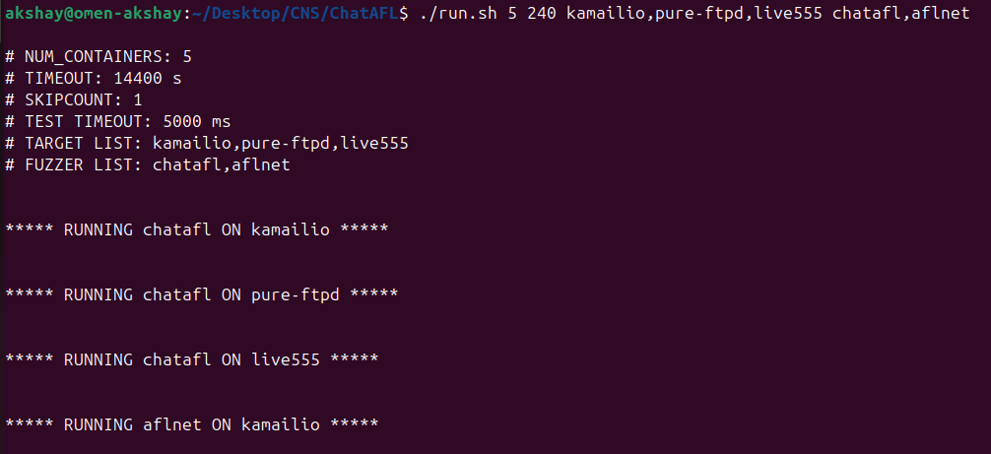
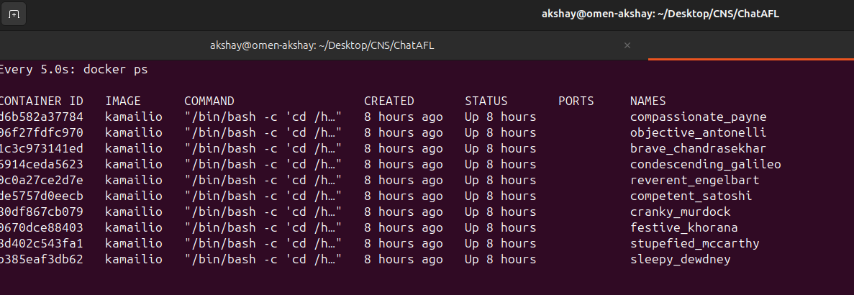
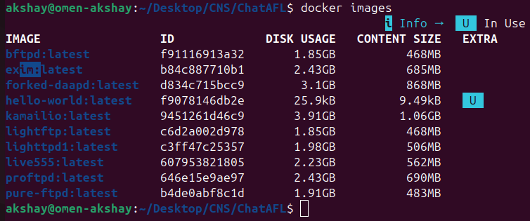
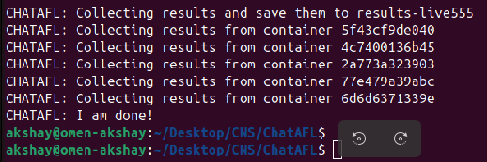
Execution & Screenshots
15 / 17

Slide 13
Key Findings & Conclusion
LLMs Know Protocols
Pre-trained LLMs carry deep knowledge of protocol specifications from RFC documents, source code, and technical writing — making them powerful guides for protocol fuzzers.
Three Synergistic Strategies
Grammar extraction + seed enrichment + stall-breaking each contribute independently to improved coverage. Removing any one strategy reduces the tool's effectiveness.
Significant Coverage Gains
ChatAFL consistently achieves higher code coverage and state coverage than AFLNet baseline, reaching the same coverage levels faster and exploring deeper server logic.
Practical & Reproducible
The tool runs in Docker with well-defined benchmarks. Free alternatives (Groq) can replace paid OpenAI credits with minimal code changes, making research reproducible for students.
16 / 17

Slide 14
Thank You

