Slide 1
Unser Service, Ihr Erfolg

Slide 2


Deployment
There is a plugin which is requried to be copied under the $TC_ROOT/portal/plugins folder of the client.
Registry is required to be run. Run the file $TC_ROOT/portal/registry/genregxml.bat
Verification of deployment:
Launch the Rich client application and locate the below highlighted menu.

Slide 3
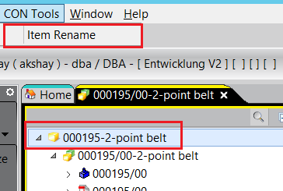
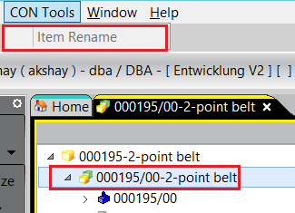
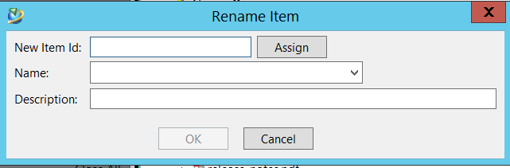
Usability
The menu Item Rename is only enabled when the any type of Item is selected. For rest all the other types the menu will be disabled.
Click on the Menu and the dialog will be visible.

Slide 4
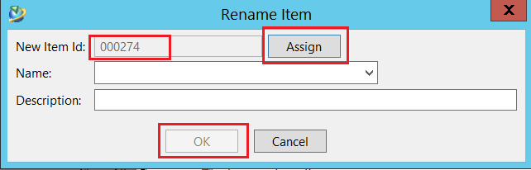
Testing
Press the Assign button to automatically assign the item id or give a valid item id manually.
Once you hit the Assign button, new Item id is generated from the system based on the item type selected.
The Naming rule therefore will not be impacted.
OK button remain disabled unless the Name field is filled in.

Slide 5
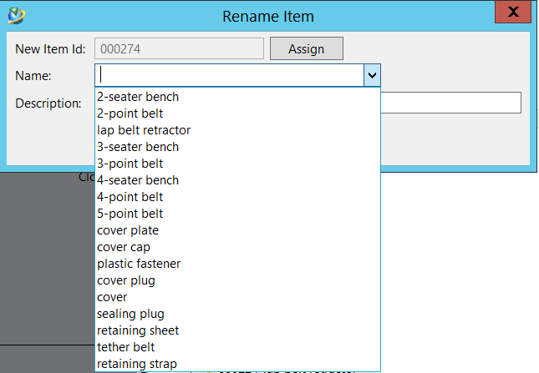
Testing…
Give the Name and Description in the respective fields.
If an LOV is assigned to the Name field then the values of the LOV will be available.
User can enter the manual value in the Name field as well.
Press the OK button when all the data is filled.
Item, Item Revisions, Datasets and Forms will be updated.

Slide 6
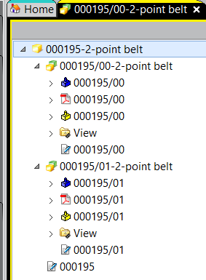
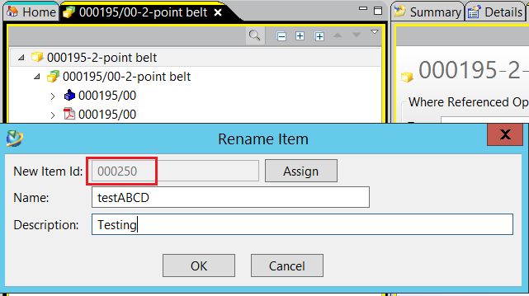
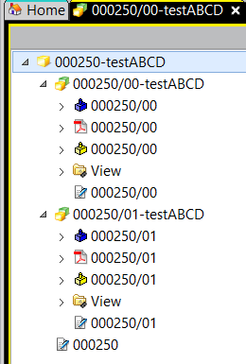
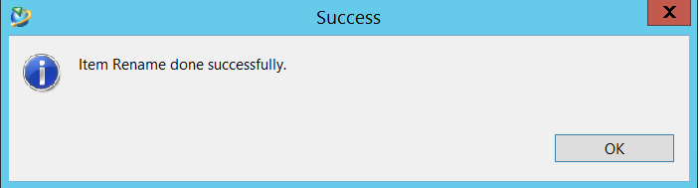
Testing…

Slide 7
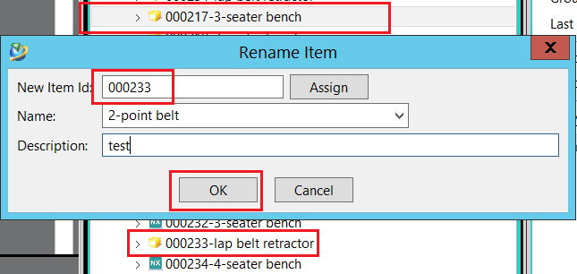
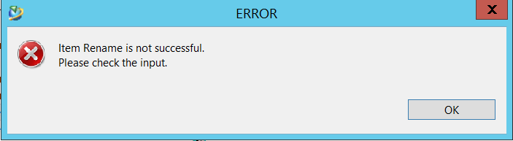
Testing…
If an existing Item Id is given as input an error will be thrown.

Slide 8
Akshay Mittal
27.11.2017

