Slide 1
Unser Service, Ihr Erfolg

Slide 2

Deployment
There is a plugin which is requried to be copied under the $TC_ROOT/portal/plugins folder of the client.
Registry is required to be run. Run the file $TC_ROOT/portal/registry/genregxml.bat
Preference CREATE_BULK_DATASET_UTILITY_MAPPING must be created.
This preference is used to define the mapping required for the type of file, the dataset type and the dataset reference. For e.g.:
.txt=Text=Text
.pdf=PDF=PDF_Reference
.prt=UGMASTER=UGPART
Preference CREATE_BULK_DATASET_UTILITY_FOLDER_TYPE must be created. It contains the type of Folder that is required to be created.
Verification of deployment:
Launch the Rich client application and locate the below icon on the toolbar.

Slide 3
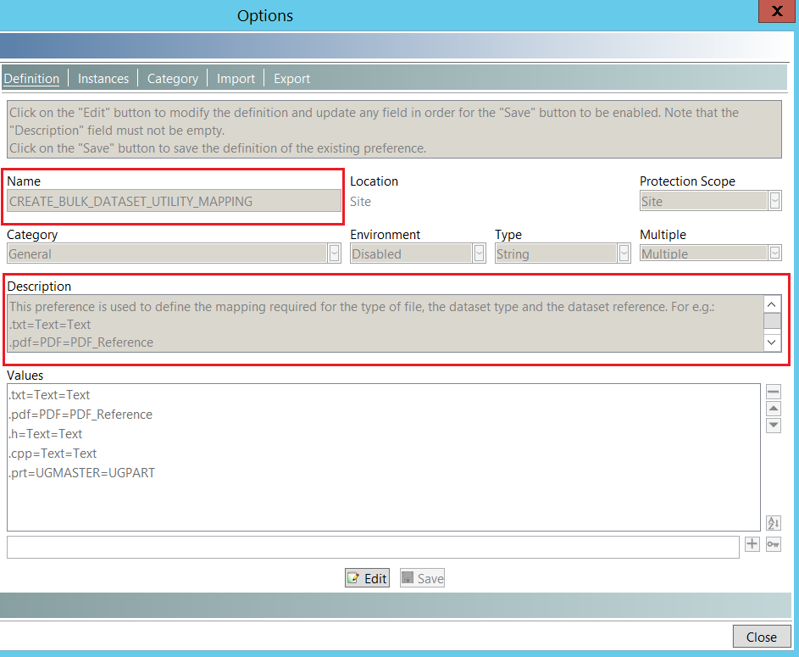
Deployment…
Sample preference:

Slide 4
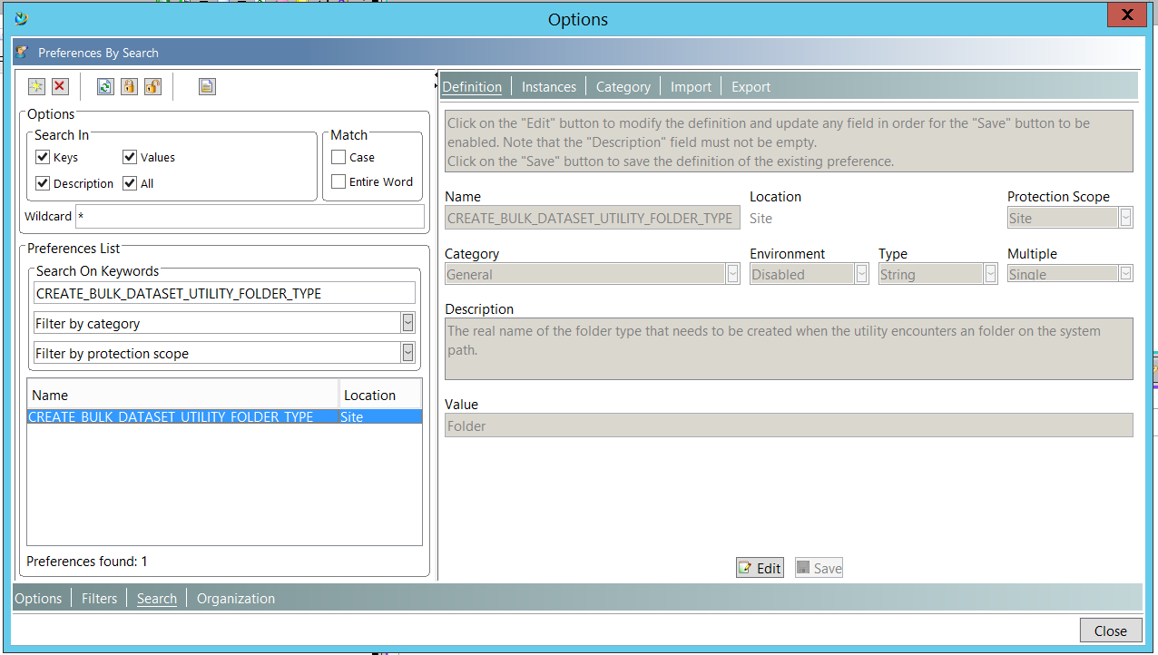
Deployment…

Slide 5
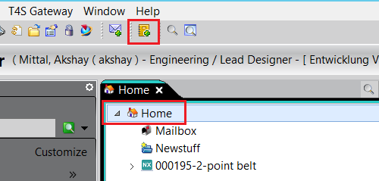
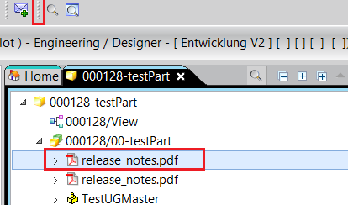
Usability
The Icon above will only be visible when the current selection is a type Folder, Item or Item Revision.
If the current selection is anything else than type Folder, Item or Item Revision then the Icon will disappear.

Slide 6
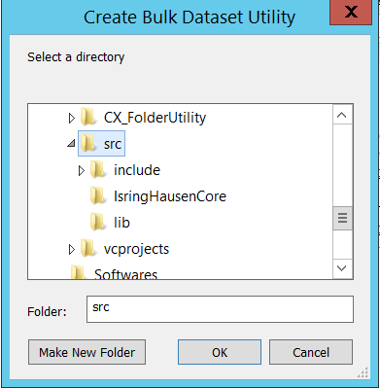
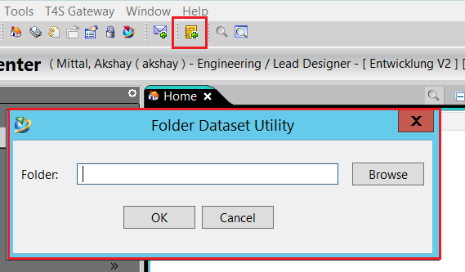
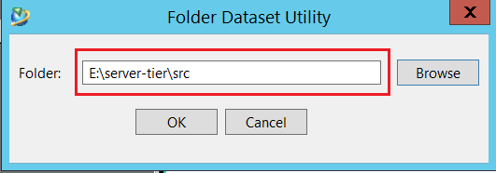
Testing
Press the button visible on the tool bar, A dialog will open.
Press the Browse button and select a folder from the Directory Dialog, or give the Folder path directly.

Slide 7
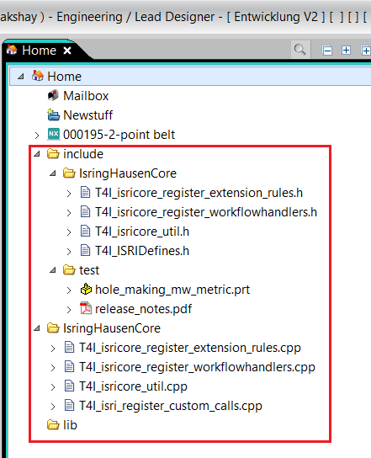
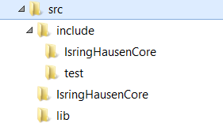
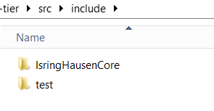
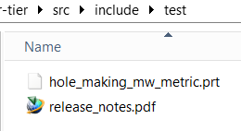
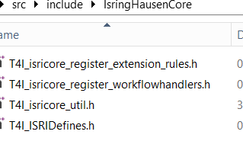
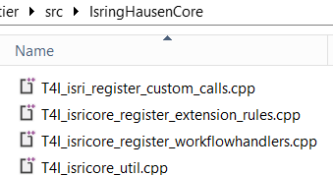
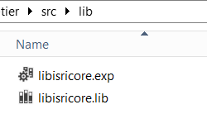
Testing…
The type of files inside the folders whose mapping is available in the preference CREATE_BULK_DATASET_UTILITY_MAPPING will have their datasets created with the same name as the files inside the Folder, Item or Item Revision which is currently selected.
If the mapping is not available then the files will be ignored and no dataset will be created.

Slide 8
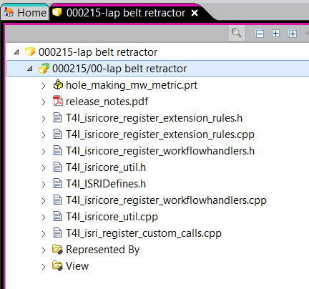
Testing…
In case of Teamcenter Folder, if a subfolder is available in the input folder on the disk then a sub folder will also be created in the Teamcenter Folder. (Example shown on the last slide.)
In case of Item or Item Revision, all the valid datasets will be created under the Item or Item Revision (what ever is selected) including the datasets available in the sub folders. The sub folders will not be created. (Example shown below.)

Slide 9
Akshay Mittal
27.11.2017

