Slide 1


WAREHOUSE
MANEGMENT
SYSTEM

Slide 2
Presenter Name
AKSHAY M KALABURGI
LATHEESH SAI
AVEZ HUSSAIN

Slide 3



Agenda
Introduction of SQL
Introduction of PL\SQL
Objective
Abstract
System Requirements
ER Diagram
Schema Diagram
Tables
Table Creation and Insertion

Slide 4




Introduction
This document outlines a mini project for the RDBMS LOT.
The project is to design the database, reports the queries related to Warehouse Management System.
This document contains information about the attributed that will be participating in the system and guidelines about reports.

Slide 5
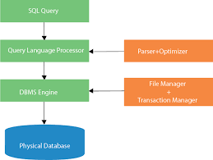
Sql introduction
SQL stands for Structured Query Language.
SQL is used to create, remove, alter the database and database objects in a database management system
To store, retrieve, update the data in a database. SQL is a standard language for creating, accessing, manipulating database management system

Slide 6
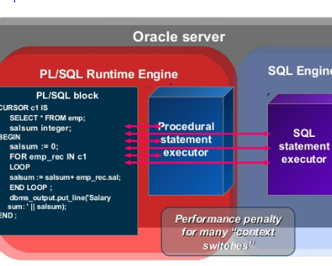
Pl/Sql introduction
PL/SQL is a combination of SQL along with the procedural features of programming languages.
It was developed by Oracle Corporation in the early 90's to enhance the capabilities of SQL.
PL/SQL is one of three key programming languages embedded in the Oracle Database, along with SQL itself and Java.

Slide 7

objective
Designing the database, developing the queries and basic reports required for Warehouse Management System.

Slide 8
abstract
Our company has several warehouses, each warehouse is designated by a unique 4-letter symbol (by a letter we mean a..z and A..Z). Each warehouse has several bins that are identified uniquely by numbers (unsigned integers), i.e. each warehouse has bins 0, 1, 2, 3, … Each bin has a particular capacity
In our warehouses (more precisely in the bins in our warehouses) we store parts. Each part is designated by a unique part number (a 5-symbol sequence of digits and letters).
When a batch arrives, its date-in is recorded. A particular manager checks its arrival, and this fact must be recorded in the database. Some parts may be backordered

Slide 9

STSTEM REQUIREMENTS
Physical Memory (RAM) - 1GB Minimum
Virtual Memory - Double the amount of RAM
Disk space - Total 5 GB
Processor - 550 MHz minimum
Video Adapter - 256 colors

Slide 10
Er diagrams

Slide 11
SCHEMA DIAGRAM
Tuesday, march 22, 2022

Slide 16


Thank You

