Slide 1
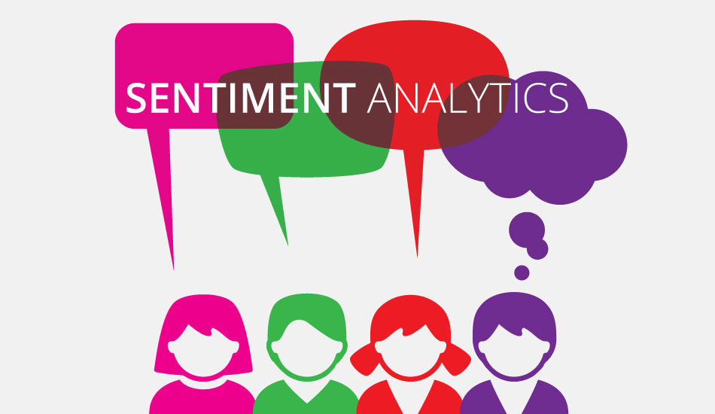
Twitter Sentiment Analysis
Project by :-
Abhinav Rahate
Akshay Mukundwar
Abhijeet Patil
Rohit Dhuratkar
Soham Wani

Slide 2
What is Sentiment Analysis?
Sentiment analysis is contextual mining of text which identifies and extracts subjective information in source material, and helping a business to understand the social sentiment of their brand, product or service while monitoring online conversations. However, analysis of social media streams is usually restricted to just basic sentiment analysis and count based metrics.
Creative use of advanced artificial intelligence techniques can be an effective tool for doing in-depth research. We believe it is important to classify incoming customer conversation about a brand based on following lines:
Key aspects of a brand’s product and service that customers care about.
Users’ underlying intentions and reactions concerning those aspects.
These basic concepts when used in combination, become a very important tool for analyzing millions of brand conversations with human level accuracy.

Slide 3


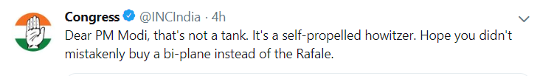
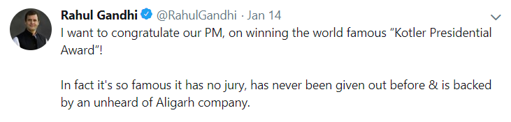
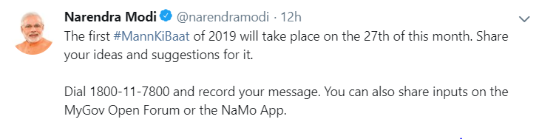

Twitter
Twitter.com is a popular microblogging website.
Each tweet is 140 characters in length.
240+ Million users.
500 Million tweets are generated everyday.
Twitter audience varies from a common man to celebrities.
Tweets are frequently used to express a tweeter’s emotion on a particular subject.
Tweets are small in size and hence unambiguous.

Slide 4
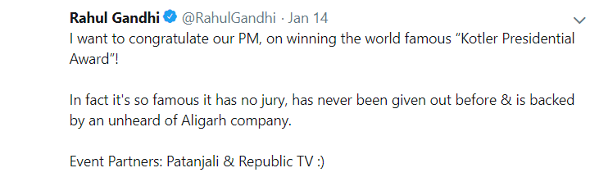

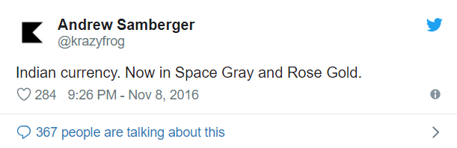
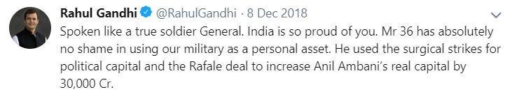
Problem!
What makes hard to classify:
Subtelity/Sarcasm
Thwarted expressions
Images and videos

Slide 5
Data Pre Processing
This is a process to remove the unwanted words from tweets that does not amount to any sentiment.
Emotional Icons- 170 emoticons; identified emotional icons and remove them.
URLs- Doesn’t signify any sentiment, replace it with blank space.
Stop words- words such as “a”, “is”, “the”,etc. Doesn’t indicate any sentiment.
UserNames and HashTags- @ symbol before the username and # for topic; both replaced with space.
ReTweets- repetition of same tweet.
Capitalisation- Converting all the letters to lowercase.

Slide 6
Visualization:
Sentiment Analysis Plot
Word Cloud

Slide 7
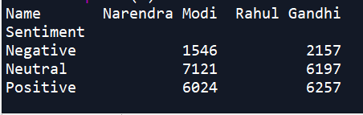
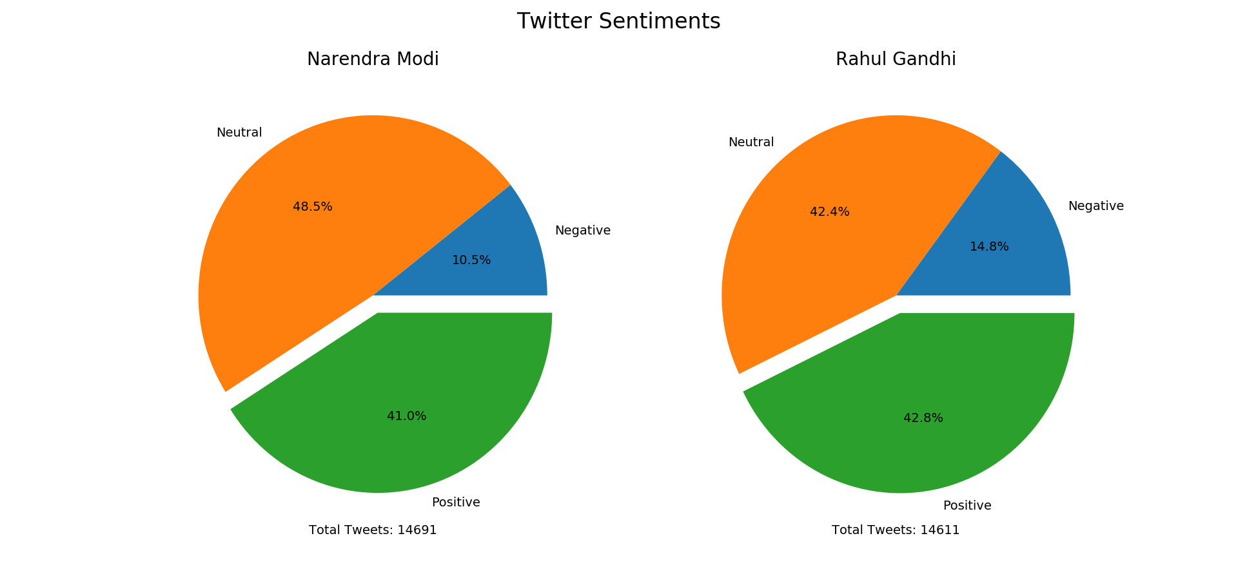

Slide 8
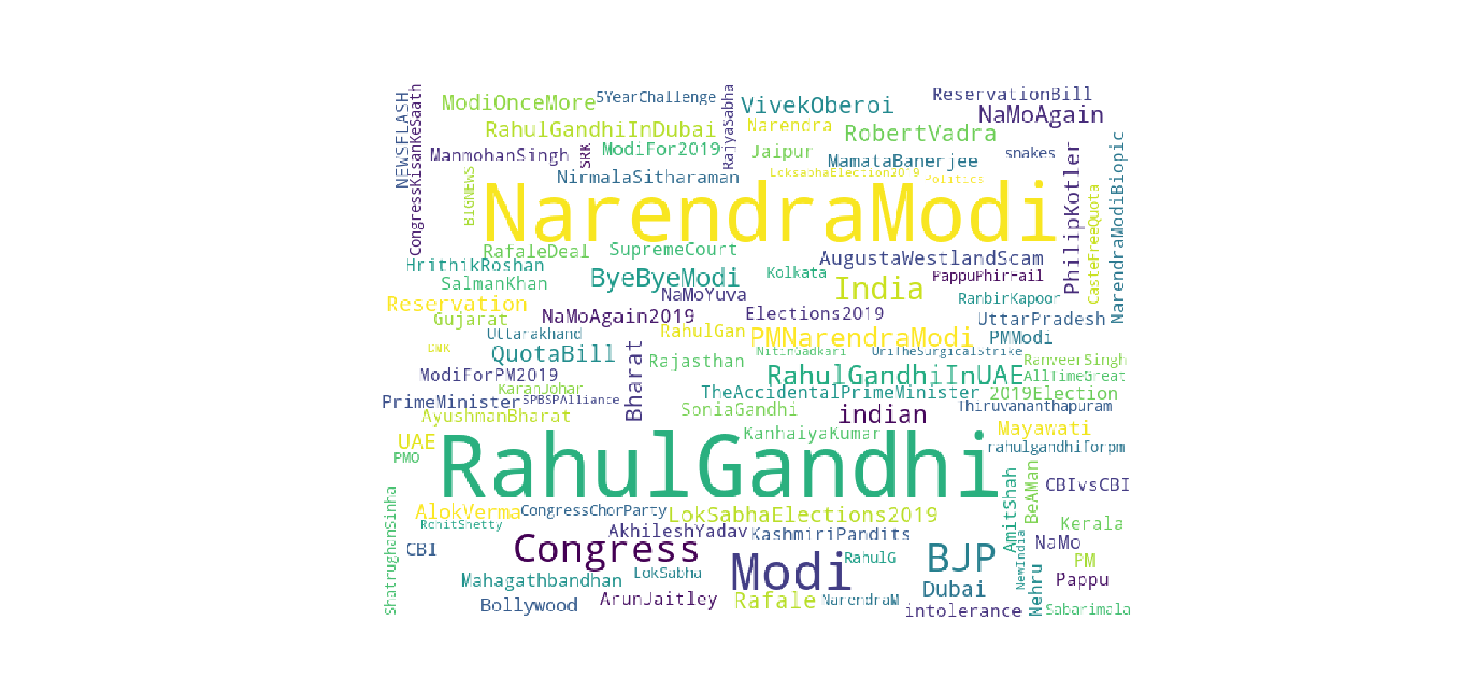

Slide 9
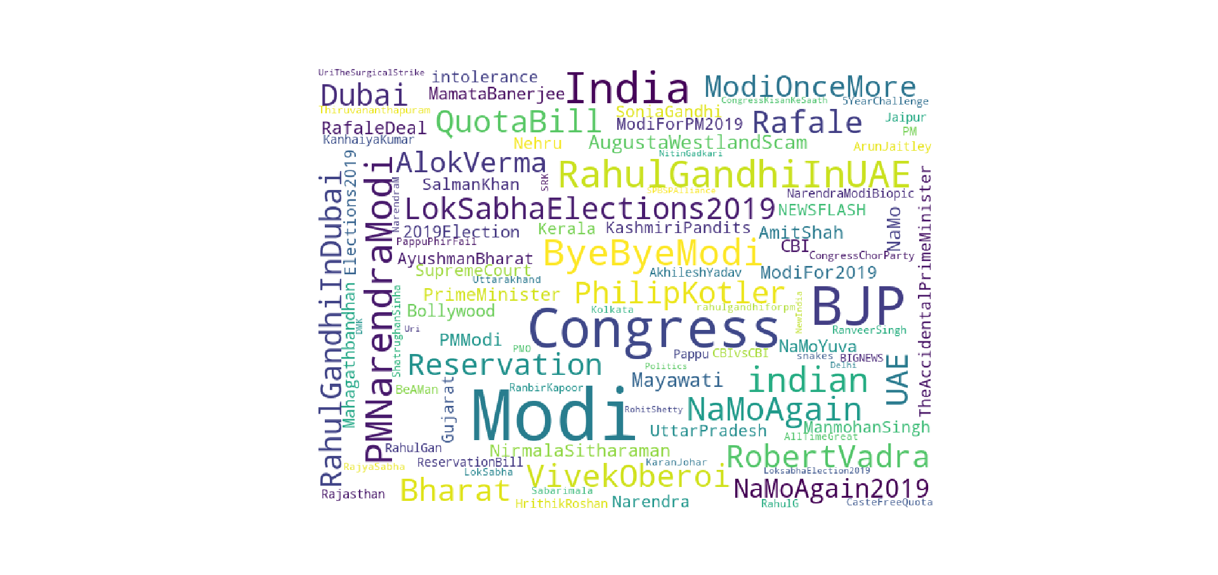

Slide 10
Classification of Tweets
3-Tier Classification
In this Tweets are classified as;
Positive
Negative
Neutral

Slide 11
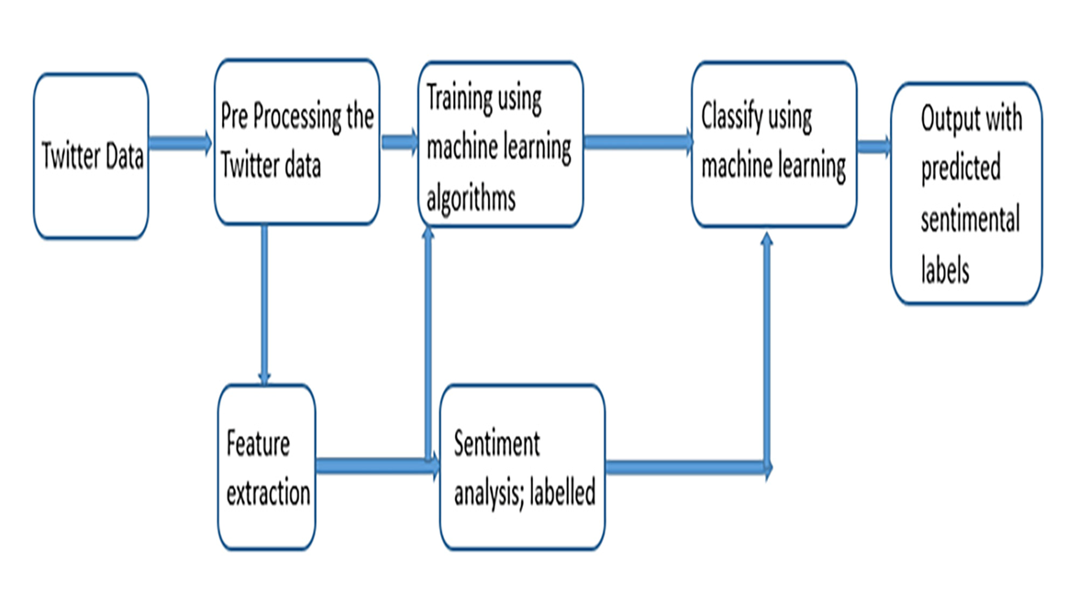
Overview

Slide 12
Naive Bayes:
The simplest solutions are usually the most powerful ones, and Naive Bayes is a good proof of that. In spite of the great advances of the Machine Learning in the last years, it has proven to not only be simple but also fast, accurate and reliable. It has been successfully used for many purposes, but it works particularly well with natural language processing (NLP) problems.
Naive Bayes is based on the Bayes theorem of probability, It is a supervised machine learning algorithm.
It assumes independence among all predictors
It is Extremely fast compared to other classification algorithms. Naive Bayes model is easy to build and particularly useful for very large data sets. Along with simplicity, Naive Bayes is known to outperform even highly sophisticated classification methods.

Slide 13
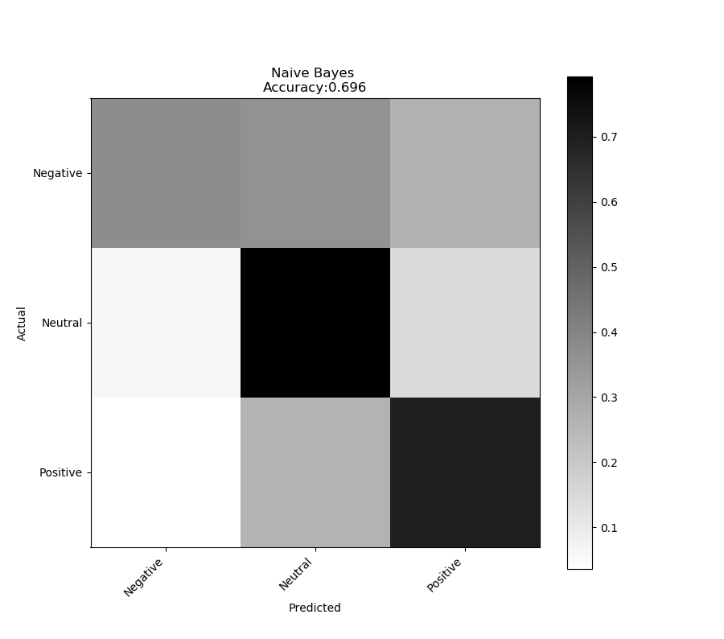
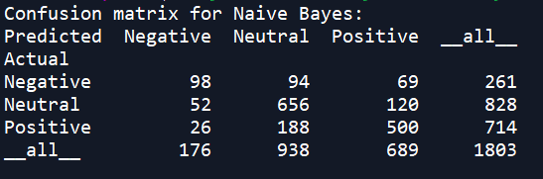

Slide 14
RandomForest
Random Forest is an ensemble learning algorithm for classification and regression. Random Forest generates a multitude of decision trees classifies based on the aggregated decision of those trees. For a set of tweets x 1 , x 2 , . . . x n and their respective sentiment labels y 1 , y 2 , . . . n bagging repeatedly selects a random sample (X b , Y b ) with replacement. Each classification tree f b is trained using a different random sample (X b , Y b ) where b ranges from 1 . . . B. Finally, a majority vote is taken of predictions of these B trees.

Slide 15
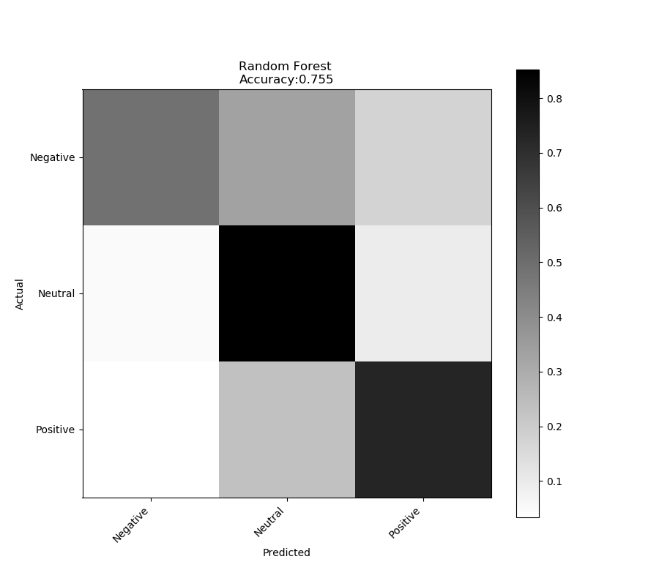
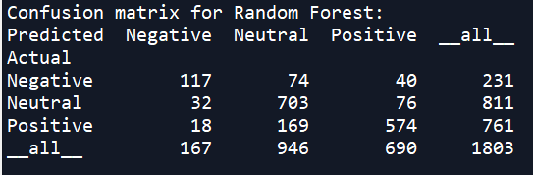

Slide 16
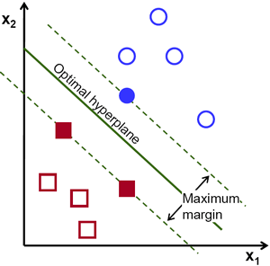
Support Vector Machine
SVM, also known as support vector machines, is a non-probabilistic binary linear classifier. For a training set of points (x i , y i ) where x is the feature vector and y is the class, we want to find the maximum-margin hyperplane that divides the points with y i = 1 and y i = −1.
The equation of the hyperplane is as follow
w . x – b = 0
We want to maximize the margin.

Slide 17
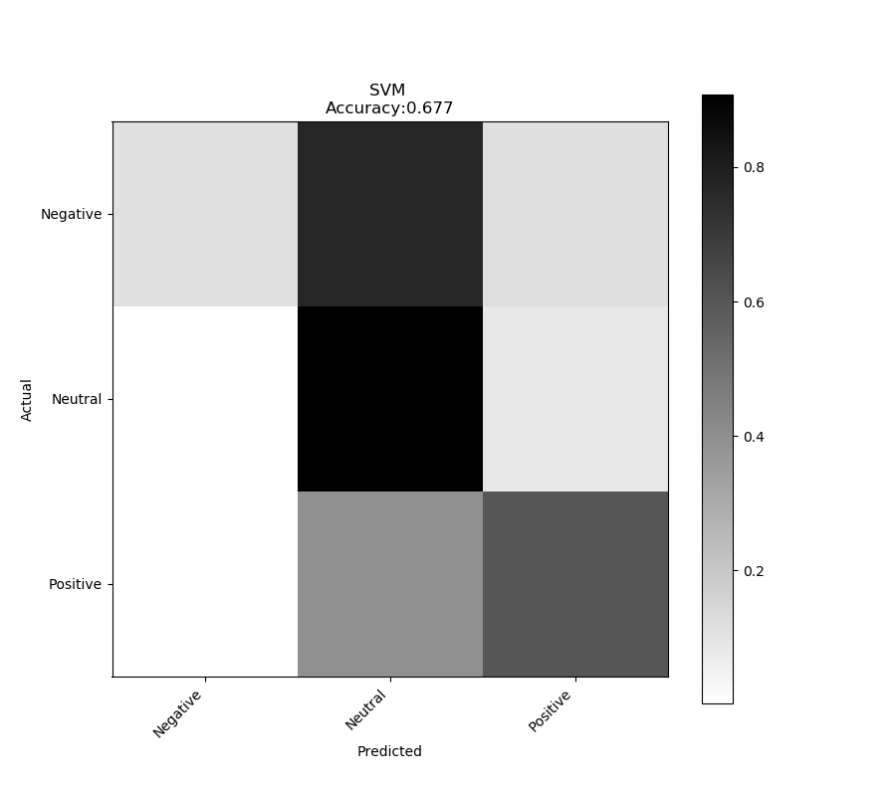
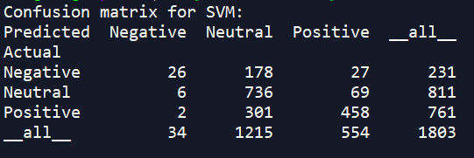

Slide 18
Measures:
As per the confusion matrix:
Accuracy(a): TP+TN Precision(p): TP Recall(r): TP (TP+TN+FP+FN) (TP+FP) (TP+FN)
F1-Score: 2rp r+p
Accuracy is one metric for evaluating classification models. Informally, accuracy is the fraction of predictions our model got right.
Precision (also called positive predictive value) is the fraction of relevant instances among the retrieved instances
Recall (also known as sensitivity) is the fraction of relevant instances that have been retrieved over the total amount of relevant instances.
F1-Score F1-Score is the weighted average of Precision and Recall. Therefore, this score takes both false positives and false negatives into account.

Slide 19
Comparison:
Results of different classification Algorithms:
 | Accuracy | Precision | Recall | F1-Score
Naive Bayes | 0.696 | 0.661 | 0.623 | 0.641
SVM | 0.677 | 0.732 | 0.541 | 0.622
RandomForest | 0.755 | 0.726 | 0.691 | 0.708

Slide 20
Team Contribution D etails
Rohit Dhuratkar:
Abhinav Rahate
Akshay Mukundwar
Abhijeet Patil
Soham Wani

Slide 21


