Slide 1

Department of Computer Science and Engineering (Cyber Security)
CCD 415 Project Phase I
Final Review
SECURE REMOTE NETWORK ACCESS USING TWING GATE AND RASPBERRY PI
Project Group No. :01
Guided By,
Ms. FARBEENA N
Assistant Professor Department of CSE
Project Members
AKSHAY N(JCE23CC008)
ABHISHEK KB(LJCE23CC034)
SHANID ALI(JCE23CC027)

Slide 2
OUTLINE
Abstract
Introduction
Objectives
Existing System and its Drawbacks
Problem Definition
Literature Survey
Proposed System and its Advantages
System Architecture
Software and Hardware Requirements
Stakeholders
Module Design
Data Flow Diagrams
Progress
Implementation and screenshots
Conclusion
References

Slide 3
ABSTRACT
Secure remote network access is essential for connecting users to private network resources while maintaining strong security and access control.
Traditional remote access methods such as Virtual Private Networks (VPNs) may require firewall modifications, port forwarding, public IP addresses, and complex network configurations, increasing deployment complexity and potential security risks.
A Raspberry Pi is configured as a network connector for Twingate, enabling remote devices to securely access authorized internal resources.
Twingate provides cloud-based management, authentication, device verification, granular access policies, and activity logging.

Slide 4
INTRODUCTION
Secure remote network access is essential for connecting users to private network resources while maintaining strong security and access control.
Traditional remote access methods such as Virtual Private Networks (VPNs) may require firewall modifications, port forwarding, public IP addresses, and complex network configurations, increasing deployment complexity and potential security risks.
A Raspberry Pi is configured as a network connector for Twingate, enabling remote devices to securely access authorized internal resources.
Twingate provides cloud-based management, authentication, device verification, granular access policies, and activity logging.

Slide 5
OBJECTIVES
To develop a secure and cost-effective remote network access solution using a Raspberry Pi integrated with the Twingate Zero Trust Network Access (ZTNA) platform.
To implement a Zero Trust security model based on identity verification, device authentication, and least-privilege access control.
To eliminate the need for traditional VPN requirements such as port forwarding, public IP addresses, firewall modifications, and complex network configurations.
To provide centralized and secure management of remote network resources through Twingate’s cloud-managed architecture, including access policies, authentication, and activity logging.
scalability.

Slide 6
EXISTINGSYSTEMAND
ITS DRAWBACKS
Firewall and port forwarding required: traditional VPNs need open ports and manual firewall changes, which increases the attack surface.
Needs a public IP and complex setup: it fails behind CGNAT or restricted networks and requires skilled staff to configure.
Excessive network access: once connected, users can often reach the entire network, which allows lateral movement.
Weak control and visibility: shared credentials, limited per-resource policies and minimal logging make auditing difficult.

Slide 7
PROBLEM DEFINITION
Traditional VPN-based remote access often requires firewall modifications, port forwarding, public IP addresses, and complex network configurations, making deployment difficult.
Conventional remote access methods may provide users with wider network access than necessary, increasing the risk of unauthorized access to internal resources.
Exposing internal network services to the internet creates security risks, increasing the possibility of unauthorized access and cyberattacks.
Conventional VPN-based solutions may provide broader network access than necessary, making it difficult to enforce least-privilege access for individual users and resources.

Slide 8
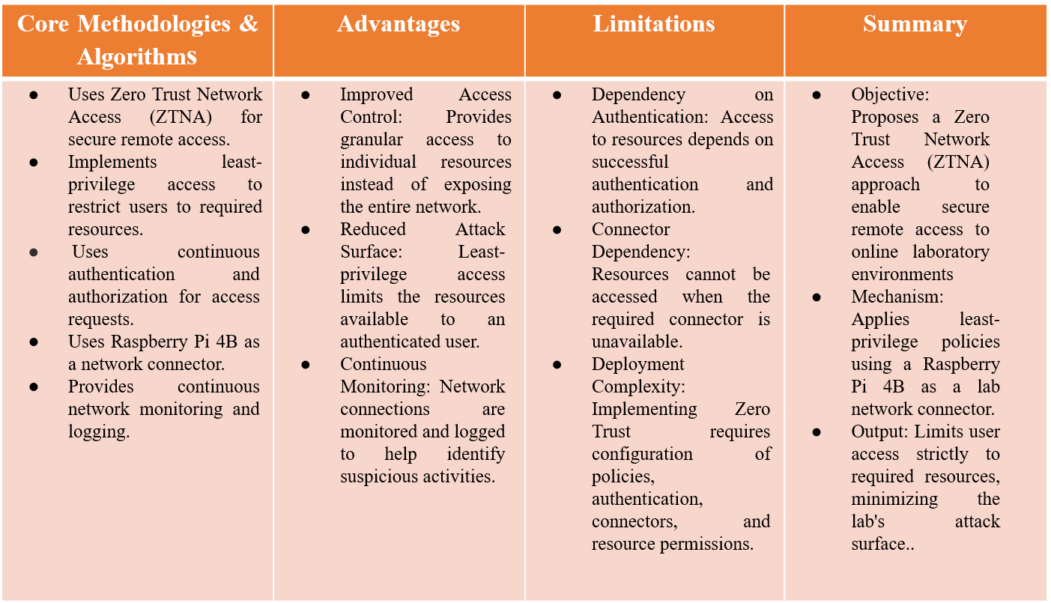
LITERATURE SURVEY

Slide 9
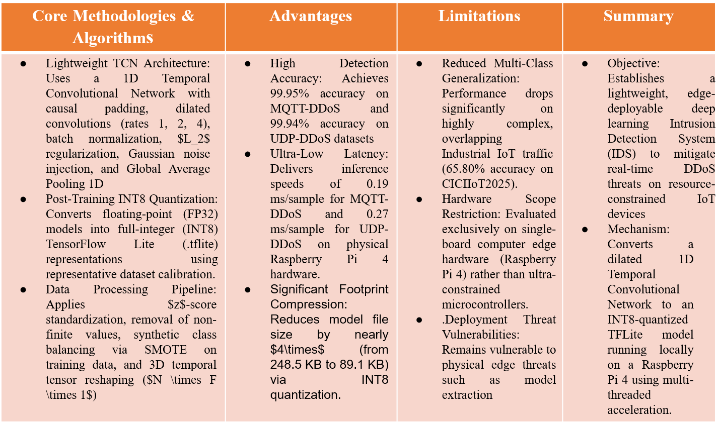
LITERATURE SURVEY

Slide 10
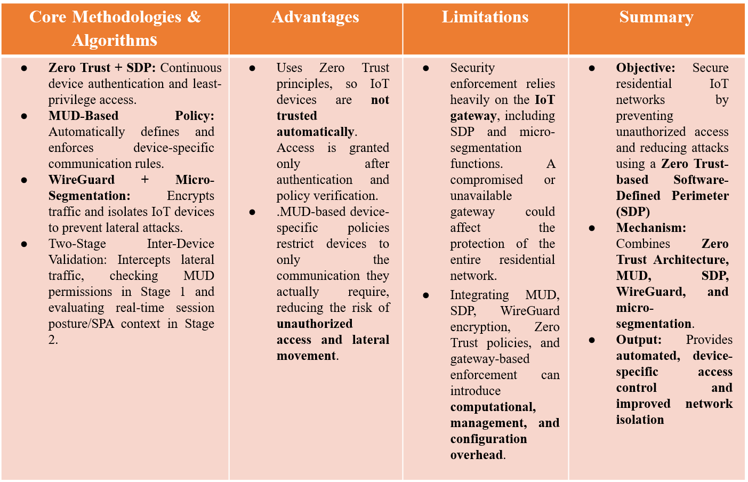
LITERATURE SURVEY

Slide 11
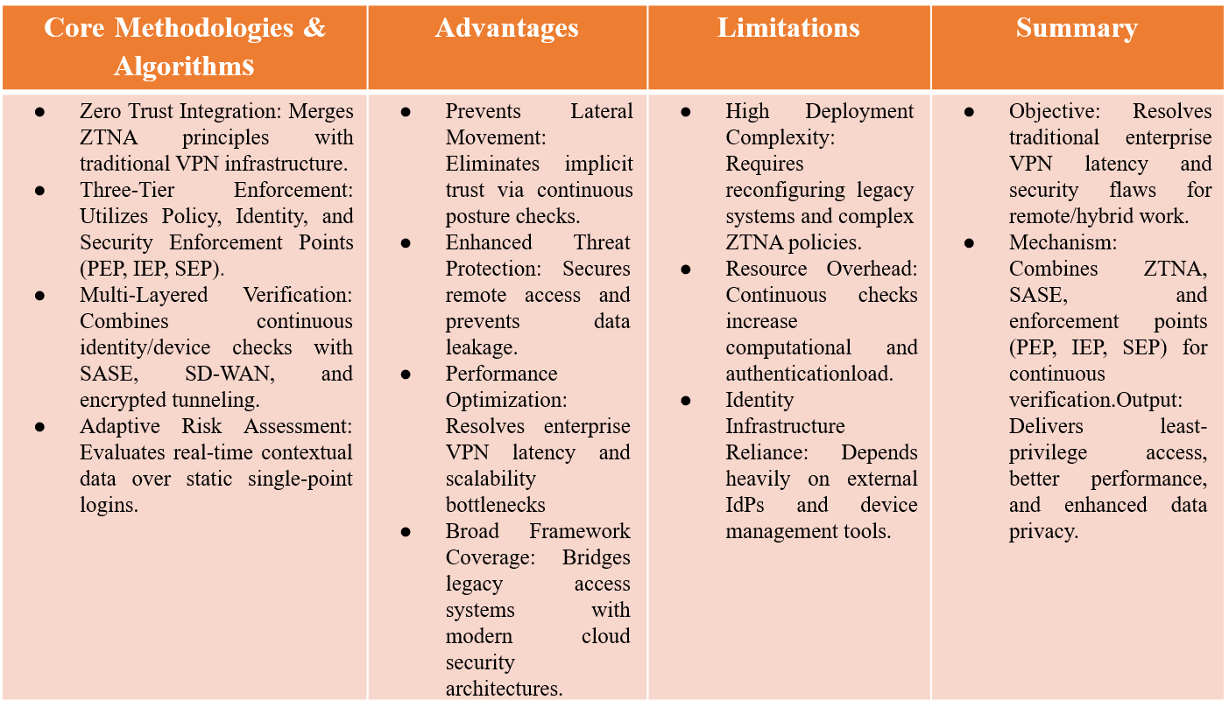
LITERATURE SURVEY

Slide 12
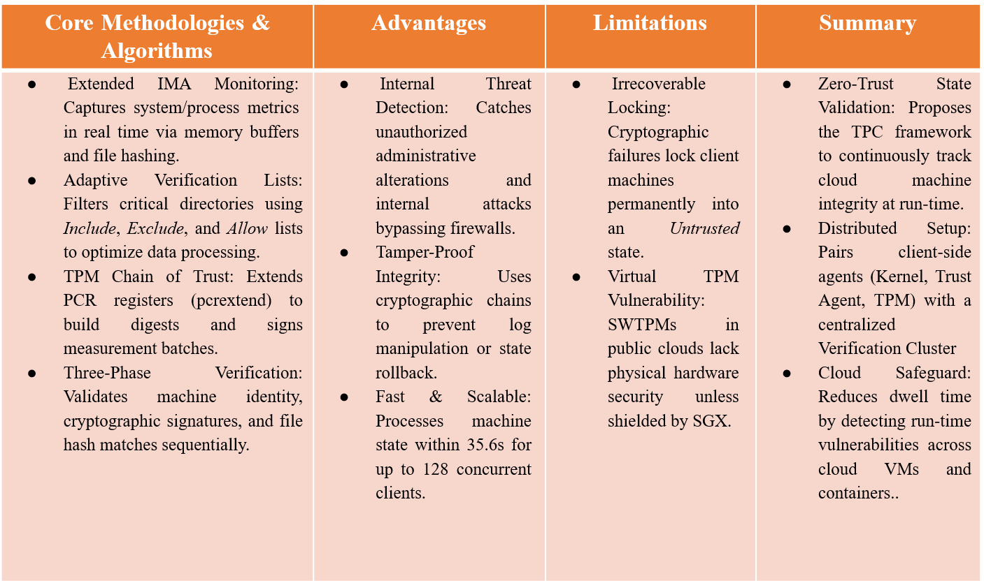
LITERATURE SURVEY

Slide 13
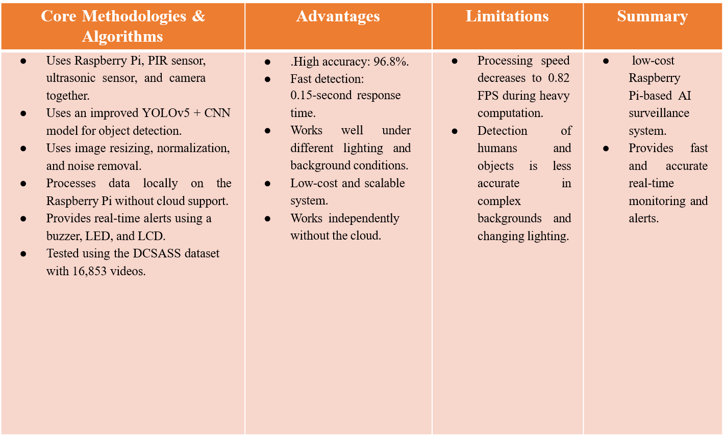
LITERATURE SURVEY

Slide 14
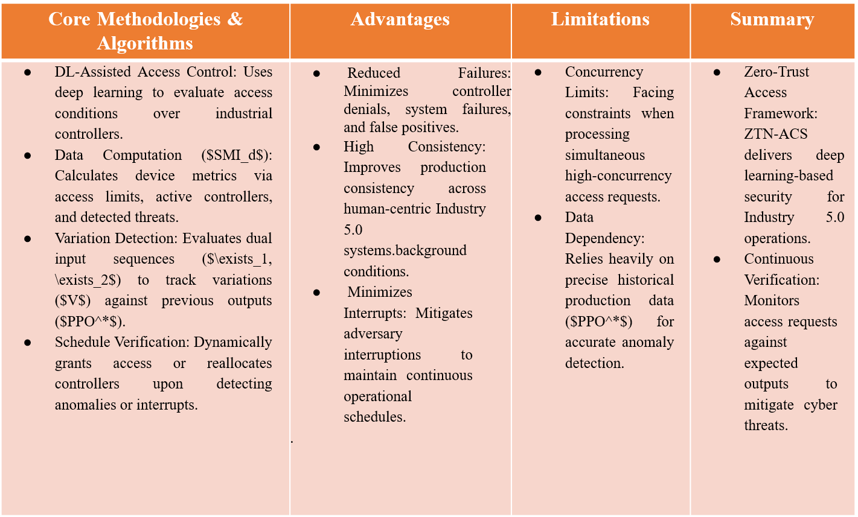
LITERATURE SURVEY

Slide 15
PROPOSED SYSTEM AND
ITS ADVANTAGES
Proposed system: a Raspberry Pi acts as a Twingate connector that links the remote network to the Twingate cloud with an outbound-only connection. Users reach only the resources they are authorized for, after identity and device verification.
Security advantages: no firewall changes, port forwarding or public IP are needed, and least-privilege access limits lateral movement.
Operational advantages: it is low cost and centrally managed, and the Python API script automates resource discovery and registration, with logging for auditing.
Low cost and automation: the Raspberry Pi is affordable and centrally managed, and the Python API script automates resource discovery, with logging for auditing.

Slide 16
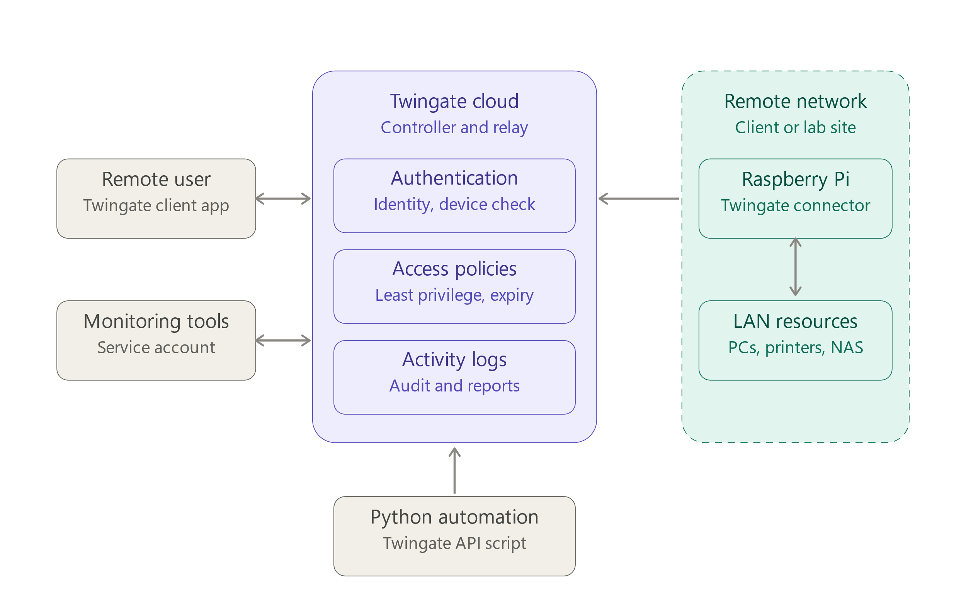
SYSTEM ARCHITECTURE

Slide 17
SOFTWARE& HARDWARE
REQUIREMENTS
Hardware Requirements
Raspberry Pi 3, 4 or 5 (the connector device)
microSD card (16 GB or more) and a power supply
Network connection: Ethernet (preferred) or Wi-Fi
Client device: laptop, PC or smartphone for remote access
Internal network devices (PC, printer, router or NAS) as test resources
Software Requirements
Raspberry Pi OS (flashed with Raspberry Pi Imager)
Twingate: cloud account (free tier), connector software and client apps (Windows, macOS, Linux, Android, iOS)
Python 3 with the requests library, for the Twingate API automation script

Slide 18
STAKEHOLDERS
Network administrators / IT support: deploy and manage the connector, define access policies and monitor activity through the Twingate console.
Remote users / employees: get secure access to only the resources they are authorized for, without VPN setup.
Small businesses and organizations (e.g. churches, schools, community groups): get a low-cost, low-maintenance way to give remote support without exposing their network.
Security teams and ethical hackers: use it for monitoring, audits and authorized security assessments with controlled, time-limited access.
Project team and guide: you as the developer, with Ms. Farbeena N as guide, responsible for design, implementation and evaluation.

Slide 19
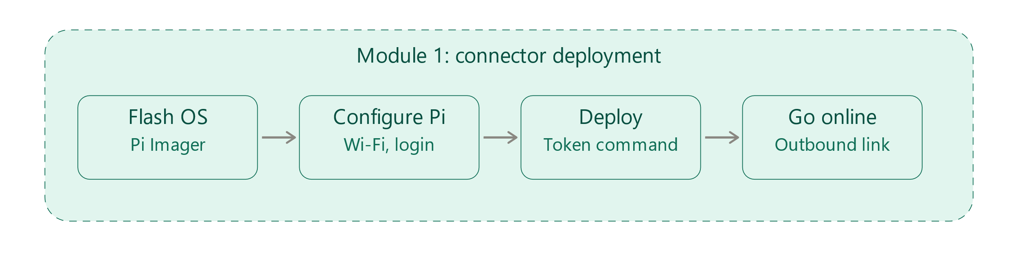
MODULE DESIGN
Connector Deployement Module
Set up the Raspberry Pi as a Twingate connector.
Pi connected to the cloud with an outbound-only link.

Slide 20
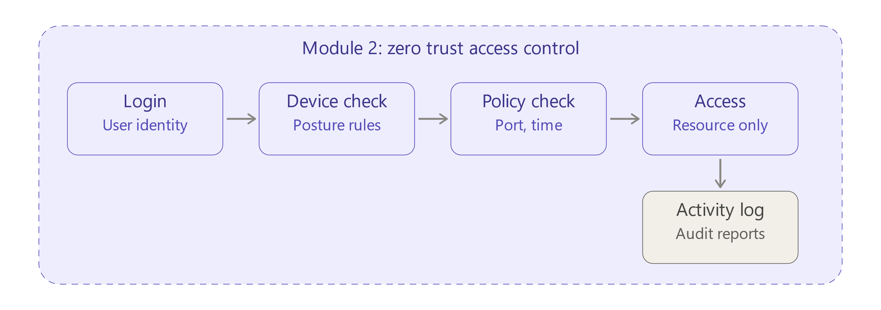
MODULE DESIGN
Access Control Module
Verify the user, the device and the policy before granting access.
Access to authorized resources only, with logs.

Slide 21
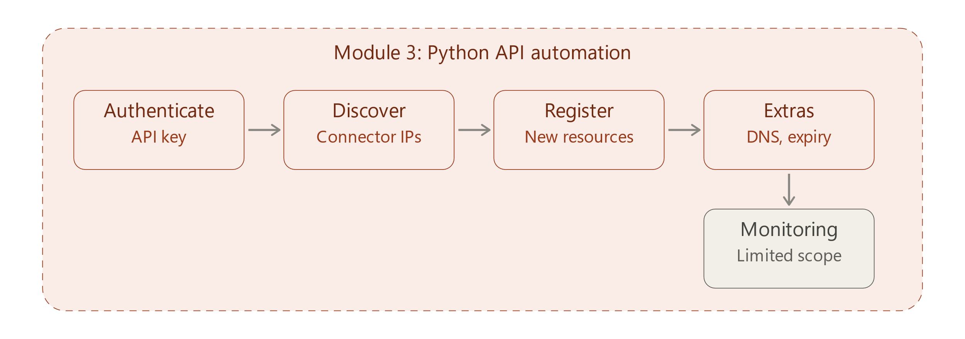
MODULE DESIGN
Python API Automation Module
Discover and register resources automatically
Resources, DNS aliases, temporary access and service accounts created without manual work.

Slide 22
DATA FLOW DIAGRAM
LEVEL 0 DFD:-
Access request
Policies, setup
Remote user
Administrator
Access granted
Logs, reports
Security remote
access system
API request
Request
Monitoring tools
LAN resources
Status data
Response data

Slide 23
DATA FLOW DIAGRAM
LEVEL 1 DFD:-
Resource data
Login
Valid
Allow
Relay
Remote user
User, device
Least privilege
Via connector
Request
Data
D1 Policies, resources
Events
LAN resources
Setup
Register
Log
Events
Admin
Python API
Audit trail
D2 Activity logs

Slide 24
DATA FLOW DIAGRAM
LEVEL 2 DFD:-
Denied
Remote user
Receive
Identity
Device
Session
Login request
Credentials
Posture check
Issue token
D1 Users, policies
Policy
Next process

Slide 25
PROGRESS
Problem definition and literature survey (VPN limitations, ZTNA): Completed
System architecture and design diagrams (architecture, DFD Levels 0 to 2): Completed
Module design, requirements and technology stack selection: Finalized
Twingate account and remote network setup: Completed
Raspberry Pi OS flashing and connector deployment: In progress
Python API automation (resource discovery and registration): Planned
Access policies, DNS aliasing, temporary access and service accounts: Planned
Integration, testing and documentation: Not started

Slide 26
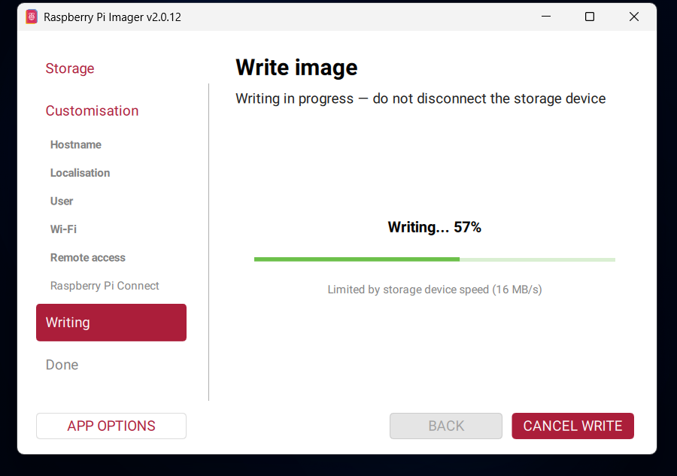
Implementation and screenshots
Setting Up Raspberry PI

Slide 27
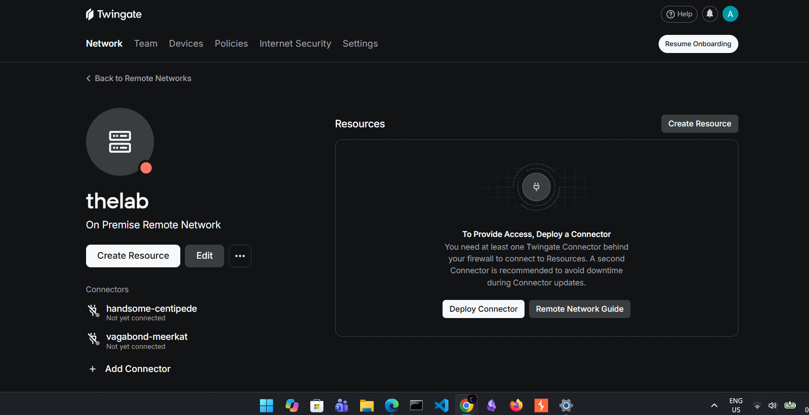
Implementation and screenshots
Twingate Admin Dashboard

Slide 28
CONCLUSION
Problem addressed: the project replaces VPN-based remote access, which needs firewall changes, port forwarding and public IPs, with a zero-trust approach.
Secure by design: a Raspberry Pi connector makes an outbound-only connection to Twingate, and users reach only the resources they are authorized for, after identity and device verification.
Low cost and automated: an affordable Raspberry Pi and a Python script using the Twingate API reduce manual setup and make it easy to scale.
Wider use: the system supports remote administration, monitoring, maintenance and authorized security assessments, with logging for auditing.

Slide 29
REFERENCE
[1]R. Tuyishime, F. Radu, E. Tuyishime, D. Cotfas, P. Cotfas, T. Balan, and A. Rekeraho, “Online Laboratory Access Control With Zero Trust Approach: Twingate Use Case,” 2024
[2]N. N. Hari et al., "Standards-Compliant Zero Trust Framework-Based Software-Defined Perimeter (SDP) for Securing Residential IoT Networks," IEEE Transactions on Consumer Electronics, vol. 72, no. 1, pp. 1312–1327, Feb. 2026
[3]M. Akhi, C. Eising, and L. L. Dhirani, "Securing IoT Using Lightweight TCN for Edge Deployment on Raspberry Pi 4," IEEE Open Journal of the Communications Society, vol. 7, pp. 1184–1200, 2026
[4]S. M. Zohaib, S. M. Sajjad, Z. Iqbal, M. Yousaf, M. Haseeb, and Z. Muhammad, "Zero Trust VPN (ZT-VPN): A Systematic Literature Review and Cybersecurity Framework for Hybrid and Remote Work," Information, 2024.
[5]D. N. Jha, G. Lenton, J. Asker, D. Blundell, M. Higgins, and D. C. H. Wallom (2023). "A Run-Time Framework for Ensuring Zero-Trust State of Client’s Machines in Cloud Environment."

Slide 30
REFERENCE
[6]D. N. Jha, G. Lenton, J. Asker, D. Blundell, M. Higgins, and D. C. H. Wallom (2023). "A Run-Time Framework for Ensuring Zero-Trust State of Client’s Machines in Cloud Environment."
[7]K. A. Abuhasel (2023). "A Zero-Trust Network-Based Access Control Scheme for Sustainable and Resilient Industry 5.0."
[8]AI-Based Smart Surveillance System Using Raspberry Pi and Embedded Vision B. Girirajan, S. Prabu, V. T. Thangam,
M. Sugumaran, P. Venkateshwaran, A. Kaur

Slide 31
THANK YOU

