Slide 1


Disaster Management
A Master Guide Covering Strategy, Community Action, Relief Operations & Behavioral Dynamics

Slide 2


Meaning, Purpose & Objectives
Meaning & Core Purpose
Strategic Objectives
Definition: A Disaster Management Plan (DMP) is a structured operational document that outlines preemptive measures and response strategies for disasters.
Primary Goal: Build resilient systems that reduce disaster vulnerability across communities and physical infrastructure.
Key Objectives: Ensure rapid emergency deployment, maintain seamless communication, safeguard critical assets, and establish smooth transition to rehabilitation.
Primary Purpose: To establish systemic readiness, minimize life and property loss, and streamline quick multi-agency recovery during emergencies.

Slide 3






Basic Components of a Plan
Risk Assessment
Standard Operating Protocols
Resource Inventory
Identification of historical hazards, geographic vulnerabilities, and community exposure to create baseline risk profiles.
Clear Command Structure detailing exact chains of responsibility, alert triggers, and inter-departmental communication protocols.
Database of emergency stockpiles, rescue equipment, medical supplies, and designated shelter facilities ready for immediate deployment.

Slide 4




Planning Process & Hazard ID
Hazard Mapping
Resource Audit
Role Mapping
Validation & Drills
Identifying geographical risk zones and potential natural or technological disaster threats.
Evaluating available manpower, machinery, medical assets, and financial reserves.
Assigning explicit roles to government, NGOs, emergency services, and community volunteers.
Testing response efficacy through periodic simulation exercises and stakeholder reviews.

Slide 5


Resources & Preparedness
Resource & Responsibility Matrix
Preparedness Measures
Resource Allocation: Pre-designating emergency funds, food stockpiles, heavy rescue vehicles, and communication gear.
Early Warning Systems: Deploying multi-channel alert mechanisms including sirens, mobile broadcasts, and weather telemetry.
Institutional Accountability: Establishing clear accountability across local authorities, police, health services, and fire rescue teams.
Capacity Building: regular maintenance of emergency gear, training of first responders, and keeping emergency contact networks updated.

Slide 6
Purpose & Event Recording
Official Record Keeping: Disaster reports capture accurate, chronological timelines of events, impact severity, and immediate environmental conditions.
Accountability & Transparency: Documents government and relief agency response actions to ensure public accountability and post-event audits.
Real-time Incident Logging: Continuous recording of hazard progression, casualty counts, infrastructure damage, and resource consumption.
Multi-Agency Coordination: Provides standardized data updates across civil defense, military, health, and non-profit organization networks.

Slide 7

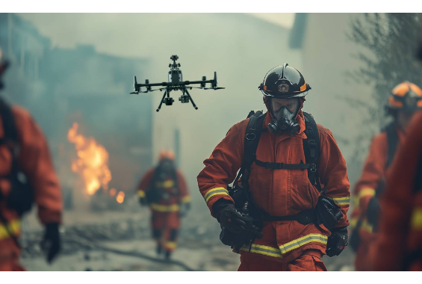
Loss Assessment & Lessons Learned
Damage & Loss Assessment: Quantifies human casualties, agricultural damage, housing destruction, and economic downtime for relief funding.
Evaluating Response Activities: Analyzes rescue efficiency, evacuation timelines, and distribution bottlenecks during the active phase.
Documenting Lessons Learned: Identifies structural vulnerabilities and plan failures to update future emergency response strategies.

Slide 8
Importance of Local Involvement
First Responders Concept
Indigenous Knowledge
Local community members are physically present at the disaster site during the critical first hours long before professional teams arrive.
Local residents understand unique local topography, weather markers, traditional safe havens, and community vulnerabilities.
Immediate community action directly correlates with higher survival rates and faster immediate triage.
Leveraging traditional knowledge enhances early warning reliability and evacuation compliance.

Slide 9


Local Role in Preparedness
Early Warning Delivery
Evacuation Guidance
Community Audits
Local volunteers act as vital links to disseminate alerts across remote households and vulnerable neighborhood pockets.
Community leaders assist children, elderly, and disabled individuals in reaching designated high-ground or shelters swiftly.
Participating in local hazard mapping, reporting blocked drainage systems, and identifying vulnerable infrastructure.

Slide 10
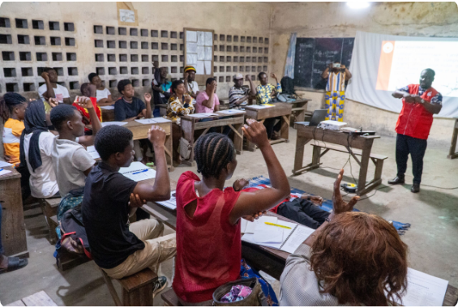
Community Awareness & Resources
Targeted Awareness Campaigns: Regular drills, safety workshops, and disaster literacy in schools and community centers.
Mobilizing Local Resources: Cataloging village boats, private trucks, generators, and community halls for emergency use.
Inter-neighborhood Cooperation: Forming local task forces dedicated to search, rescue, first aid, and shelter management.

Slide 11





Volunteering & Action
Structured Volunteer Cadres
Relief Logistics Support
Shelter Support Operations
Training youth and civic groups in basic first aid, fire containment, and light search-and-rescue operations.
Assisting official authorities in unloading, sorting, packaging, and distributing emergency food kits and blankets.
Managing community kitchens, maintaining hygiene, and helping register displaced individuals within local shelters.

Slide 12
Need & Core Objectives
Need for Relief Camps
Core Objectives
Disasters often destroy homes and lifelines, leaving thousands homeless and vulnerable to extreme weather and secondary hazards.
Primary Protection: Deliver immediate shelter, physical safety, nourishment, and medical treatment to displaced populations.
Relief camps provide temporary safe havens that preserve human dignity and prevent post-disaster mortality.
Systemic Stability: Prevent disease outbreaks and establish centralized hubs for humanitarian relief distribution.

Slide 13
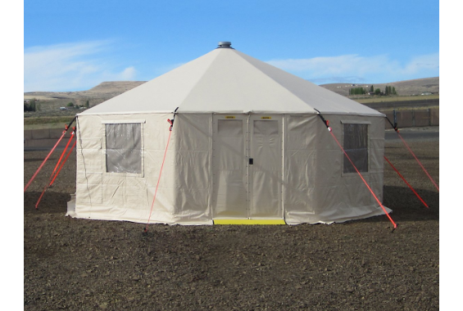
Site Selection & Organization
Safe Site Selection: Built on elevated, hazard-free ground away from floodplains, landslide paths, or industrial hazards.
Accessibility & Logistics: Close to main transport routes for supply trucks and ambulances with good natural drainage.
Basic Spatial Zoning: Organizing distinct areas for sleeping, dining, sanitation, medical triage, and administrative desks.

Slide 14



Camp Administration Structure
Camp Commandant
Registration Desk
Security & Safety Team
Overall administrative lead responsible for policy execution, official reporting, and high-level decision making.
Log-in team tracking family units, vulnerable individuals, missing persons, and special nutritional/medical needs.
Law enforcement and trained personnel ensuring order, protecting women/children, and managing entry points.

Slide 15
Space Allocation & Security
Operational Pillar | Standard Guidelines | Key Objective
Space Allocation | Minimum 3.5m² covered shelter space per person with adequate head clearance. | Prevents overcrowding, maintains family privacy, and reduces stress.
Security & Safety | Well-lit perimeters, dedicated safe spaces for women/children, and 24/7 patrols. | Mitigates theft, exploitation, physical violence, and camp conflicts.
Inter-Agency Coordination | Daily updates between government officials, military logistics, and international NGOs. | Eliminates resource duplication and ensures smooth supply replenishment.

Slide 16

Essential Life-Support Amenities
Food & Nutrition
Safe Drinking Water
Sanitation & Hygiene
Minimum 2,100 kcal per person/day. Hygienic communal kitchens providing culturally appropriate meals and infant food.
15-20 liters per person daily for drinking, cooking, and personal hygiene. Continuous water quality monitoring.
1 toilet per 20 persons (gender-segregated). Proper waste management, vector control, and hygiene kit distribution.

Slide 17
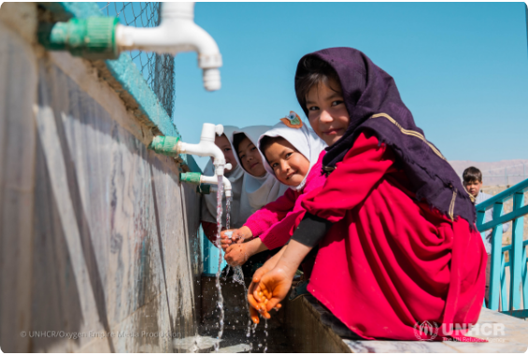
Healthcare & Infrastructure
Healthcare Facilities: On-site primary health clinics, emergency trauma care, essential drugs, and maternal health services.
Electricity & Lighting: Generator back-ups and solar lights for latrines, medical bays, and pathways to ensure safety.
Communication Hubs: Public announcement systems, family reunifying desks, and charging stations.

Slide 18
Human Reactions in Crises
Panic & Acute Fear Response
Stress & Survival Dynamics
Panic Triggers: Sudden loss of control, breakdown of communication, and conflicting rumors can cause mass panic.
Acute Stress Reaction: Shock, disorientation, denial, and hyper-vigilance are common psychological responses.
Behavioral Risk: Irrational flight behavior, stampedes at relief distribution points, and severe cognitive freeze.
Pro-Social Altruism: Contrary to myths, communities frequently exhibit immense mutual helpfulness and solidarity during acute crises.

Slide 19
Effective Behavior Management
Transparent Public Communication: Deliver factual, calm, authoritative, and actionable updates frequently to counter rumor mills and prevent panic.
Structured Crowd Management: Use clear queueing barriers, empathetic personnel, and organized staging areas during food/supply distribution.
Promoting Community Cooperation: Involve survivors in routine camp tasks to restore agency, purpose, and social order.
De-escalation Training: Equipping field responders with calm verbal skills to defuse rising tensions in stressed groups.

Slide 20
Psychological Trauma & Support
Psychological Toll: Grief, severe anxiety, depression, and Post-Traumatic Stress Disorder (PTSD) triggered by loss of loved ones and property.
Psychological First Aid (PFA): Non-intrusive, compassionate care focusing on safety, comfort, listening, and connecting survivors to support.
Specialized Vulnerable Care: Targeted emotional support for children, orphans, widows, and elderly survivors.

Slide 21


Counselling & Care Systems
Community Debriefing
Professional Counselling
Care for First Responders
Facilitated group interactions allowing survivors to share experiences and normalize emotional reactions in a safe environment.
Clinical referral pathways for individuals exhibiting severe depression, prolonged trauma, or self-harm tendencies.
Managing compassion fatigue and vicarious trauma among emergency workers through mandatory rest and debriefing.

Slide 22



Training & Core Attributes
Rigorous Skill Training
Discipline & Ethics
Clear Communication
Continuous drills in search and rescue, incident command systems, hazard containment, and medical triage.
Adhering to non-discriminatory relief distribution, preserving human dignity, and maintaining strict professional integrity.
Succinct multi-channel communications across rescue teams, administrative leads, and vulnerable civilians.

Slide 23
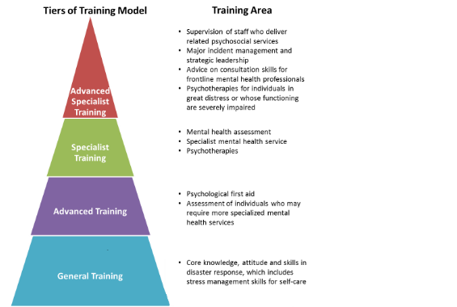
Leadership & Team Conduct
Decisive Emergency Leadership: Ability to analyze incomplete data rapidly, make high-stakes choices, and direct rescue operations under extreme pressure.
Inter-Agency Teamwork: Harmonizing civil administration, military units, medical personnel, and local volunteer corps.
Professional Accountability: Taking responsibility for resource stewardship, operational outcomes, and field safety protocols.

Slide 24
Individual Capacity Building
Building Personal Skills
Self-Reliance Culture
Practical First-Aid: Training citizens in CPR, wound dressing, fracture stabilization, and basic triage techniques.
Reducing Dependence: Cultivating personal confidence so individuals act decisively without waiting for external aid.
Household Preparedness: Equipping families to create 72-hour emergency kits, escape plans, and secure vital records.
Risk Awareness: Educating individuals to recognize environmental warning signs and evacuate proactively.

Slide 25


Strengthening Community Resilience
Community Disaster Committees
Resilient Infrastructure
Long-term Adaptability
Establishing localized, community-led committees responsible for maintenance of local early warning systems and safe shelters.
Encouraging community-driven retrofitting, safe building practices, mangrove protection, and sustainable land use.
Integrating climate resilience and risk reduction into everyday local development planning and social programs.

Slide 26






Image Sources
https://cdn.sanity.io/images/vjj9kuff/production/e87e12ff47ccbd85d78d9af228f244f0acb1a60d-1500x918.jpg?q=85&auto=format&w=1920
Source: flytbase.com
https://preparecenter.org/wp-content/uploads/2024/02/Night-Time-First-Aid-Training-scaled.jpg
Source: preparecenter.org
https://images.squarespace-cdn.com/content/v1/66623a178f69fa695b49dcb1/0eeb28cb-32cf-4310-a262-38ec63de0f99/western%2Bshelter%2Bgatekeeper%2B20%2Bcommand%2Band%2Bcontrol%2Bshelter.jpg
Source: www.westernshelter.com
https://www.unrefugees.org/media/3z4jk5su/wash-explainer-3.png
Source: www.unrefugees.org
https://www.goodtherapy.org/blog/blog/wp-content/uploads/2019/08/How-to-Give-Psychological-First-Aid-800x1760.png
Source: www.goodtherapy.org
https://hadps.ha.org.hk/GetFile.ashx?file=%2FPreparedness%2FTraining%20Model%20(Eng)%202022.png
Source: hadps.ha.org.hk

