Slide 1
REMOTE NETWORK ACCESS USING TWIN GATE AND RASPBERRY PI
Guided By : MS FARBEENA N
ASSIT.PROFESSOR DEPT. OF COMPUTERSCIENCE
Presented By : AKSHAY N
JCE23CC008

Slide 2
OUTLINE
Abstract
Introduction
System Analysis
Literature Review
Existing System
Proposed System
4. System Overview
System Requirements
System Design
System Working
5. Conclusion
6. References

Slide 3
1. ABSTRACT
Uses a Raspberry Pi as a secure network connector for the Twingate Zero Trust Network Access (ZTNA) platform.
Provides identity-based and least-privilege access, allowing users to access only authorized network resources.
Enables centralized authentication, access control, device verification, and activity logging without directly exposing internal services to the internet.
Integrates the Twingate API with Python automation for resource discovery, dynamic registration, DNS aliasing, temporary access, and service accounts.

Slide 4
2. INTRODUCTION
Objectives:
To develop a secure remote access system using Raspberry Pi and Twingate ZTNA.
To implement identity-based authentication and least-privilege access to network resources.
To reduce the need for public IPs, port forwarding, and complex firewall configurations.
To automate resource discovery and registration using the Twingate API and Python.

Slide 5
3. SYSTEM ANALYSIS LITERATURE REVIEW
[1] Toward Zero-Trust IoT Networks via Per-Packet Authorization
Proposes a Zero Trust architecture called OUTSIDE for fine-grained authorization in IoT networks.
Uses per-packet verification to ensure that only authorized applications can access network resources.
The system was implemented using Raspberry Pi and ESP32, with experiments showing negligible performance degradation
[1] Syed et al., “Zero Trust Architecture (ZTA): A Comprehensive Survey,” IEEE Access, 2022.
5

Slide 6
3. SYSTEM ANALYSIS LITERATURE REVIEW
[2] Toward Zero-Trust IoT Networks via Per-Packet Authorization
Proposes a standards-compliant Zero Trust Framework to enhance security in residential IoT networks.
Uses Software-Defined Perimeter (SDP) to restrict network access to authenticated and authorized devices.
3. Implements identity-based access control and continuous verification to reduce unauthorized access and potential cyberattacks.
[2] N. N. Hari et al., “Standards-Compliant Zero Trust Framework-Based Software-Defined Perimeter (SDP) for Securing Residential IoT Networks,” IEEE

Slide 7
3. SYSTEM ANALYSIS LITERATURE REVIEW
[3] Online Laboratory Access Control With Zero Trust Approach: Twingate Use Case
Proposes a standards-compliant Zero Trust framework for securing residential IoT networks..
Integrates Software-Defined Perimeter (SDP) to control access to connected IoT devices.
3. Uses authentication and authorization mechanisms to prevent unauthorized network access.
[3] E. Tuyishime et al., “Online Laboratory Access Control With Zero Trust Approach: Twingate Use Case,” IEEE.

Slide 8
EXISTING SYSTEM
Traditional Remote Network Access:
Traditional remote access systems primarily rely on VPNs to connect remote users to private networks.
VPN deployment often requires firewall modifications, port forwarding, and public IP configuration..
Complex network setup and maintenance increase administrative workload.
Broad network access may allow users to access resources beyond their actual requirements..
Exposing network services to the internet can increase the risk of unauthorized access and cyberattacks.
Manual configuration of users, permissions, and network resources makes scalability and centralized management challenging.

Slide 9
EXISTING SYSTEM
Limitations:
Complex Configuration: Requires firewall changes, port forwarding, and network setup.
High Maintenance: Regular updates and manual configuration increase administrative effort.
Security Risks: Exposed services and misconfigured VPNs may create vulnerabilities.
Excessive Access: Traditional VPNs may provide broader network access than necessary.
Limited Automation: Resource registration and permission management often require manual intervention..
Scalability Issues: Expanding access to new users and resources can increase complexity and management costs.

Slide 10
PROPOSED SYSTEM
The proposed system uses a Raspberry Pi as a lightweight network connector integrated with the Twingate Zero Trust Network Access (ZTNA) platform.
Components of system:
Raspberry Pi
Acts as a low-cost connector between private network resources and the Twingate platform.
Twingate ZTNA Platform
Provides centralized access management, secure connectivity, and zero-trust policy enforcement
Python Automation Script
Integrates with the Twingate API to discover network resources and automate resource registration.

Slide 11
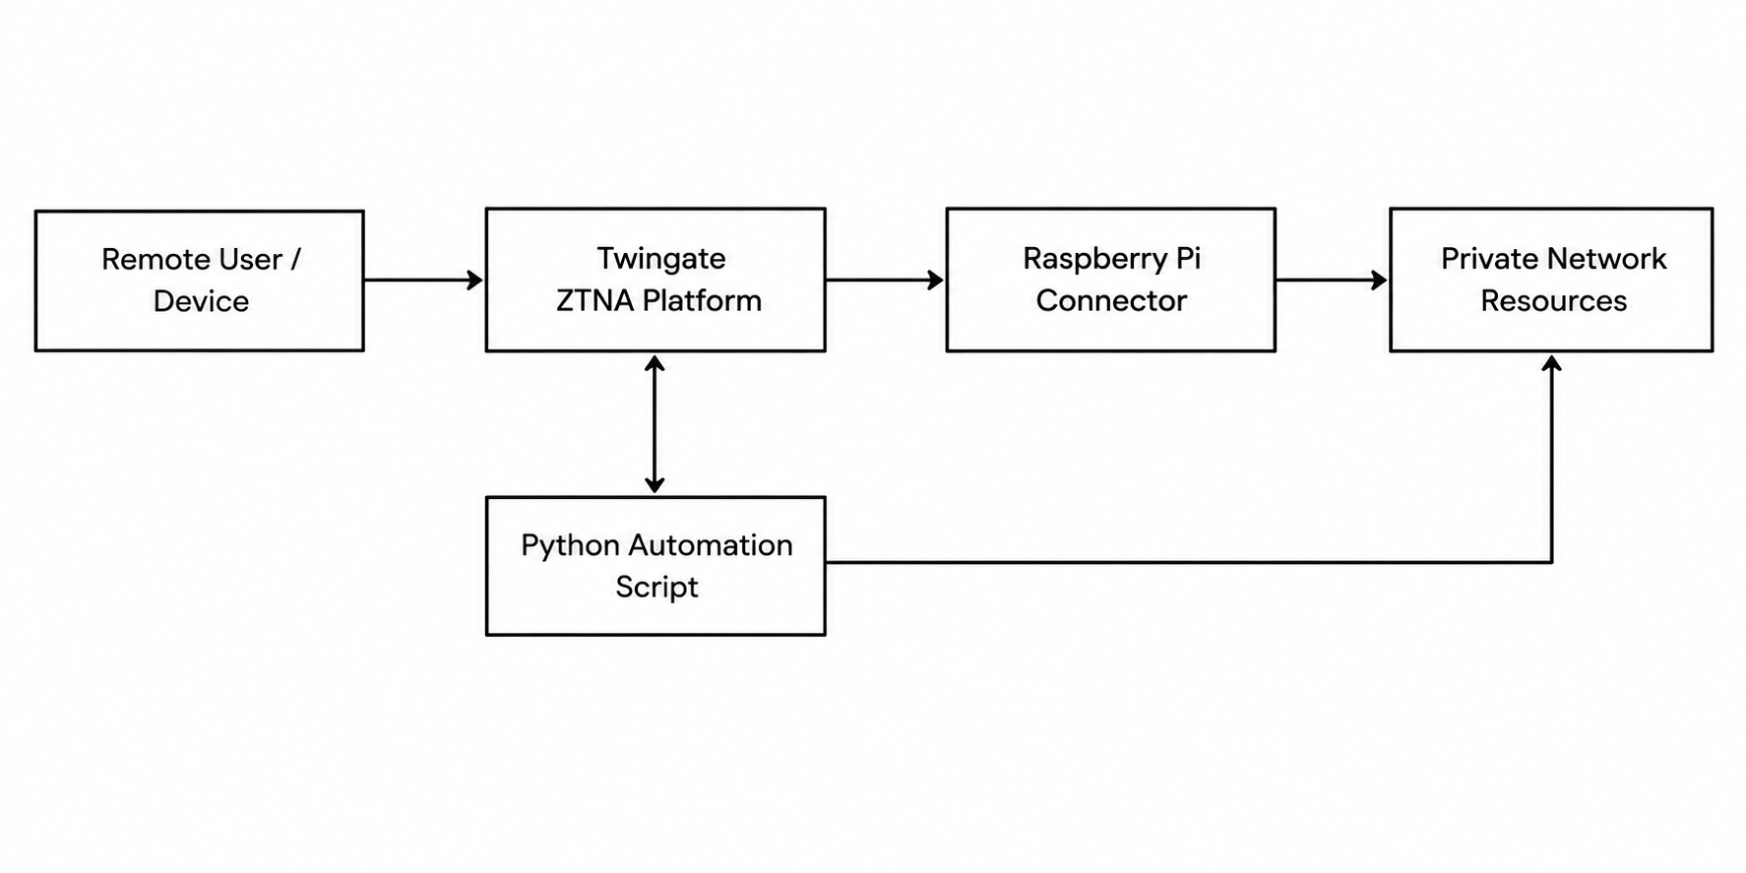
PROPOSED SYSTEM
SYSTEM ARCHITECTURE:
Raspberry Pi–Based Twingate Zero Trust Network Access

Slide 12
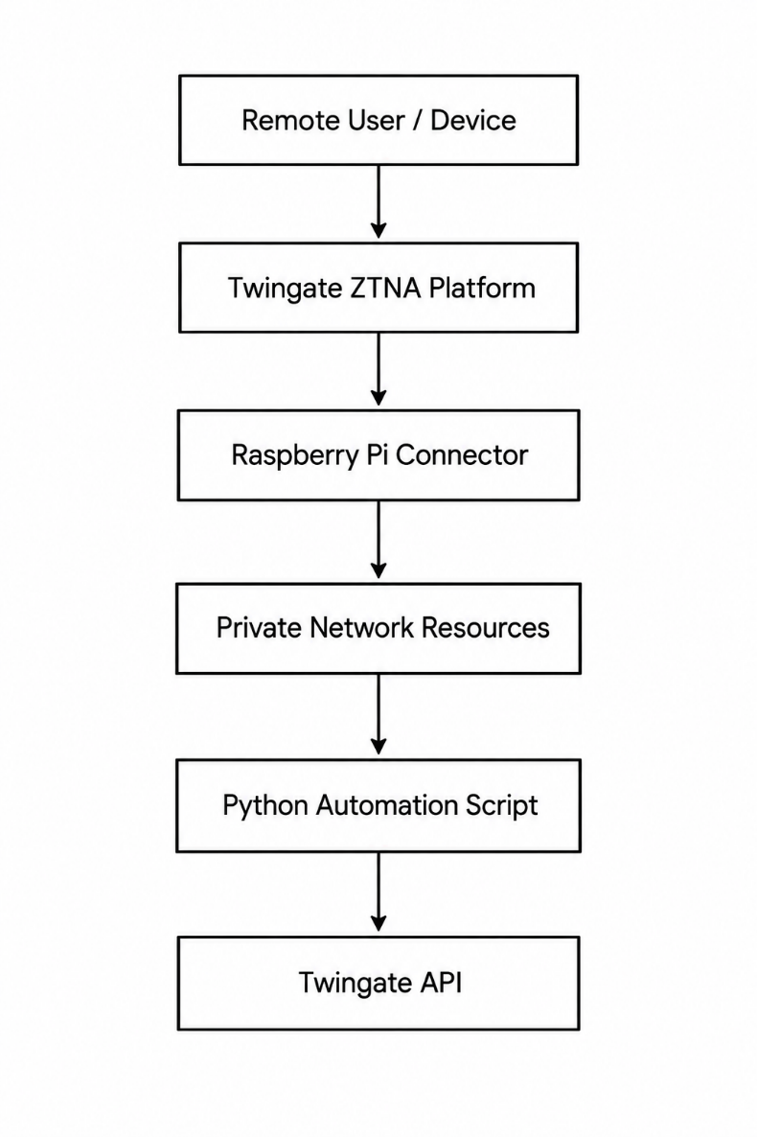
SYSTEM DESIGN

Slide 13
4.SYSTEM OVERVIEW
SECURITY APPROCH:
Implements a Zero Trust security model with identity verification, device authentication, and least-privilege access control. Protects private network resources through encrypted connections, granular access policies, and activity logging.
HARDWARE COMPONENTS:
1.Raspberry Pi – Acts as the network connector.
2.Power Supply – Provides power to the Raspberry Pi.
3.Network Interface (Ethernet/Wi-Fi) – Connects the Raspberry Pi to the local network and internet.
4.Private Network – Contains internal servers, applications, and services

Slide 14
SYSTEM REQUIREMENTS
SOFTWARE REQUIREMENTS:
Raspberry Pi OS / Linux – Operating system for running the connector and automation scripts.
Twingate Connector – Establishes secure connectivity between the private network and Twingate.
Twingate ZTNA Platform – Handles centralized access management and security policies.
Twingate Client – Enables remote users to securely access authorized resources.
Python – Used to develop automation scripts.
Twingate API – Provides programmatic access to Twingate resource management.
DNS Configuration – Supports hostname-based access through DNS aliasing

Slide 15
SYSTEM WORKING
Modules:
1.Network Connector Module
Private Network
Raspberry Pi is configured as a Twingate Connector.
Establishes a secure connection between the private network and Twingate.
Private Network
Network Connector
(Twingate)
Private Remote Client

Slide 16
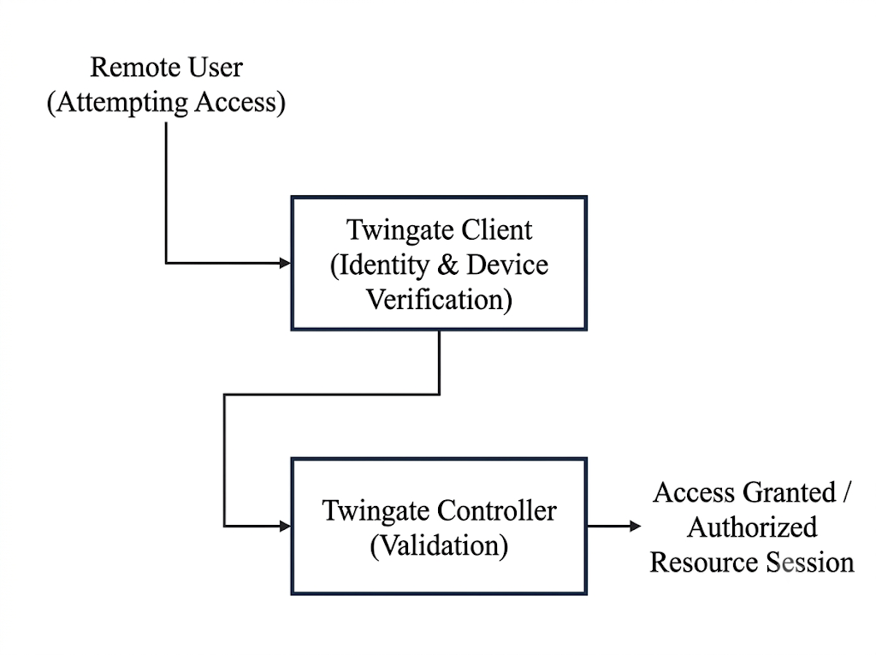
SYSTEM WORKING
Modules:
2.User Authentication Module
Remote users connect through the Twingate Client.
User identity and device authorization are verified.

Slide 17
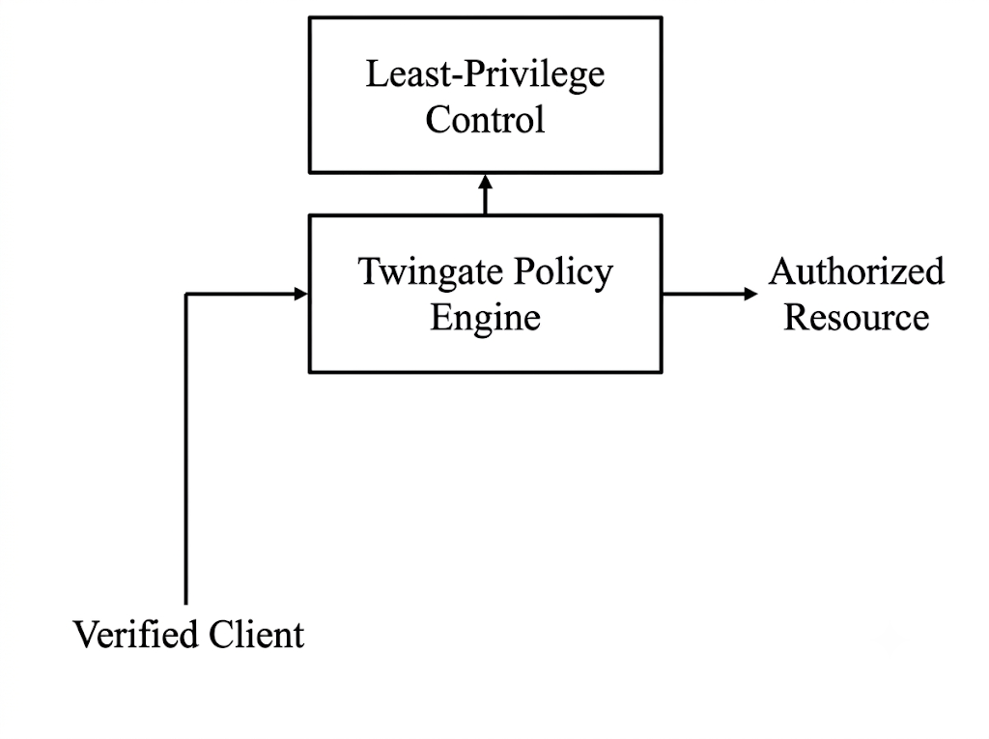
SYSTEM WORKING
Modules:
3.Zero Trust Access Control Module
Twingate checks access policies before granting access.
Implements least-privilege access to authorized resources only.

Slide 18
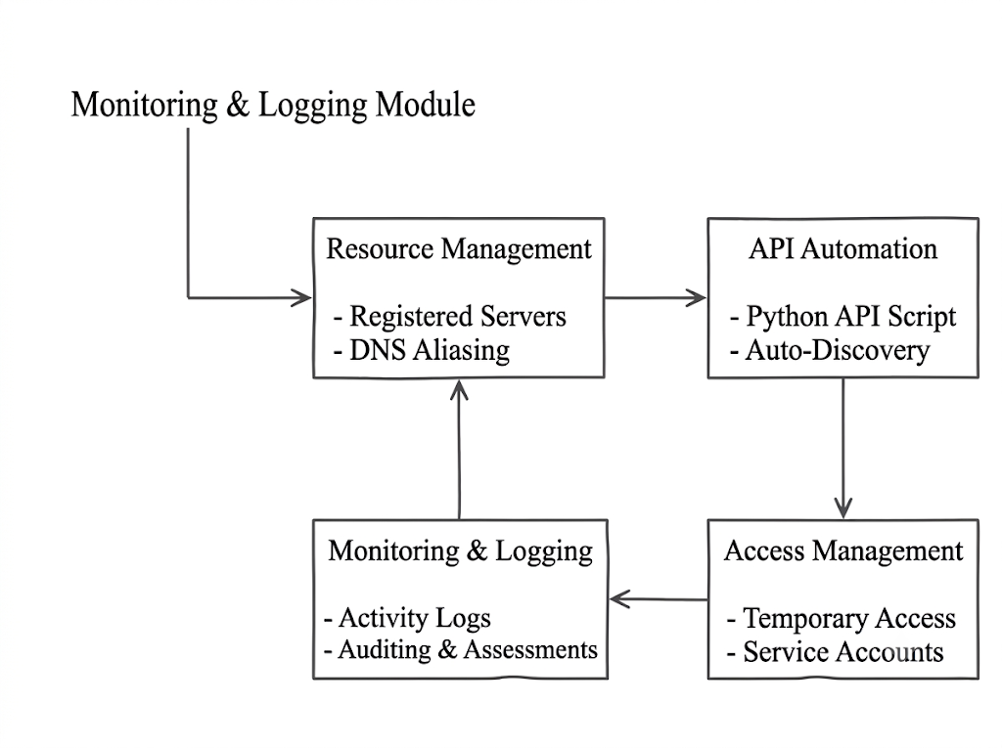
SYSTEM WORKING
Modules:
4.Monitoring and Logging Module
A cyclical workflow where resource registration feeds into automated API discovery.
Positioning the "Monitoring & Logging Module" as the external input indicates that continuous system auditing directly informs.

Slide 19
5. CONCLUSION
Cost-Effective Zero Trust: The project successfully implements a secure, lightweight Zero Trust Network Access (ZTNA) architecture utilizing an affordable Raspberry Pi as a network connector.
Enhanced Security Posture: Replaces traditional VPNs by enforcing strict identity verification and least-privilege access, ensuring users only access authorized resources without exposing internal services to the internet.
Simplified Infrastructure: Eliminates the need for complex traditional network configurations, such as firewall modifications, port forwarding, and the assignment of public IP addresses.
Automated Scalability: The integration of a Python-based API automation script allows for the dynamic discovery and seamless registration of network resources, significantly reducing manual administration

Slide 20
6.REFERENCES
[1] Syed et al., “Zero Trust Architecture (ZTA): A Comprehensive Survey,” IEEE Access, 2022.
[2] N. N. Hari et al., “Standards-Compliant Zero Trust Framework-Based Software-Defined Perimeter (SDP) for Securing Residential IoT Networks,” IEEE
[3] E. Tuyishime et al., “Online Laboratory Access Control With Zero Trust Approach: Twingate Use Case,” IEEE.

Slide 21
THANK YOU

