Slide 1
Using Hoeffding Bounds and Project Elimination for faster Bellwether prediction
Advisor:
Dr. Timothy Menzies
Akshay Nalwaya (200159155)

Slide 2
Tasks involved in this project and their owners
This project work was started as a group project in Fall 2018 for CSC 591: Foundations of Software Science course
The group members were: Akshay Nalwaya, Sanjana Kacholia, Shantanu Sharma
Establishing the baseline model, implementing Hoeffding bounds and performing iterative sampling were done collectively by the group members
I have added project elimination and feature selection strategies to this work

Slide 3
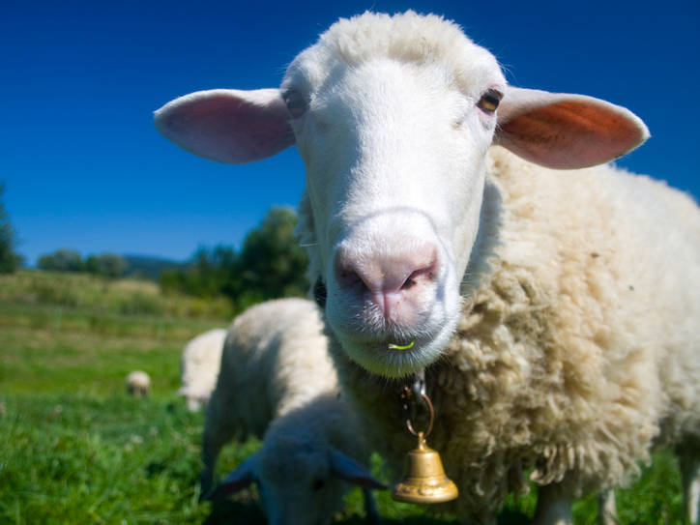
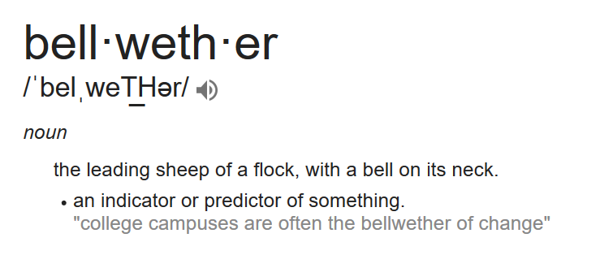

Slide 4
Motivation
Why: Identifying the Bellwether project among a group of projects would make the task of defect prediction easier
What: Making the identification of this Bellwether project faster than the current O(N²) approach
How: Using Hoeffding bounds and project elimination to reduce the dataset required for Bellwether identification

Slide 5
Why Bellwethers?
Model built using Bellwether project can serve as a representative model among the projects in the same domain
Bellwether project can serve as a baseline model for constructing different transfer learners in various domains of software engineering
Instead of exploring all the available data, we find one dataset that offers stable results for longer period of time

Slide 6
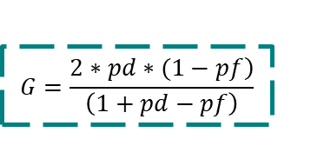
Existing Approach
Train
Use a Random Forest Classifier
Test
Test on all the other projects
Compute g-score for each project
Bellwether
Prediction
Calculate median g-score
Project with best median g-score is declared as “Bellwether”
Train on data from one of the projects at a time, for all projects
$$G=\frac{\left.2∗pd∗(1−pf\right)}{\left(1+pd−pf\right)}$$

Slide 7


New approach reduces the amount of data used for training classifier
TRAINING DATASET
Existing Approach
Training Classifier
Model Evaluation and Metric Calculation
X% of TRAINING DATASET
New Approach
Advantages:
Reduction in the model building time, hence reduced space and time requirement
Faster identification of Bellwether

Slide 8
Research Questions
RQ1 : Can we predict which dataset will be the bellwether?
RQ2 : Can we reduce the time to find bellwether by reducing the size of data?
RQ3 : Does Hoeffding sampling give better performance than project elimination?
RQ4 : Does feature selection improve the time for bellwether identification?

Slide 9
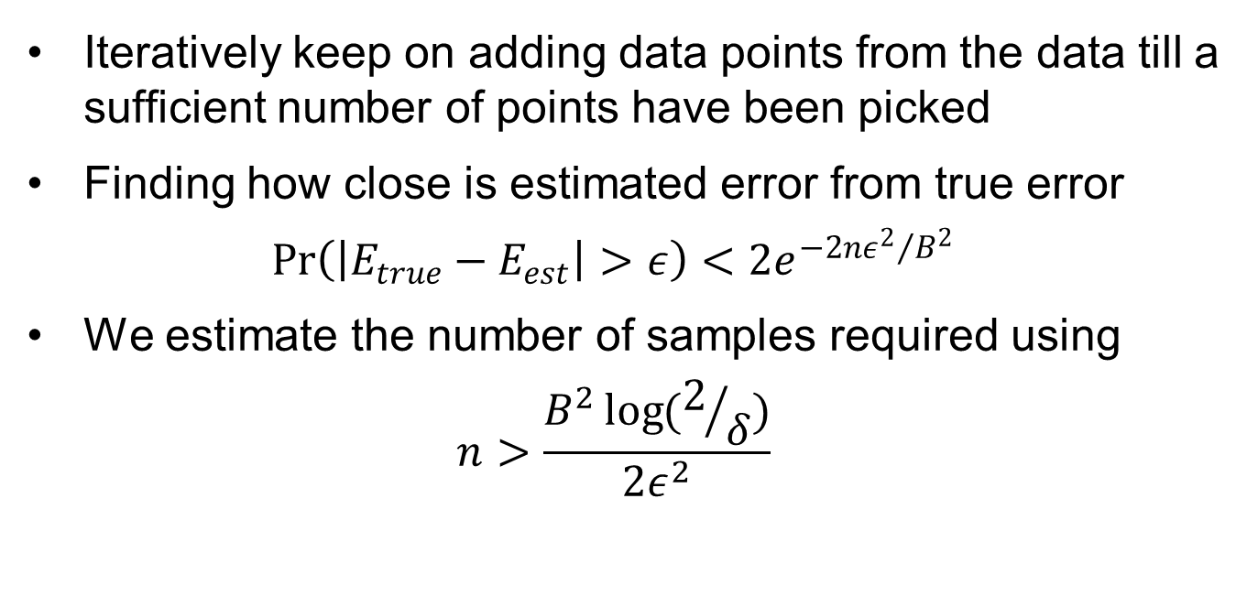
Sampling using Hoeffding Bounds
Iteratively keep on adding data points from the data till a sufficient number of points have been picked
Finding how close is estimated error from true error
$$\operatorname{Pr}\left(\left|E_{true}−E_{est}\right|>ε\right)<2e^{−2n{ε^{2}}/{B^{2}}}$$
We estimate the number of samples required using
$$n>\frac{B^{2}\log{(2/δ)}}{2ε^{2}}$$

Slide 10
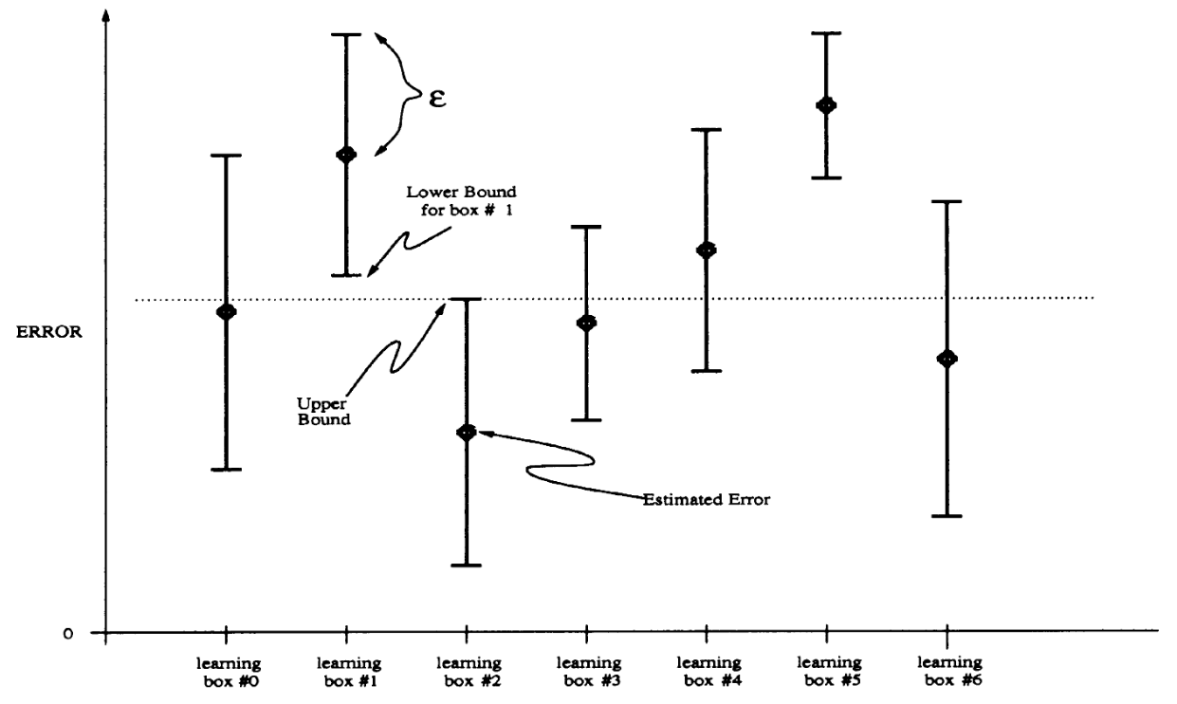
Sampling using Hoeffding Bounds
The upper bound of learning box #2 eliminates the learning boxes #1 and #5

Slide 11
Project Elimination to reduce the candidate projects
Core idea behind this approach is to eliminate projects having significantly poor performance from the pool of candidate projects
This will reduce the number of projects required to be analyzed for making bellwether identification
Conditions for elimination:
Project is testing on atleast 1/3rd of the projects
G-score value is less than the threshold value

Slide 12
Project Elimination to reduce the candidate projects
Algorithm
for each project do
load X_train, y_train
train random forest classifier
set threshold g-score
for all other projects
load X_test, y_test
make predictions
compute g-score
if g-score < threshold and #projects tested >= 3:
g-score = 0
append results, g-score
return results

Slide 13
Exploring Feature Selection algorithms to filter unimportant attributes
In this work, we have explored the following feature selection algorithms:
Forward feature selection
Backward feature elimination
Information Gain as a feature selector
Correlation as a feature selector

Slide 14

Forward Feature Selection
Initialize with one feature
Features
Make predictions and compute g-score
Report the features selected
Add one feature to the set
Repeat until g-score doesn’t improve

Slide 15
Backward Feature Elimination
Initialize with all features
Features
Make predictions and compute g-score
Report the features selected
Eliminate one feature
Repeat until g-score doesn’t improve

Slide 16
Information Gain as a feature selector
Entropy-based feature evaluation method
Information Gain: Amount of information provided by a feature for the items to be predicted
Information gain for each attribute is calculated and attributes with higher values of information gain are chosen
Attributes with lower information gain are eliminated since they do not provide significant information about the class label

Slide 17
Correlation-based Feature Selection (CFS)
Evaluates subsets of attributes rather than individual attributes
Considers the usefulness of individual attributes for predicting class label and also the inter-correlation between attributes
Ideal subset: High correlation with class while low inter-correlation with each other
Computes correlation between attributes and applies heuristic search strategy for finding ideal subset

Slide 18
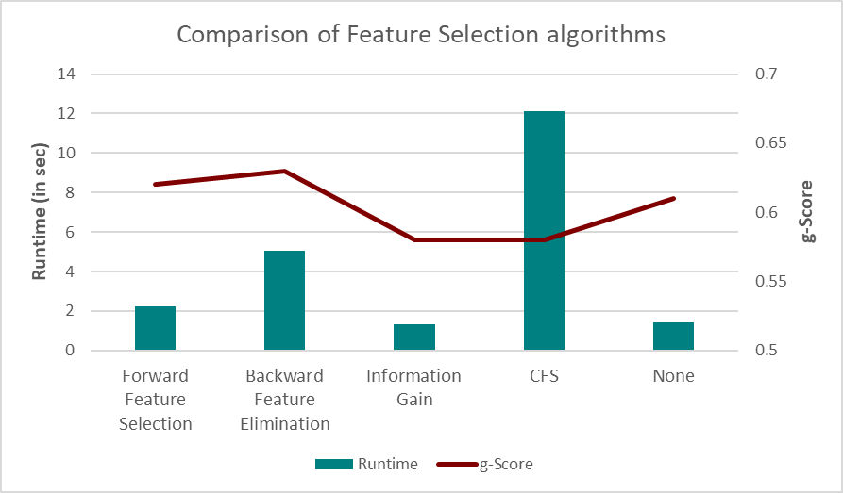
Comparison of these feature selection algorithms
NOTE: These results are for the Bellwether project (poi)

Slide 19
Key takeaways from the feature selection approaches
None of the approaches provide a significant improvement of g-score than conventional Random Forest Classifier
Forward selection and Backward elimination methods operate in a sequential manner and hence do not cover all subsets
Information gain takes each attribute but does not account of relationship between attributes
CFS answers the shortcomings of other approaches but takes a lot of time to run without any proportional improvement

Slide 20
Comparing results from Hoeffding bounds and Project Elimination
Project | Baseline Approach | Hoeffding Bounds | Modified Hoeffding Bounds
ant | 0.18 | 0.18 | 0.19
camel | 0.24 | 0.25 | 0.24
ivy | 0.09 | 0.12 | 0.12
jedit | 0.04 | 0.03 | 0.04
log4j | 0.34 | 0.34 | 0.32
lucene | 0.52 | 0.52 | 0.51
poi | 0.61 | 0.62 | 0.61
velocity | 0.49 | 0.49 | 0.49
xalan | 0.56 | 0.58 | 0.57
xerces | 0.42 | 0.43 | 0.43
‘poi’ is the bellwether dataset for the baseline method as well as after the implementation of Hoeffding bounds.
Training data of around ~8.5% for each dataset gives similar results, reducing the time and data required for training effectively.

Slide 21
Project elimination performance
Project | Baseline Approach | Project Elimination
ant | 0.18 | 0.0
camel | 0.24 | 0.0
ivy | 0.09 | 0.0
jedit | 0.04 | 0.0
log4j | 0.34 | 0.0
lucene | 0.52 | 0.54
poi | 0.61 | 0.61
velocity | 0.49 | 0.49
xalan | 0.56 | 0.57
xerces | 0.42 | 0.41
Key takeaways:
‘poi’ remains the bellwether project for this approach also
Projects which are pruned are assigned value 0
G-score values are very close to those obtained by the baseline approach

Slide 22
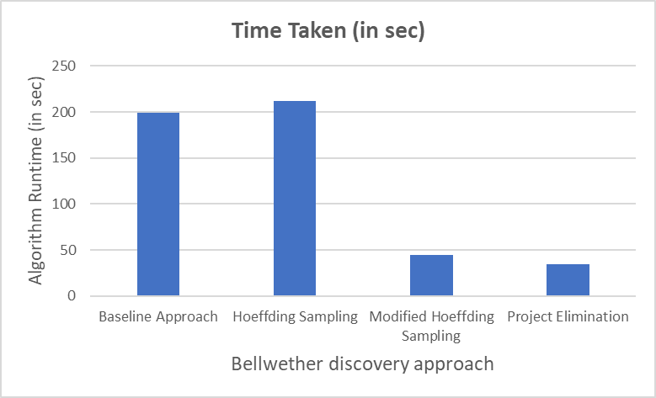
Average runtime for all the approaches for Bellwether identification
Experiment | Runtime (in sec)
Baseline Approach | 199.32
Hoeffding Sampling | 211.57
Modified Hoeffding Sampling | 44.16
Project Elimination | 34.63

Slide 23
Future Work / Open issues
Exploring alternative sampling techniques
Extending this work to different target domains like code smells, issue lifetime estimation and effort estimation
Racing between project elimination and sampling

Slide 24
APPENDIX

Slide 25
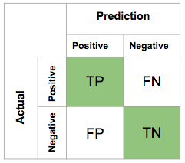

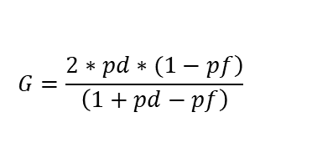


Metrics for measuring classifier performance
$$accuracy= \frac{true positive+true negative}{total number of instances}$$
$$recall (or pd)=\frac{true positive}{true positive+false negative}$$
$$pf=\frac{false positive}{false positive+true negative}$$
$$G=\frac{\left.2∗pd∗(1−pf\right)}{\left(1+pd−pf\right)}$$

Slide 26
Data Dictionary
Metric Notation | Metric Name | Metric Description
$amc | Average Method Complexity | This metric measures the average method size for each class. Size of a method is equal to the number of Java binary codes in the method.
$avg_cc | Average of Cyclomatic Complexity (CC) | CC is equal to number of different paths in a method (function) plus one. The McCabe cyclomatic complexity is defined as: CC=E-N+P; where E is the number of edges of the graph, N is the number of nodes of the graph, and P is the number of connected components. CC is the only method size metric. The constructed models make the class size predictions. Therefore, the metric had to be converted to a class size metric.
$ca | Afferent Coupling | The CA metric represents the number of classes that depend upon the measured class.
$cam | Cohesion Among Class Methods | This metric computes the relatedness among methods of a class based upon the parameter list of the methods. The metric is computed using the summation of number of different types of method parameters in every method divided by a multiplication of number of different method parameter types in whole class and number of methods.
$cbm | Coupling between Methods | The metric measures the total number of new/redefined methods to which all the inherited methods are coupled. There is a coupling when at least one of the conditions given in the IC metric is held.
$cbo | Coupling between Object Classes | The CBO metric represents the number of classes coupled to a given class (efferent couplings and afferent couplings).
$ce | Efferent Couplings | The CE metric represents the number of classes that the measured class is depended upon.
$dam | Data Access Metric | This metric is the ratio of the number of private (protected) attributes to the total number of attributes declared in the class.
$dit | Depth of Inheritance Tree | The DIT metric provides for each class a measure of the inheritance levels from the object hierarchy top.
$ic | Inheritance Coupling | This metric provides the number of parent classes to which a given class is coupled. A class is coupled to its parent class if one of its inherited methods functionally dependent onthe new or redefined methods in the class.

Slide 27
Data Dictionary
Metric Notation | Metric Name | Metric Description
$lcom | Lack of cohesion in methods | The LCOM metric counts the sets of methods in a class that are not related through the sharing of some of the class fields.
$lcom3 | Lack of cohesion in methods | A low value of LCOM2 or LCOM3 indicates high cohesion and a well-designed class. It is likely that the system has good class subdivision implying simplicity and high reusability. A cohesive class will tend to provide a high degree of encapsulation. A higher value of LCOM2 or LCOM3 indicates decreased encapsulation and increased complexity, thereby increasing the likelihood of errors.
$loc | Lines of Code | The LOC metric calculates the number of lines of code in the Java binary code of the class under investigation.
$max_cc | Maximum value of CC | The greatest value of CC among methods of the investigated class.
$mfa | Measure of Functional Abstraction | This metric is the ratio of the number of methods inherited by a class to the total number of methods accessible by the member methods of the class.
$moa | Measure of Aggregation | This metric measures the extent of the part-whole relationship, realized by using attributes. The metric is a count of the number of class fields whose types are user defined classes.
$noc | Number of Children | The NOC metric simply measures the number of immediate descendants of the class.
$npm | Number of Public Methods | The NPM metric counts all the methods in a class that are declared as public.
$rfc | Response for a Class | The RFC metric measures the number of different methods that can be executed when an object of that class receives a message.
$wmc | Weighted methods per class | The value of the WMC is equal to the number of methods in the class (assuming unity weights for all methods).

Slide 28
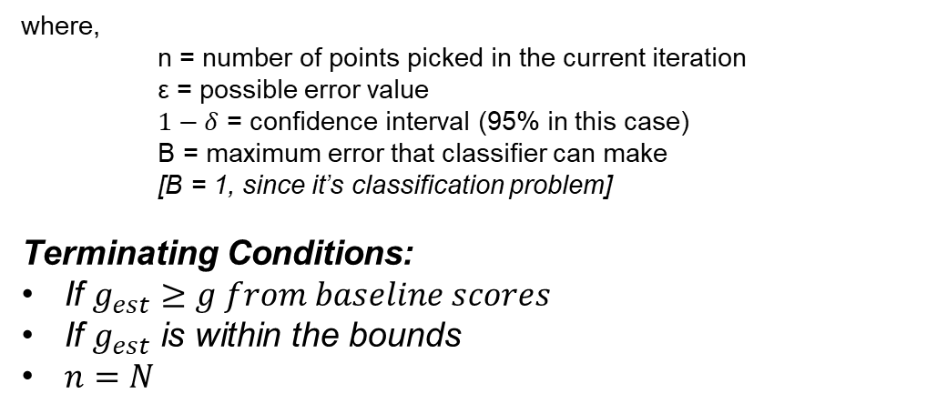
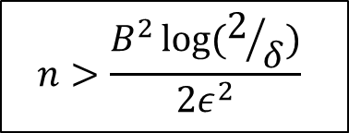
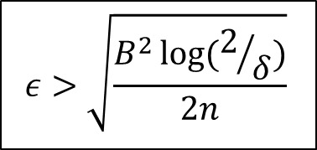
Hoeffding’s Bound
$$ε>\sqrt{\frac{B^{2}\log{(2/δ)}}{2n}}$$
$$n>\frac{B^{2}\log{(2/δ)}}{2ε^{2}}$$
where,
n = number of points picked in the current iteration
ε = possible error value
$1−δ$ = confidence interval (95% in this case)
B = maximum error that classifier can make
[B = 1, since it’s classification problem]
Terminating Conditions:
If $g_{est}≥g from baseline scores$
If $g_{est}$ is within the bounds
$n=N$

