Slide 1
Summary
This software lets you do 2 things:
1) Trace individual MRI images manually, and stack them in 3D.
2) Put a virtual electrode in the 3D space and let you move. And depending on the position of the electrode, display corresponding coronal and sagittal MR images with the electrode tip marking on them. So that you know which part of the brain the electrode is at as you move the electrode.
To achieve this you need to do 3 things:
Save individual MR images as BMP files and name them. The name should reflect the coordinate of the section.
Provide the position and tilt of the recording grid for the 3D application (the tip of the electrode will be placed at the center of the grid, by default).
Provide the dimension of the MRI pixel, indicate the origin (0, 0) of the MR image, for the coronal and sagittal MR images.
*In the following, the detailed directions for each step will be given.
Notes:
References:
Neural substrate of Temporal Discount:
9. Samejima K, Ueda K, Doya K, Kimura M: Representation of action-specific reward values in the striatum. Science 2005, 310:1337-1340.
10. Tanaka SC, Doya K, Okada G, Ueda K, Okamota Y, Yamawaki S: Prediction of immediate and future rewards differentially recruits cortico-basal ganglia loops. Nat Neurosci 2004, 7:887-893.
28. Doya K: Metalearning and neuromodulation. Neural Netw 2002, 15:495-506.

Slide 2

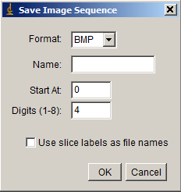
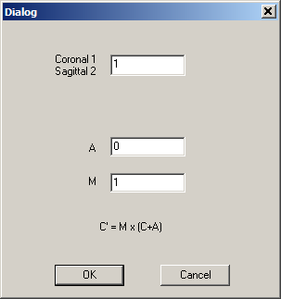
Preparation of MR picture files.
Get BMP images from the ImageJ:
Open the sequence of images using the ImageJ and crop it(Image -> Crop).
For the sagittal images leftward is rostral (positive).
For the coronal images, Right side (of the animal) is positive. This can be flipped by the following button:
Save the sequence of BMP images to a folder (File->Save As->Image Sequence).
When a dialog window pops out. Leave “Name:” part blank. And click “ok”
Using the application “RenameFiles”, give an appropriate name indicating the depth of the MR image for each image. For coronal slice, for example, 4.5.bmp or -4.5.bmp to indicate it is the slice 4.5mm / -4.5mm anterior of the anterior commissure (or relative to any other origin that you chose). For sagittal slices, L3.52.bmp and L-3.52.bmp to indicate 3.52 mm away from the midline on the right side and left side of the brain, respectively. To do so,
1) Run “RenameFiles.exe”
Here, the user specifies that these MR images are coronal slices. And directs to change the file name to a new one by adding A and multiplying M at the original number part: NewName=Mx(OldName+A). Click “OK”.
2) Another dialog box will appear asking to choose the folder containing the MRI BMP files to be converted to new names. When the user chooses a folder, the program will then make a new folder “_NewData” under the same parent directory and move those name-changed files in it.
Y (Dorsa)
Z (Rostral)
X
Notes:
References:
Neural substrate of Temporal Discount:
9. Samejima K, Ueda K, Doya K, Kimura M: Representation of action-specific reward values in the striatum. Science 2005, 310:1337-1340.
10. Tanaka SC, Doya K, Okada G, Ueda K, Okamota Y, Yamawaki S: Prediction of immediate and future rewards differentially recruits cortico-basal ganglia loops. Nat Neurosci 2004, 7:887-893.
28. Doya K: Metalearning and neuromodulation. Neural Netw 2002, 15:495-506.

Slide 3
Optional: Make traces or mark some features of the MR pictures.
Load the bmp images by executing “Anatomy3D.exe”, and clicking the icon:
Mark any wanted anatomical landmarks. See the next page for more details.
And save it.
After doing the 3, 4 steps for every image, click to see the compiled markings of the MRI in 3D.
Notes:
References:
Neural substrate of Temporal Discount:
9. Samejima K, Ueda K, Doya K, Kimura M: Representation of action-specific reward values in the striatum. Science 2005, 310:1337-1340.
10. Tanaka SC, Doya K, Okada G, Ueda K, Okamota Y, Yamawaki S: Prediction of immediate and future rewards differentially recruits cortico-basal ganglia loops. Nat Neurosci 2004, 7:887-893.
28. Doya K: Metalearning and neuromodulation. Neural Netw 2002, 15:495-506.

Slide 4
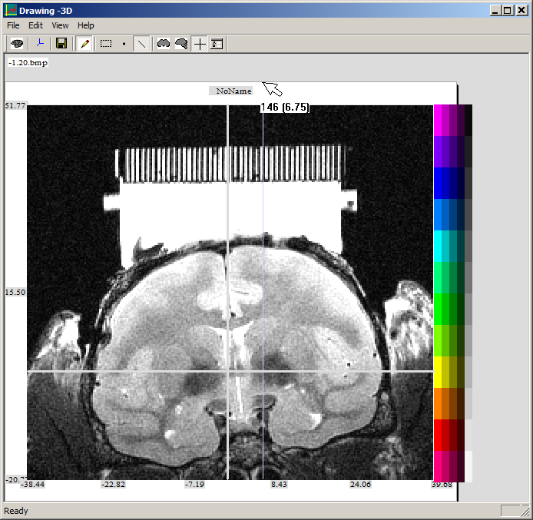
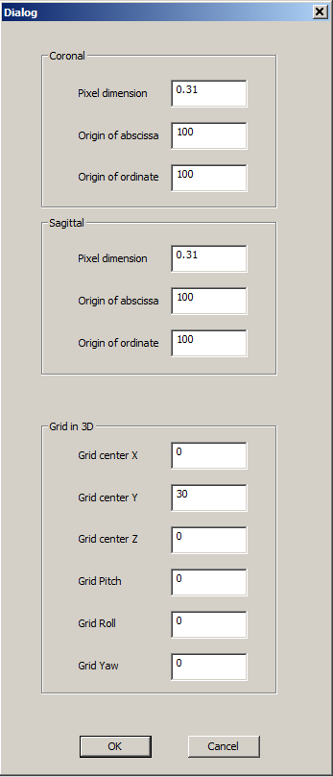
How to use the marking software – Registering the images in the space.
When you click the MRI marking program( ), you get to choose a BMP figure.
If it is the first image of a series, you may want to set the scale and origin of the picture. The center can be measured by clicking the margin of the figure and dragging it to the place you want. It will show the coordinate of x or y axis in terms of MR pixels and the internal data coordinate in a parenthesis. (See the figure on the right). After doing this for the x and y axes, open the configuration Dialog by clicking .
You can now enter 12 parameters: first 3 pertaining to the coronal MR images, the next 3 to sagittal images (Origin of abscissa and ordinate are expressed in MRI pixels explained in 2 above). The next 6 parameters are about the coordinates of the bottom-center of the recording grid in 3D (in mm), and the pitch, roll and yaw of the grid (in degrees). These 12 parameters will help configure the images to be registered in 2D and 3D spaces. When you click the “OK” button, the variables will be automatically saved to a file, and used later again.
After this configurations, now you click on the figure to make marks. The editor generally follows the behavior of the MS-Powerpoint. Clicking the color legend will select the color for marking. Currently, some advance features such as copy / paste / redo / undo are not supported.
Notes:
References:
Neural substrate of Temporal Discount:
9. Samejima K, Ueda K, Doya K, Kimura M: Representation of action-specific reward values in the striatum. Science 2005, 310:1337-1340.
10. Tanaka SC, Doya K, Okada G, Ueda K, Okamota Y, Yamawaki S: Prediction of immediate and future rewards differentially recruits cortico-basal ganglia loops. Nat Neurosci 2004, 7:887-893.
28. Doya K: Metalearning and neuromodulation. Neural Netw 2002, 15:495-506.

Slide 5
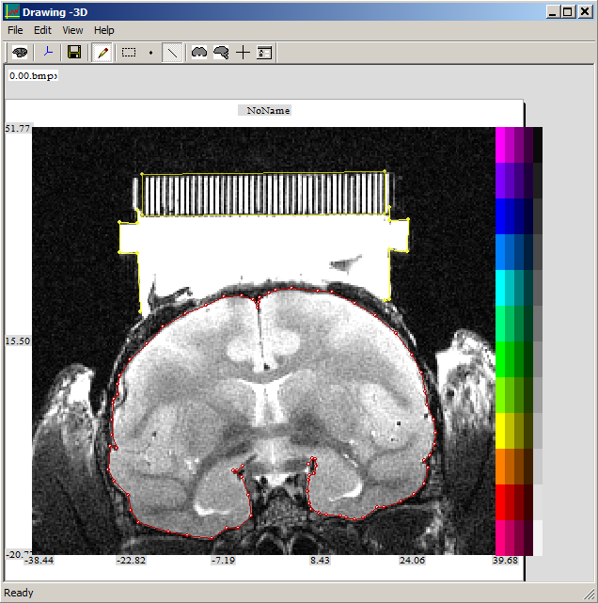
How to use the marking software – Drawing on the MR image
You can click “Point” or “Line” icons to select the marking mode.
To select a group of points or line segments, first click the dotted rectangle icon; and drag your mouse to capture or manipulate, in order to move the positions or delete them.
Selecting a group of points and clicking the color legend will make the points to follow the selected color.
After doing line-drawing, you can push the Escape key on the keyboard to end the line-drawing.
You can click a line segment of a line object to select the whole line object.
You can edit a lined object by right-clicking on it and selecting “Edit Points” menu.
After finishing the marking, click the save icon to save the marking data to a file in the same folder where its MR image is (e.g., “_Data”).
Notes:
References:
Neural substrate of Temporal Discount:
9. Samejima K, Ueda K, Doya K, Kimura M: Representation of action-specific reward values in the striatum. Science 2005, 310:1337-1340.
10. Tanaka SC, Doya K, Okada G, Ueda K, Okamota Y, Yamawaki S: Prediction of immediate and future rewards differentially recruits cortico-basal ganglia loops. Nat Neurosci 2004, 7:887-893.
28. Doya K: Metalearning and neuromodulation. Neural Netw 2002, 15:495-506.

Slide 6
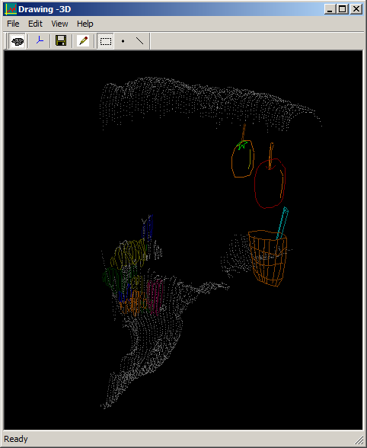
How to display in 3D
After marking the MRI slices, click the 3D program icon( ). You get to choose a folder containing the marking data files (e.g., “_Data”).
The program will display all the markings in the files under the folder.
You can drag the 3D figure to rotate. Use the control key in combination with the mouse to translate the 3D object.
Notes:
References:
Neural substrate of Temporal Discount:
9. Samejima K, Ueda K, Doya K, Kimura M: Representation of action-specific reward values in the striatum. Science 2005, 310:1337-1340.
10. Tanaka SC, Doya K, Okada G, Ueda K, Okamota Y, Yamawaki S: Prediction of immediate and future rewards differentially recruits cortico-basal ganglia loops. Nat Neurosci 2004, 7:887-893.
28. Doya K: Metalearning and neuromodulation. Neural Netw 2002, 15:495-506.

Slide 7
3D system (and Hot Keys)
Electrode
Electrode position in the standard allocentric
3D space
Electrode position in Grid coordinate
x (3)
x=1, y= 2 (X, Y, Z)
z=1000
Grid
y (1)
z (↓)
Y (F8)
X (F3)
Z (F1) Rostral
Z (F1) Rostral
Notes:
References:
Neural substrate of Temporal Discount:
9. Samejima K, Ueda K, Doya K, Kimura M: Representation of action-specific reward values in the striatum. Science 2005, 310:1337-1340.
10. Tanaka SC, Doya K, Okada G, Ueda K, Okamota Y, Yamawaki S: Prediction of immediate and future rewards differentially recruits cortico-basal ganglia loops. Nat Neurosci 2004, 7:887-893.
28. Doya K: Metalearning and neuromodulation. Neural Netw 2002, 15:495-506.

Slide 8
Under the hood
Notes:
References:
Neural substrate of Temporal Discount:
9. Samejima K, Ueda K, Doya K, Kimura M: Representation of action-specific reward values in the striatum. Science 2005, 310:1337-1340.
10. Tanaka SC, Doya K, Okada G, Ueda K, Okamota Y, Yamawaki S: Prediction of immediate and future rewards differentially recruits cortico-basal ganglia loops. Nat Neurosci 2004, 7:887-893.
28. Doya K: Metalearning and neuromodulation. Neural Netw 2002, 15:495-506.

Slide 9
How 3D figure calls 2D figures
When the 3D rendering is displayed, the coordinate of the tip of the electrode is detected and the closest coronal and sagittal figures are displayed (if those corresponding applications are running).
3D application: At the beginning of the application, it reads the files, and figures out the A-P depth using the file name. For example 4.5.txt means A-P 4.5mm from the origin. Also, you can programmably shift and scale the coordinate of the slice using Load_All_DrawingData(m_BiasX,m_BiasY,m_BiasZ,ScaleX, ScaleY, ScaleZ).
2D applications: At the beginning of the application, it reads the file names under the Data Folder that the 3D application is using, and registers the A-P (for coronal 2D application) or M-L (for sagittal 2D application) level of each BMP file.
Whenever the tip of the electrode moves, the 2D applications get informed and they recalculate the closest section to display.
Notes:
References:
Neural substrate of Temporal Discount:
9. Samejima K, Ueda K, Doya K, Kimura M: Representation of action-specific reward values in the striatum. Science 2005, 310:1337-1340.
10. Tanaka SC, Doya K, Okada G, Ueda K, Okamota Y, Yamawaki S: Prediction of immediate and future rewards differentially recruits cortico-basal ganglia loops. Nat Neurosci 2004, 7:887-893.
28. Doya K: Metalearning and neuromodulation. Neural Netw 2002, 15:495-506.

Slide 10
Rotation coordinates –Right hand system
Current Configuration
y
z
x
Notes:
References:
Neural substrate of Temporal Discount:
9. Samejima K, Ueda K, Doya K, Kimura M: Representation of action-specific reward values in the striatum. Science 2005, 310:1337-1340.
10. Tanaka SC, Doya K, Okada G, Ueda K, Okamota Y, Yamawaki S: Prediction of immediate and future rewards differentially recruits cortico-basal ganglia loops. Nat Neurosci 2004, 7:887-893.
28. Doya K: Metalearning and neuromodulation. Neural Netw 2002, 15:495-506.

Slide 11
Three-D Vector Representation
Pre-Rotation Object-Centered coordinate surface point vector
(ObjCntrd_Coordnt_SrfcPoint[0], , )
Light Source
(LtSourceX, LtSourceY, LtSourceZ)
Object Rotation
*
Object-Centered coordinate surface point vector
(ObjCntrd_Coordnt_SrfcPoint[0], , )
ζ
Normal Vector
Object Center
(ObjCntrX, ObjCntrY, ObjCntrZ)
Light Reflection
(li[0], li[1], li[2])
In right-handed system:
Object-Centered coordinate surface point vector
(ObjCntrd_Coordnt_SrfcPoint[0], , )
ξ
Rotation along x-axis
Allocentric coordinate surface point vector
(AlloCntrc_Coordnt_SrfcPoint[0],,)
Observer
(ObserverCntrX,ObserverCntrY,ObserverCntrZ)
Egocentric coordinate surface point vector
(EgoCntrc_Coordnt_SrfcPoint[0], , )
Rotation along y-axis
Pre-Rotation Egocentric coordinate surface point vector
(EgoCntrc_Coordnt_SrfcPoint[0], , )
Object Center
(ObjCntrX, ObjCntrY, ObjCntrZ)
y
Allocentric coordinate surface point vector
(AlloCntrc_Coordnt_SrfcPoint[0],,)
0°
z
Rotation along z-axis
Viewer Rotation
(rotation matrix is negative)
z
*
y
Observer
(ox,oy,oz)
x
Egocentric coordinate surface point vector
(EgoCntrc_Coordnt_SrfcPoint[0], , )
x
Allocentric Origin
(0,0,0)
3D to 2D Mapping (Y-asis is the gaze axis):
Monitor (X,Y)=(x/y, z/y)
Retinal Image
2-D Egocentric Representation
Notes:
References:
Neural substrate of Temporal Discount:
9. Samejima K, Ueda K, Doya K, Kimura M: Representation of action-specific reward values in the striatum. Science 2005, 310:1337-1340.
10. Tanaka SC, Doya K, Okada G, Ueda K, Okamota Y, Yamawaki S: Prediction of immediate and future rewards differentially recruits cortico-basal ganglia loops. Nat Neurosci 2004, 7:887-893.
28. Doya K: Metalearning and neuromodulation. Neural Netw 2002, 15:495-506.

