Slide 1
IILM UNIVERSITY, GREATER NOIDA
INTERNSHIP REPORT PRESENTATION
Ethical Hacking
Virtual Internship
AICTE – EduSkills Virtual Internship Program | Supported by EduSkills Academy
Akshay Pandey
Roll No. 2410030690 | B.Tech CSE
April – June 2026

Slide 2
ABOUT THE STUDENT
Candidate Profile
👤
Roll Number
Akshay Pandey
2410030690
B.Tech CSE • Batch 2024-2028
Institute
IILM University, Greater Noida, U.P.
Programme
B.Tech CSE, Batch 2024–2028
Internship Domain
Ethical Hacking (English Language)
Duration
8 Weeks | April – June 2026
Ethical Hacking Virtual Internship • Akshay Pandey

Slide 3
ABOUT THE PROGRAM
EduSkills, AICTE & the National Internship Portal
EduSkills Academy is an organization working under the theme “Nation Building Through Skills.” It partners with the All India Council for Technical Education (AICTE) to run the AICTE – EduSkills Virtual Internship Program, for the Ethical Hacking track under the patronage of the AICTE National Internship Portal. EduSkills designs an industry-aligned curriculum that helps engineering students build a practical understanding of cybersecurity fundamentals and ethical hacking practices.
🏛
🎓
📚
AICTE Patronage
EduSkills Academy
Structured Curriculum
Run under the AICTE National Internship Portal
“Nation Building Through Skills” – the program's guiding theme
Weekly modules, quizzes, and a Final Assessment Test
Ethical Hacking Virtual Internship • Akshay Pandey

Slide 4
PROBLEM STATEMENT
From Theoretical Security to Hands-On Practice
Although many engineering students study the theoretical foundations of networking and computer security during coursework, very few get structured, hands-on exposure to the actual practice of ethical hacking – the lawful identification of vulnerabilities using an attacker's techniques, but with permission and for defensive purposes.
This internship addressed that gap — practically learning the full ethical hacking workflow:
🔍
🛰
🛡
📝
→
→
→
Reconnaissance
Scan & Enumerate
Exploit Safely
Report & Remediate
Ethical Hacking Virtual Internship • Akshay Pandey

Slide 5
PROJECT OBJECTIVES
What the Internship Set Out to Achieve
🎯
🕵
📡
Security Fundamentals
Footprinting & Recon
Scanning & Enumeration
Understand the core concepts, terminology, and legal/ethical framework of security testing
Learn passive and active techniques for gathering information on a target
Identify live hosts, open ports, and running services using scanning tools
💻
🌐
✅
System Hacking
Web App Security
Vulnerability Assessment
Understand password attacks, privilege escalation, and system-level vulnerabilities
Identify OWASP Top 10 vulnerabilities at a conceptual and applied level
Carry out a basic vulnerability assessment and suggest fixes
Ethical Hacking Virtual Internship • Akshay Pandey

Slide 6
TECHNOLOGY & TOOLS
The Toolkit Behind the Internship
🌐
📡
🔎
⚠
TCP/IP & Ports
Nmap
Recon Techniques
Vuln. Analysis
Networking fundamentals
Host & port scanning
Passive & active footprinting
Weak configs, outdated software
🔐
🔑
📋
🧪
Web App Basics
Cryptography Basics
EduSkills LMS
Local Test Lab
Auth flaws, injection concepts
Core cryptographic concepts
Structured modules & assessments
Isolated, deliberately vulnerable app
Ethical Hacking Virtual Internship • Akshay Pandey

Slide 7
WORKFLOW
From Reconnaissance to Remediation
1
Information Gathering Layer
Passive & active reconnaissance to collect information about a target
2
Scanning Layer
Identifying live hosts, open ports & services with basic scanning tools
3
Vulnerability Identification Layer
Analysing gathered information to spot weaknesses or misconfigurations
4
Reporting Layer
Documenting findings clearly, as in a professional pentest report
5
Assessment Layer
Weekly quizzes and a Final Assessment Test tracking progress
Ethical Hacking Virtual Internship • Akshay Pandey

Slide 8
METHODOLOGY
The 8-Week Learning Journey
1
2
3
4
Introduction to Ethical Hacking
Footprinting & Reconnaissance
Scanning Networks
System Hacking Concepts
Infosec overview, terminology, legal/ethical framework
Passive & active info gathering techniques
Live hosts, open ports & services
Password attacks, privilege escalation
5
6
7
8
Malware Threats
Social Engineering & Sniffing
Web App & Network Security
Cryptography & Security Policies
Viruses, worms, trojans, ransomware
Phishing, pretexting, network sniffing basics
Common web vulnerabilities & countermeasures
Crypto basics & organisational security policy
Ethical Hacking Virtual Internship • Akshay Pandey

Slide 9
EXPECTED OUTCOMES
Skills & Capabilities Gained
✓
Ability to explain the fundamental concepts and legal/ethical boundaries of ethical hacking
✓
Practical understanding of the basic phases of hacking and common vulnerabilities
✓
Familiarity with basic reconnaissance and scanning tools used in security assessments
✓
Basic awareness of malware, social engineering, and web-application security concepts
✓
Hands-on exposure to conducting a simple vulnerability assessment and documenting findings responsibly
✓
Successful clearance of all weekly assessments and the Final Assessment Test, resulting in Grade “A”
Ethical Hacking Virtual Internship • Akshay Pandey

Slide 10
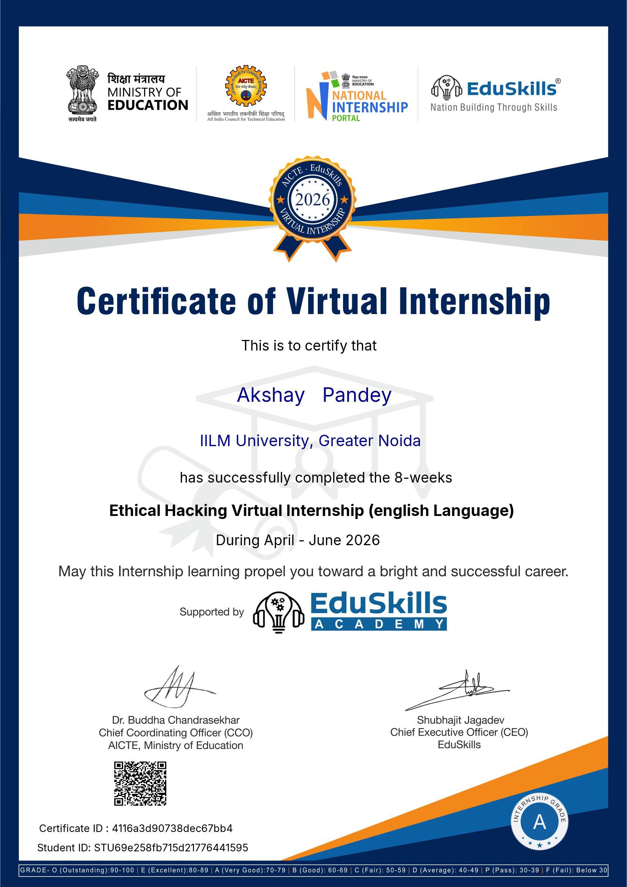
CERTIFICATION
Successfully Completed
GRADE
A – Very Good
CERTIFICATE ID
4116a3d90738dec67bb4
STUDENT ID
STU69e258fb715d21776441595
DURATION
8 Weeks | April – June 2026
Ethical Hacking Virtual Internship • Akshay Pandey

Slide 11
>_
Thank You
Ethical Hacking Virtual Internship | AICTE – EduSkills Program
Akshay Pandey
Roll No. 2410030690 | IILM University, Greater Noida

