Slide 1
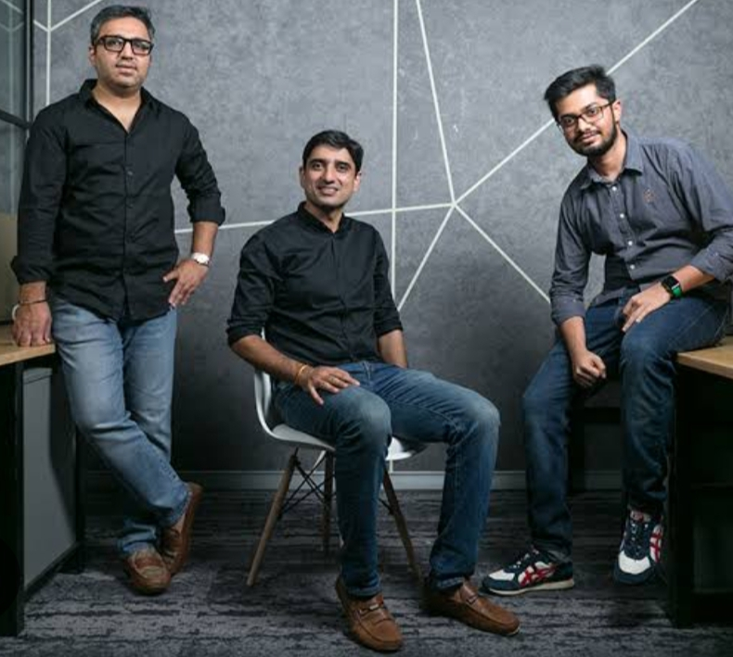
ECOSYSTEM OF BHARATPE
STARTED IN
BHARATPE started in 2018, by ashneer grover, shashvat nakrani and bhavik koladiya.
VISION
To make financial inclusion a reality for Indian merchant.
HEADQUATERS
BHARATPE have its headquarter in new Delhi, and have 5 offices across the country.

Slide 2
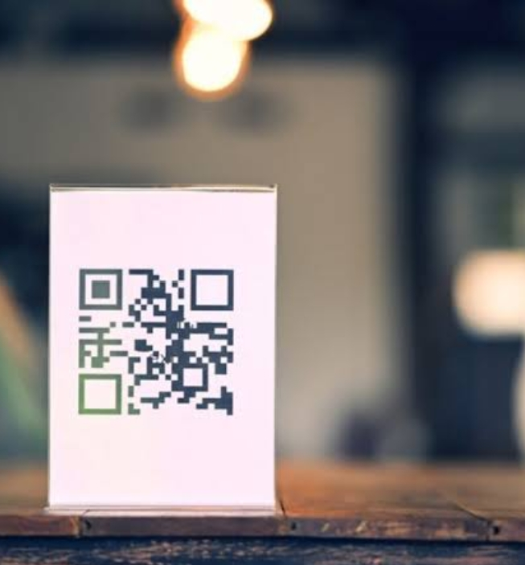

What is BHARATPE?
BHARATPE is a B2B fintech player, that enables merchants to accept payments from all UPI apps, through a single QR code
HOW IT WORKS?
> Merchants spending more hours on app, will certainly increase its amount to about $2000.
> It helps offline merchants with there payments.
> It is an Indian QR code based payment company that operates on B2B and B2C model.

Slide 3
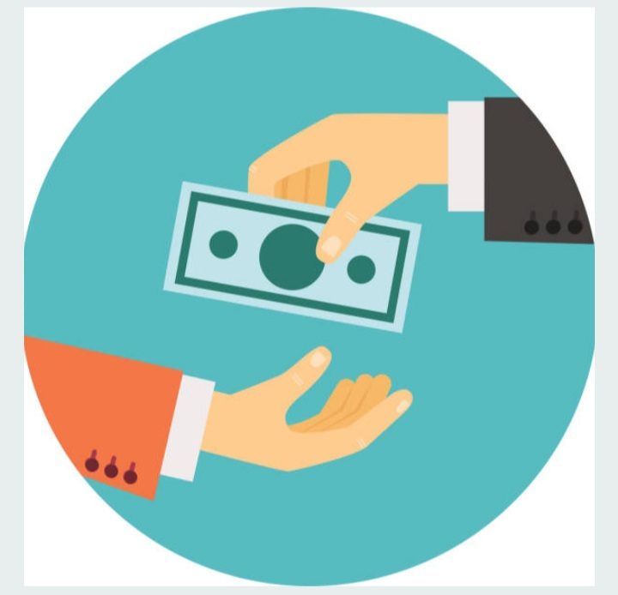
CUSTOMERS OF BHARATPE
Business owners
Retailers
Merchants
COMPETITORS OF BHARATPE
BENOW
PAYTM
CHQBOOK
PHONEPE
GOOGLE
TOTAL FUNDING RAISED BY BHARATPE
$617 MILLION, OVER 15 ROUNDS

Slide 4

HOW BHARATPE MAKES PROFIT?
It earns interest income from the loans, it disburses to merchants and consumers.
BHARATPE partners with banks and NBFC’s for providing these loans.
LOSSES FOR BHARATPE
RS .5594 CR IN FY 2022
RS. 1619 CR IN FY 2021
STAKES AFTER JOINING OF ASHNEER GROVER IN 2018
Ashneer grover- 32%
Shashvat nakrani- 25.5%
Bhavik koladia- 42.5%

Slide 5

STRATEGY
BHARATPE offers unified QR code which is compatible with over 10 UPI apps .
It enables merchants to accept payments from multiple apps without maintaining separate QR codes.
IT IS AN FINTECH UNICORN

