Slide 1


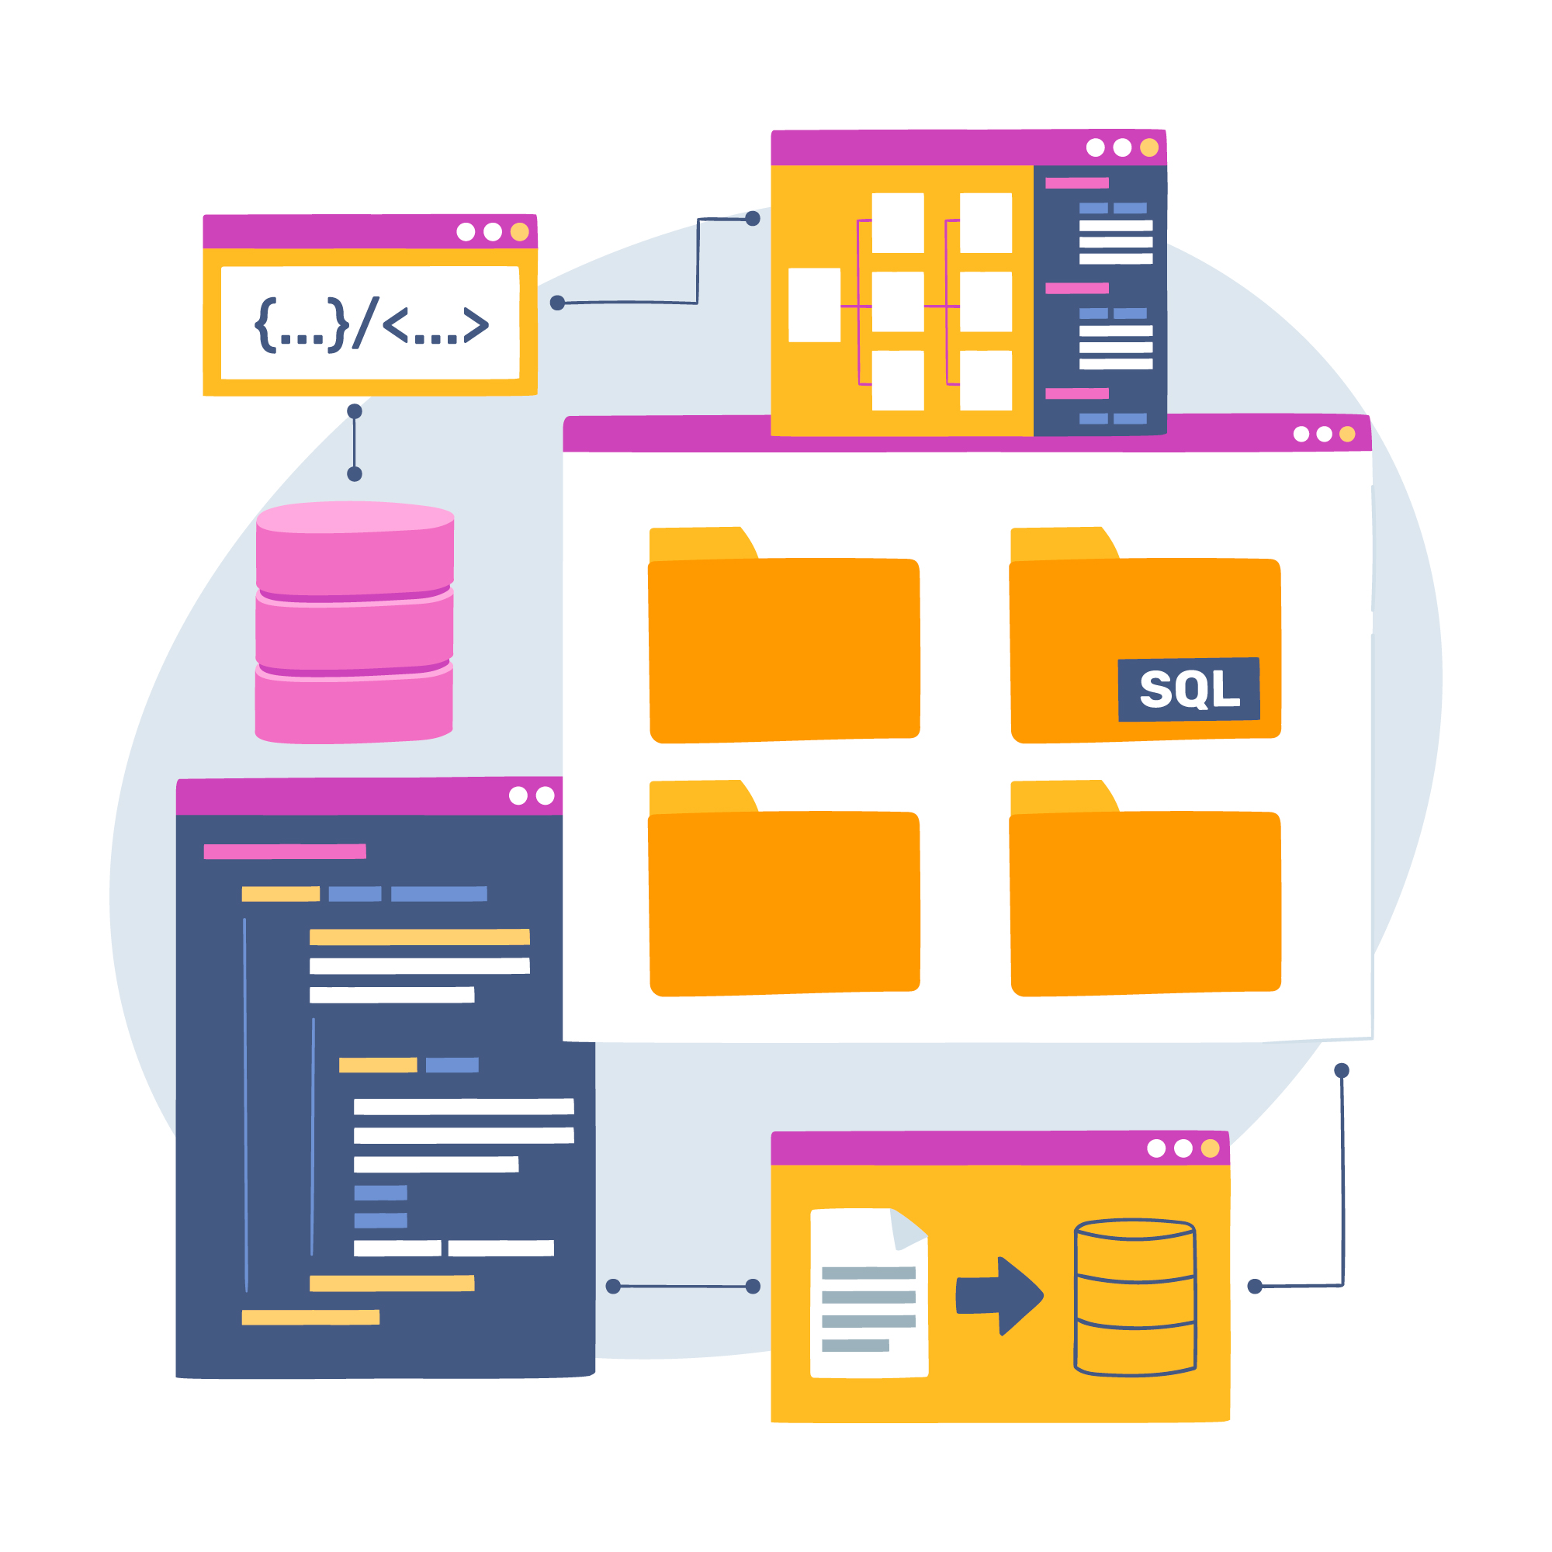
Consumer Good Analysis Using SQL
AtliQ Hardwares

Slide 2
Unveiling Insights: Leveraging Data for Strategic Decision-Making
Problem Statement:
AtliQ Hardware, a leading global producer of computer hardware, encountered a significant challenge in its operations. To remain competitive in an increasingly dynamic market, the company needed to make swift, data-driven decisions. However, the management identified a critical gap—lack of actionable insights was hindering strategic planning and decision-making.
To address the challenge, AtliQ Hardware assembled a dedicated data analytics team and I took on the SQL initiative. My objective was clear: to resolve 10 ad-hoc business queries by transforming raw data into actionable insights that would empower strategic decision-making.
AtliQ Hardwares

Slide 3
Key Insights
There was a significant growth in unique products, rising from 245 in 2020 to 334 in 2021.
The "Notebook" segment holds the largest variety, with a total of 129 products.
The "Accessories" segment experienced a notable expansion, adding 34 more products in 2021 compared to 2020.
"Flipkart" recorded the highest average pre-invoice discount percentage, standing at 30.83%.
While fiscal year 2020 saw a dip in sales during March and April, performance notably improved in the same period of fiscal year 2021.
The "Retailer" channel emerged as the dominant sales contributor, accounting for 73.22% of total gross sales.
AtliQ Hardwares

Slide 4
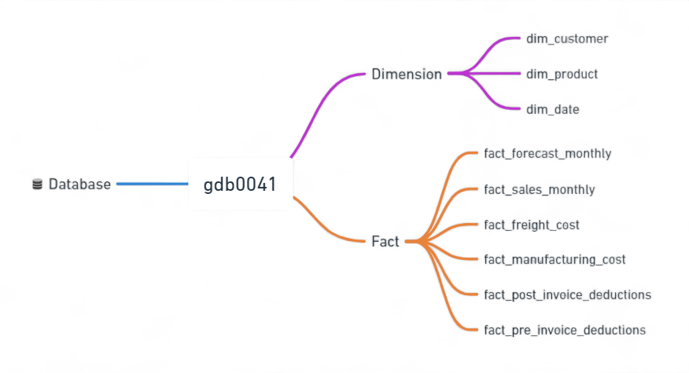
Data Sets
AtliQ Hardwares

Slide 5
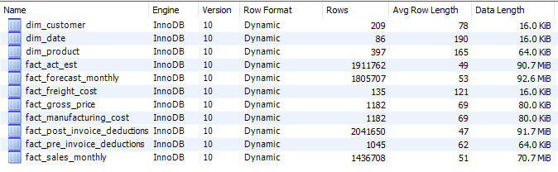
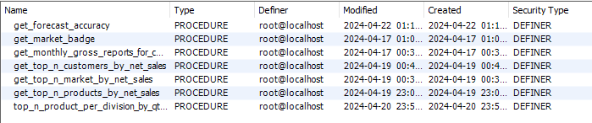

Database Overview
Tables
Stored Procedures
Functions
Views
AtliQ Hardwares

Slide 6
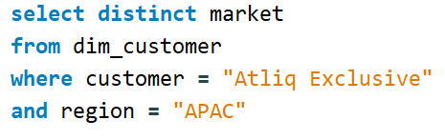
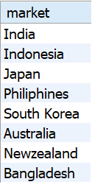
Provide the list of market in which customer “Atliq Exclusive” operates its business in APAC region
AtliQ Hardwares

Slide 7
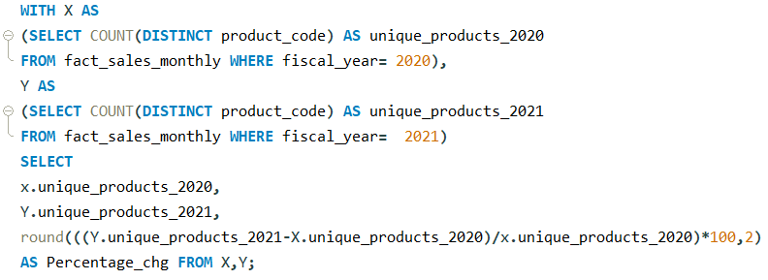

What is the percentage of unique product increase in 2021vs.2020?
AtliQ Hardwares

Slide 8
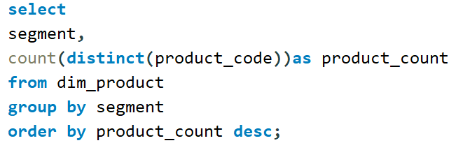
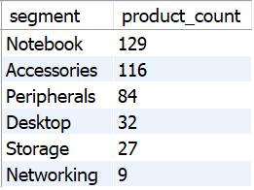
Provide a report with all the unique product counts for each segment
and sort them in descending order of product counts.
The final output contains 2 fields, segment product count.
AtliQ Hardwares

Slide 9
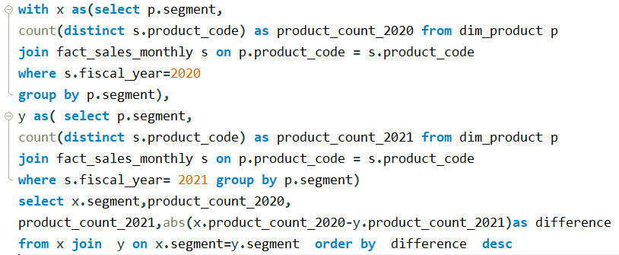
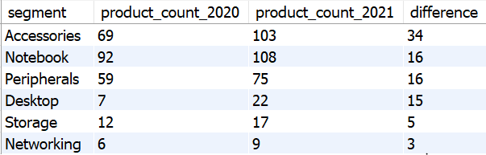
Follow-up: Which segment had the most increase in unique products in 2021 vs 2020? The final output contains these fields, segment, product count 2020 product_count_202I difference.
AtliQ Hardwares

Slide 10
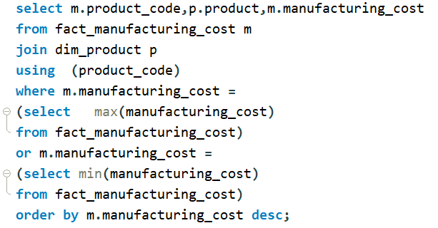

Get the products The final output that have the highest and lowest manufacturing costs
should contain these fields, product_code, product
AtliQ Hardwares

Slide 11
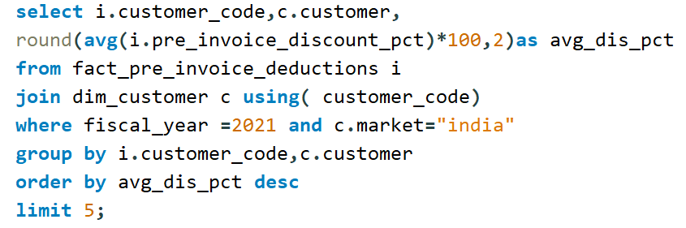
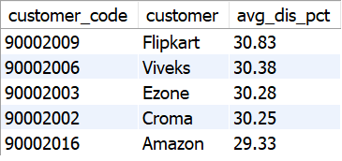
Generate a report which contains the top 5 customers who received an average high pre invoice discount_pct for the fiscal year 202I and in the Indian market. The final output contains these fields
customer_code customer average_discount_percentage.
AtliQ Hardwares

Slide 12
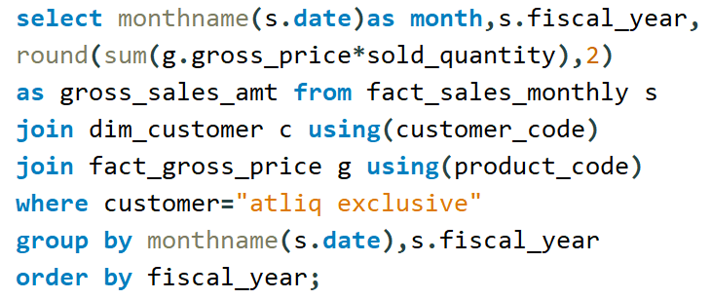
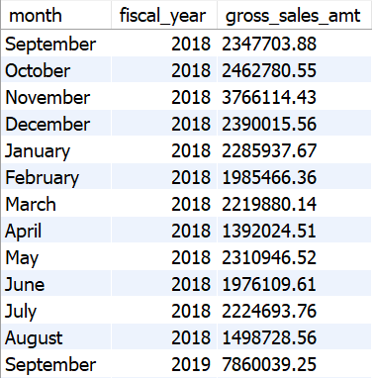
Get the complete report of the Gross sales amount for the customer "Atliq Exclusive "for each month. This analysis helps to get an idea of low and high-performing months and take strategic decisions. The final
report contains these columns: Month Year Gross sales Amount.
AtliQ Hardwares

Slide 13
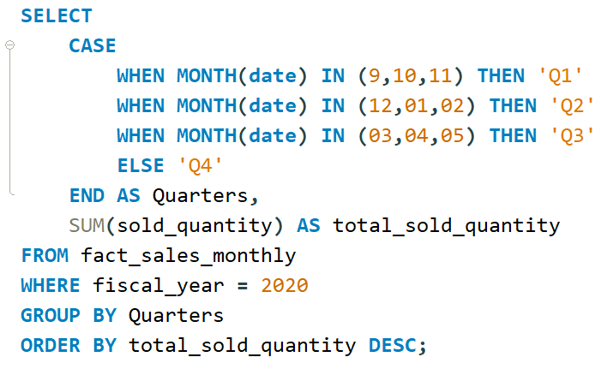
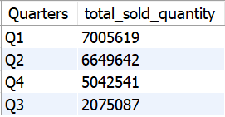
Which quarter of 2020, got the maximum total_sold_quantity? The final output contains these fields sorted by the total_sold_quantiy, Quarter, total_sold_quantity.
AtliQ Hardwares

Slide 14
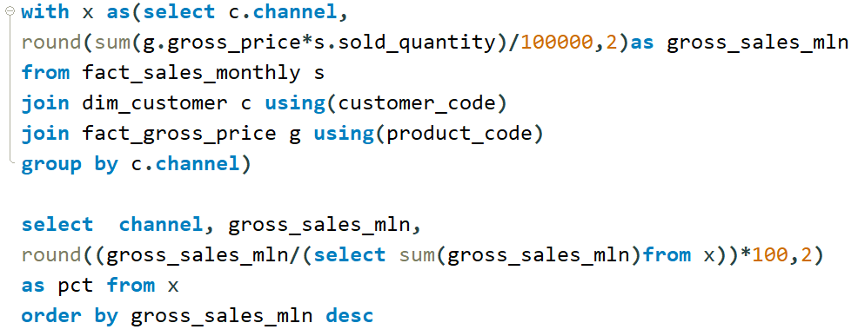
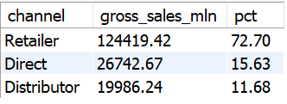
Which channel helped to bring more gross sales in the fiscal year 2021 and the percentage of contribution? The final output contains these fields, channel gross sales min percentage.
AtliQ Hardwares

Slide 15
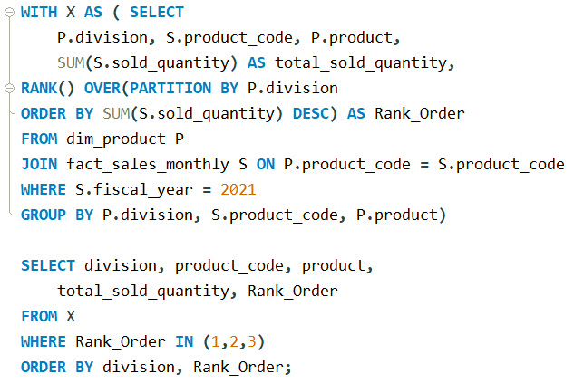
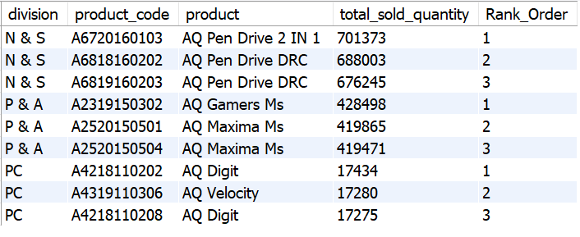
Get the Top 3 products in each division that have a high total_sold_quantity in the fiscal_year 2021? The final output contains these fields, division product_code.
AtliQ Hardwares

Slide 16
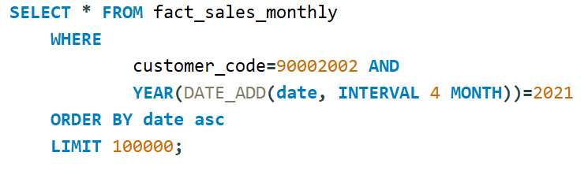
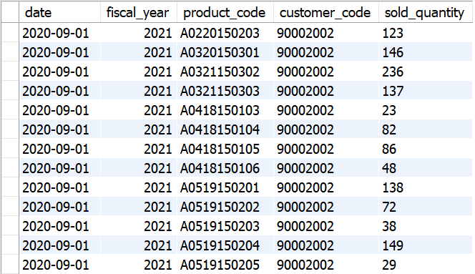
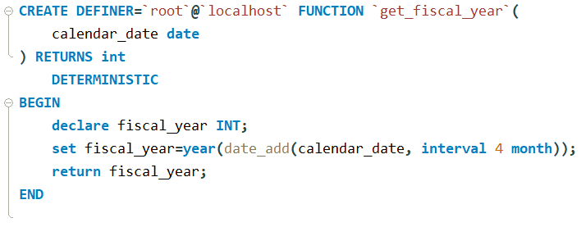
Get all the sales transaction data from fact_sales_monthly table for that customer(croma: 90002002) in the fiscal_year 2021
Create function for fiscal_year
AtliQ Hardwares

Slide 17
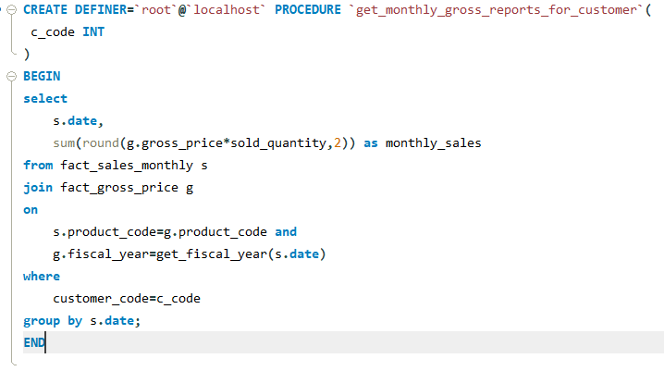
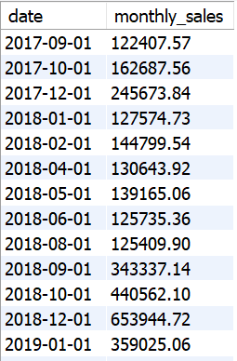
Generate monthly gross sales report for any customer using stored procedure
AtliQ Hardwares

Slide 18
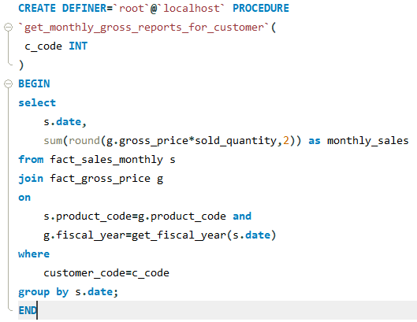
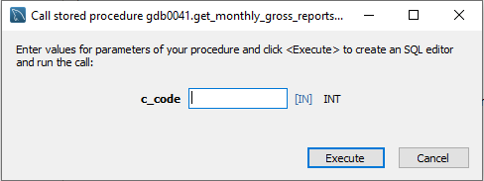
Generate monthly gross sales report for any customer using stored procedure
AtliQ Hardwares

