Slide 1



Finance & Supply Chain Analytics Using SQL
AtliQ Hardwares

Slide 2
About AtliQ Hardwares and the Problem Statement
AtliQ Hardwares is a global leader in the hardware industry, specializing in a wide range of products including PCs, printers, mice, and computers. With its rapidly expanding operations, the company has encountered performance challenges due to the increasing size and complexity of its Excel-based data systems. These issues have led to system inefficiencies and unresponsiveness, hindering timely decision-making.
To address this, AtliQ Hardwares has initiated a strategic project aimed at optimizing data handling and analysis. A dedicated team of data analysts has been assembled to transition data operations from Excel to a robust MySQL-based database management system. This shift will enable efficient data storage, streamlined queries, and deeper analytical insights. By leveraging MySQL, AtliQ Hardwares aims to enhance operational efficiency, improve business intelligence, and support more informed, data-driven decisions across the organization.
AtliQ Hardwares

Slide 3
Project Overview
This project focuses on analyzing and deriving actionable insights from the AtliQ Hardware database. The dataset includes comprehensive information on sales, products, customers, and regional performance. The primary objective is to answer key business questions related to sales trends, market dynamics, customer behavior, and supply chain forecasting. By leveraging these insights, the project aims to support data-driven decision-making and operational optimization across the organization.
AtliQ Hardwares

Slide 4
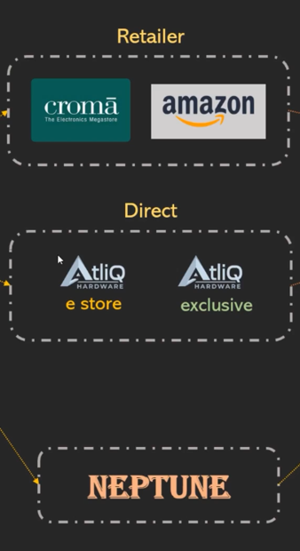
AtliQ Hardware – Business Model
Customers Channels
Customer Platforms
Brick and Mortar
E-Commerce
Croma
Best Buy
Amazon
Flipkart
Customers
Croma
Best Buy
Staples
Flipkart
AtliQ Hardwares

Slide 5
AtliQ Hardware – Business Model
Product Division
PC
N&S
P&A
Personal Laptop
Gaming Laptop
Wi-Fi Extenders
USB Flash Drives
Processor
Motherboard
Keyboard
Mouse
Product Segment
Storage
Peripherals
Notebook
Desktop
Accessories
AtliQ Hardwares

Slide 6
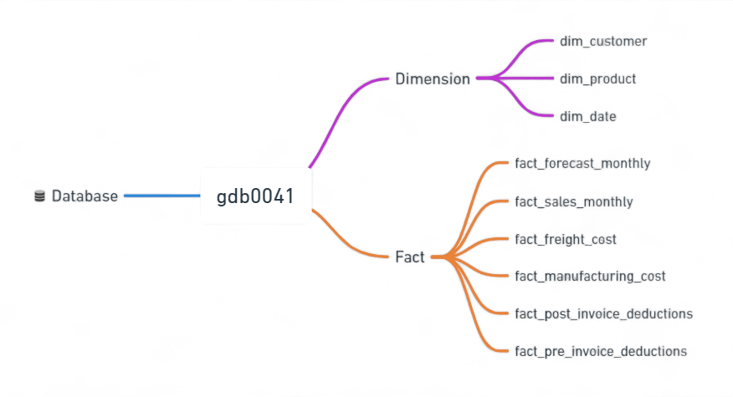
Data Sets
AtliQ Hardwares

Slide 7
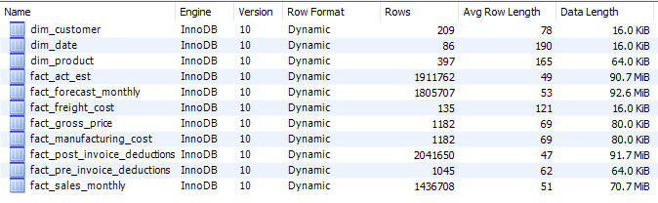
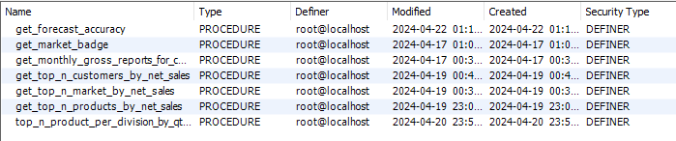

Database Overview
Tables
Stored Procedures
Functions
Views
AtliQ Hardwares

Slide 8
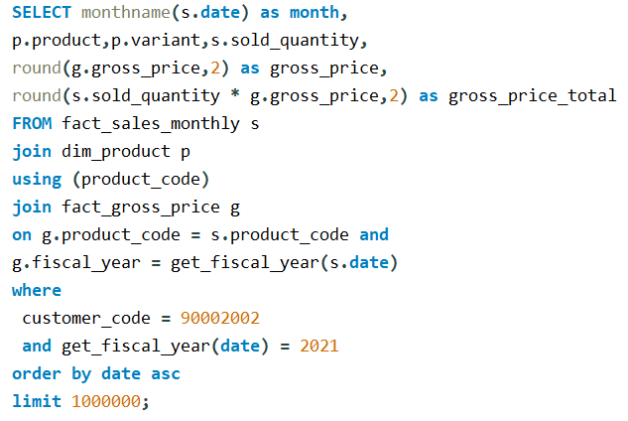
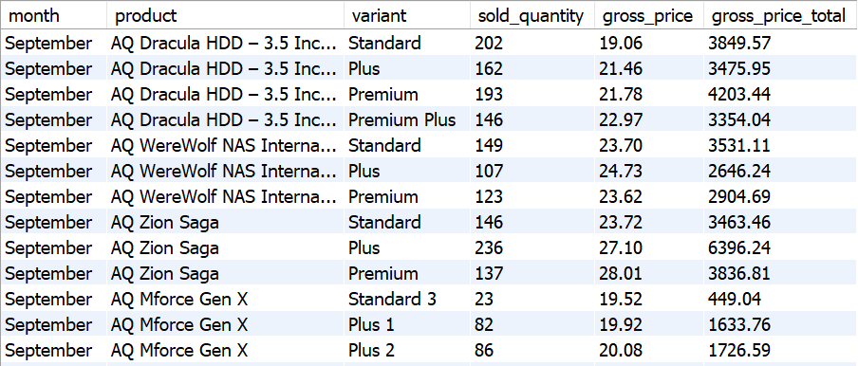
Croma India product wise sales report for fiscal year - 2021
AtliQ Hardwares

Slide 9
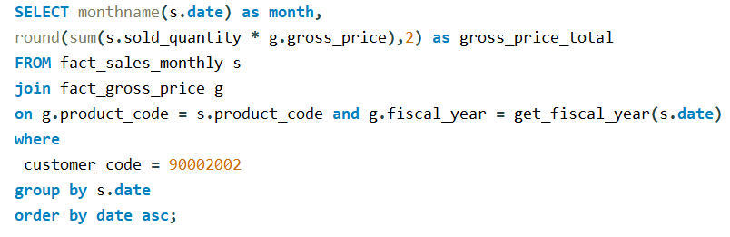
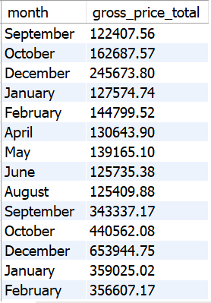
Gross monthly total sales for Croma
AtliQ Hardwares

Slide 10
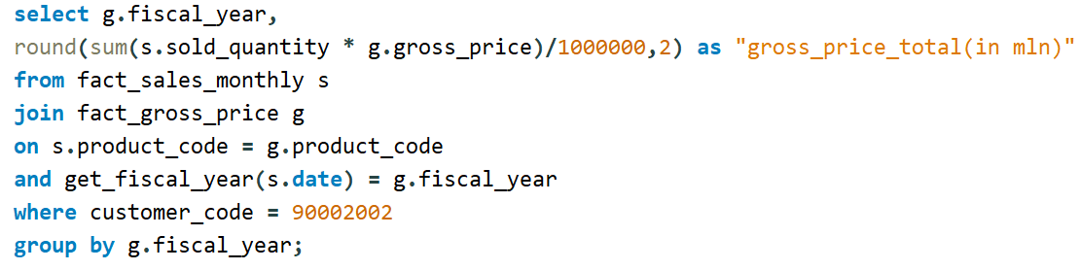
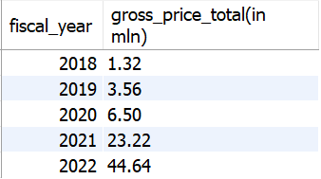
Yearly gross sales report for Croma India
AtliQ Hardwares

Slide 11
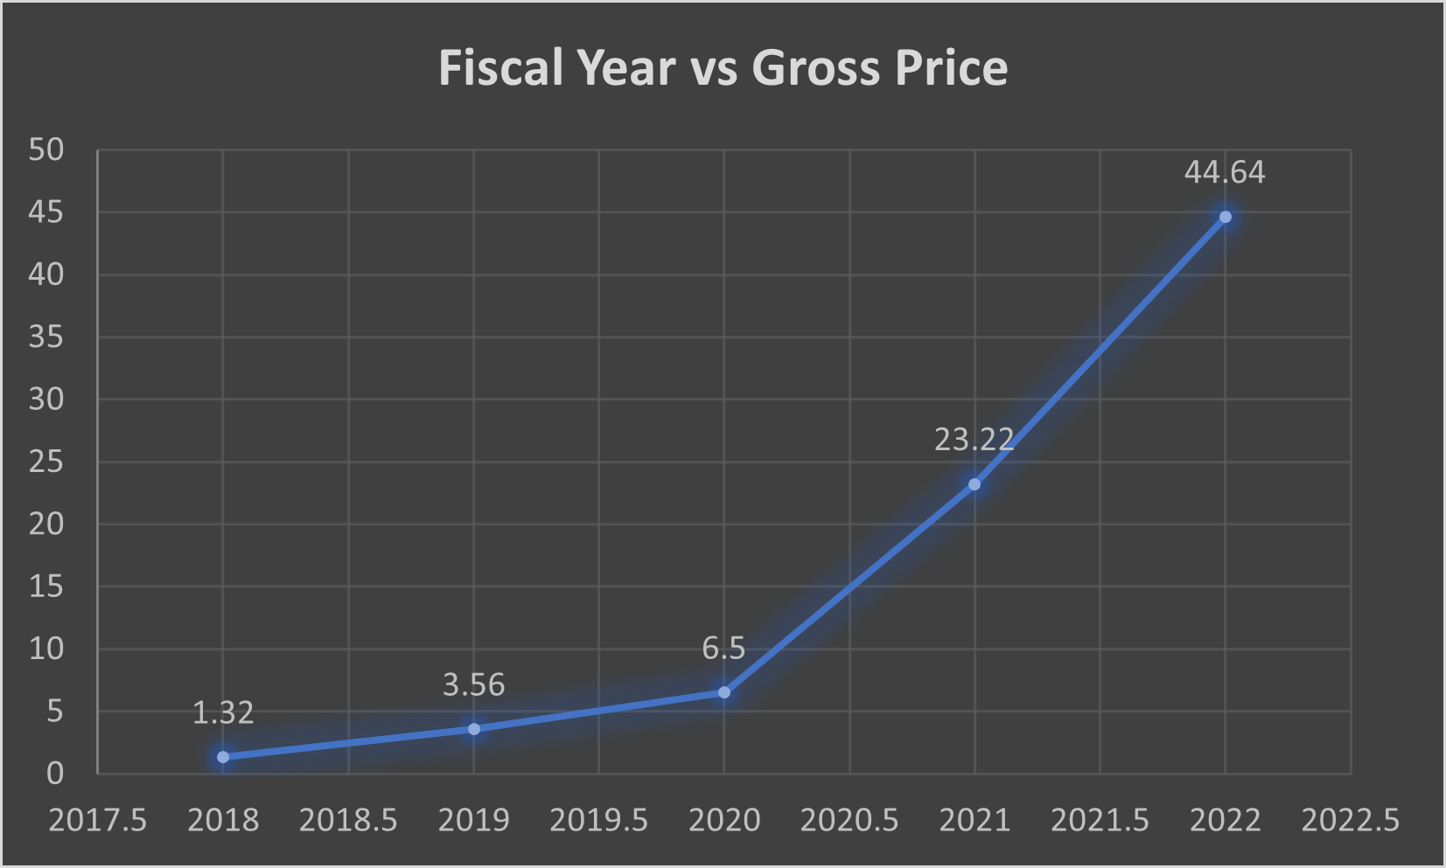
Yearly gross sales report for Croma India
AtliQ Hardwares

Slide 12
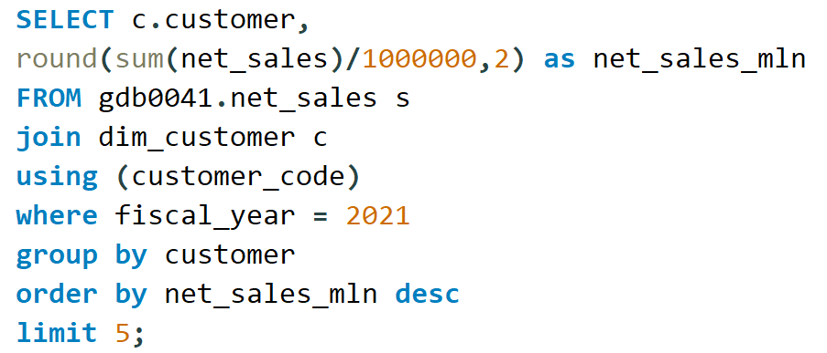
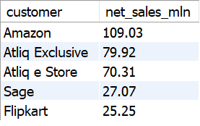
Top Market and Customers for a Financial Year 2021 Customer
AtliQ Hardwares

Slide 13
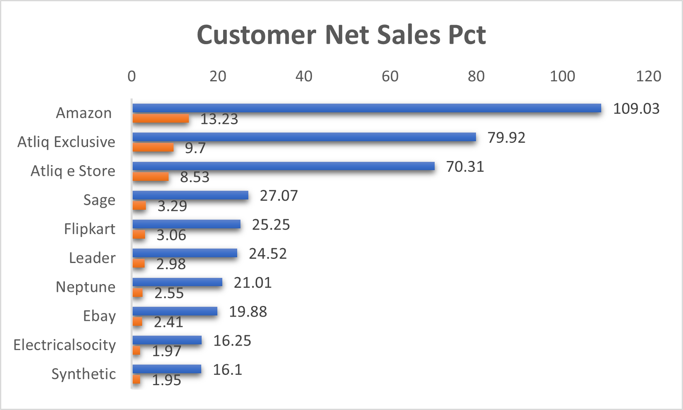
Top Market and Customers for a Financial Year 2021 Customer
AtliQ Hardwares

Slide 14
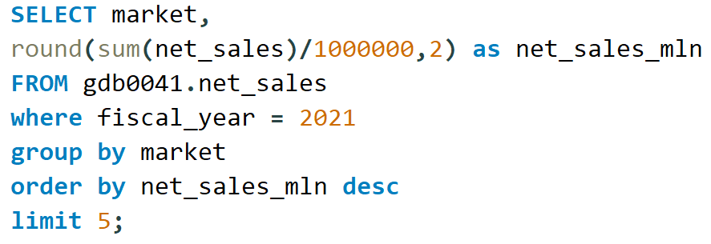
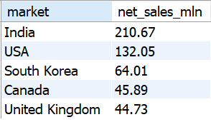
Top Market and Customers for a Financial Year 2021 Market
AtliQ Hardwares

Slide 15
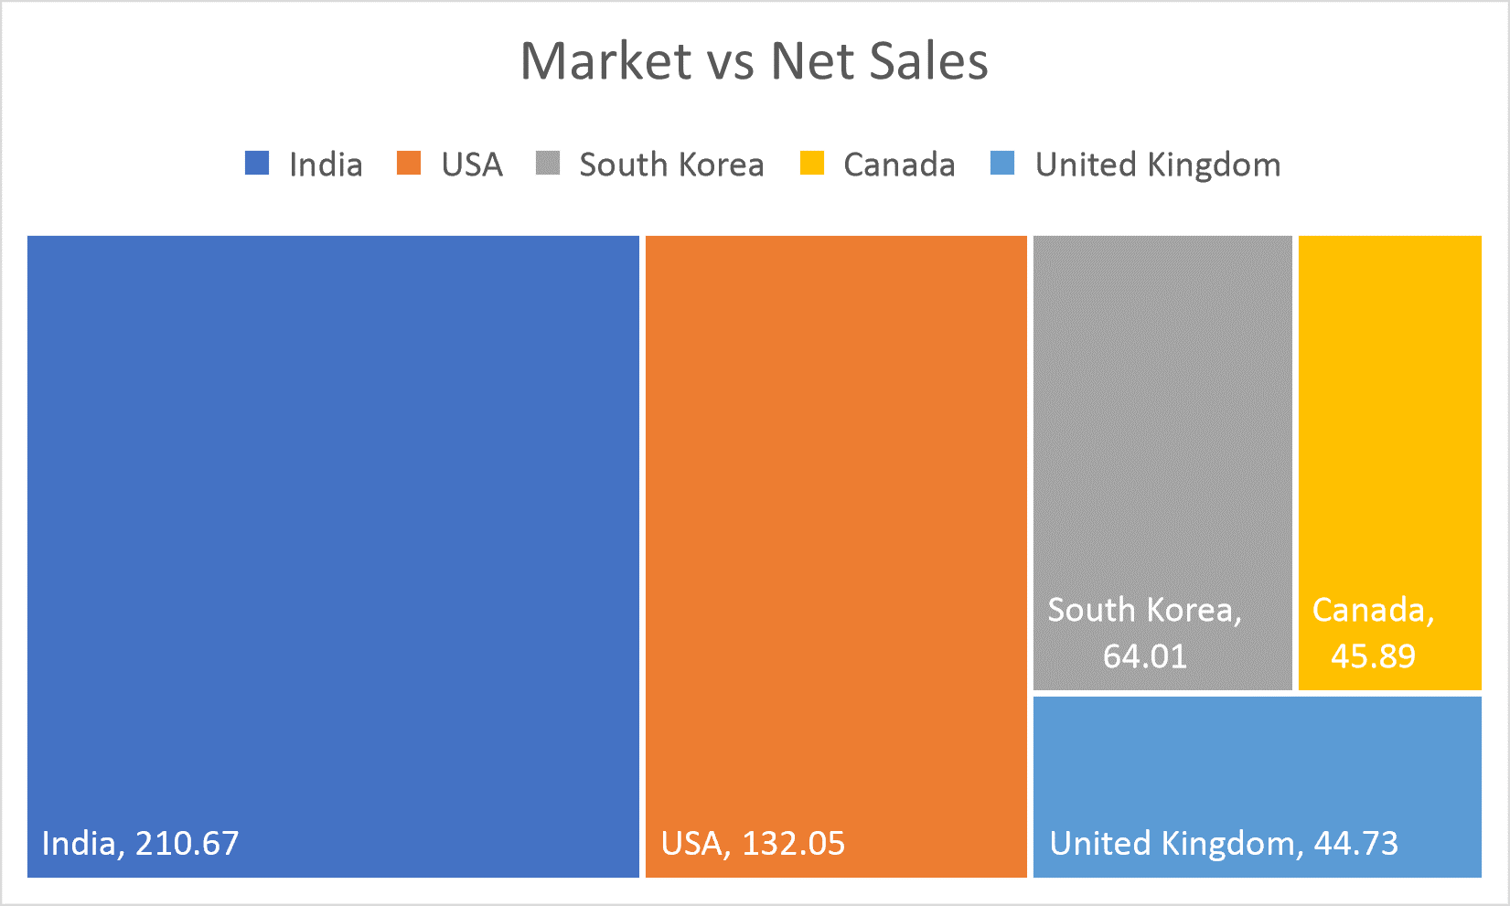
Top Market and Customers for a Financial Year 2021 Market
AtliQ Hardwares

Slide 16
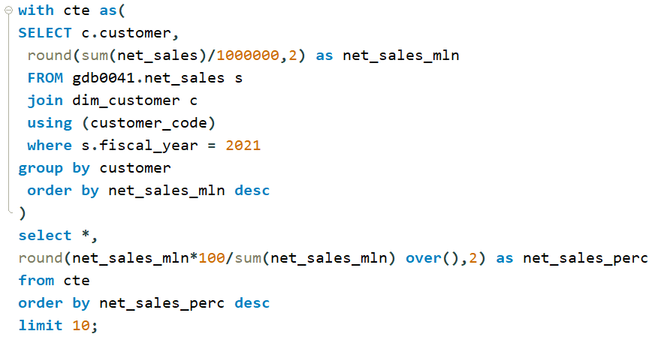
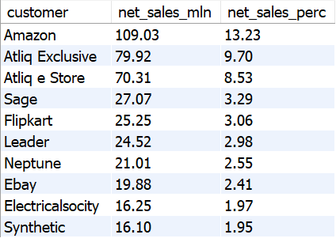
Net sales % share by Customers
AtliQ Hardwares

Slide 17
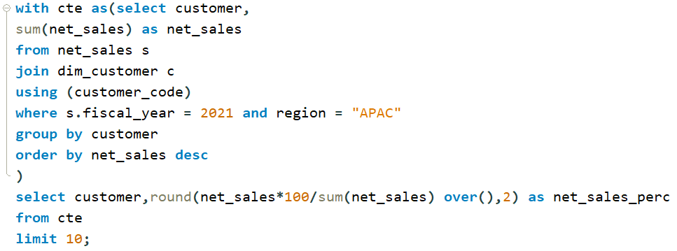
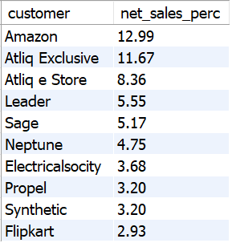
Net sales % share by Region - APAC
AtliQ Hardwares

Slide 18
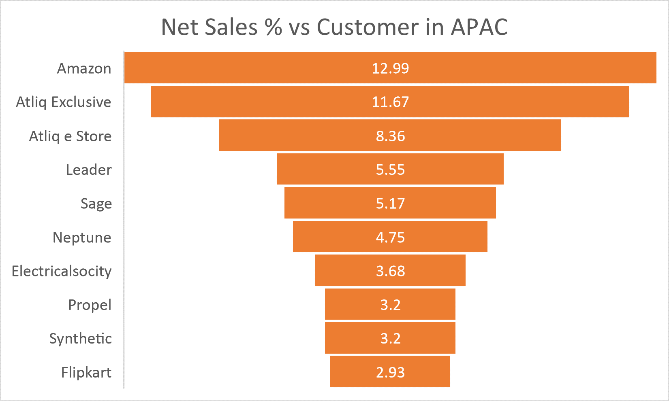
Net sales % share by Region - APAC
AtliQ Hardwares
Presented by - Yatin Lokhande

Slide 19
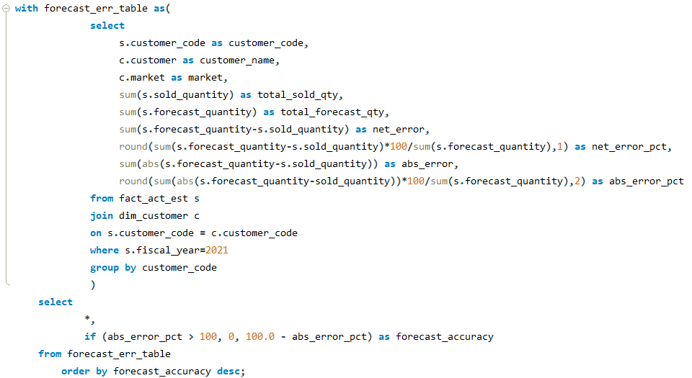
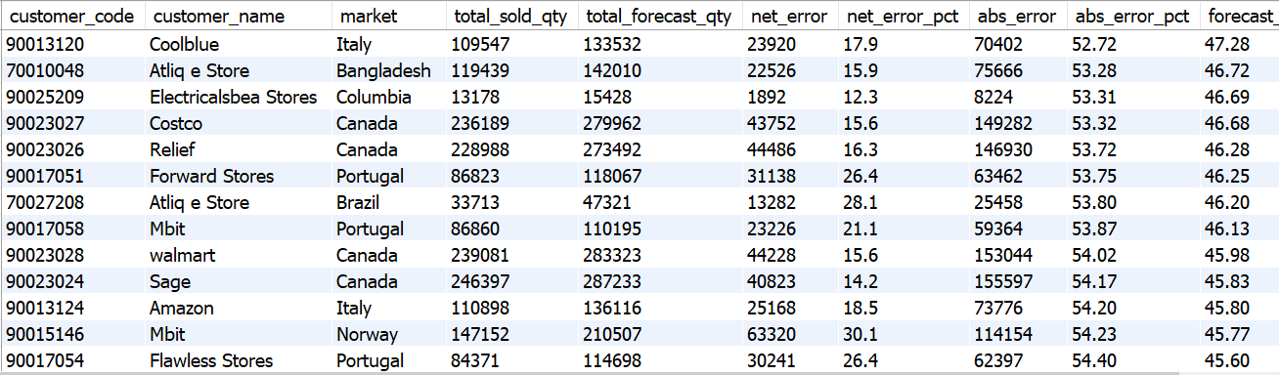
Supply Chain – Forecast Quantity
AtliQ Hardwares

Slide 20
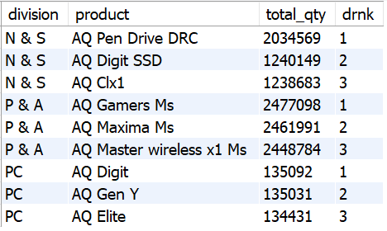
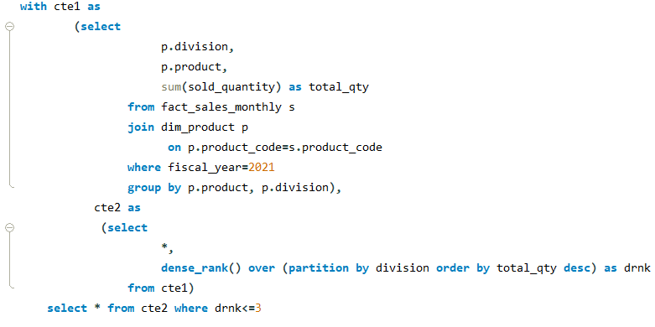
Top 3 products from each division by total quantity sold in a given year
AtliQ Hardwares

Slide 21
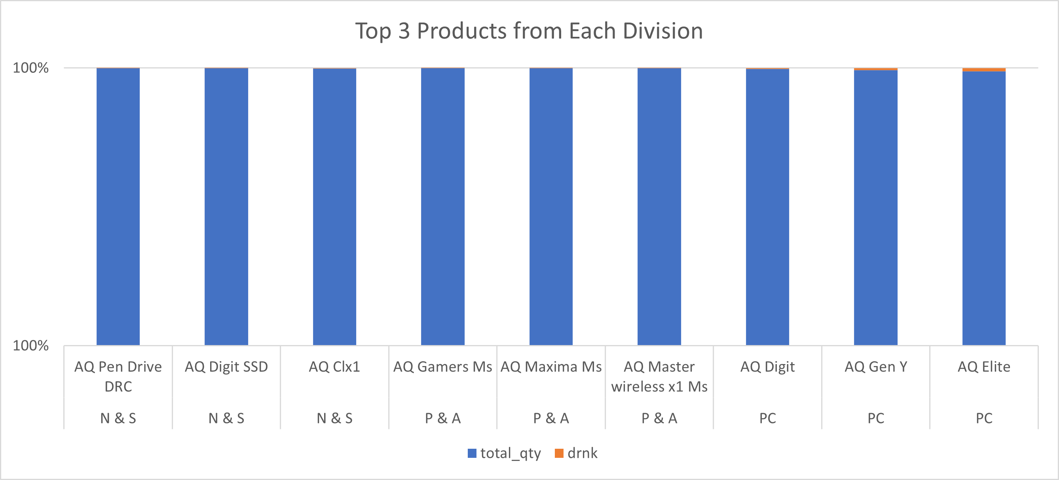
Top 3 products from each division by total quantity sold in a given year
AtliQ Hardwares

Slide 22
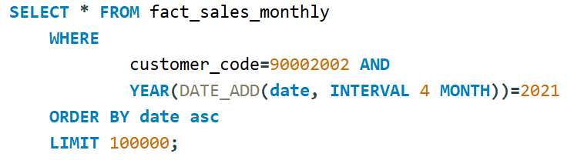
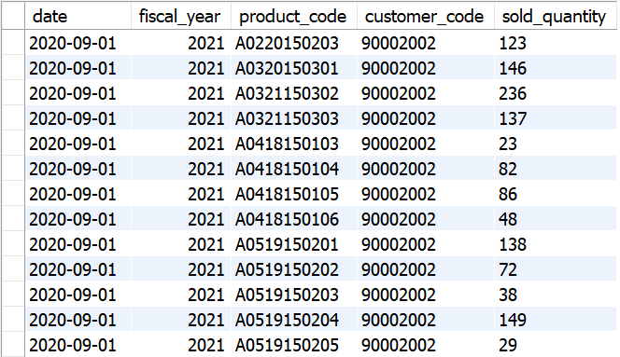
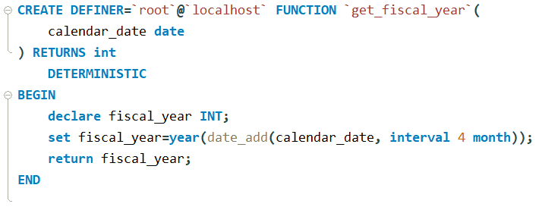
Get all the sales transaction data from fact_sales_monthly table for that customer(croma: 90002002) in the fiscal_year 2021
Create function for fiscal_year
AtliQ Hardwares

Slide 23
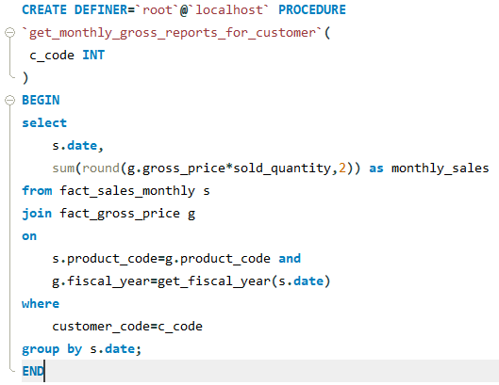
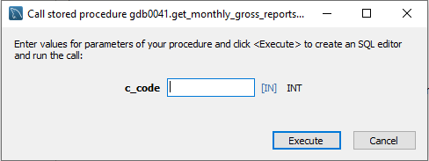
Generate monthly gross sales report for any customer using stored procedure
AtliQ Hardwares

