Slide 1

Real Time Stocks Fluctuation Notifications
Notes:
1

Slide 2

Outline
Introduction
Objective
Methodology
Work-Flow
KPI
Conclusion
Notes:
2

Slide 3
Introduction
Why Stock Market Analysis is required?
Stock market plays a pivotal role in financial aspect of the nation's growth, but stock market is highly volatile and complex in nature.
It is affected by significant political issues, analyst calls, news articles, company's future plans of expansions and growth and many more.
Hence, any investor would be interested in understanding the stock market over time and how the factors mentioned above affect the behaviour of the stock market.
Notes:
3

Slide 4

The aim of the project is to analyse the live data so that investor can take better decision in buying stocks.
Notes:
4

Slide 5
Tools and Technology
Python (Jupyter Notebook)
AWS S3
Aws Lambda
Aws SNS
Data-Set Link:
https://www.bseindia.com/
Yahoo Finance API
Content:
Sector wise total companies-50
Interval: Every 1 minute

Slide 6
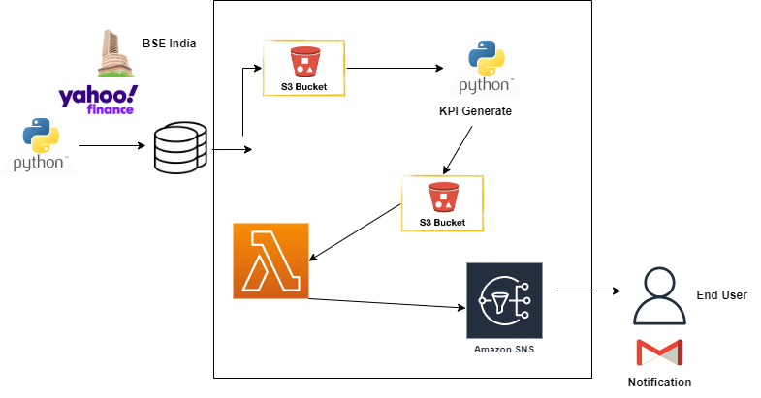
Real Time Architecture

Slide 7
Workflow
Select 5 sector: 50 Companies (1Min Data) from BSE India.
Fetch the Data through Yahoo Finance API.
Data injection to S3 bucket.
Generate KPI’S through Python codes.
Load the KPI to S3 bucket.
Create topic & subscription.
Trigger Lambda for KPI.
Notification send to End user.

Slide 8
KPI’S
Above 5% growth company.
Below 5% down company.
comparison of current price to high52 in percentage.
comparison of current price to low52 in percentage.
5% growth company below 100Rs.
5% down company above 1000Rs.
Sector-wise highest growth companies.
Sector-wise lowest growth companies.

Slide 9
Conclusion
So in this project, we have analysed the data from each sectors and provided this information to the investors who wants to take better decision when buying stocks.

Slide 10
Thank you!
Notes:
10

