Slide 1

Git and GitHub for Writers
Cloning
Getting a local copy of a remote repository

Slide 2
Introduction
Covers
What is cloning?
How to clone a project on GitHub
HTTPS vs SSH cloning
What is the origin in Git commands?

Slide 3
What is cloning?
Cloning is making a local copy of a remote repository
This creates copies of all the files and history locally
Creates both visible and hidden files

Slide 4
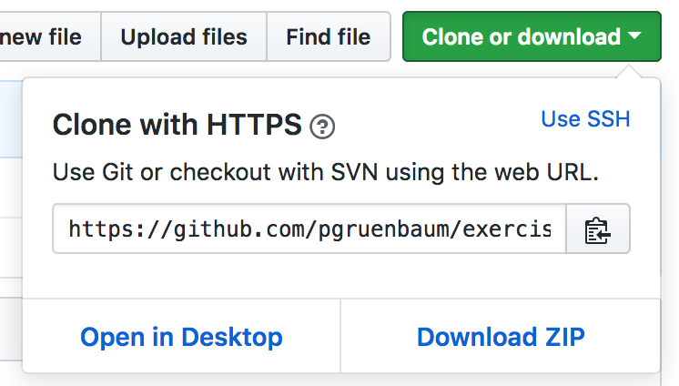
Cloning from GitHub
If you have access to a GitHub repo, you can simply click the Clone or Download button
Copy the URL
Paste after the git clone command

Slide 5
Placeholder
<Show>
Go to my GitHub project
Copy URL
Clone repo

Slide 6
HTTPS vs SSH
You may have noticed a link that says “Use SSH”
You can clone using either secure HTTP or secure shell (SSH)
HTTPS is simpler
Some people feel SSH is more secure
Requires generating a special SSH key and providing the passphrase

Slide 7
origin
origin in Git is just shortcut for the URL where you cloned your repository from
So if you cloned your repository from https://github.com/pgruenbaum/exercise.git
then git push origin is the same as:
git push https://github.com/pgruenbaum/exercise.git
In theory you can push your changes to other repos
This is very unusual

Slide 8
Exercise
Find an interesting repository on GitHub
Clone it

