Slide 1
🛡️
ARPShield
REAL-TIME ARP SPOOFING
DETECTION & DDOS
PREVENTION SYSTEM
CLIENT
SWITCH
GATEWAY
FORGED ARP TRAFFIC
Official Topic:
ARP Spoofing Attack Detection to Prevent DDoS Attack
GROUP 52
VIT BHOPAL UNIVERSITY
Supervisor: Dr. Sreevani Maddukuri
ATTACKER
Chintanika M (23BCY10056) • Rishima Sharma (23BCY10231) • Anju Kumari (23BCY10267)
Akshay Singh (23BCY10283) • Oveiya K (23BCY10309)

Slide 2
THE SECURITY PROBLEM
LEGITIMATE TRAFFIC
01
ARP LACKS AUTHENTICATION
VICTIM
SWITCH
GATEWAY
The ARP protocol has no built-in verification mechanism for sender identity.
ARP SPOOFING ATTACK
ATTACKER
02
FORGED MAPPINGS ENABLE IMPERSONATION
Attackers can associate their MAC with another host's IP, enabling MitM attacks.
FORGED ARP REPLY
VICTIM'S IP-MAC
MAPPING CORRUPTED
03
NETWORK DISRUPTION → DoS CONDITIONS
Corrupted ARP caches can cause traffic blackholes and denial of service.

Slide 3
WHAT ARPShield DOES
1
2
3
4
5
6
MONITOR
DETECT
IDENTIFY
ANALYZE
MITIGATE
RECOVER
Capture live ARP
packets via Scapy
Apply 7 rule-based
heuristic checks
Pinpoint attacker
MAC & IP address
Quantify DDoS
impact & disruption
Isolate malicious
device via firewall
Restore legitimate
IP-MAC mappings
From suspicious ARP traffic to actionable network defense.

Slide 4
SYSTEM ARCHITECTURE
network/
NETWORK · ARP TRAFFIC
DETECTION RULES
network/sniffer.py
PACKET CAPTURE (Scapy)
BASELINE VIOLATION
IP-MAC vs trusted config
network/parser.py
PACKET PARSING
GATEWAY SPOOFING
Non-gateway MAC claims gateway IP
config/trusted_baseline.json
IP-MAC BASELINE CHECK
IP-MAC CONFLICT
Known IP → new MAC address
detection/
DETECTION ENGINE (7 Rules)
DUPLICATE IP
Multiple MACs claim same IP
detection_engine/
ATTACKER IDENTIFICATION
MAC CHANGE
Existing IP → changed MAC
backend/routes/alerts.py
SUSPICIOUS REPLY
ALERT / LOGGING
Unsolicited gratuitous ARP
testing/evaluation/
RATE THRESHOLD
DDoS IMPACT ANALYSIS
Abnormal ARP packets-per-second
prevention/
MITIGATION (ISOLATE)
database/
DATABASE (SQLite)
dashboard/
DASHBOARD (Flask)

Slide 5
HOW ARPShield DETECTS SPOOFING
7 rule-based heuristic checks applied to every ARP packet in real-time
⚠
⚠
⚠
⚠
PACKET → DETECTION FLOW
BASELINE
VIOLATION
GATEWAY
SPOOFING
IP-MAC
CONFLICT
DUPLICATE
IP CLAIM
ARP Packet Received
Known IP → unexpected MAC
vs trusted_baseline.json
Non-gateway MAC claims
gateway IP in ARP reply
Previously seen IP now
associated with new MAC
Multiple distinct MACs
claim the same IP address
↓
Extract: src_ip, src_mac, dst_ip, dst_mac, op
↓
Update ARP Table State
⚠
⚠
⚠
↓
MAC
CHANGE
SUSPICIOUS
ARP REPLY
HIGH ARP
RATE
Run All 7 Rules Against Packet + Context
↓
Established IP-MAC pair
changes unexpectedly
Unsolicited gratuitous ARP
without preceding request
Abnormal packets-per-second
DDoS/flood precursor
Collect Alerts (rule, severity, reason)
↓
Return Alert List to Pipeline
All detection rules are defined in detection/arp-detection/detection_engine/rules/

Slide 6
FROM PACKET TO ALERT
ARP REPLY PACKET
1
EXTRACT FIELDS
Parse sender/target IP, MAC, operation, timestamp
Sender IP:
192.168.1.1
2
UPDATE ARP TABLE
Sender MAC:
de:ad:be:ef:00:01
Record latest IP-MAC observation
Target IP:
192.168.1.10
3
COMPARE WITH BASELINE
Target MAC:
00:11:22:33:44:10
Check against config/trusted_baseline.json
Operation:
REPLY
4
VIOLATION DETECTED
Timestamp:
2026-10-07T12:08:14
gateway_rule.check → Non-gateway MAC claimed gateway IP
TRUSTED BASELINE:
CLASSIFY SEVERITY
192.168.1.1 → aa:bb:cc:dd:ee:01 (gateway)
5
❌ MISMATCH: de:ad:be:ef:00:01 ≠ aa:bb:cc:dd:ee:01
Critical — Gateway impersonation attempt
6
GENERATE ALERT
Event logged with rule, severity, reason, timestamp

Slide 7
ATTACKER IDENTIFICATION
✓ LEGITIMATE MAPPING
⚠ SUSPICIOUS MAPPING
Gateway IP:
192.168.1.1
Gateway MAC:
aa:bb:cc:dd:ee:01
Gateway IP:
192.168.1.1
Attacker MAC:
d6:70:e5:8e:03:51
VS
DETECTION ALERT
Rule:
gateway_impersonation
Attacker IP:
192.168.1.1
Severity:
CRITICAL
Attacker MAC:
d6:70:e5:8e:03:51
Reason:
Non-gateway MAC claimed gateway IP in ARP reply
Action:
ISOLATE_DEVICE

Slide 8
DDoS / DoS IMPACT ANALYSIS
NORMAL
TRAFFIC
ABNORMAL
ARP ACTIVITY
NETWORK
DISRUPTION
DETECTION
MITIGATION
RECOVERY
0.48 pps
9.24 pps
1825%
8
24.67s
NORMAL
ARP RATE
ATTACK
ARP RATE
RATE
INCREASE
AFFECTED
HOSTS
ATTACK
DURATION
PRE-MITIGATION DISRUPTION INDEX
TRAFFIC COMPARISON
0.5727
Total Packets:
60 normal / 228 abnormal
Request:Reply:
1:1 normal / 3.38:1 abnormal
IP-MAC Conflicts:
0 normal / 4 abnormal
Unique Source MACs:
7 normal / 15 abnormal
⚠ IMPORTANT DISTINCTION
ARP spoofing ≠ DDoS. ARP spoofing can contribute to network disruption and DoS conditions. This module evaluates the network-disruption impact of ARP spoofing activity, not DDoS attribution.

Slide 9
PREVENTION & MITIGATION
SOC-Style Incident Response Pipeline
PRIMARY ACTION
1
DETECTION
Rule engine identifies ARP anomaly
ISOLATE
_DEVICE
ALERT
Event logged with severity + reason
2
3
RISK ASSESSMENT
Combine rule score → LOW / MEDIUM / HIGH / CRITICAL
Block attacking MAC/IP
via OS-level firewall rules
(iptables / Windows Firewall)
4
RESPONSE REQUEST
Generate ISOLATE_DEVICE request
5
ADMIN APPROVAL
Administrator approves the response action
6
EXECUTE MITIGATION
Block attacker MAC/IP via OS firewall rules
RISK SCORING
0–24
LOW
7
MONITOR
Continue monitoring for further suspicious activity
25–49
MEDIUM
50–74
HIGH
8
RECOVERY
Broadcast corrective Gratuitous ARP to restore mappings
75–100
CRITICAL

Slide 10
TECHNOLOGY STACK
CORE
NETWORK
BACKEND
DATABASE
FRONTEND
TESTING
Python 3
Scapy
Flask
SQLite
Jinja / HTML
CSS / JS
pytest
unittest
Primary language for
all modules
Real-time ARP packet
capture & parsing
RESTful API server
& route handling
Persistent storage via
Flask-SQLAlchemy
Dashboard templates
& live UI
Automated test suite
& evaluation

Slide 11
TESTING STRATEGY
6 controlled scenarios · 288 synthetic packets · Automated evaluation pipeline
SCENARIO
PACKETS
EXPECTED
SEVERITY
RESULT
EVENTS
DESCRIPTION
NORMAL TRAFFIC
60 pkts
No alert
NONE
FAIL (FP)
20
Baseline mismatch with test fixture
IP-MAC CONFLICT
35 pkts
Detection
MEDIUM
PASS
52
Known IP → unexpected MAC
GATEWAY SPOOFING
25 pkts
Detection
CRITICAL
PASS
46
Non-gateway MAC claimed gateway IP
DUPLICATE IP
11 pkts
Detection
HIGH
PASS
15
Multiple MACs claim same IP
SUSPICIOUS REPLIES
27 pkts
Detection
MEDIUM
PASS
21
Unsolicited gratuitous ARP
HIGH ARP RATE
130 pkts
Detection
HIGH
PASS
73
Abnormal ARP flood rate
⚠ The Normal Traffic scenario FAIL is due to the test fixture using MAC addresses not present in the trusted baseline configuration, producing expected false positives.

Slide 12
FINAL RESULTS & PERFORMANCE
100%
83.33%
90.91%
1.96 ms
DETECTION RATE
(RECALL)
PRECISION
F1 SCORE
AVG DETECTION
LATENCY
ACCURACY
FNR
FPR
TP
TN
FP
FN
83.33%
0.00%
100.00%
5
0
1
0
DETECTION LATENCY BREAKDOWN
DDoS IMPACT VALIDATION
Minimum:
0.54 ms
Average:
1.96 ms
Median:
1.15 ms
ARP rate increased 19.2x during attack (0.48 → 9.24 pps)
IP-MAC conflicts: 0 → 4 during active spoofing
Unique source MACs: 7 → 15 (forged MAC addresses)
Maximum:
5.83 ms
Std Dev:
2.19 ms
⚠ Evaluation Limitation:
Normal traffic test fixture used MAC addresses not present in the configured trusted baseline (trusted_baseline.json), producing false positives. This is an expected artifact of the strict baseline enforcement and synthetic test data.

Slide 13
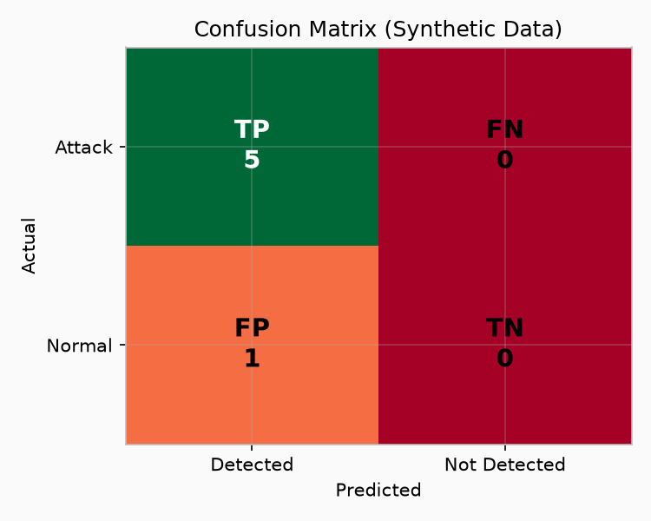
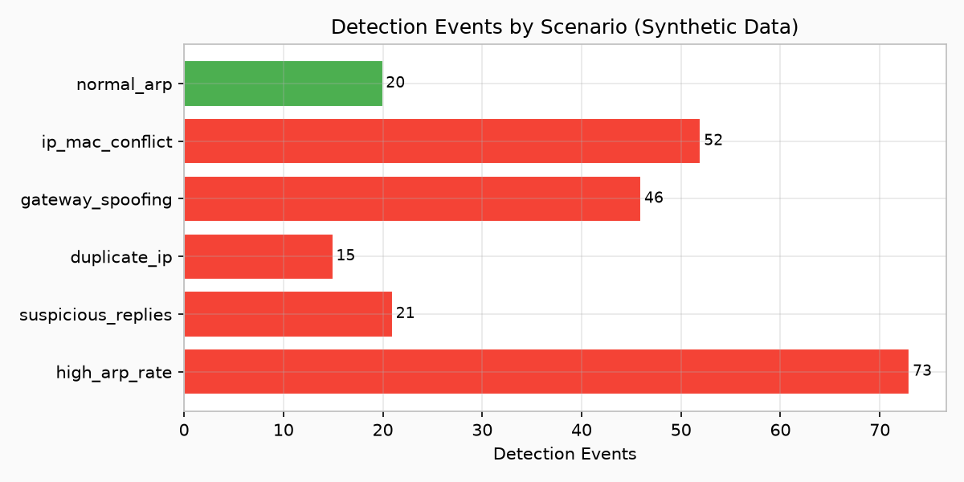
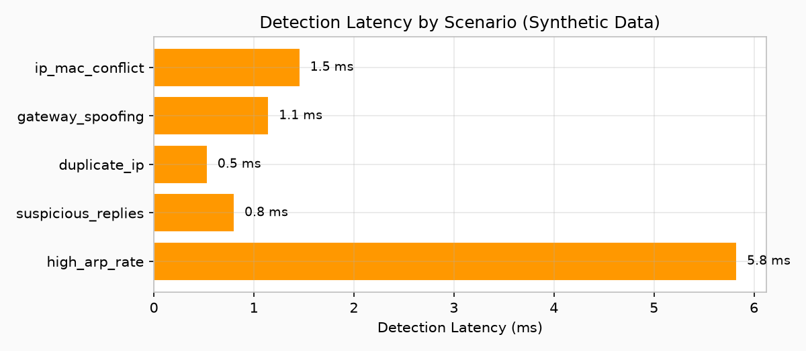
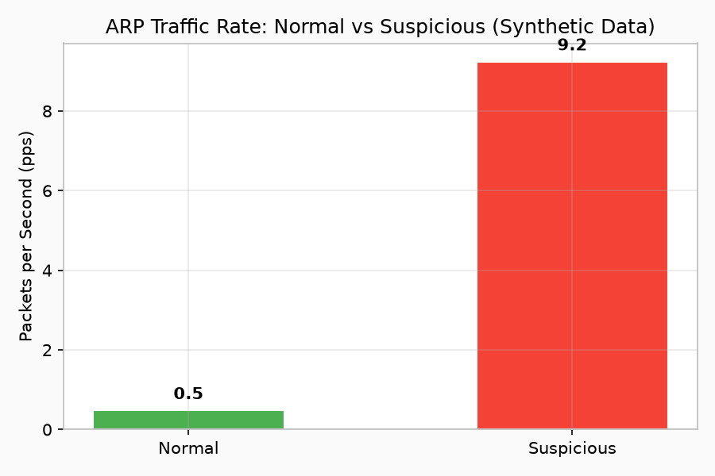
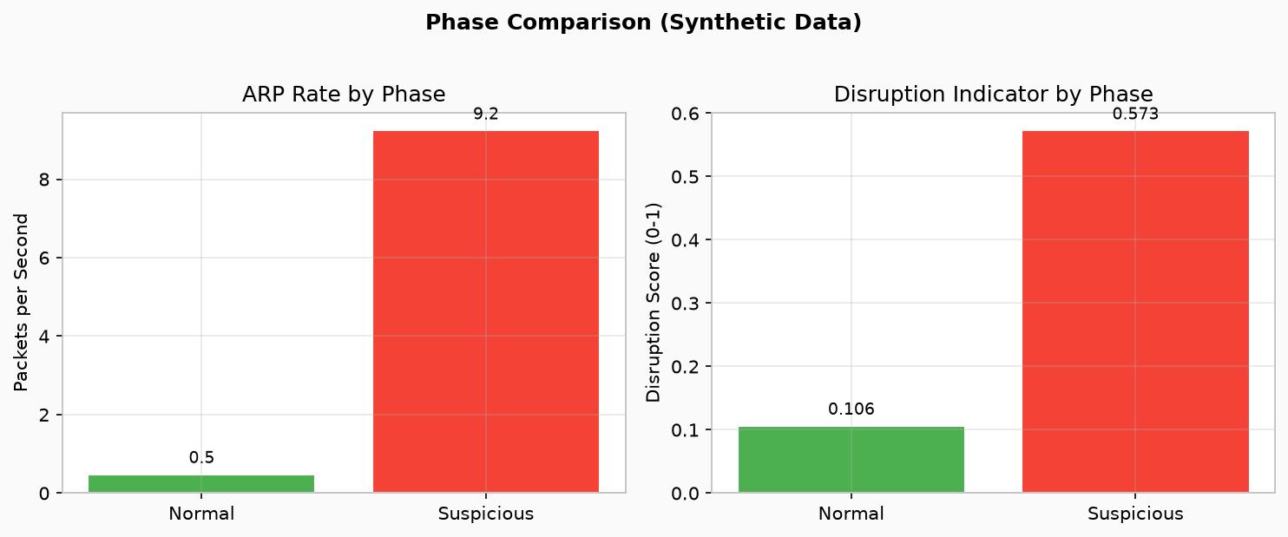
PERFORMANCE VISUALIZATION
All charts generated from actual evaluation data · Synthetic controlled test environment

Slide 14
SECURITY DASHBOARD
Flask + Jinja + SQLite · Real-time web interface for network administrators
OVERVIEW
ALERTS
DEVICES
INCIDENTS
Network status metrics,
connected devices, system health,
active alerts count
Real-time alert feed with
severity classification,
timestamps, and source data
Known device registry,
IP-MAC mappings,
device status tracking
Historical incident log
with full event details
and investigation data
overview.html
alerts.html
devices.html
incidents.html
IMPACT
MITIGATION
RECOVERY
ARP TRAFFIC
DDoS/DoS impact metrics,
traffic rate analysis,
disruption indicators
Response action history,
isolation status,
firewall rule tracking
Network restoration status,
corrective ARP broadcasts,
recovery verification
Live ARP packet monitoring,
request/reply breakdown,
traffic visualization
impact.html
mitigation.html
recovery.html
arp.html
8 RESTful API Blueprints · 8 Dashboard Pages · 8 SQLAlchemy Models · Served at http://127.0.0.1:5000

Slide 15
END-TO-END INCIDENT WORKFLOW
Proving full integration from ARP packet capture to dashboard visualization
1
2
3
4
5
6
7
8
ARP PACKET
CAPTURED
RULES
EVALUATED
ALERT
GENERATED
ATTACKER
IDENTIFIED
IMPACT
ANALYZED
DEVICE
ISOLATED
NETWORK
RECOVERED
LOGGED IN
DASHBOARD
Scapy sniffs
packet on wire
7 detection rules
checked in sequence
Severity + reason
assigned to event
Source MAC/IP
pinpointed
DDoS/DoS metrics
calculated
Firewall rule
executed
Corrective ARP
broadcast
Persisted in DB
& visible in UI
network/
detection/
detection_engine/
detection_engine/
testing/evaluation/
prevention/
prevention/
backend/
✓ FULLY INTEGRATED PIPELINE
Every module is connected and operational · 98 unit tests passing · 6 integration scenarios validated · 288 synthetic packets processed

Slide 16
GROUP 52 · TEAM CONTRIBUTIONS
C
R
A
A
O
CHINTANIKA M
RISHIMA SHARMA
ANJU KUMARI
AKSHAY SINGH
OVEIYA K
23BCY10056
23BCY10231
23BCY10267
23BCY10283
23BCY10309
Network
Monitoring
ARP Spoofing
Detection
Prevention &
Mitigation
Testing &
Evaluation
Backend &
Dashboard
Scapy ARP packet capture,
network parsing,
packet extraction
7 rule-based detection rules,
baseline validation,
ARPSpoofDetector engine
Risk scoring, ISOLATE_DEVICE,
firewall integration,
incident response
6 test scenarios, metrics,
DDoS impact analysis,
automated testing
Flask API, SQLite DB,
8 dashboard pages,
Jinja templates
Supervisor: Dr. Sreevani Maddukuri

Slide 17
🛡️
ARPShield
MONITOR
DETECT
IDENTIFY
ANALYZE
MITIGATE
RECOVER
An integrated cybersecurity approach to
ARP spoofing detection and network disruption analysis.
100%
90.91%
1.96 ms
98
Detection Rate
F1 Score
Avg Latency
Tests Passing
THANK YOU
QUESTIONS?
Supervisor: Dr. Sreevani Maddukuri · VIT Bhopal University · Group 52

