Slide 1
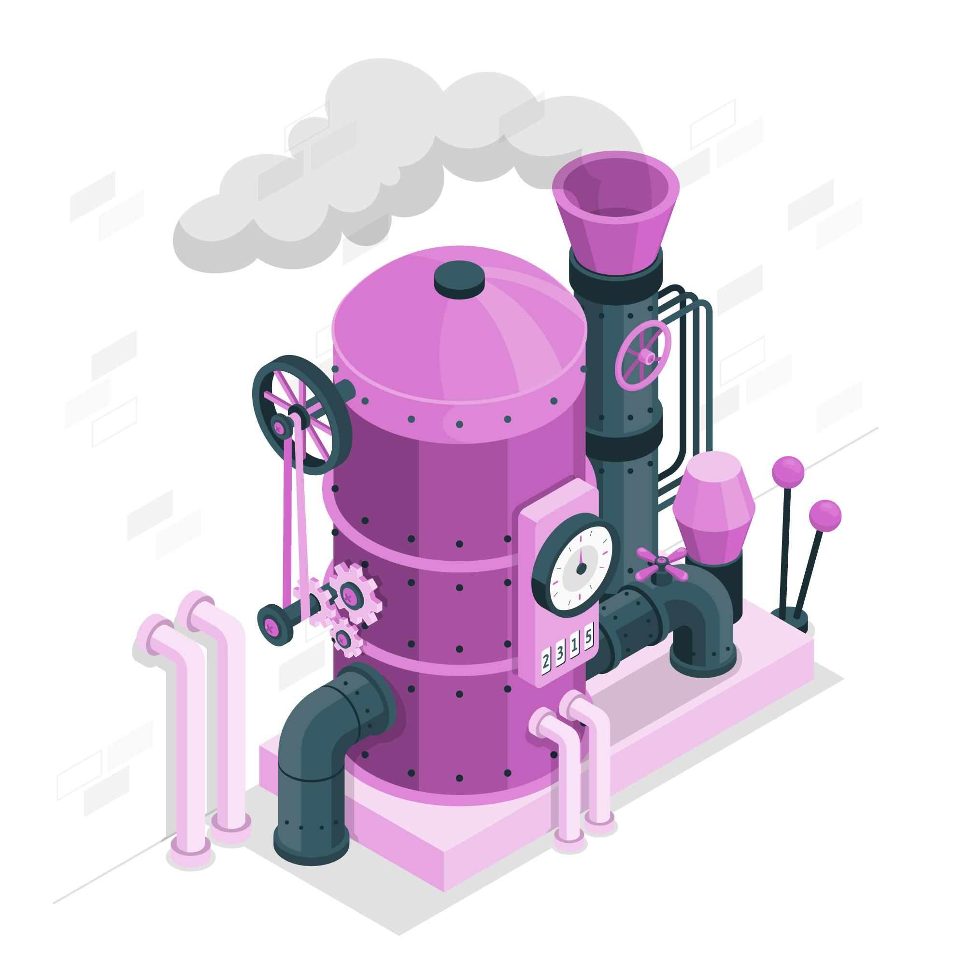
Combined Cycle Power Plant
Regression Model For The Prediction Of Energy Generated

Slide 2
EDA
Identifies general patterns in the data
Work Flow
Model Building
Exploring different models in Regression
Model Evaluation
Evaluating the model based on regression metrics
Model Deployment
Deploy the end results using flask/streamlit

Slide 3


Exploratory Data Analysis
Datatype
Correlation
Converting the datas into proper data type
Find the correlation between the datas
Null Values
Outliers
Check for null values,
if present replace them
Check for outliers in the data and handle them properly
Duplicate Records
Visualization
Check for duplicate records and drop them
if needed
Using proper visualizations in the datas for understanding the data

Slide 4
1
Multi Linear Regression
4
Regression
Models
Decision Tree Regression
2
Lasso Ridge
5
Support Vector Regression
3
Ensemble Models

Slide 5
STREAMLIT
Deploy the model using streamlit

