Slide 1

AI-DRIVEN ADAPTIVE SOFTWARE QUALITY ASSURANCE AND SECURITY AUTOMATION PLATFORM
ASE Project Review-1
Thursday, August 20th, 2026
 | Under the Guidance of Dr.J.Kavitha Reddy Assistant Professor, Department of Computer Science and Engineering, KLH CSE Bowrampet Campus
Team Members A.Akhil – 2420030540 S.Akshay – 2420030579 P.Ruthvik - 2420030546

Slide 2
Outline of Research Work
Focus
Introduction
Literature Survey
Challenges
Research Objectives
Conclusion & Future Work
References
Publications Details

Slide 3
Problem Statement
Traditional software testing and security practices are often manual, static, and time-consuming, making them ineffective for rapidly changing applications and CI/CD environments. They usually apply the same testing effort to all software components without considering their individual risk levels.
There is a need for an AI-driven adaptive platform that can continuously analyze code changes, defects, vulnerabilities, complexity, and test coverage to predict software risk and dynamically prioritize testing and security activities.
The proposed ASSQP addresses this problem by integrating AI, automated testing, DevSecOps, CI/CD, and MLOps into a unified platform to improve software quality, security, testing efficiency, and resource utilization.

Slide 4
Objectives
Develop an AI-driven platform for automated software quality assurance and security monitoring.
Analyze source code and software metrics such as code complexity, code churn, defects, vulnerabilities, and test coverage.
Predict software risk levels using a machine learning-based risk prediction model.
Implement adaptive test prioritization by assigning more testing effort to high-risk components.
Integrate DevSecOps tools such as SonarQube, OWASP ZAP, and Trivy for continuous quality and security analysis.
Automate the CI/CD workflow for building, testing, security scanning, and deployment.
Apply MLOps practices for model training, versioning, deployment, and performance monitoring.
Provide a centralized dashboard to display risk scores, defects, vulnerabilities, test coverage, and recommended corrective actions.
Improve testing efficiency and resource utilization while maintaining software reliability and security.

Slide 5
Literature Survey
Authors | Title of the Paper | Methodology | Inferences | Limitation / Future Work
Romero et al. [1] | Automated Machine Learning for Test Case Prioritisation, Empirical Software Engineering, 2026 | • Uses AutoML for test case prioritization • Grammar-guided genetic programming • Automatically selects ML algorithms and hyperparameters for each software build | • Adapts test prioritization to changing software builds • Reduces manual ML configuration • Highly relevant to adaptive CI-based testing | • Focuses mainly on test prioritization • Does not integrate security scanning, vulnerability analysis, or unified QA monitoring
Ramzan et al. [2] | Data-Driven Test Case Prioritization (DD-TCP): A Machine Learning Framework for Intelligent Software Quality Assurance, Computers, Materials & Continua, 2026 | • Uses code-change frequency, dependencies, execution time and failure history • Gradient-boosted decision trees • Dynamically reorders tests based on predicted fault probability | • Supports intelligent and adaptive regression testing • Uses historical CI data for prioritization • Improves fault detection while reducing testing overhead | • Mainly focuses on test-case prioritization • Does not combine software security, vulnerability severity, and DevSecOps tools
Zarrad et al. [3] | A Hybrid Approach to Software Testing Efficiency: Stacked Ensembles and Deep Q-Learning for Test Case Prioritization and Ranking, Computers, Materials & Continua, 2026 | • Ensemble ML models for test prioritization • Deep Q-Learning for test ranking • Genetic Algorithm for optimization | • Combines ML and reinforcement learning for efficient testing • Improves fault detection and test execution efficiency • Supports intelligent QA automation | • Computational complexity can increase • Focuses on testing rather than complete QA + security automation • Security risk prediction is not included

Slide 6
Innovation, Creativity, and Novelty
Innovation
AI-Based Risk Prediction – Predicts software component risk using code complexity, code churn, defects, vulnerabilities, and test coverage.
Intelligent Decision Making – Automatically identifies high-risk components that require greater testing and security attention.
Continuous Learning – Uses new testing and security results to improve future risk predictions.
Creativity
Adaptive Test Prioritization – Dynamically changes test priority based on the predicted risk of each component.
Unified QA & Security – Brings testing, code quality, vulnerability scanning, and CI/CD into one platform.
Actionable Dashboard – Presents risk scores, defects, vulnerabilities, coverage, and recommended actions in a simple interface.

Slide 7
Novelty
Risk-Driven Testing & Security – Combines ML risk prediction with adaptive testing and security scanning rather than treating them separately.
Continuous Feedback Loop – Automatically feeds CI/CD, testing, and security results back into the risk analysis process.
AI + DevSecOps + MLOps – Integrates these three approaches into a single adaptive software quality platform.

Slide 8
Tech Stack
Layer | Technology Stack
Programming / Backend | Python, FastAPI
AI & Machine Learning | TensorFlow
Software Quality Analysis | SonarQube
Security Scanning | OWASP ZAP, Trivy
Testing & Automation | PyTest, Automated Test Suite
CI/CD & DevOps | GitHub Actions, Docker
Database | PostgreSQL
MLOps | MLflow
Dashboard / Visualization | React.js

Slide 9
Feasibility
Technical Feasibility
The platform can be developed using available technologies such as Python, TensorFlow, FastAPI, SonarQube, OWASP ZAP, Trivy, Docker, and GitHub Actions.
Operational Feasibility
The system automates testing, code quality analysis, security scanning, and risk assessment, making it practical for CI/CD-based software development.
Economic & Time Feasibility
The project primarily uses open-source tools and frameworks, reducing development cost and making implementation achievable within the academic project timeline.

Slide 10
Project Plan
Phase | Activity | Output
Phase 1 | Literature Survey & Requirement Analysis | Problem definition and system requirements
Phase 2 | System Architecture & Module Design | ASSQP architecture and module specifications
Phase 3 | Data Collection & Preprocessing | Software metrics and QA/security dataset
Phase 4 | ML Risk Prediction Model Development | Component risk prediction model
Phase 5 | Adaptive Testing & Security Integration | Risk-based test prioritization and automated security scanning
Phase 6 | CI/CD, Docker & MLOps Integration | Automated build, testing, scanning and model deployment
Phase 7 | Dashboard, Testing & Validation | Centralized dashboard and validated working platform
Phase 8 | Documentation & Final Demonstration | Project report and final working prototype

Slide 11
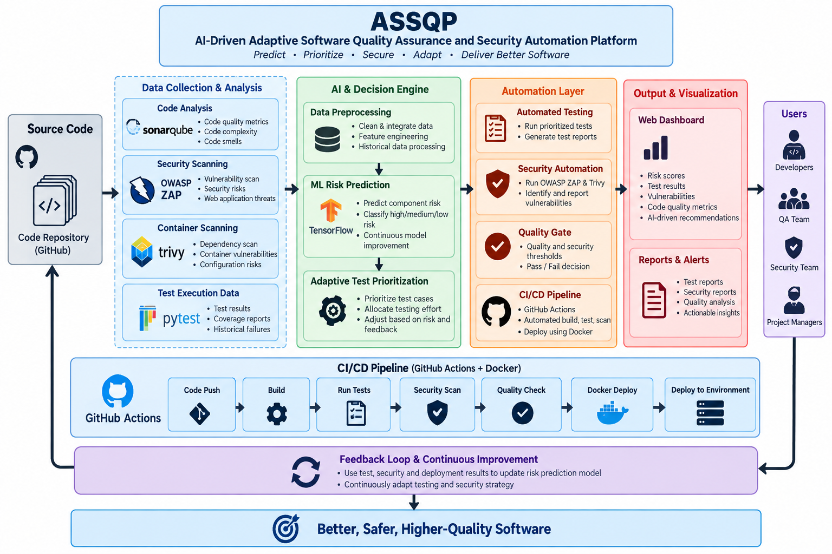
Project Architecture/Project Overview:

