Slide 1

Smart Source-to-Instruction Compiler
COMPILER DESIGN (24CS2235F) Project Review-2
Friday, September 18th, 2026
 | Under the Guidance of Mr. B. Dwarakanath Assistant Professor, Department of Computer Science and Engineering, KLH CSE Bowrampet Campus
Team Members D.Surya - 2420030440 S,Akshay – 2420030579 P.Ruthvik – 2420030546 D.Jai - 2420090104

Slide 2
Outline of Project Work
Focus
Introduction
Literature Survey
Challenges
Research Objectives
Conclusion & Future Work
References
Publications Details

Slide 3
Problem Statement
Traditional compiler systems often perform complex compilation processes internally, making it difficult for students and developers to understand how high-level source code is transformed into low-level instructions. The intermediate stages such as lexical analysis, syntax analysis, semantic analysis, intermediate code generation, and code optimization are usually not visible as a complete, connected workflow. Error information may also be difficult to trace back to the corresponding compilation phase.
The Smart Source-to-Instruction Compiler addresses this problem by developing an integrated compiler system that accepts high-level source code, performs the major phases of compilation, detects and reports errors, generates intermediate representations, applies optimization techniques, and produces target-level instructions. The system provides phase-wise outputs, making the compilation process transparent, traceable, and easier to understand, while demonstrating the practical implementation of fundamental compiler design concepts.

Slide 4
Objectives
Develop a compiler that translates high-level source code into low-level target instructions through a complete compilation pipeline.
Implement major compiler phases: Lexical Analysis, Syntax Analysis, Semantic Analysis, Intermediate Code Generation, Code Optimization, and Target Code Generation.
Detect and report lexical, syntax, and semantic errors with meaningful feedback.
Generate and visualize intermediate representations such as Abstract Syntax Tree (AST) and Three-Address Code (TAC).
Apply code optimization techniques to eliminate unnecessary operations and improve generated code efficiency.
Provide phase-wise outputs to make the source-to-instruction transformation transparent and easy to understand.
Demonstrate practically how fundamental compiler design concepts work together in a complete compiler system.

Slide 5
Literature Survey
Authors | Title of the Paper | Methodology | Inferences | Limitation / Future Work
Resler, R. D. & Deaver, D. M. (1998) | VCOCO: A Visualization Tool for Teaching Compilers | • Developed a visible compiler for observing the compilation process. • Used visualization to make compiler internals easier to inspect. • Focused on supporting compiler education. | • Visualization can make complex compiler processes easier to understand. • Students can observe compilation rather than treating the compiler as a black box. | • Primarily designed as a teaching/visualization tool .• Scope can be extended to provide more complete phase-wise transformation and target-code traceability.
Schäckeler, S., Shang, W. & Davis, R. (2009) | Compiler Optimization Pass Visualization: The Procedural Abstraction Case | • Visualized the effect of compiler optimization passes. • Represented optimization effects across program code and instructions. • Focused on helping students understand complex optimization behavior. | • Optimization visualization helps users understand when, where, and how optimizations transform code. • Visual representations can make optimization algorithms more concrete. | • Focuses mainly on specific optimization visualization, rather than an end-to-end source-to-instruction pipeline. • Future work can integrate multiple compiler phases with optimization traceability.
Stamenković, S., Jovanović, N. & Chakraborty, P. (2020) | Evaluation of Simulation Systems Suitable for Teaching Compiler Construction Courses | • Reviewed and evaluated 16 compiler-construction simulation systems. • Defined evaluation criteria for educational compiler simulators. • Studied how simulation supports experimentation and learning. | • Simulation tools provide opportunities to visualize abstract compiler concepts and experiment interactively. • Compiler education benefits from practical visualization-based systems. | • Evaluation covers existing simulation systems rather than proposing a unified compiler implementation. • Opportunity exists for an integrated system combining analysis, IR, optimization, and target generation.

Slide 6
Problem Gap Identification
Existing compiler tools mainly focus on individual phases such as analysis, visualization, optimization, or code generation.
Limited end-to-end integration is available to show the complete transformation from source code to target instructions in one workflow.
Source-to-instruction traceability is limited, making it difficult to track how a particular source statement changes through each compiler phase.
Optimization transformations are often not clearly connected to the original source statement.
Therefore, our project addresses this gap by providing an integrated compilation pipeline with phase-wise visualization and statement-level traceability from source code to optimized target instructions.

Slide 7
Existing Research / Approach | Problem Gap Identification | Existing Research / Approach
1. Compiler Phase Visualization – Existing educational tools visualize compiler phases such as lexical analysis, syntax analysis, and code generation to help learners understand compiler internals. | Existing tools may focus on individual phases, with limited continuous visibility of how a source statement moves through the complete compilation pipeline. | 1. Compiler Phase Visualization – Existing educational tools visualize compiler phases such as lexical analysis, syntax analysis, and code generation to help learners understand compiler internals.
2. Compiler Optimization Visualization – Existing approaches visualize optimization techniques and demonstrate how optimization passes transform program code or intermediate representations. | Optimization is often presented separately from the original source program, creating a limited connection between source statements and their optimized representations. | 2. Compiler Optimization Visualization – Existing approaches visualize optimization techniques and demonstrate how optimization passes transform program code or intermediate representations.
3. Source-to-Target Compilation Tools – Existing compiler systems translate source programs into intermediate representations and target/assembly code. | The transformation is generally treated as a compiler-internal process, with limited statement-level traceability showing the relationship between source code, IR, optimization, and final instructions. | 3. Source-to-Target Compilation Tools – Existing compiler systems translate source programs into intermediate representations and target/assembly code.

Slide 8
Innovation, Creativity, and Novelty
Innovation
Source-to-Instruction Traceability — Tracks a source statement through Lexical Analysis → AST → Semantic Analysis → IR/TAC → Optimization → Target Instructions.
Phase-Wise Compilation View — Shows the output and transformation at every major compiler phase.
Integrated Error Mapping — Connects errors to their specific compilation phase and source location.
Creativity
Provides an interactive visual representation of the compilation process instead of displaying only the final output.
Allows users to observe how a source statement changes at each stage of compilation.
Presents optimization as a visible transformation, making it easier to understand what was changed and why.
Novelty
Introduces statement-level Source-to-Instruction Traceability as the central feature.
Maintains the connection between the original source statement, its intermediate representations, optimization changes, and final target instructions.
Combines compilation, visualization, error analysis, and transformation tracking into one integrated workflow.

Slide 9
Feasibility
Technical Feasibility: Uses well-established compiler algorithms, AST/parse trees, intermediate representation, and optimization techniques that can be implemented with standard programming tools.
Implementation Feasibility: The system can be developed modularly, integrating lexical, syntax, semantic, IR, optimization, and target-code generation phases.
Resource Feasibility: Requires only standard computer hardware and open-source software, with no specialized hardware.
Time Feasibility: The modular architecture allows each compiler phase to be developed, tested, and integrated progressively within the project timeline.
Academic Feasibility: Directly applies the major concepts of Compiler Design, making the project suitable for practical implementation and demonstration.

Slide 10
Project Plan
Phase | Activity | Output
Phase 1 | Literature Survey & Requirement Analysis | Problem definition, objectives, requirements, research gap and novelty
Phase 2 | Language & Compiler Specification | Source-language syntax, grammar rules, tokens and supported constructs
Phase 3 | Lexical & Syntax Analysis | Token stream, parse tree/AST and lexical/syntax error detection
Phase 4 | Semantic Analysis | Symbol table, type checking and semantic error detection
Phase 5 | Intermediate Code Generation | Intermediate Representation (IR) / Three-Address Code (TAC)
Phase 6 | Code Optimization & Traceability | Optimized IR, optimization transformations and source-statement mapping
Phase 7 | Target Code Generation & System Integration | Target instructions and complete source-to-instruction compilation pipeline
Phase 8 | Testing, Documentation & Final Demonstration | Test results, working prototype, project report and final demonstration

Slide 11
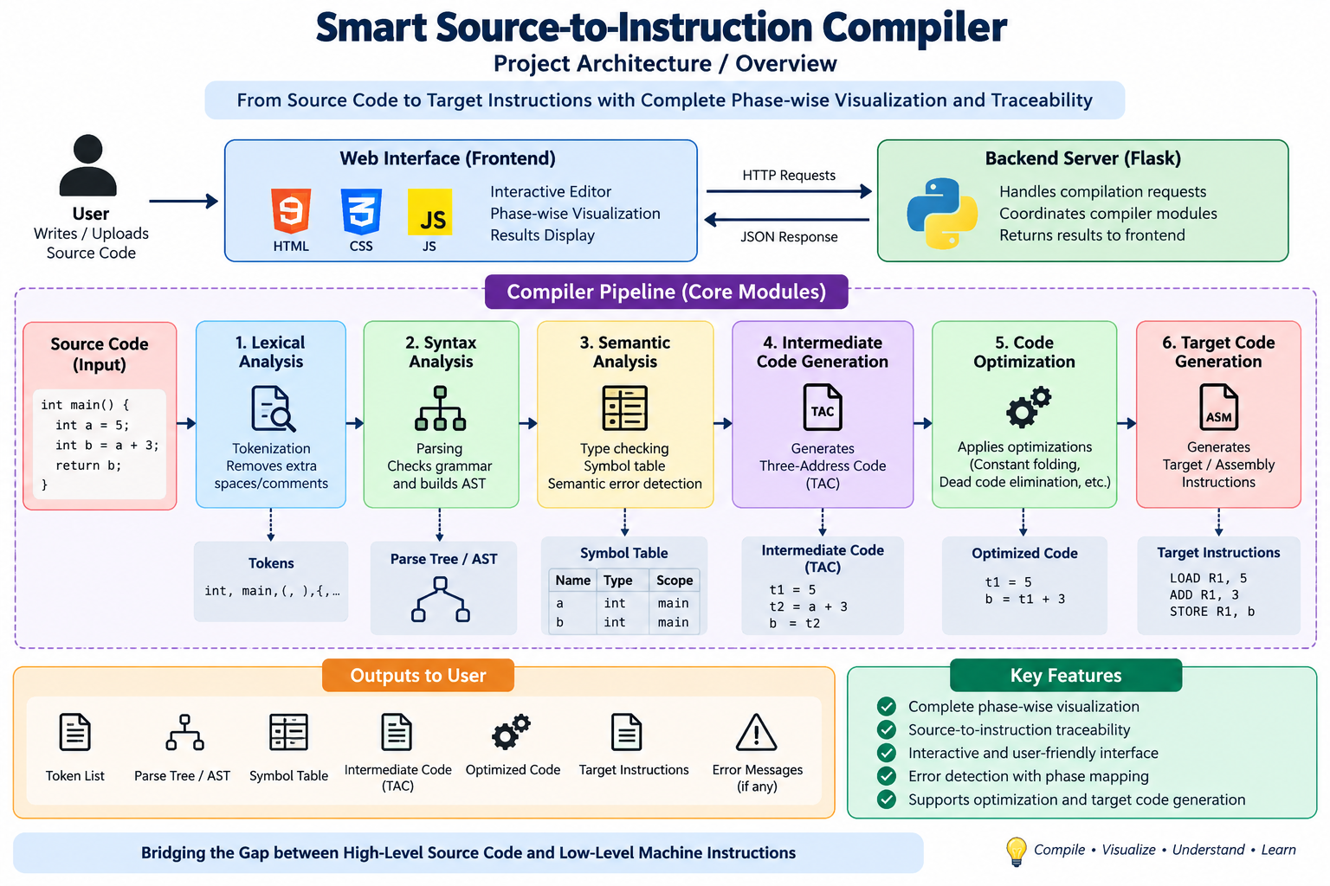
Project Architecture/Project Overview:

